Slide 1
PHY 245L: Modern Physics Lab Dr. Daniel Hickox-Young (hickoxyo@augsburg.edu)
9/19/2023
Lecture Topic(s): Millikan Discussion, Command Line Text Editing, Plotting with Jupyter/matplotlib
Reading for Next Class: Assigned on Moodle
Logistics:
- Reflection 3 due Monday, 9/25 at midnight
- Lab Activity 3 due Friday, 9/22 at 5pm

Slide 2
Millikan Discussion
Discuss the following with the others who read your article:
Perspective is important. Anytime we present someone, or read an article about a historical figure (who also happens to be a scientist), the perspective of the author frames and tints the way that we view the historical figure. What is the perspective of the author toward Millikan? Is s/he supportive of Millikan's work and accomplishments or antagonistic?
What is the main purpose of the article? Or, how does Millikan fit into the purpose of the article? What role specifically did he carry out? Was his goal accomplished? Was he successful?
What personal elements about Millikan do you gain from the article? Are there character elements that are presented (or implied) by the tone of the article? Are there quotes by Millikan that reveal something of his persona?
Do you notice conflict or controversy surrounding Millikan's career as a scientist and/or public figure? If so, please describe the apparent tension. From the article, can you determine how Millikan's personality contributed to the controversy?

Slide 3
Millikan Discussion
How should we view Millikan in 2023?
What can we learn from Millikan’s story about what the practice of science should look like in the 21st century?

Slide 4
Vi
Vi is a command line text editor.
It is what we will routinely use to view and edit input/output files when we perform materials simulations.
There is nothing to install, simply type “vi <filename>” and the editor will open.
Key commands
i – “insert” mode, you must be in insert mode to type
Esc – “command” mode, you can use command mode to navigate quickly and to save
ZZ – save and close
GG – jump to the end of the document
gg – jump to the beginning of the document
For more helpful commands (and a good guide) see https://ryanstutorials.net/linuxtutorial/vi.php

Slide 5
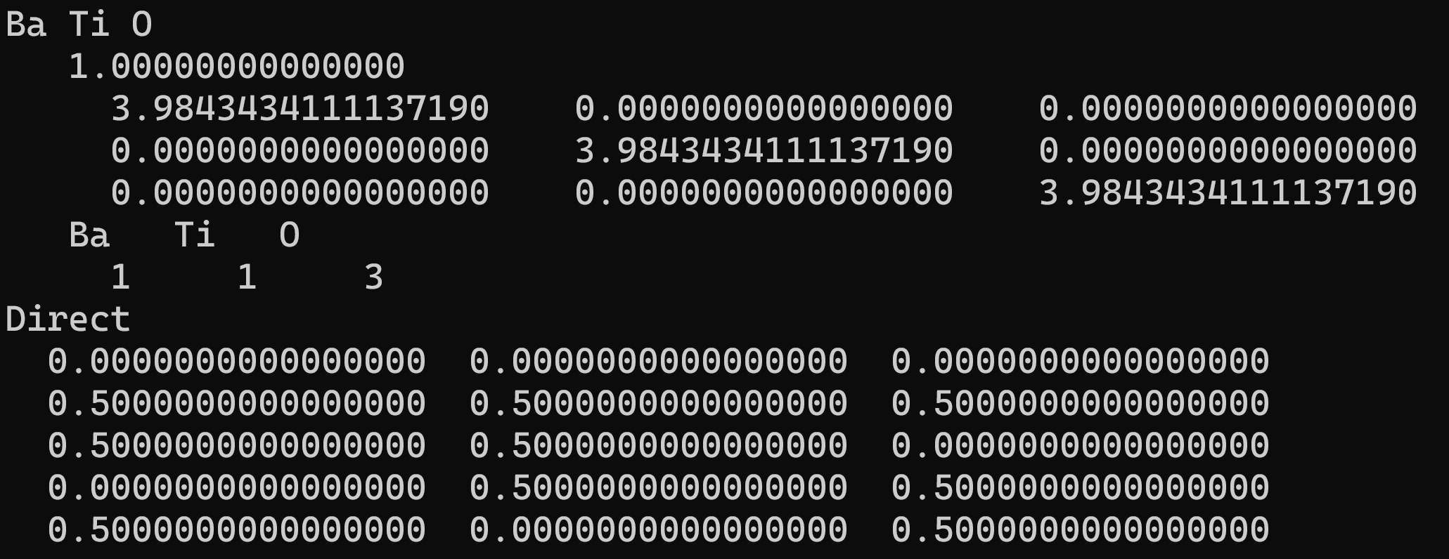
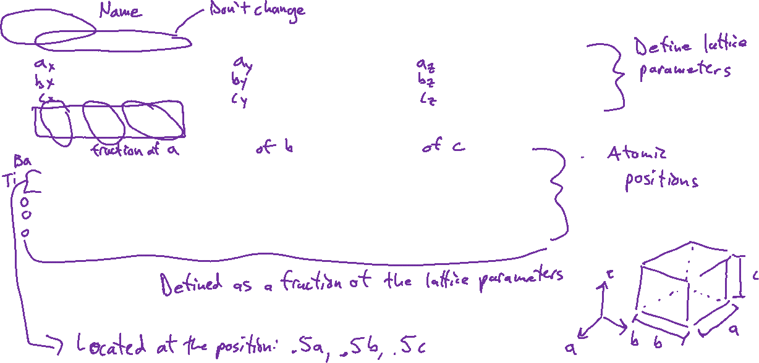
Unit Cell Description

Slide 6
Anaconda -> Jupyter Notebook
Install Anaconda: https://www.anaconda.com/download
See Moodle for assignment description

