Slide 1
PHY 245L: Modern Physics Lab Dr. Daniel Hickox-Young (hickoxyo@augsburg.edu)
9/26/2023
Lecture Topic(s): Science and Beauty Discussion, Introduction to DFT, Compiling Quantum Espresso
Reading for Next Class: Assigned on Moodle
Logistics:
- Reflection 4 due Monday, 10/2 at midnight
- Lab Activity 4 due Friday, 10/6 at 5pm

Slide 2
Science and Beauty – Class Discussion
There is much discussion about “Nature's beauty” as it appears in the physical sciences. What is one aspect or principle within the physical sciences that you personally find beautiful? For what reasons does the principle appeal to your own sense of beauty?
What is your conception of art, and how are mathematics and/or science forms of art? Even if you disagree, please discuss specific statements from the article and respond to them.

Slide 3
Science and Beauty – Choose Your Own Q
Turn to your neighbor and share the question (and answer) you chose for your reflection:
(p.25) Fry and Poincare: Do you agree with Poincare's statements about the “usefulness” of science? How is beauty the primary distinction between science and engineering? What do you make of Fry's statements about the inevitability of science versus art?
(p.26) Ramanujan and Boltzmann: Chandrasekhar is very transparent in describing Ramanujan's knowledge of identities and formulas as intuitive, in the sense that he knew things unprovable at the time of his statement of them (p. 26). How do you explain this principle of intuition? Have you ever known others to think this way, or to claim this intuition? Have you ever experienced this sort of knowing?
(p27-28) Einstein and Heisenberg: Einstein refers to the general theory relativity as “magic”. What is the general theory of relativity, and what do you think Einstein means by the term magic? What is your own experience with “feeling giddy” (Heisenberg) in relation to mathematical proofs or scientific formulas?
(p27-28) Einstein and Heisenberg (pt 2): In Heisenberg's conversation with Einstein, the connection between truth and beauty is made. For Heisenberg, what is the determination of something being true? How does beauty come along truth and bear witness to its truthfulness? Do you agree with the statements made by Heisenberg
(p.29-30) Einstein and the criteria of beauty: What do you think makes something in science beautiful? Do you agree with Chandrasekhar's criteria?

Slide 4



The beginning
Using quantum mechanics to simulate materials requires solving the Schrödinger equation
Only problem: this cannot be done analytically for a system with more than two electrons
-e
-e
-e
-e
-e
-e

Slide 5
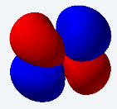
The beginning
Hohenberg, Pierre, and Walter Kohn. Physical review 136, no. 3B (1964): B864.
Kohn, Walter, and Lu Jeu Sham. Physical review 140, no. 4A (1965): A1133.
To get around this, our software uses density functional theory (DFT)
Convert to density -> find the density which leads to the lowest energy
Immense collaborative effort to develop, but pioneered by Hohenberg, Kohn, and Sham, winning Kohn a Nobel Prize in 1998
Total Energy (E)
-e
Ψ_{i}
-e density
-e
Compare to previous E, converged?
-e
No
Yes
Done!

Slide 6
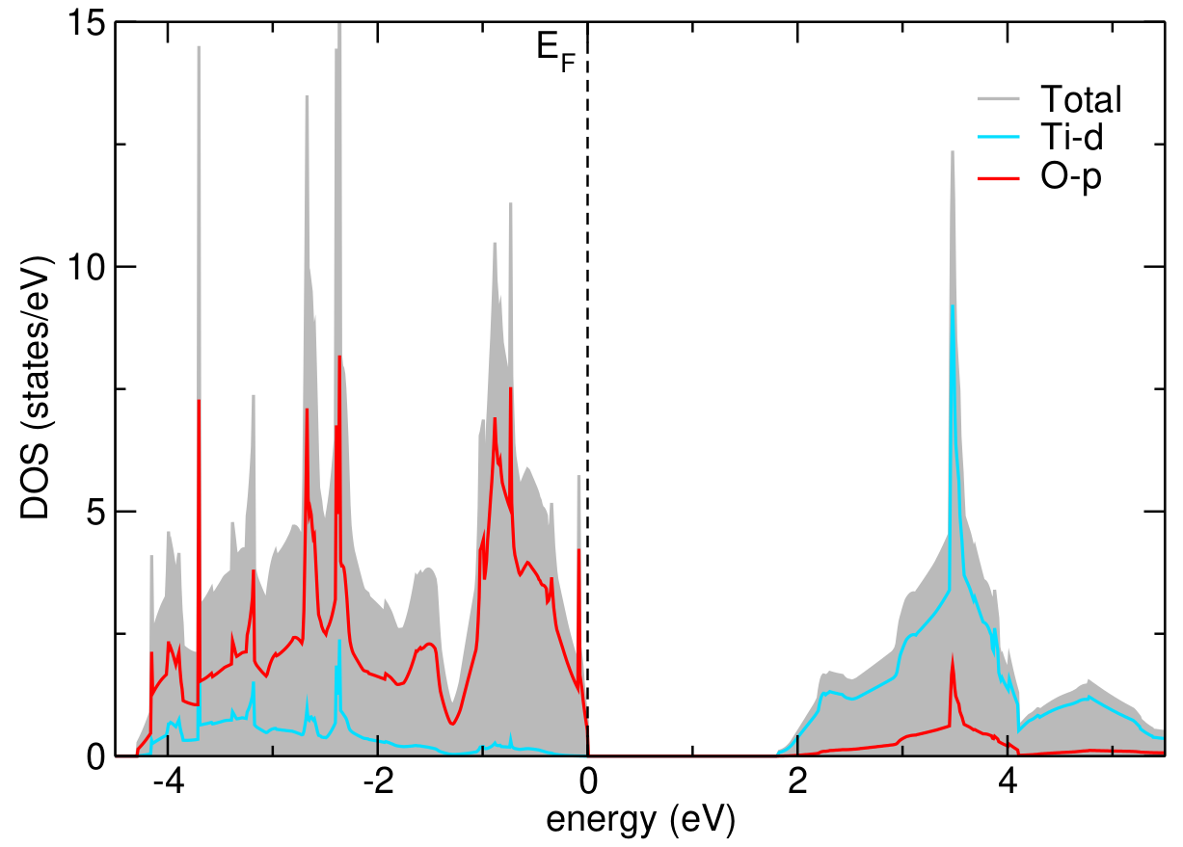
The beginning
-e
-e
-e
-e
-e
-e
-e
-e
-e
-e
-e
-e
-e
-e
-e
-e
Atom alone, discrete energy states
Clustered atoms, clusters of states
Multiple types of atoms, bonding, separate orbitals
Periodic solid, energy bands

Slide 7
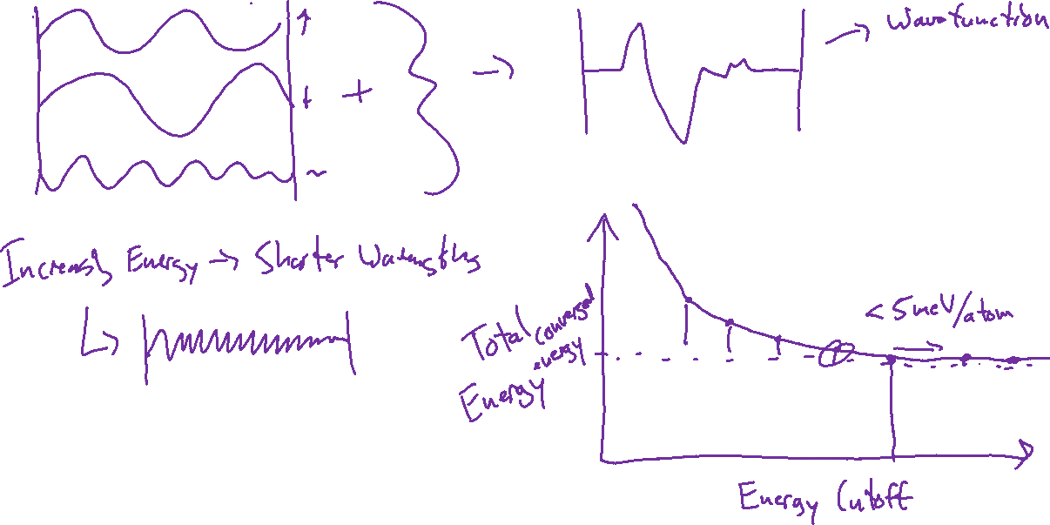
Plane Wave Basis – Energy Cutoff Convergence

Slide 8
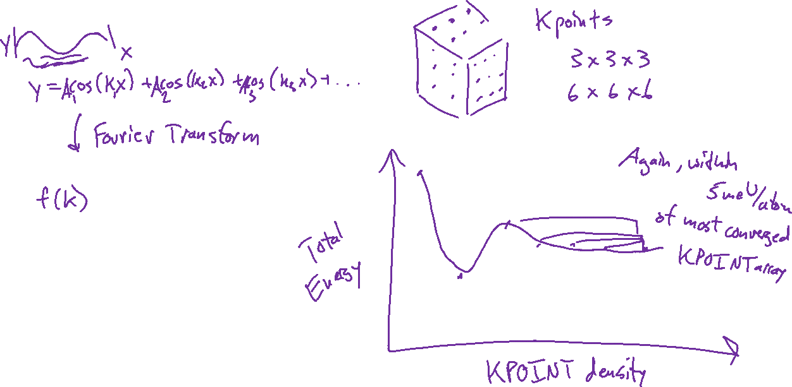
KPOINTS – Kpoint Convergence

Slide 9
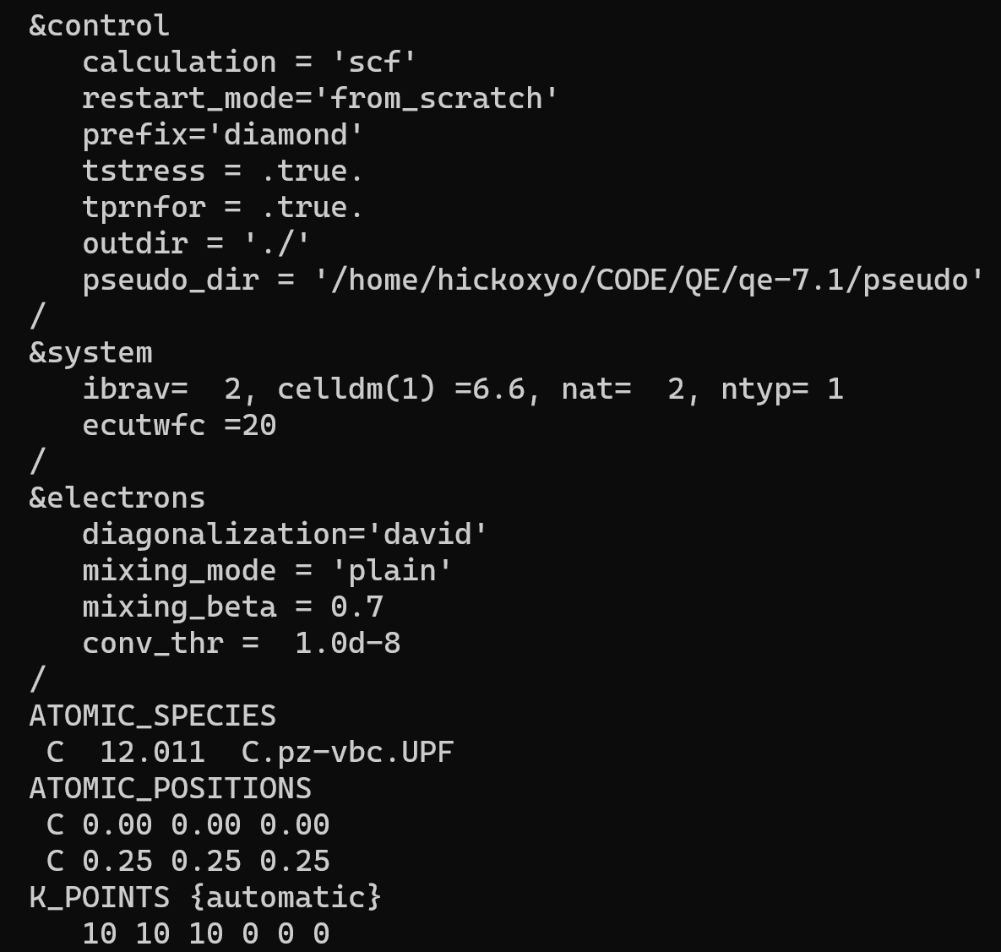
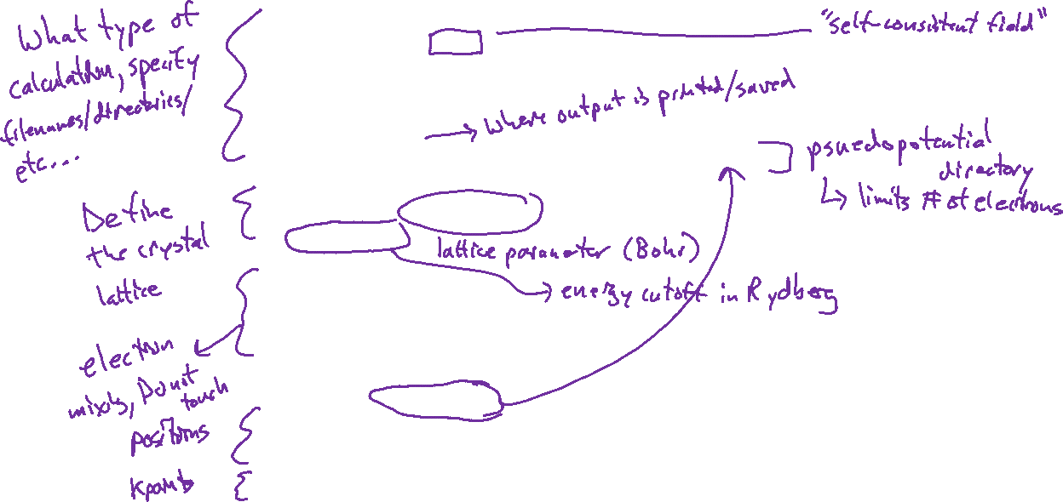
Quantum Espresso – Anatomy of an Input File

Slide 10
Adding Locations to Your Path
Recommendation: Do not attempt on your own unless you are confident in your abilities. I will demonstrate in class for those who are interested. [ADDENDUM: We will start with this next week]

