Slide 1
PHY 245L: Modern Physics Lab Dr. Daniel Hickox-Young (hickoxyo@augsburg.edu)
10/3/2023
Lecture Topic(s): DFT Reminders
Reading for Next Class: Assigned on Moodle
Logistics:
- Reflection 4 due Monday, 10/9 at midnight
- Lab Activity 4 due Monday, 10/9 at midnight

Slide 2
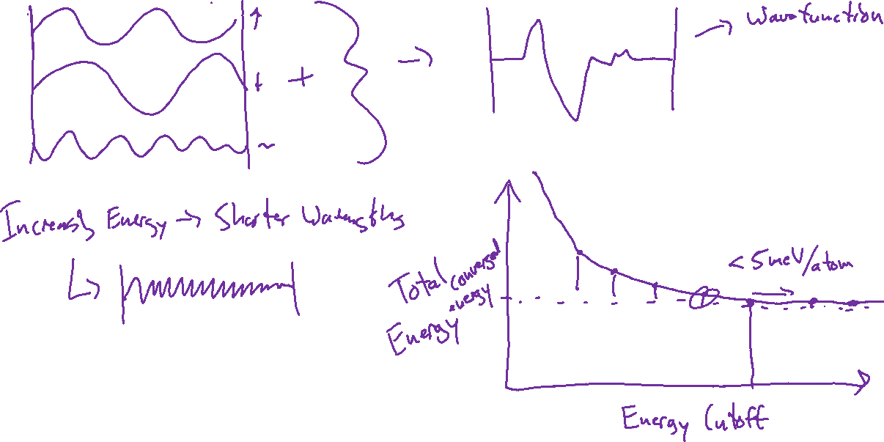
Plane Wave Basis – Energy Cutoff Convergence

Slide 3
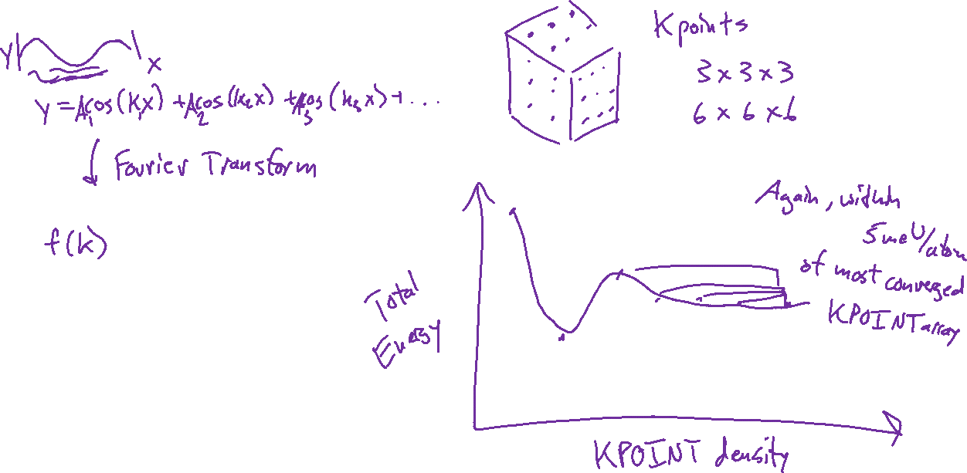
KPOINTS – Kpoint Convergence

Slide 4
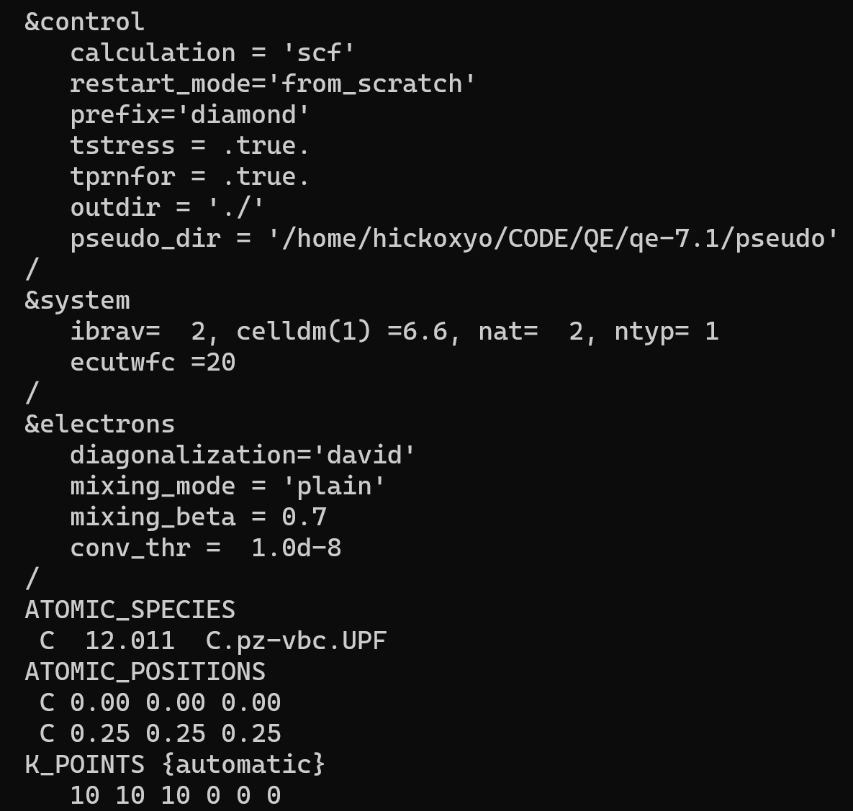
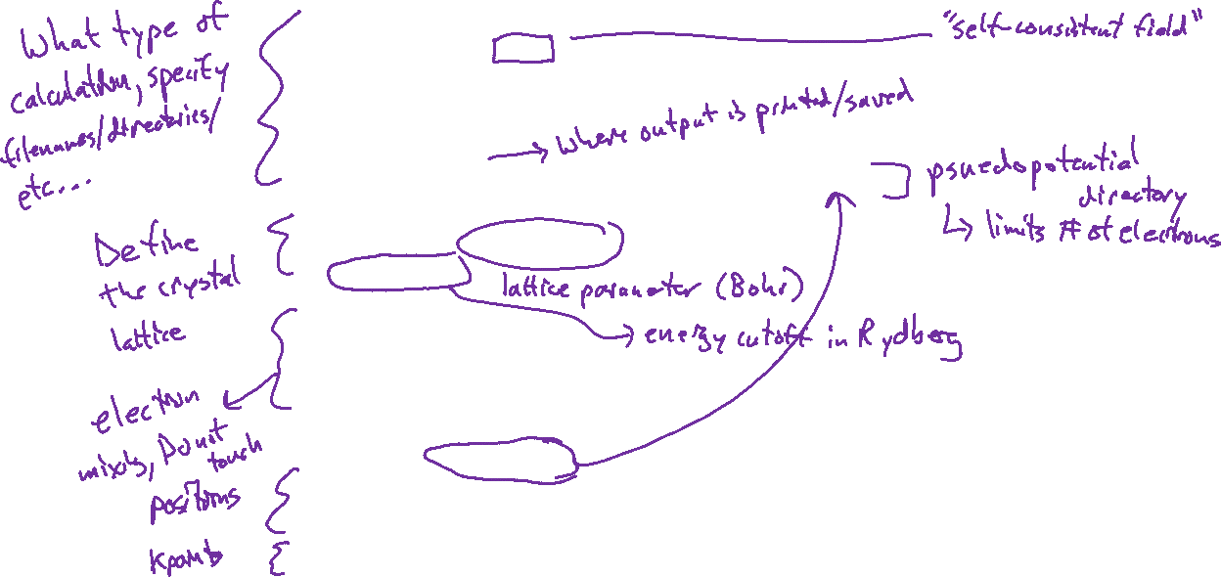
Quantum Espresso – Anatomy of an Input File

Slide 5
Adding Locations to Your Path
Recommendation: Do not attempt on your own unless you are confident in your abilities. I will demonstrate in class for those who are interested. [ADDENDUM: We will start with this next week]

