Slide 1
PHY 245L: Modern Physics Lab Dr. Daniel Hickox-Young (hickoxyo@augsburg.edu)
10/10/2023
Lecture Topic(s): Nobel Prize Discussion, Mass-Spring Model
Reading for Next Class: Assigned on Moodle
Logistics:
- Reflection 5 due Monday, 10/16 at midnight
- Lab Activity 5 due Monday, 10/16 at midnight

Slide 2
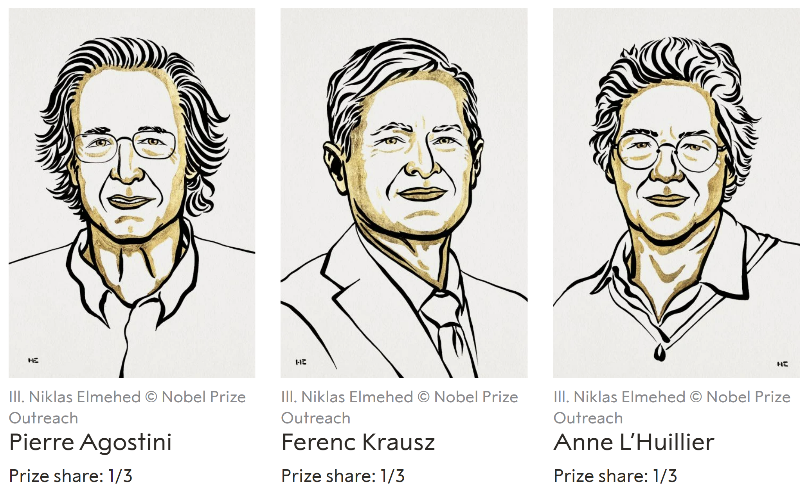
2023 Nobel Prize in Physics
Born: 23 July 1941, Tunis, French protectorate of Tunisia (now Tunisia)
The Ohio State University, USA
Born: 17 May 1962, Mór, Hungary
Max Planck Institute of Quantum Optics, Garching, Germany; Ludwig-Maximilians-Universität München, Munich, Germany
Born: 16 August 1958, Paris, France
Lund University, Lund, Sweden

Slide 3
Nobel Prize Discussion
Summarize: What was the Nobel prize-winning discovery? Why was it deemed worthy of a Nobel Prize?
Think about the physics topics you have learned about in your college physics career thus far. Try and list all of the topics in this Nobel prize summary that you were able to understand thanks to the work you've done over the past year or two.
Have you paid attention to Nobel Prize announcements in the past? Why or why not?
Do you think the general public cares about Nobel prize announcements?
In our society, we celebrate a variety of people, ranging from athletes to actors to artists and more. I think it is safe to say that scientists do not receive nearly the same level of public celebration/recognition as people in these other fields. Do you think we should do more to celebrate and recognize the work that scientists do? Why or why not? And if so, do you have any idea as to how we might do a better job?

Slide 4
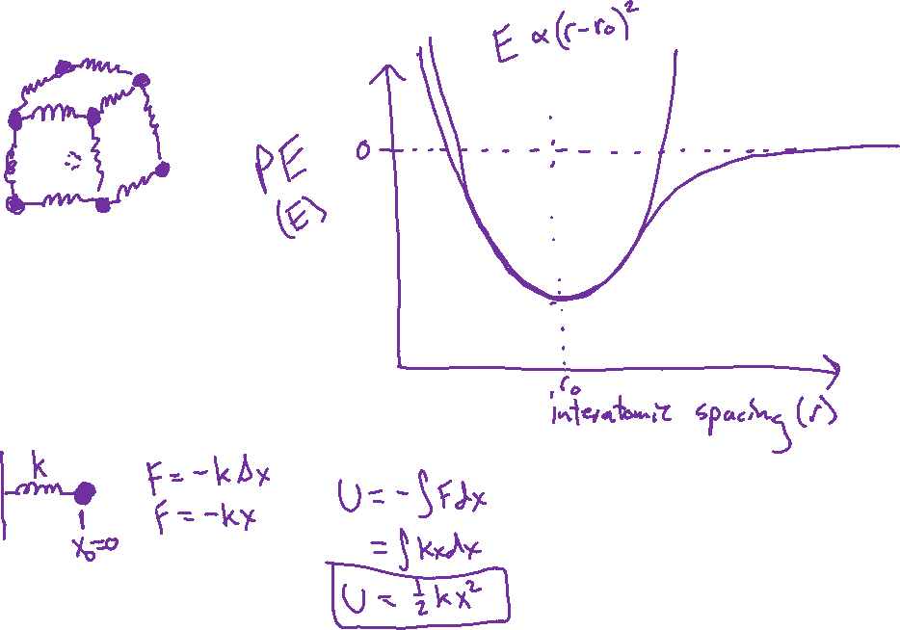
Mass-Spring Model

Slide 5
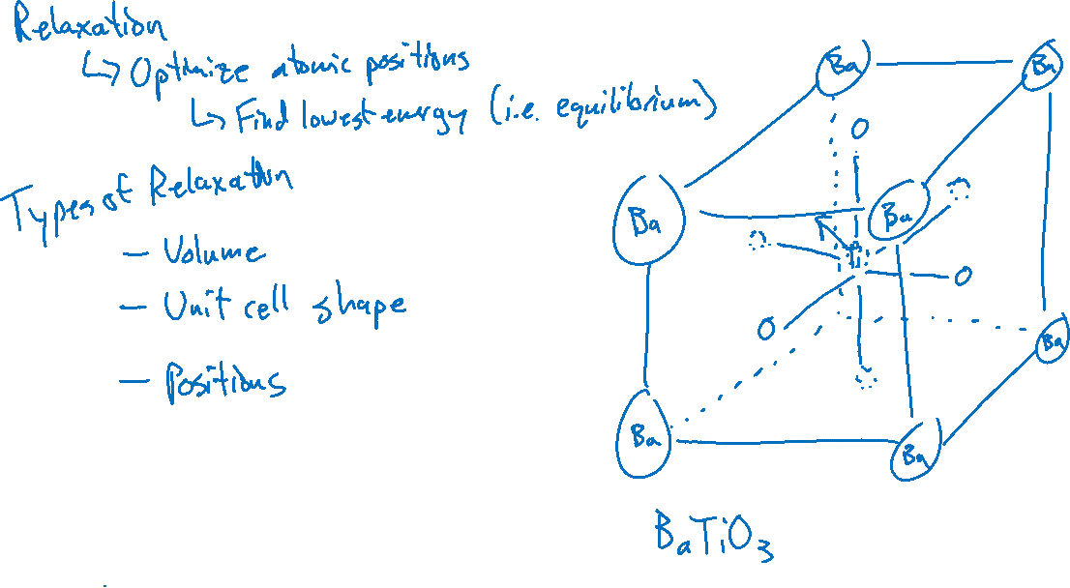
Structure Optimization

