Slide 1
Association Between Working Hours and Total Blood Cholesterol Among Adults in the United States
Christian Hicks
25 April 2022

Slide 2
Acknowledgements
Committee
Dr. Richard Shaffer
Dr. John Alcaraz
Dr. Humberto Parada
Professors
Peers
Thank you all!!!

Slide 3
Introduction

Slide 4
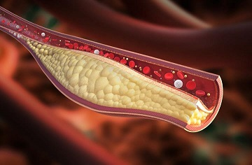
Background: Total Cholesterol
One third of Americans have high cholesterol ¹
High cholesterol ≥ 200 mg/dL ²
2015-2018 ¹
Mean total cholesterol = 190.6 mg/dL
Healthy People 2020 goal ¹
Mean ≤ 177.9 mg/dL

Slide 5

Background: Work hours
U.S. during 2019³
Mean workweek = 44 hours
Policy comparisons³
European Union = 48-hour cap
Australia = 38-hour cap
USA = no cap
CA AB 2932

Slide 6
Research Question
Are greater self-reported hours worked associated with higher measurements of total blood cholesterol?
H0: No association
H1: Greater hours worked is positively associated with total blood cholesterol

Slide 7
Methods

Slide 8
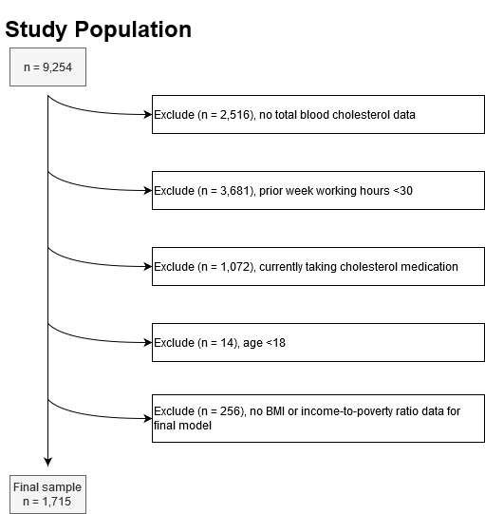
NHANES 2017-2018
Random selection survey
Interview and physical examination
1,715 out of 9,254 observations selected
Weighted to represent 95,960,477 U.S. adults

Slide 9
Measurements
Total blood cholesterol
Work hours
Serum collection and lab analysis
Continuous variable
Mg/dL
Min = 94
Max = 416
Self-report
Prior week from all jobs
Discrete variable
Min = 30
Max = 80

Slide 10
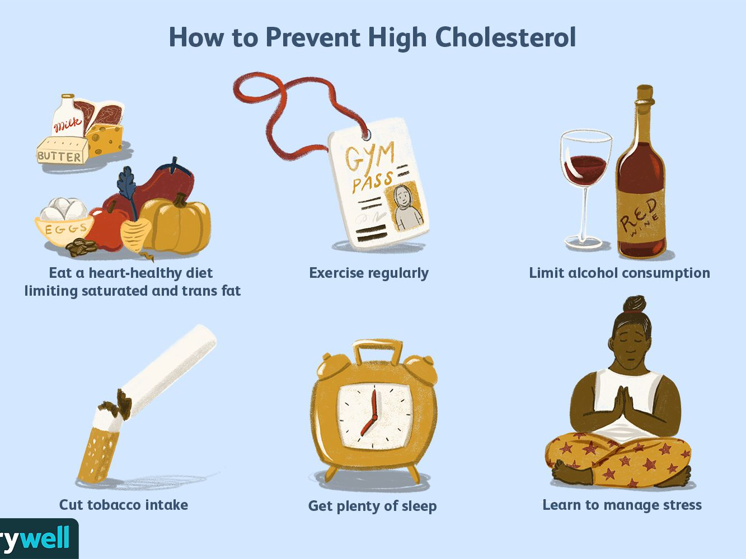
Covariates
Age
BMI
Race/Ethnicity
Physical activity
Income-to-poverty ratio

Slide 11
Stat Analysis
R 4.1.1
Correlation check
Bivariate analysis: simple linear regression
Multiple linear regression
Alpha = .05

Slide 12
Results

Slide 13
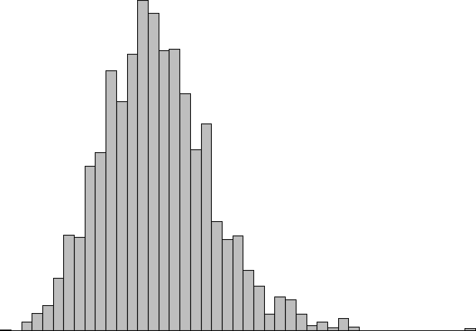
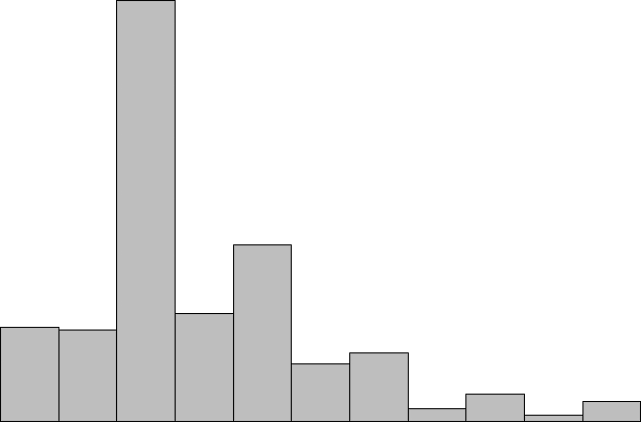
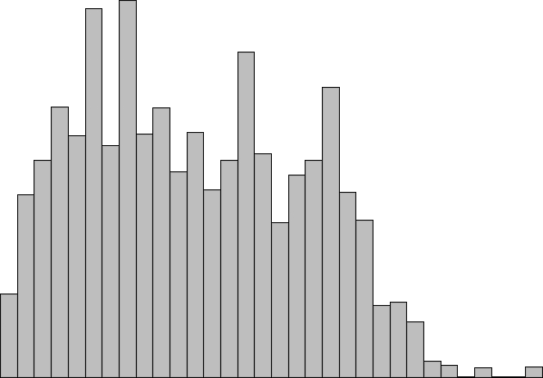
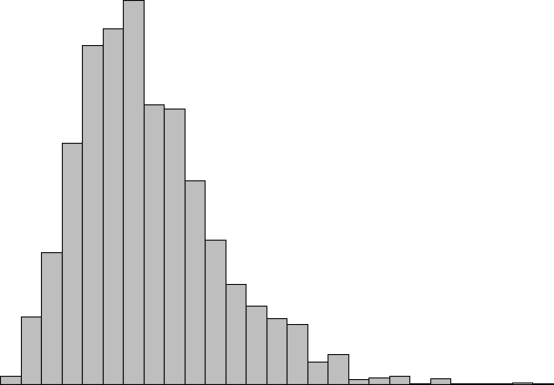

Table 1
Variable | Weighted n | Statistic
Total cholesterol (mg/dL) | 95,960,477 | 190.0 (1.4) ª
Work hours | 95,960,477 | 40.0 (30.0 – 80.0) ^{b}
Age | 95,960,477 | 39.0 (18.0 – 80.0) ^{b}
BMI | 95,960,477 | 28.4 (15.5 – 68.2) ^{b}
Gender (male) | 95,960,477 | 56.0 (1.8) ^{c}
ª mean (SE)
^{b} median (range)
^{c} percent (SE)

Slide 14
Table 2
Variable | Correlation | Beta Estimate (95% CI)
Work hours | -0.08 | -0.31 (-0.53 – -0.09)
Age | 0.31 | 0.93 (0.72 – 1.13)
BMI | 0.12 | 0.65 (0.32 – 0.97)
Sitting minutes daily | 0.03 | 0.01 (-0.01 – 0.02)
Income-to-poverty ratio | 0.10 | 2.5 (0.90 – 4.1)

Slide 15
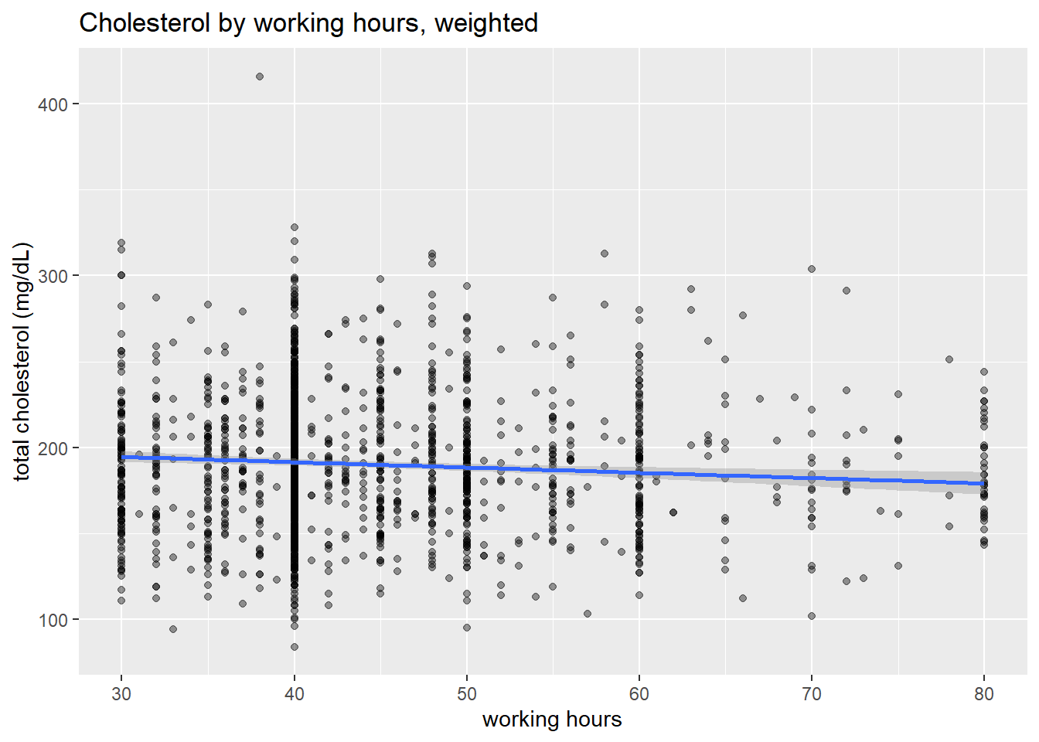

Slide 16
Table 3
Statistic | Value
Unweighted n | 1,715
Weighted n | 95,960,477
Working Hours Beta (95% CI) | -0.28 (-0.4 – -0.1)
Adjusted R² | 0.12
Root mean square error | 37.2
p-value | <.001

Slide 17
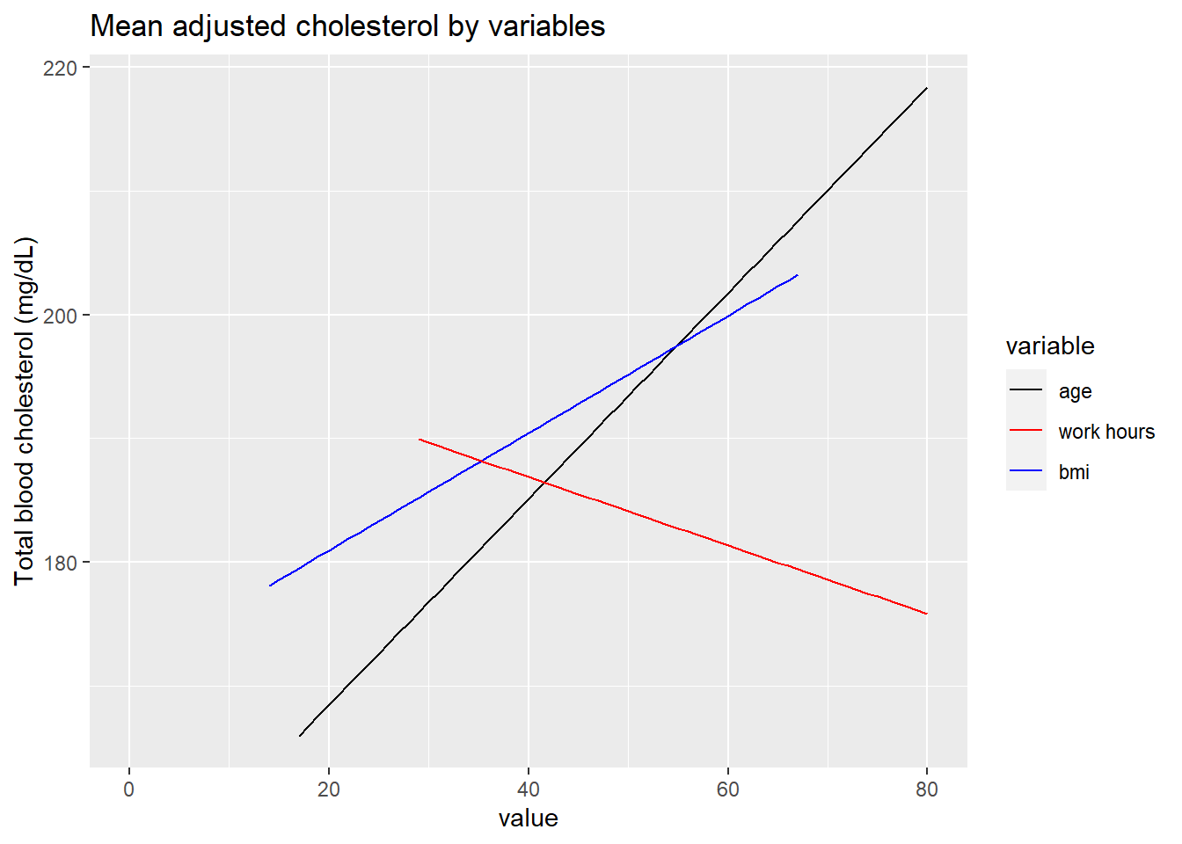
Table 3
Statistic | Value
Unweighted n | 1,715
Weighted n | 95,960,477
Working Hours Beta (95% CI) | -0.28 (-0.4 – -0.1)
Adjusted R² | 0.12
Root mean square error | 37.2
p-value | <.001

Slide 18
Post-hoc Analysis
Population Group (weighted) | High Cholesterol (row %) | Not High Cholesterol (row %)
Study | 35,479,051 (37.0%) | 60,481,426 (63.0%)
Excluded | 31,039,012 (41.6%) | 43,549,424 (59.4%)
OR: 1.21
p=.06

Slide 19
Key Findings
37% of the weighted population had clinically high cholesterol.
47% reported working more than 40 hours in the prior week.
Increase in work hours associated with decrease in total cholesterol
Very weak correlation
Possible healthy worker effect

Slide 20
Discussion

Slide 21
Comparisons
Author | Study Population | Association
Sisaki et al. (1999) | Japanese machinery engineers | Age interaction
Lee et al. (2016) | Korean NHANES | Negative
Reynolds et al. (2018) | 22-year-old Australian cohort | None
Virtanen et al. (2019) | French CONSTANCES | Positive

Slide 22
Discussion
Strengths
Limitations
Linear regression
Weighted observations
Able to control for confounders
Self-report
Blood collected once
Cross-sectional

Slide 23
Bias
Selection bias (full-time workers)
Recall bias (questionnaire)
Measurement bias (blood collection & working hours)

Slide 24
Implications
Total cholesterol may not be at risk of worsening due to recent working hours
Generalizable to full-time working adults in the U.S.
Healthy worker effect must be controlled for in similar studies

Slide 25
Future Studies
Longitudinal design
Multiple serum collections
Examine work hours over longer period
Include underemployed and unemployed
Collect data on past work exposures

Slide 26
References
Virani, S. S., Alonso, A., Aparicio, H. J., Benjamin, E. J., Bittencourt, M. S., Callaway, C. W., Carson, A. P., Chamberlain, A. M., Cheng, S., Delling, F. N., Elkind, M. S. V., Evenson, K. R., Ferguson, J. F., Gupta, D. K., Khan, S. S., Kissela, B. M., Knutson, K. L., Lee, C. D., Lewis, T. T., … Tsao, C. W. (2021). Heart Disease and Stroke Statistics—2021 Update. Circulation, 143(8), 254–743. https://doi.org/10.1161/CIR.0000000000000950
National Institutes of Health. (2001, May). ATP III Guidelines At-A-Glance Quick Desk Reference. National Heart, Lung, and Blood Institute. https://www.nhlbi.nih.gov/health-topics/all-publications-and-resources/atp-iii-glance-quick-desk-reference
Rivera, A. S., Akanbi, M., O’Dwyer, L. C., & McHugh, M. (2020). Shift work and long work hours and their association with chronic health conditions: A systematic review of systematic reviews with meta-analyses. PLOS ONE, 15(4), e0231037. https://doi.org/10.1371/journal.pone.0231037
Sasaki, T., Iwasaki, K., Oka, T., & Hisanaga, N. (1999). Association of Working Hours with Biological Indices Related to the Cardiovascular System among Engineers in a Machinery Manufacturing Company. Industrial Health, 37(4), 457–463. https://doi.org/10.2486/indhealth.37.457
Lee, D.-W., Hong, Y.-C., Min, K.-B., Kim, T.-S., Kim, M.-S., & Kang, M.-Y. (2016). The effect of long working hours on 10-year risk of coronary heart disease and stroke in the Korean population: The Korea National Health and Nutrition Examination Survey (KNHANES), 2007 to 2013. Annals of Occupational and Environmental Medicine, 28(1). https://doi.org/10.1186/s40557-016-0149-5
Reynolds, A. C., Bucks, R. S., Paterson, J. L., Ferguson, S. A., Mori, T. A., McArdle, N., Straker, L., Beilin, L. J., & Eastwood, P. R. (2018). Working (longer than) 9 to 5: Are there cardiometabolic health risks for young Australian workers who report longer than 38-h working weeks? International Archives of Occupational and Environmental Health, 91(4), 403–412. https://doi.org/10.1007/s00420-018-1289-4
Virtanen, M., Magnusson Hansson, L., Goldberg, M., Zins, M., Stenholm, S., Vahtera, J., Westerlund, H., & Kivimäki, M. (2019). Long working hours, anthropometry, lung function, blood pressure and blood-based biomarkers: Cross-sectional findings from the CONSTANCES study. Journal of Epidemiology and Community Health, 73(2), 130–135. https://doi.org/10.1136/jech-2018-210943

Slide 27
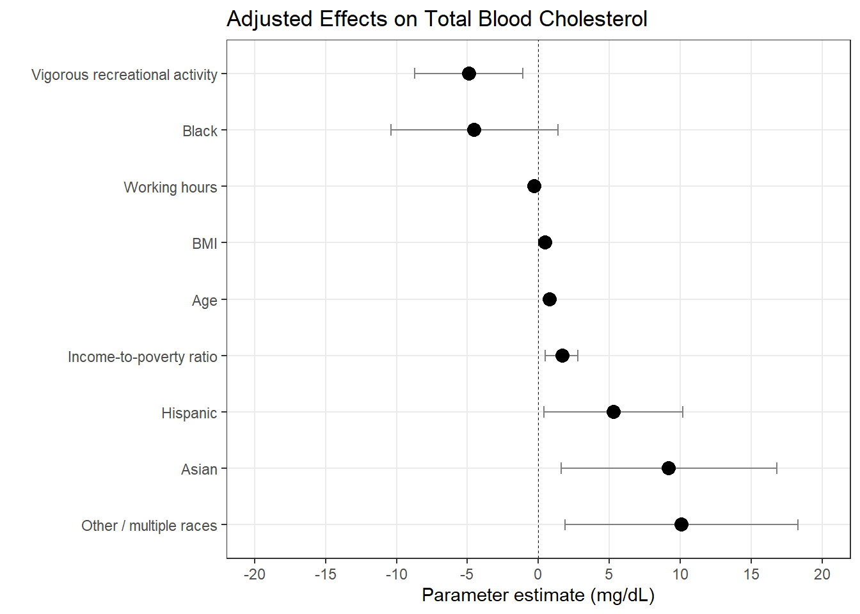

Slide 28
Table 1
Variable | Weighted n | Statistic
Daily sitting minutes | 95,871,954 | 300.0 (2.0 – 1,140.0) ^{b}
Doctor says cholesterol is high (yes) | 95,809,095 | 18.6 (1.5) ^{c}
Vigorous work activity (yes) | 95,932,245 | 35.0 (1.7) ^{c}
Vigorous recreational activity (yes) | 95,960,477 | 35.2 (1.8) ^{c}
Income-to-poverty ratio | 95,960,477 | 3.5 (0.0 – 5.0) ^{b}
ª mean (SE)
^{b} median (range)
^{c} percent (SE)

Slide 29
Table 1
Race/Ethnicity (n = 95,960,477) | Percent (SE)
Hispanic | 16.5 (1.0)
Non-Hispanic White | 63.0 (1.5)
Non-Hispanic Black | 10.2 (0.6)
Non-Hispanic Asian | 5.6 (0.4)
Other/Multiple | 4.7 (0.8)
Education (n = 95,960,477) | Percent (SE)
No HS/GED | 7.7 (0.7)
HS/GED | 26.1 (1.6)
Some college | 31.8 (1.6)
College or more | 34.4 (1.8)

Slide 30
Table 2
Variable | Weighted n | Statistic
Gender: Male | 53,762,535 | 190.3 (1.8)
Gender: Female | 42,197,943 | 189.7 (2.0)
Doctor high cholesterol: Yes | 17,815,106 | 213.9 (3.2)***
Doctor high cholesterol: No | 77,993,989 | 184.5 (1.4)***
Vigorous work activity: Yes | 33,618,508 | 189.5 (2.5)
Vigorous work activity: No | 62,313,737 | 190.3 (1.6)
Vigorous recreational activity: Yes | 33,773,462 | 182.8 (2.0)***
Vigorous recreational activity: No | 62,187,015 | 193.9 (1.8)***

Slide 31
Table 2
Race/Ethnicity (n = 95,960,477) | Statistic***
Hispanic | 191.0 (2.3)
Non-Hispanic White | 189.6 (2.0)
Non-Hispanic Black | 182.5 (2.2)
Non-Hispanic Asian | 196.3 (2.4)
Other/Multiple | 200.0 (5.3)
Education (n = 95,960,477) | Statistic
No HS/GED | 198.0 (3.9)
HS/GED | 189.9 (3.2)
Some college | 190.0 (2.3)
College or more | 190.0 (2.2)

Slide 32
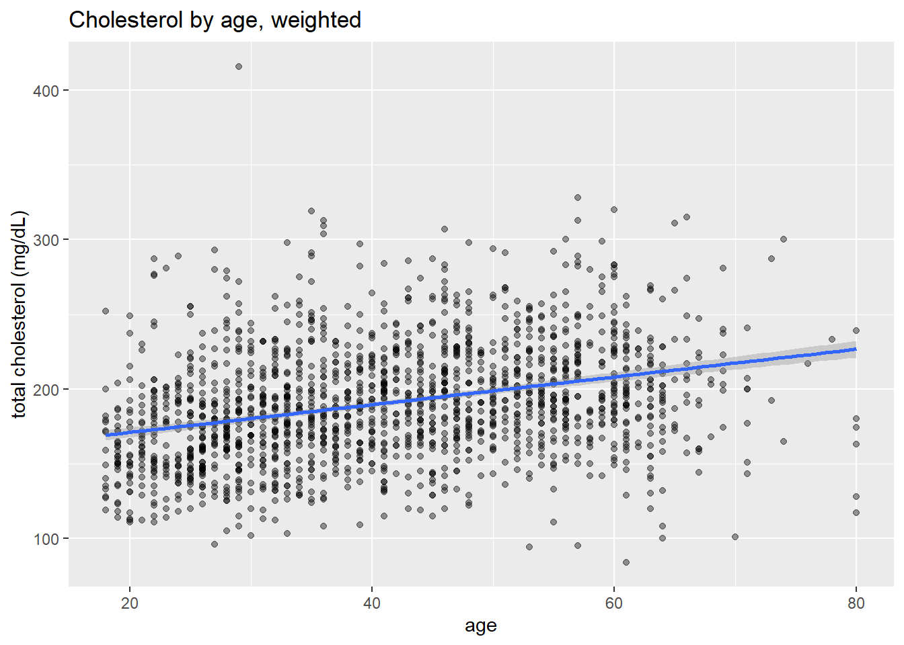

Slide 33
