Slide 1
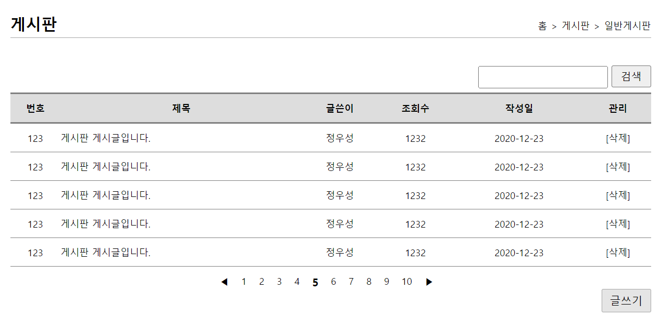
mysite3>board>리스트(검색기능)
http://localhost:8000/mysite3/board/list2?
keyword=오늘
/board/list2
list2(keyword)
keyword
keyword
keyword
selectList(
"board.selectList2",
keyword
)
getList2(keyword)
selectList2(keyword)
List<BoardVo>
List<BoardVo>
List<BoardVo>
List<BoardVo>
list.jsp
mysite3>board>리스트
http://localhost:8000/mysite3/board/list?
/board/list
list()
getList2()
selectList()
selectList(
"board.selectList"
)
List<BoardVo>
List<BoardVo>
List<BoardVo>
List<BoardVo>
list.jsp

Slide 2
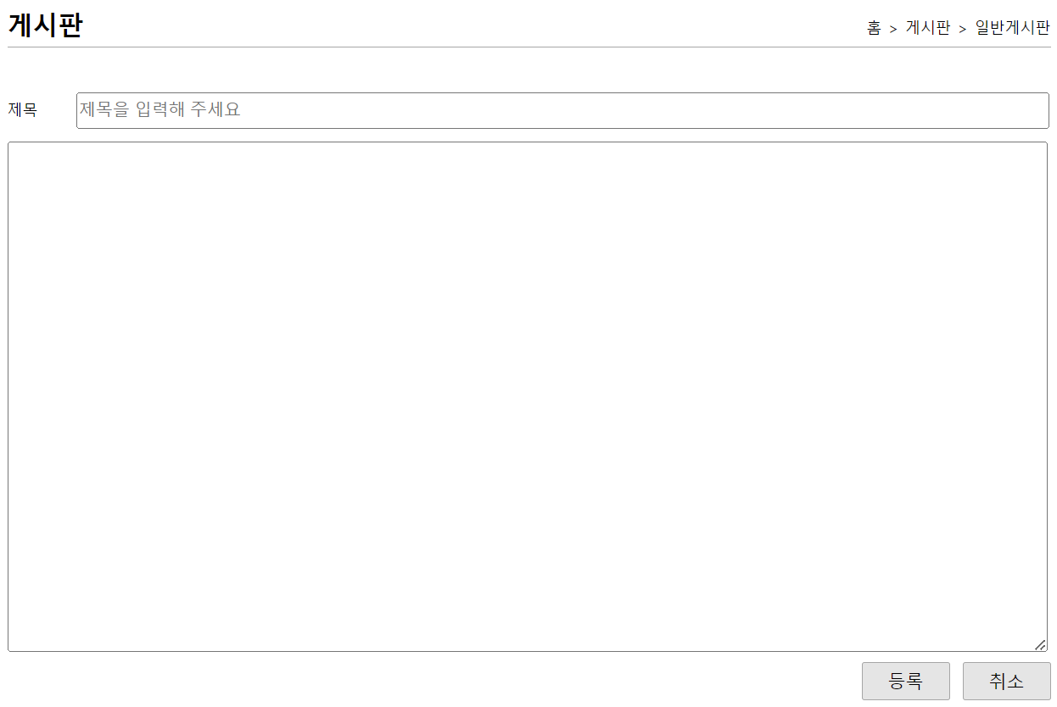
mysite3>board>글쓰기폼
http://localhost:8000/mysite3/board/writeForm
/board/writeForm
writeForm()
writeForm.jsp
0x228
BoardVo boardVo
no
title = 1번글
content = 글내용
hit
regDate
userNo ←세션에서
name
mysite3>board>글쓰기
http://localhost:8000/mysite3/board/write?
title=1번글&content=글내용
/board/write
write(boardVo)
boardVo
boardVo
boardVo
addBoard(boardVo)
insertBoard(UserVo)
insert(
"board.insert",
boardVo
)
count
count
count
리스트 리다이렉트
세션에서 userNo 추가

