Slide 1
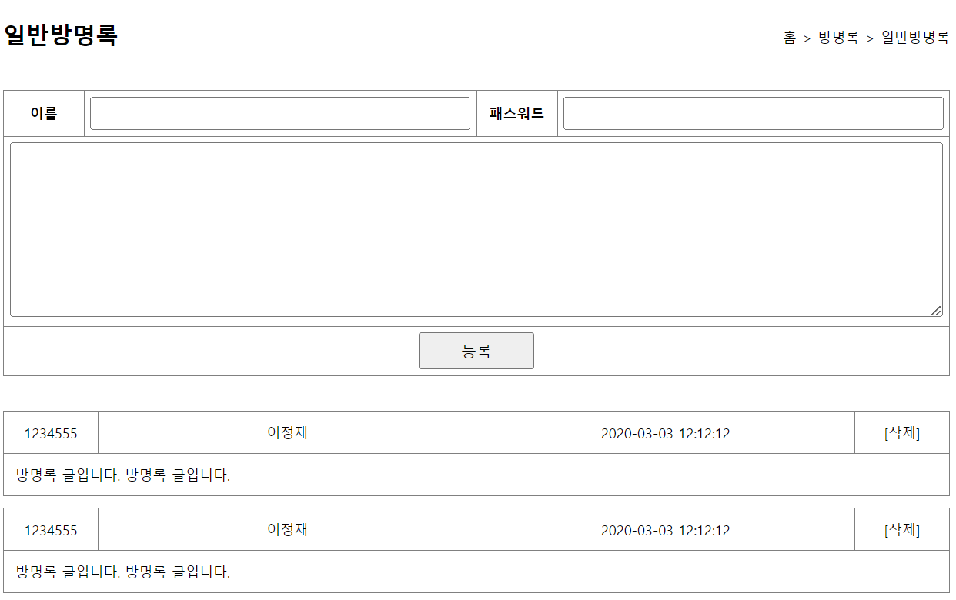
mysite3>guestbook>등록폼+리스트
http://localhost:8000/mysite3/guestbook/addList
/api/guestbook/addList
addList()
selectList(
"guestbook.selectList"
)
getGuestList()
selectGuestList()
“guestbookList”
List<GuestVo>
List<GuestVo>
List<GuestVo>
List<GuestVo>
Ajax장치
addList.jsp
0x789
mysite3>guestbook>ajax등록
GuestbookVo guestbookVo
no <--17
name = 이효리
password = 1234
content = 방문합니다
regDate
guestbookVo no값이 추가된다
http://localhost:8000/mysite3/api/guestbook/add?
name=이효리&password=1234&content=방문
/api/guestbook/add
addList(GuestbookVo)
guestbookVo
guestbookVo
insert(
"guestbook.insertSelectKey“,
guestbookVo
)
addGuest()
InsertSelectKey()
등록
guestbookVo
count
count
guestbookVo
no
0x999
GuestbookVo guestbookVo
no= 17
name = 이효리
password = 1234
content = 방문합니다
regDate = 2023-09-01
no
selectOne(
“guestbook.selectGuest“,
no
)
selectGuest()
guestbookVo

Slide 3
mysite3>guestbook>등록폼+리스트
http://localhost:8000/mysite3/guestbook/addList
/guestbook/addList
addList()
selectList(
"guestbook.selectList"
)
getGuestList()
selectGuestList()
List<GuestVo>
List<GuestVo>
List<GuestVo>
List<GuestVo>
addList.jsp
0x789
GuestbookVo guestbookVo
no
name = 이효리
password = 1234
content = 방문합니다
regDate
mysite3>guestbook>등록
http://localhost:8000/mysite3/guestbook/write
/guestbook/write
write(guestbookVo)
writeGuest(guestbookVo)
insertGuest(guestbookVo)
insert(
"guestbook.insert",
guestbookVo
)
count
count
count
방명록리스트
리다이렉트

Slide 4
mysite3>guestbook>삭제폼
http://localhost:8000/mysite3/guestbook/deleteForm?
no=3
/guestbook/deleteForm
deleteForm()
deleteForm.jsp
jsp에서 parameter값을 꺼내쓴다
0x274
GuestbookVo guestbookVo
no = 3
name
password = 1234
content
regDate
mysite3>guestbook>삭제
http://localhost:8000/mysite3/guestbook/delete
/guestbook/delete
delete(guestbookVo)
removeGuest(guestbookVo)
deleteGuest(guestbookVo)
delete(
"guestbook.delete",
guestbookVo
)
count
count
count
방명록리스트
리다이렉트

