Slide 1
La Posh hotel room reservation
System

Slide 2
TABLE OF CONTENTS
01
04
About the Project
Implementation
02
05
Project Stage
Major Requirements
03
06
Project Goals
Our Team

Slide 3
About The Project
La posh hotel room reservation
This project was intended to design a web tool that will facilitate the clients of La posh hotel to make room reservation easier and make the overall booking system excellent.
01

Slide 4
Current manual system
BOOK BASED
IT IS NOT PROGRAMED
NOT ACCESSIBLE REMOTELY

Slide 5
NEW SYSTEM
BRANDING
POSITIONING
ADAPTABILITY
24/7 ACCESSIBLE
Centralized Database

Slide 6
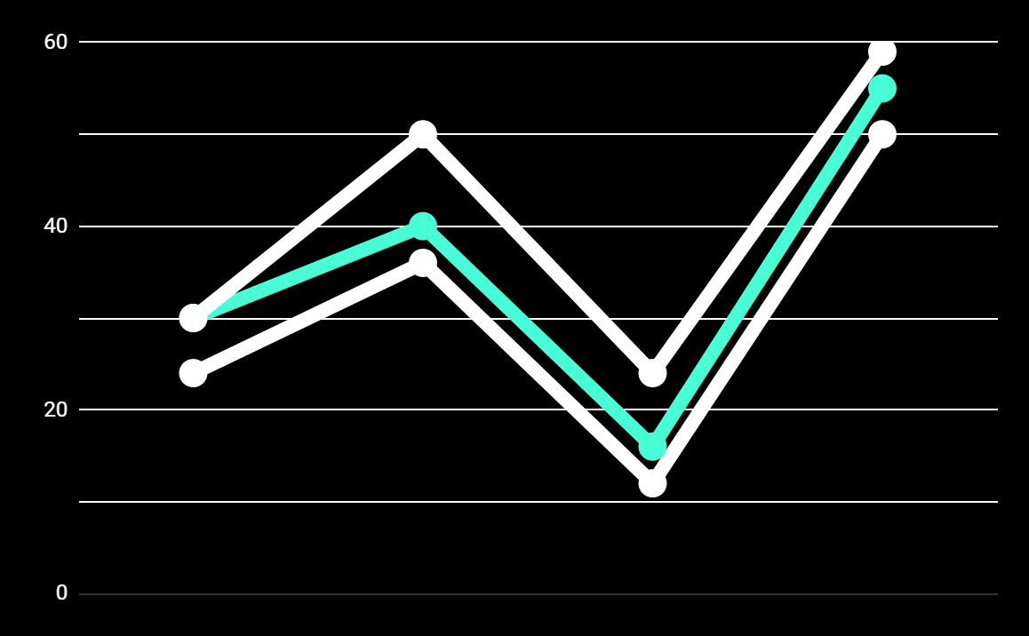
PREDICTED RESULTS
+30%
MONTHLY VISITS
+20%
NEW CLIENTS
+40%
ANNUAL BOOKINGS

Slide 7
MAJOR REQUIREMENTS
LOGIN
CREATE ACCOUNT
MAKE RESERVATION
To access his/ her account, the user will provide credentials to be logged in
The clients must have an account to make a reservation
Our clients will be alllowed to make reservations remotely and all their data will be handled
02

Slide 8
OUR GOALS
EXPANSION
POSITIONING
USABILITY
Secure user information and easy system future expansion
The hotel will be easily located
Having the system which easy to use
03

Slide 9
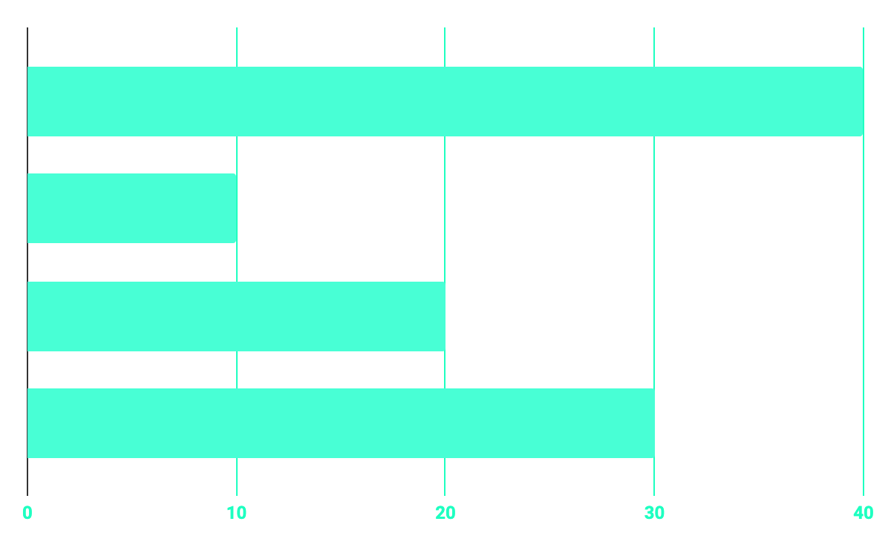
Time partitioning
20%
40%
PROGRAMMING
10%
30%
DATABASE
WEB DESIGN
RESEARCH

Slide 10
WHAT WE HAVE IMPLEMENTED
SECURE
ACCESSIBLE
FAST AND RELIABLE
We designed a system which is secure
The system will be accessible 24/7
The system will ease things and stuffs about room booking
04

Slide 11
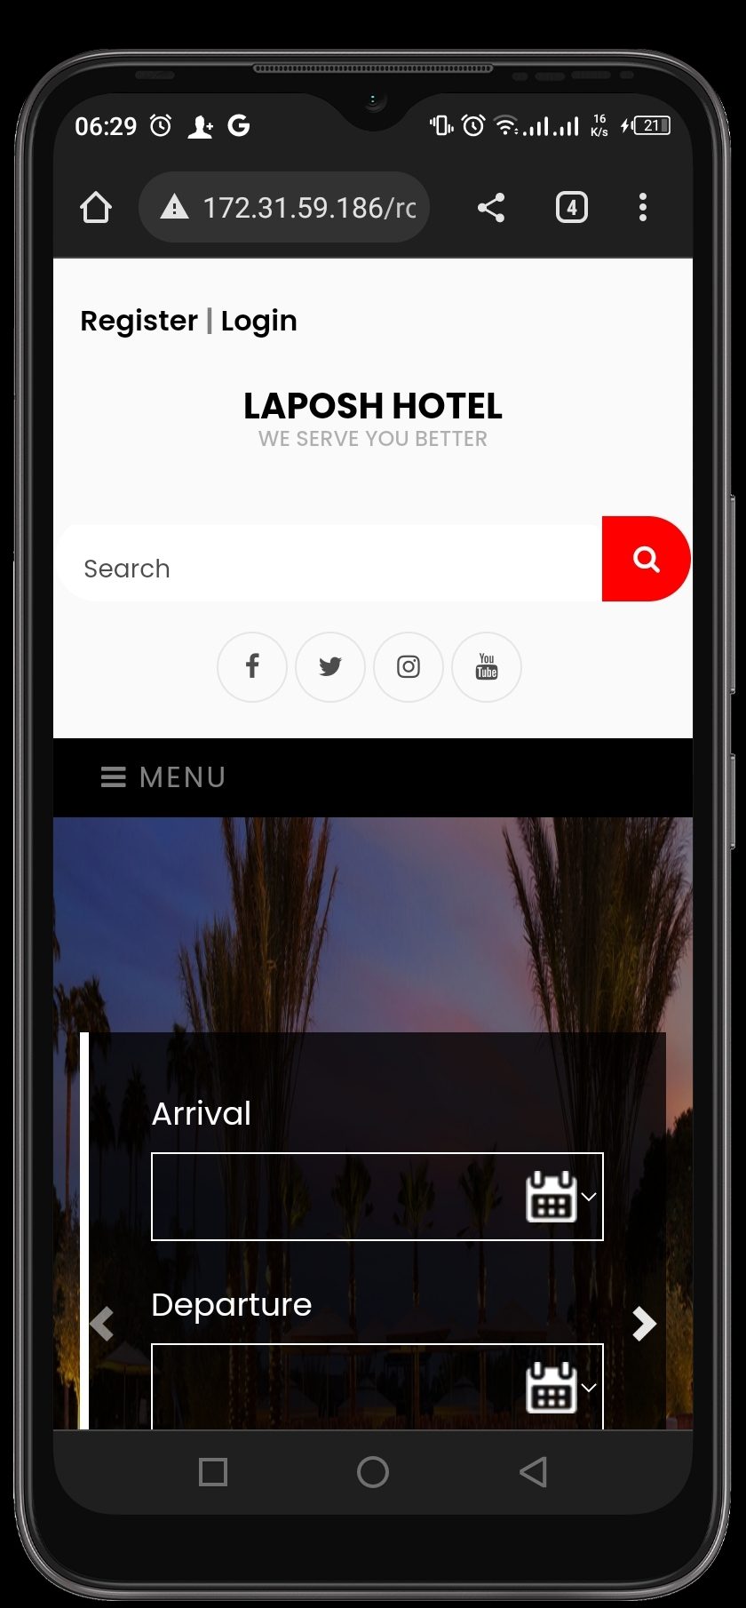
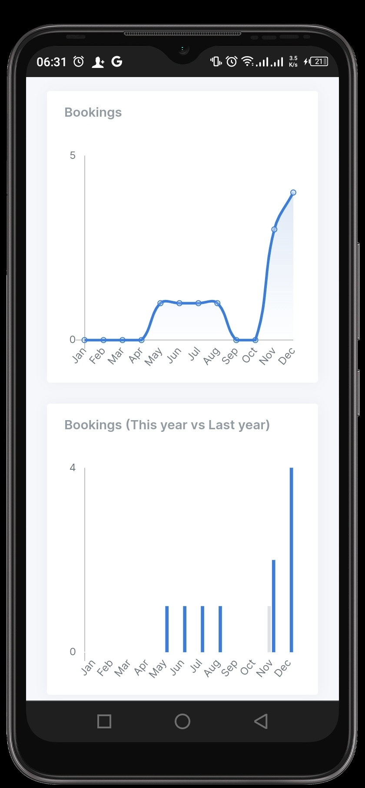
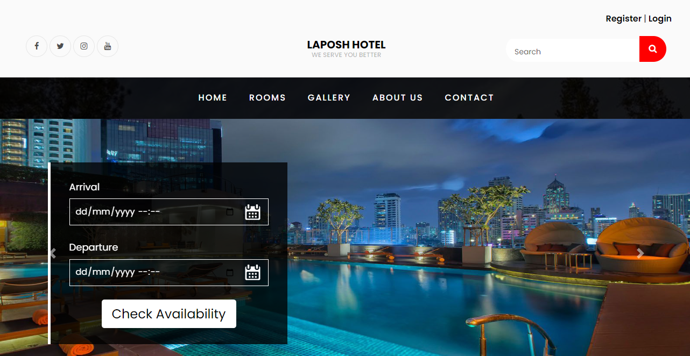
LAYOUT

Slide 12
CURRENT PROGRESS
WE ARE NOW AT
+94%
All with
PHP-Laravel
MySQL
05

Slide 13
THE TEAM
JEAN CLAUDE HIRWA
ANGELIQUE UWAMAHORO
System analyst and designer
System analyst and designer
06

Slide 14

OUR TARGET PARTNERS
La posh Hotel
BANKS
Businesses

Slide 15
THANKS!
Does anyone have any question?

Slide 16
CREDITS
We could like to express our gratitudes to:
Lecturer Mr. Eric HITIMANASlidesgo
KTU Developers
The university of RwandaFreepik
La Posh Hotel

