Slide 1
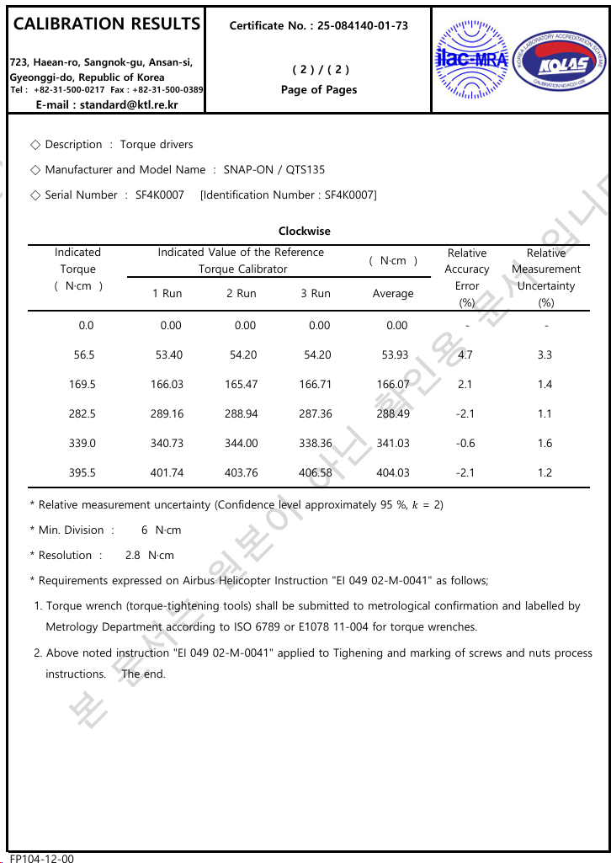
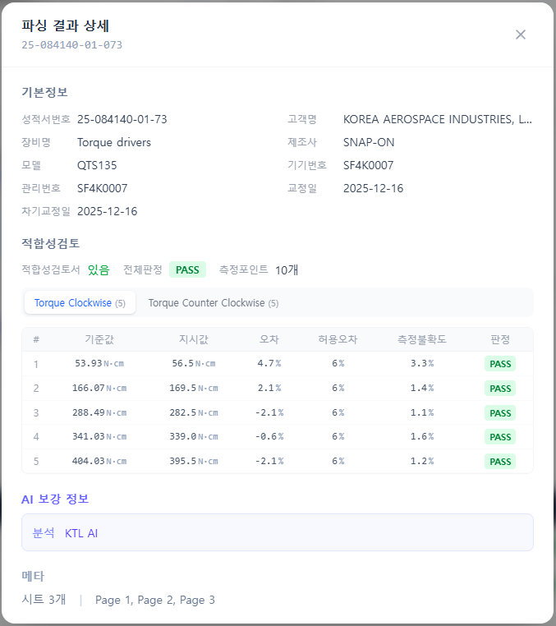

Slide 2
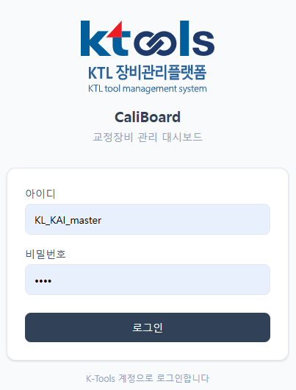
URL: https://project-caliboard.vercel.app ID: KL_KAI_master
PWD: 1234

Slide 3
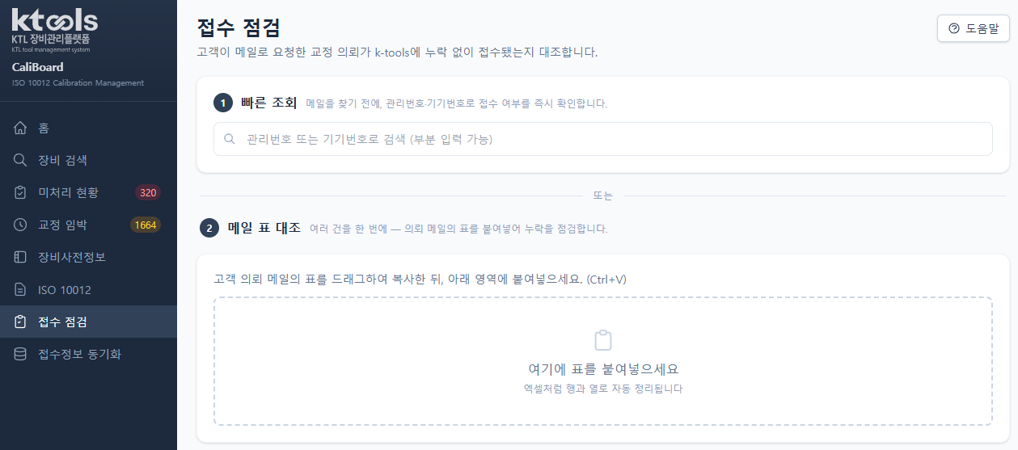

Slide 4
