Slide 1
PartsUnlimited
Data Warehouse
EV Expansion
(Author: Hicran Arnold)

Slide 2
Background Information
The topic I wish to explore for my data warehouse project is the management of Parts Unlimited's EV parts business. This topic was inspired by "The Unicorn Project," which describes the challenges and opportunities of digital transformation in a large organization. Specifically, I plan to focus on storing and analyzing data related to charging stations, EV product price lists, EV car information, and EV customer data, such as their geographic location, the model of the car they own, and location data.In this scenario Parts Unlimited already sells EV parts, and my goal is to improve the organization's data management, reporting, and analysis capabilities related to this business.

Slide 3
Project Objective
The primary objective of this project is to create a concept data warehouse project using a slowly changing dimension approach. I will identify the business requirements by formulating specific business questions that the data warehouse will help answer. Based on these requirements, I will develop a consolidated ERD schema for the data warehouse.
I will focus on storing and analyzing data related to EV charging stations,ev manufacturers and their product information, ev car geographic location. To accomplish this, I will use a slowly changing dimension approach to ensure that data is properly tracked over time. Specifically, I will use SCD Type 3 to track changes to the locations information like manufacturer locations, charging stations location and , SCD Type 2 to track changes to the EV charging stations information, and SCD Type 1 to track changes to the changing in the date information.
Finally, I will use Tableau and Postgres SQL to create reports that will help the business make data-driven decisions based on the data stored in the data warehouse. By using a consolidated ERD schema and slowly changing dimensions, I will ensure that the data warehouse accurately reflects the business needs and can be used to provide valuable insights to the organization

Slide 4
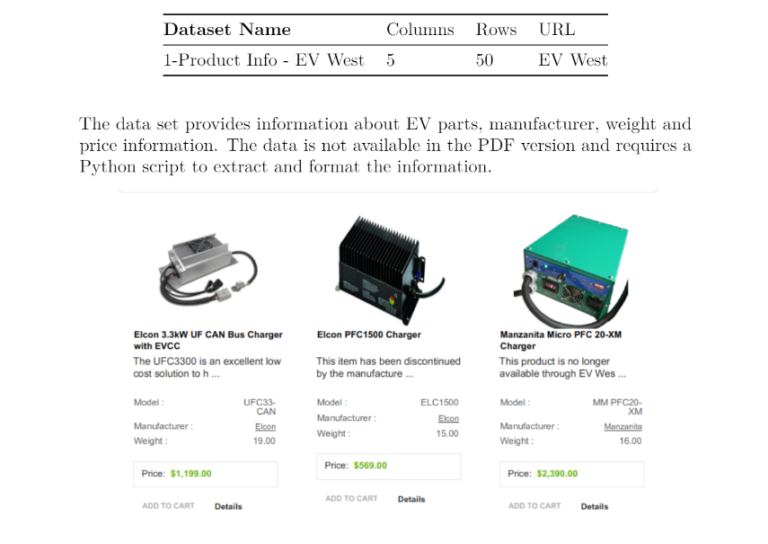
Information About the Datasets

Slide 5
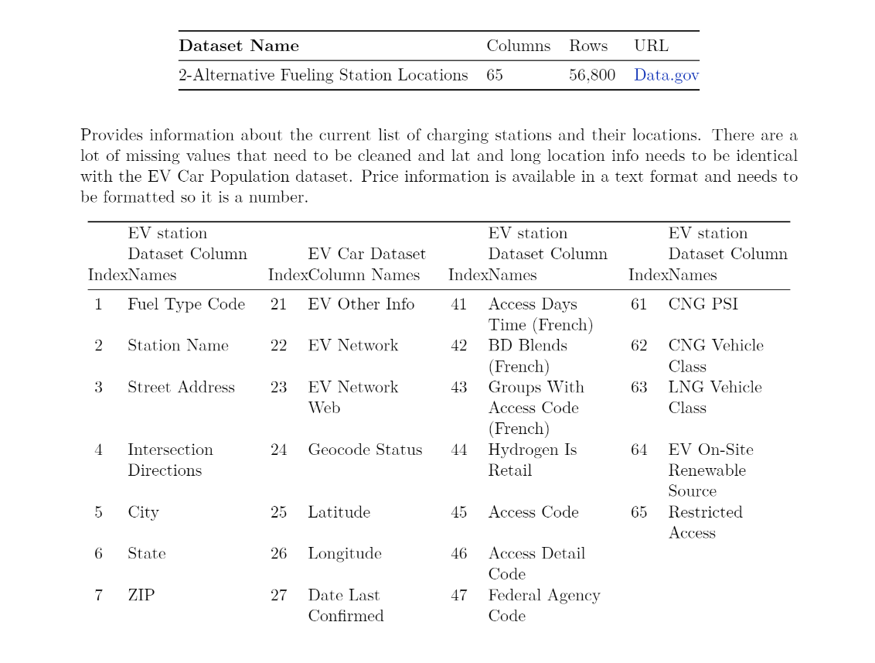
Information About the Datasets

Slide 6
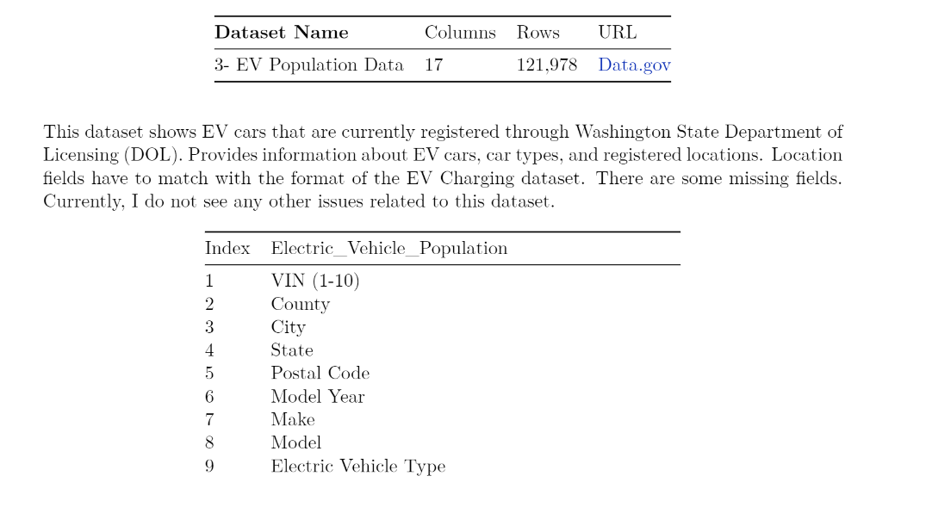
Information About the Datasets

Slide 7
Consolidated ERD Schema (SCD DIM)

Slide 8
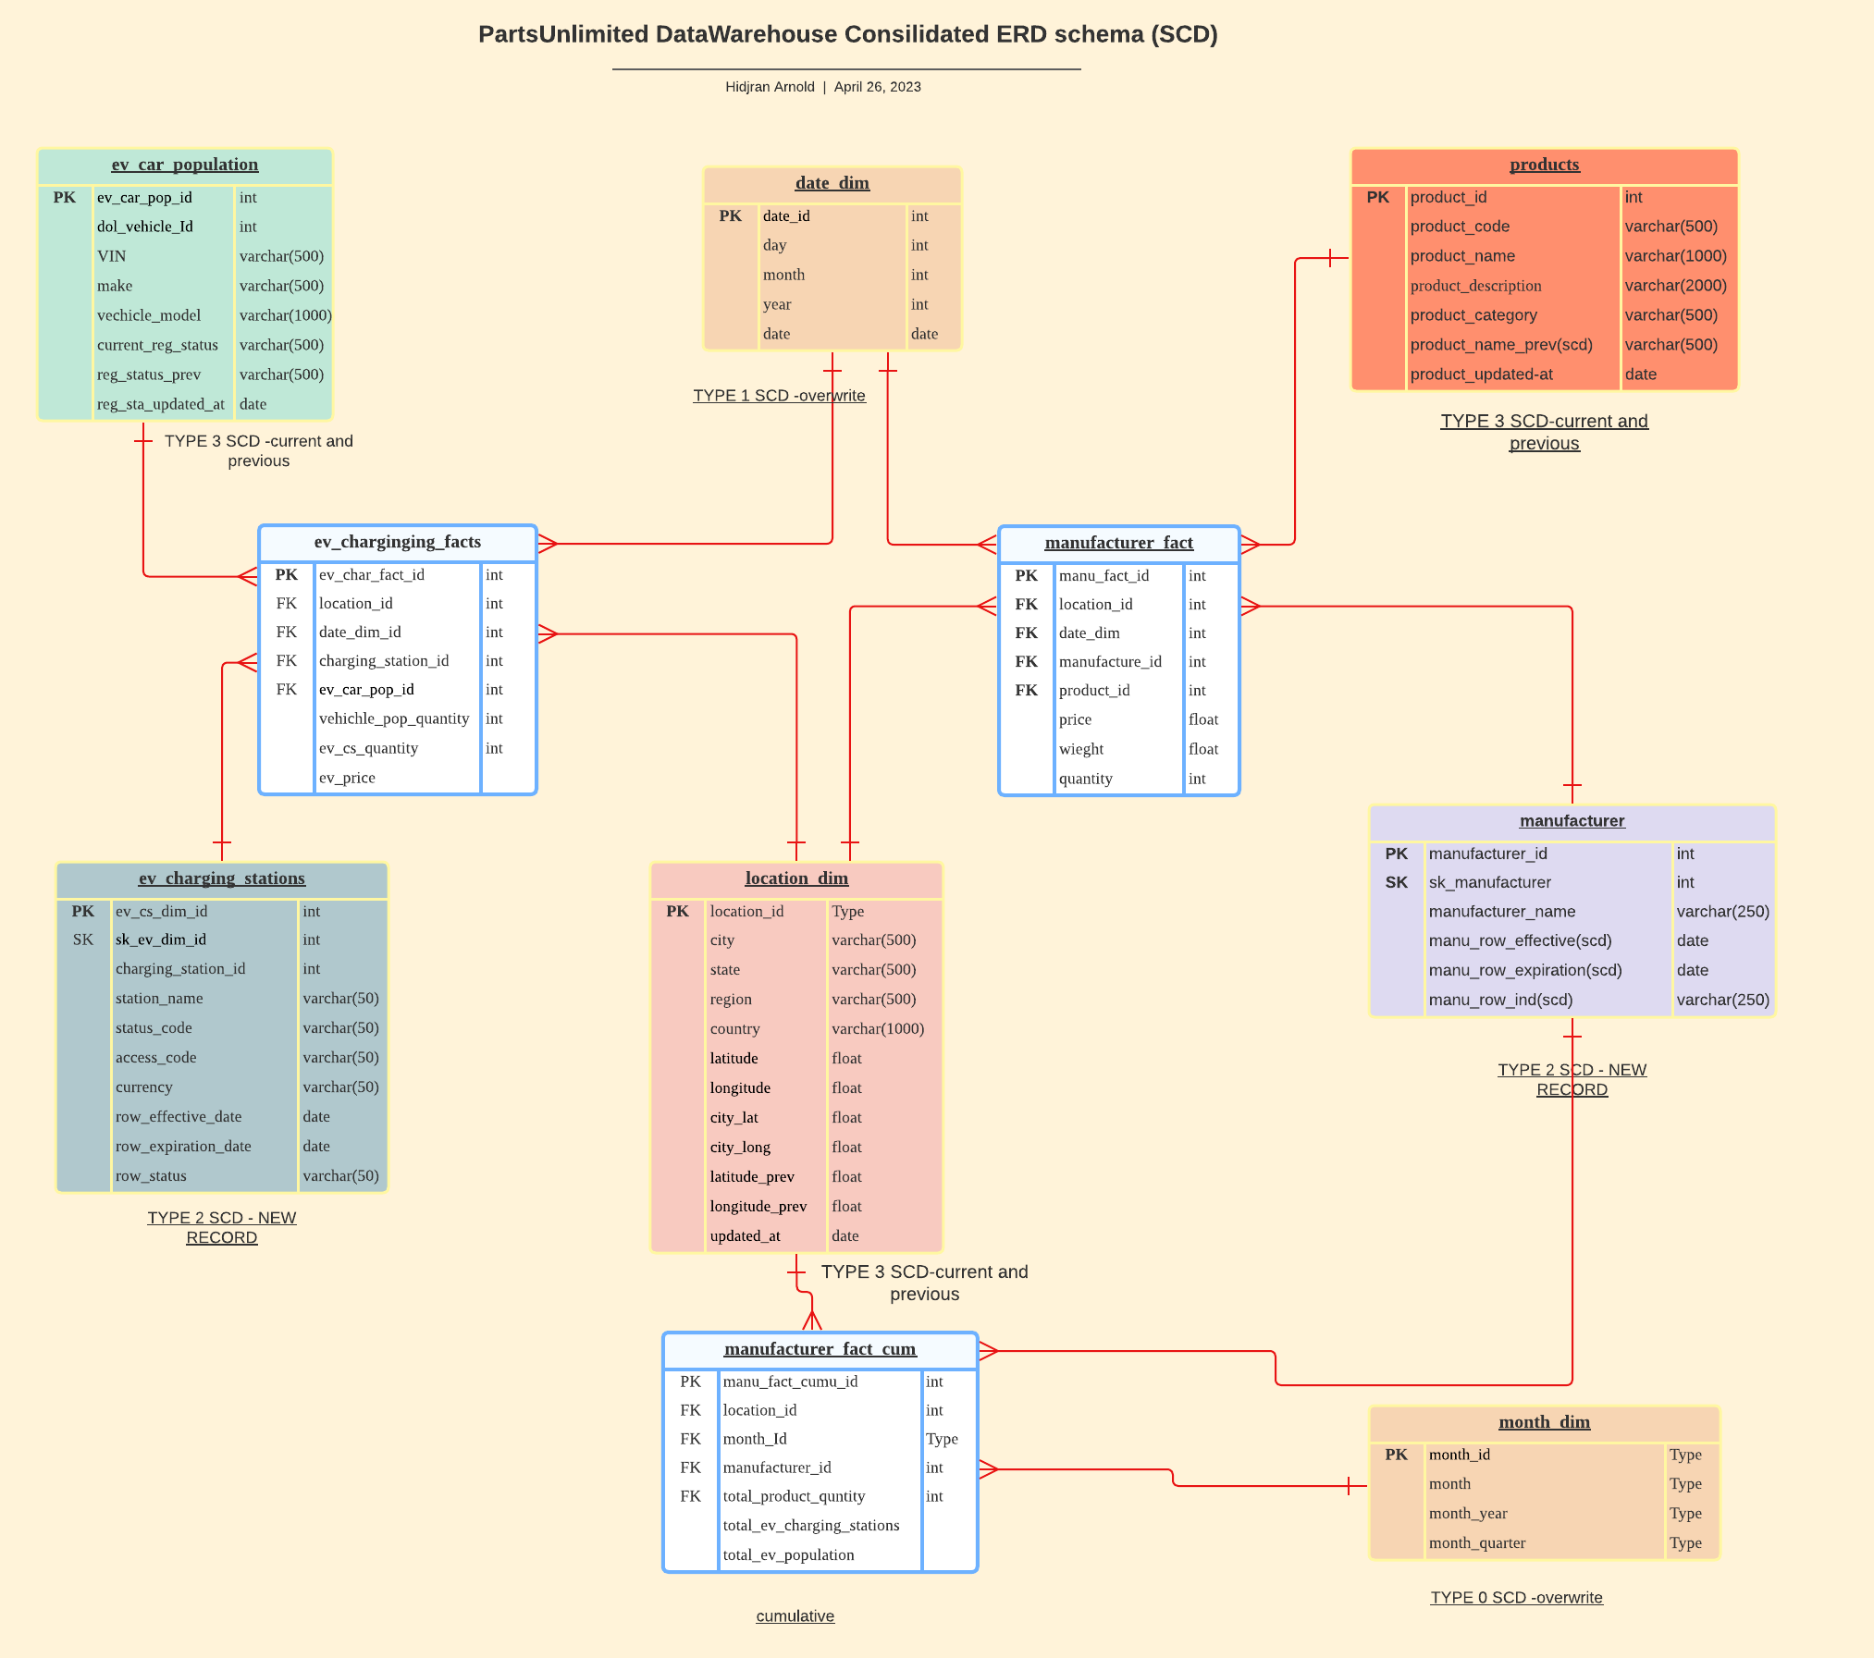

Slide 9
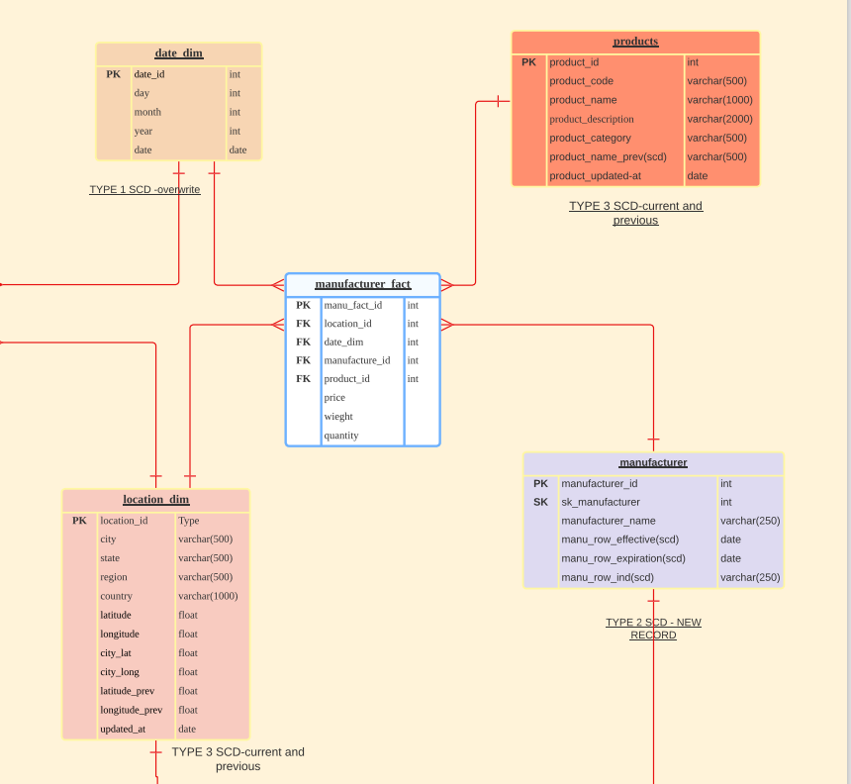
Manufacturer Fact
This table tracks information about the manufacturer's products, price, weight and how many different type products manufacturer sells
I used a snapshot fact table
I select product as scd type 3 and manufacturer scd type 2 but I think it should of be the opposite because of how many attributes each table includes

Slide 10
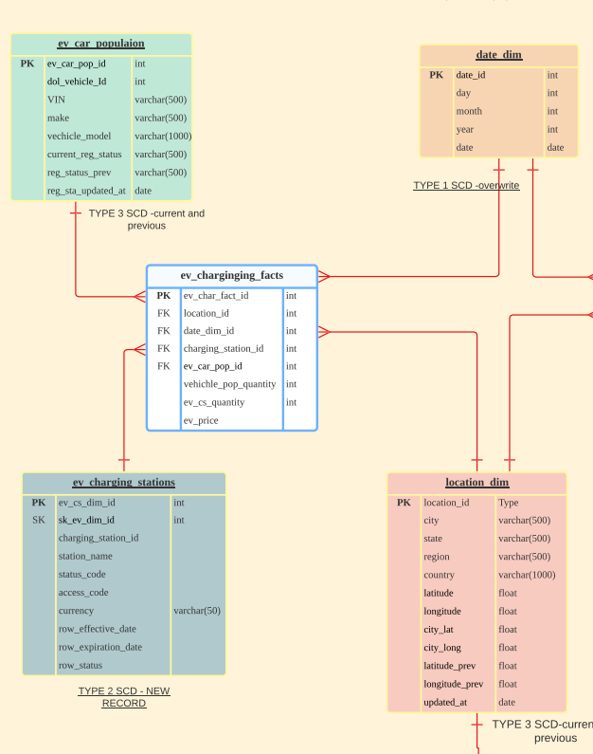
EV Charging and
EV Car Population
This table tracks information about how many cars in each data points and how many charging stations in that are and pricing information
I used date and location table as role playing dimension

Slide 11
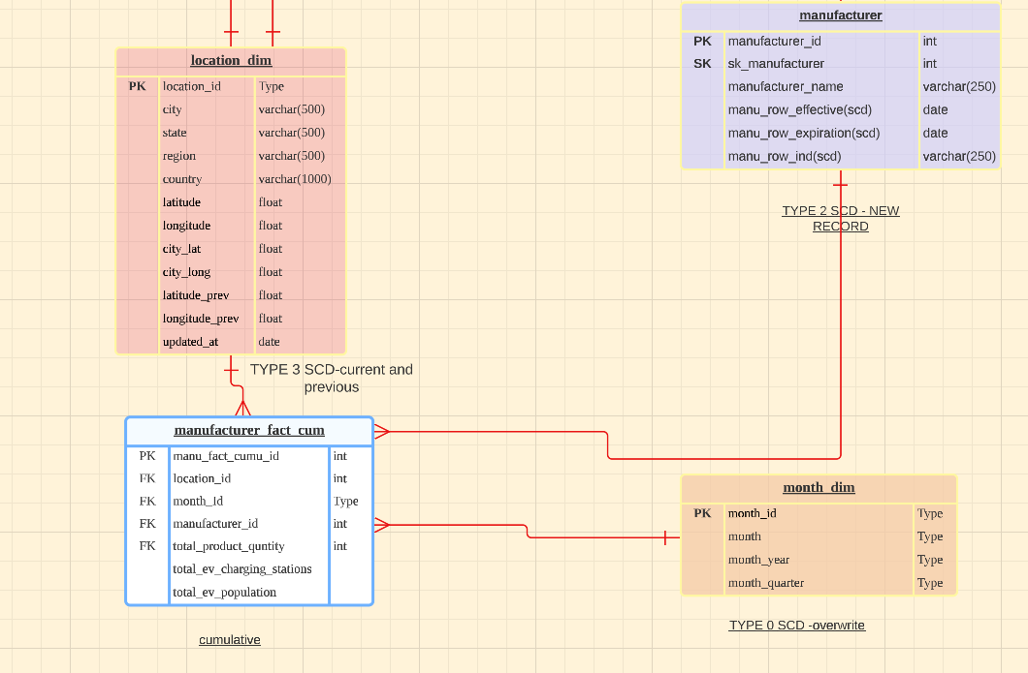
Cumulative
Fact Table
This is the cumulative table. This tracks of summary of ev cars and charging stations and links with the manufacturers. It is a summary and also a common bridge table where we get to see all cumulative information.

Slide 12
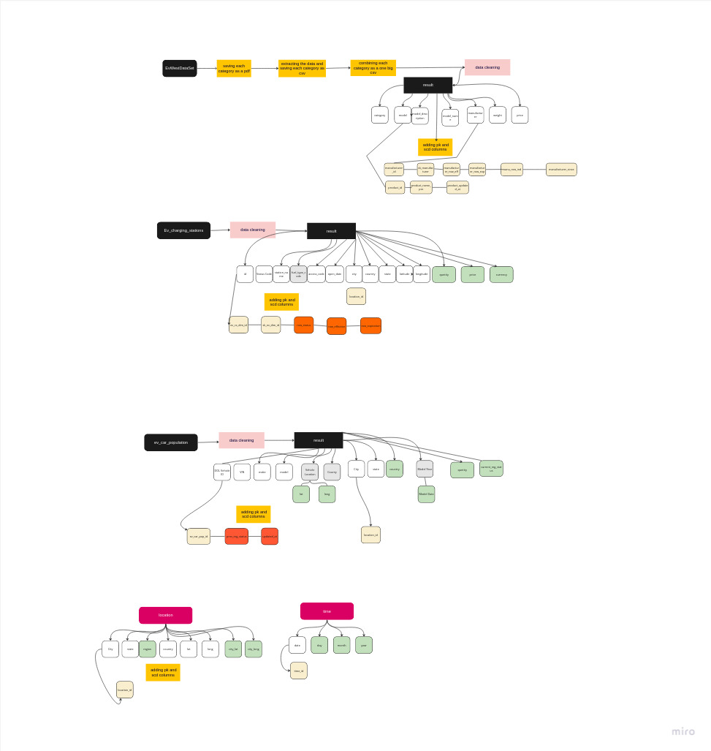
Since the data was complex I created
Data flows to track and visualize
The change in the data

Slide 13
Some code Highlights

Slide 14
from pypdf import PdfReader
import pandas as pd
for page_num in range(number_of_pages):
page = reader.pages[page_num]
text = page.extract_text()
# we start splitting chunks from "Price:" because this splits two chunks
chunks = text.split("Price:")
for i, chunk in enumerate(chunks[1:], start=1): # Skip the first chunk which is before the first "Price"
#print("line", i)
if "Show" in chunk:
# If "Show" is in the chunk, break out of the loop
break
if "Model" in chunk:
# Get the text between "Price" and "Model"
model_description = chunk.split("Model")[0].split("\n")[0].strip()
#get the description
model_name = chunk.split("Model")[0]
# Get the text between "Model" and "Manufacturer"
model = chunk.split("Model :")[1].split("Manufacturer :")[0]
manufacturer = chunk.split("Manufacturer")[1].split("Weight")[0]
# print("Manufacturer")
I used pydpf to extract the data. I extract data with chunks and split with key words

Slide 15
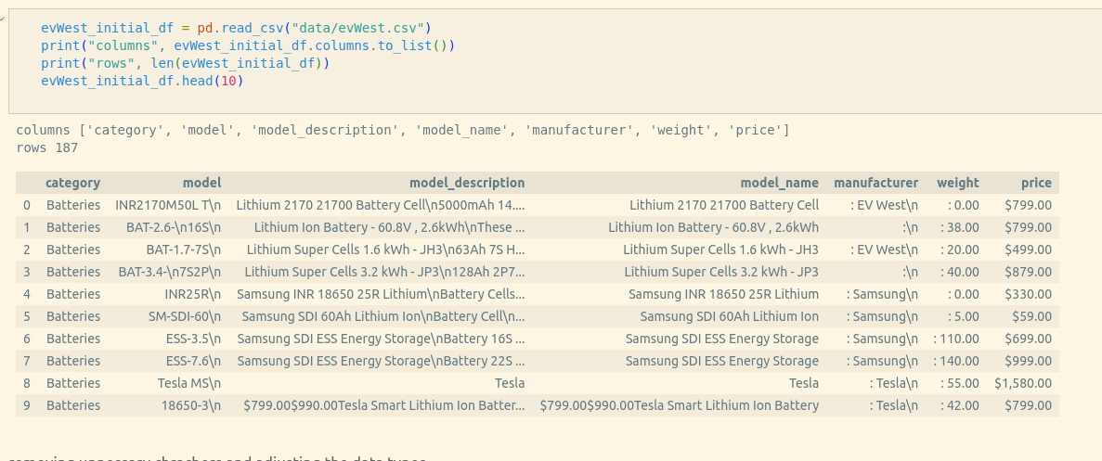
The extracted data looked like this

Slide 16
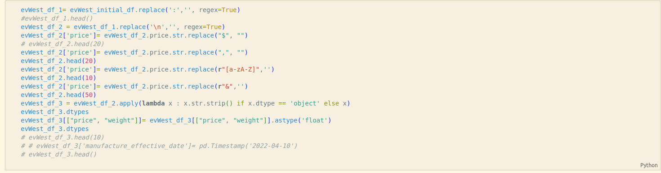
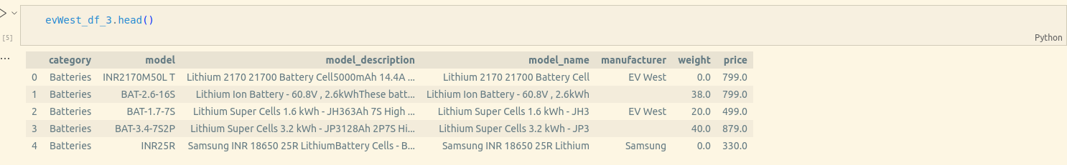
I used regex expression to trim the data and transformed I added other transformation to make sure that it matches with my data

Slide 17
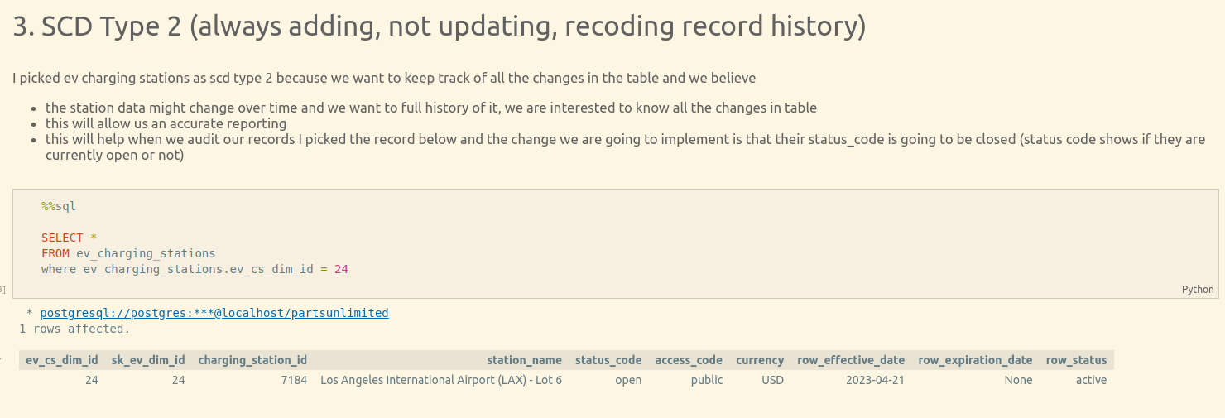
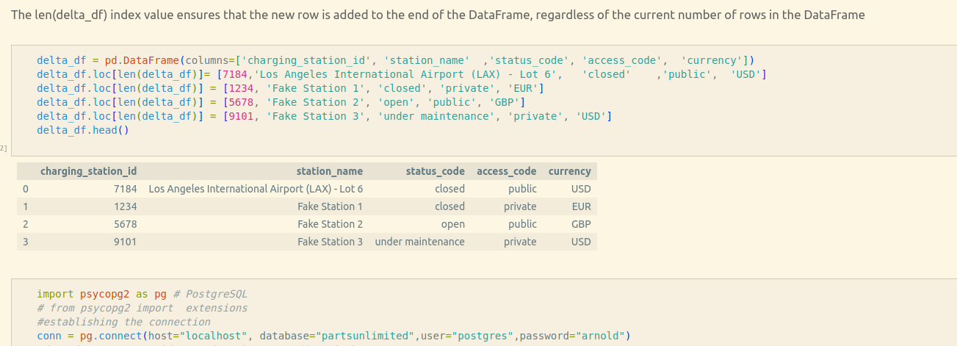
For SCD Type 2 first I altered my table to automatically increase the the keys
And then I added a sample data that I created but before load I load the data to pandas pdf and identified new records using pandas merge then later used compare function to identify the records that has changed
I saved new records with automated sk and pk, and default scd fields
For adjustment I used update
To set old record expiration date and status
And then add the new records with the same sk number

Slide 18
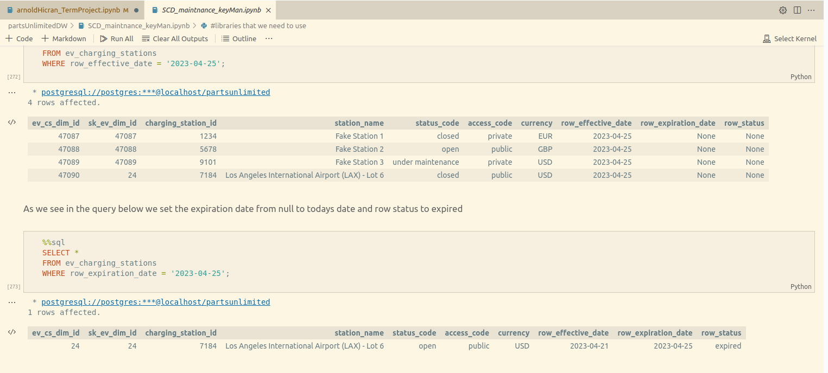
The end result we see the new records and the updated one

Slide 19
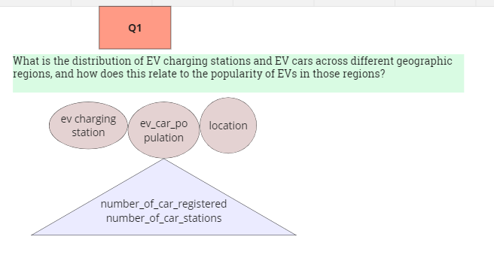
For the first question I did not want to include time and location dimension because originally I do not have this data but in my visualization I have included the time dimenstion

Slide 20
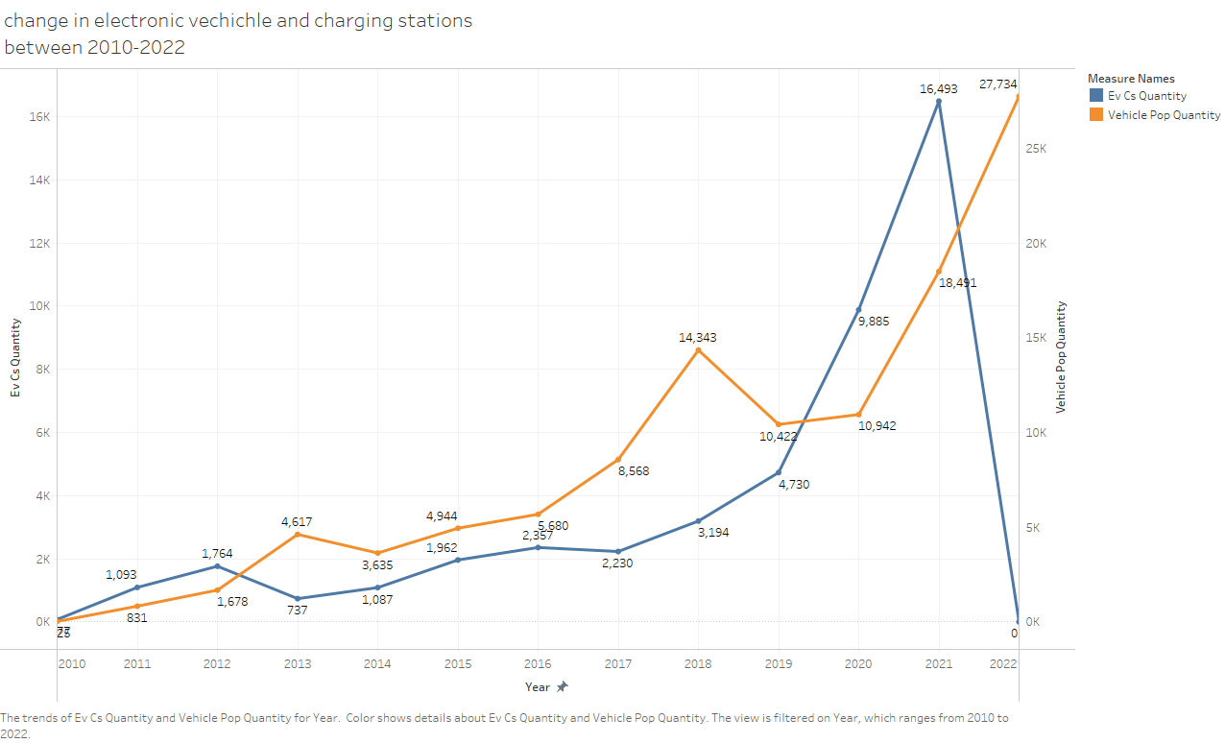
In here we see that charging stations went down , maybe we are missing some data, it needs further research but rest of the graph shows that both increases together over the years

Slide 21
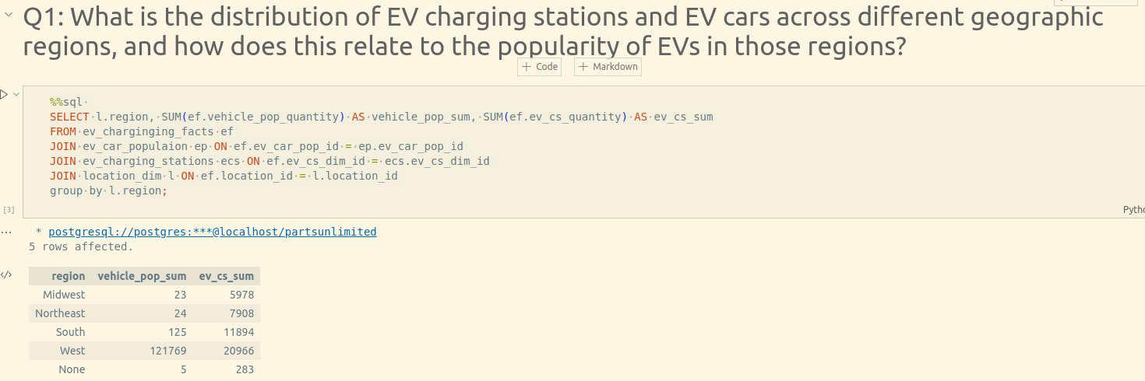
I wrote this query to respond to this question we see the different regions
In the next page will see the visualization that shows over all charging stations

Slide 22
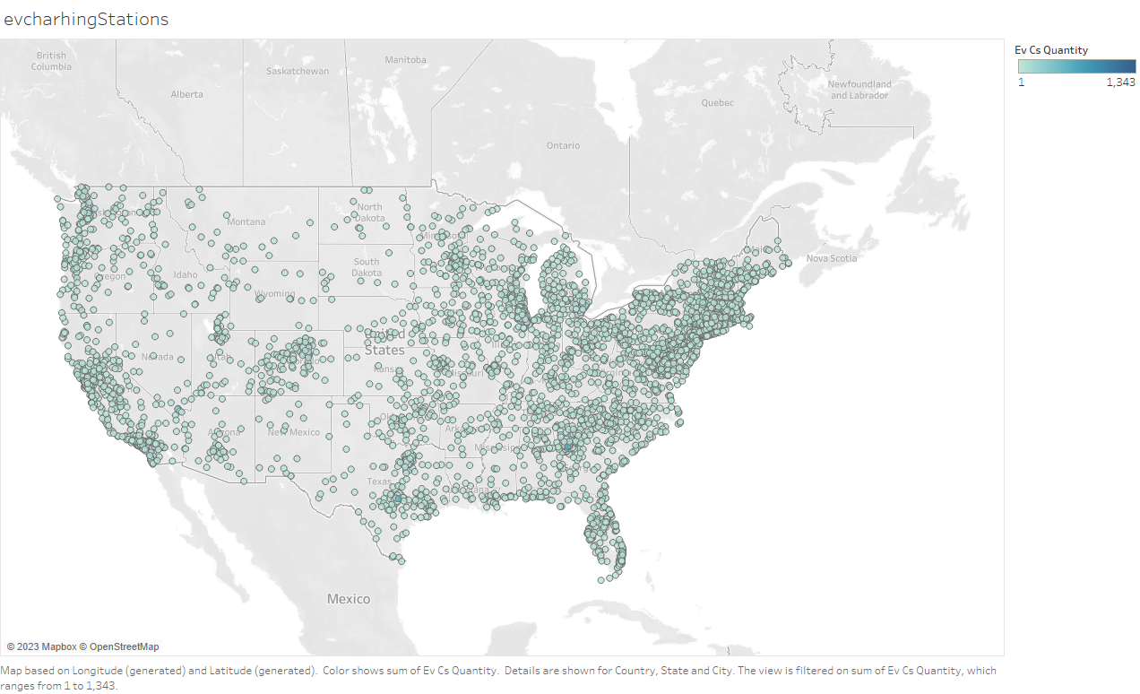

Slide 23
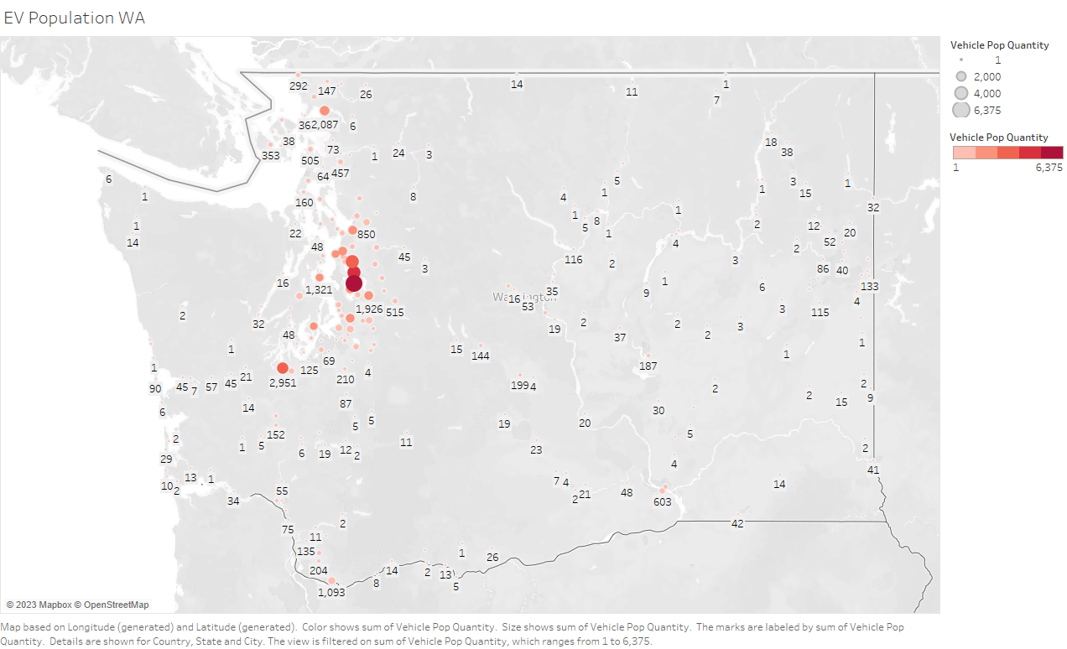

Slide 24
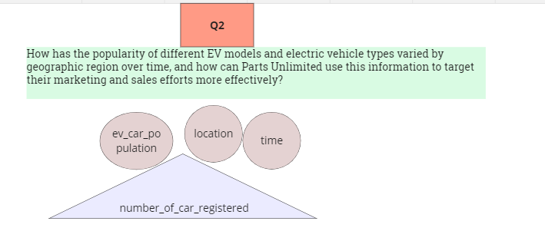
In this questions we have time and location information

Slide 25
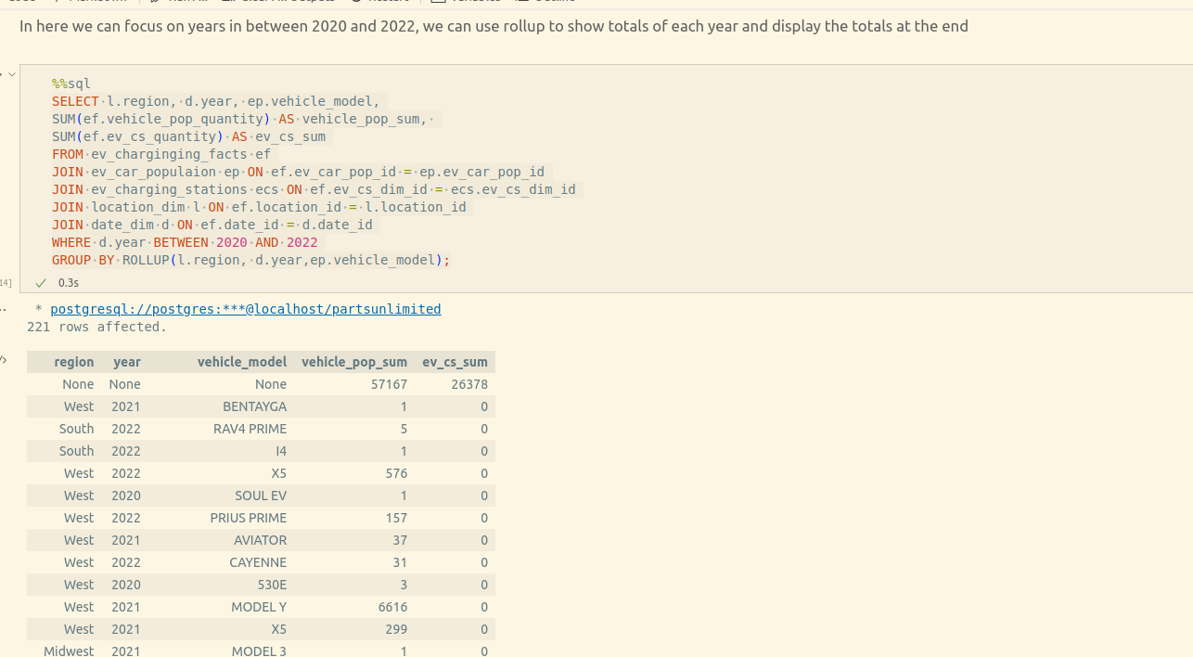
This query gives us a little bit of summary, we can filter even more to see more details
In the next slide we will have a better idea which car model is the most popular

Slide 26
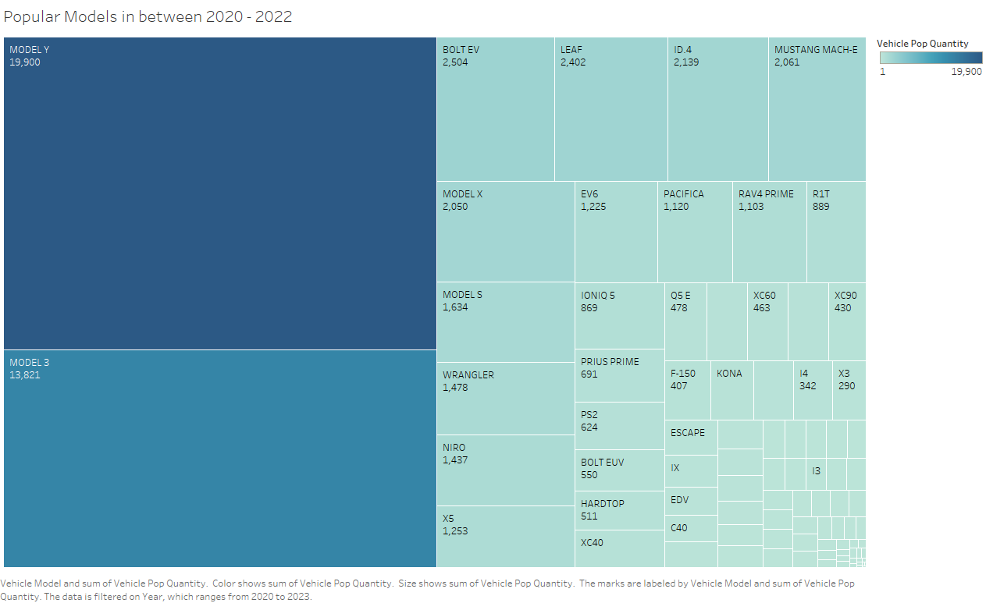

Slide 27
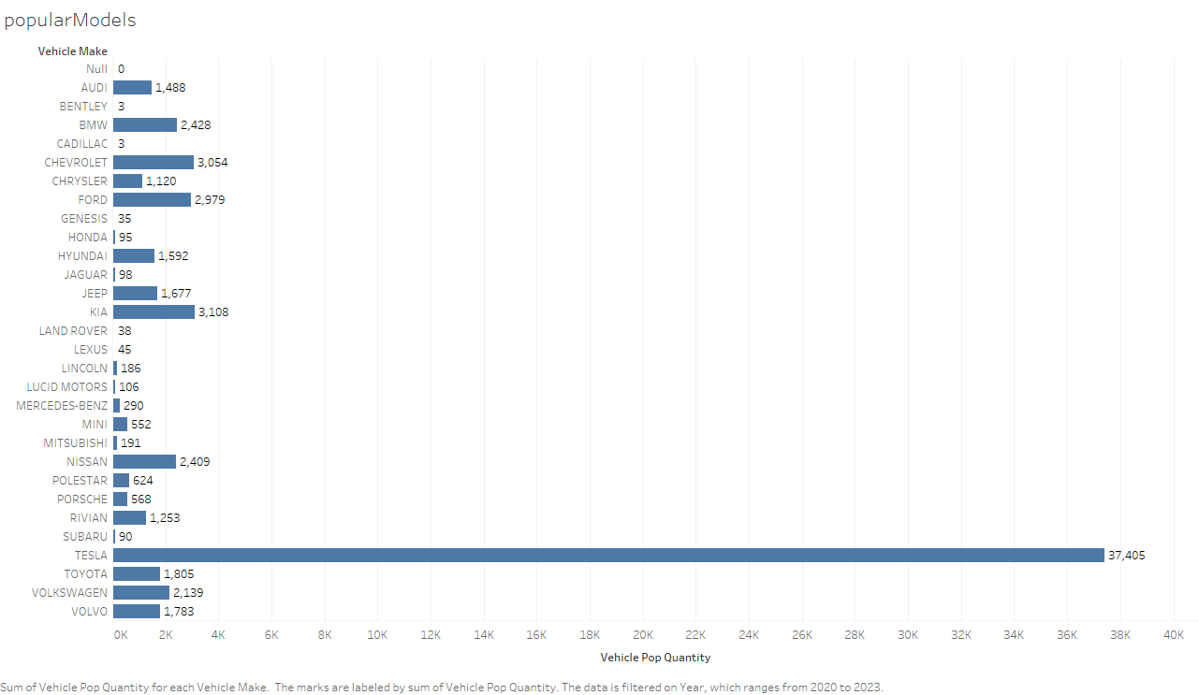

Slide 28
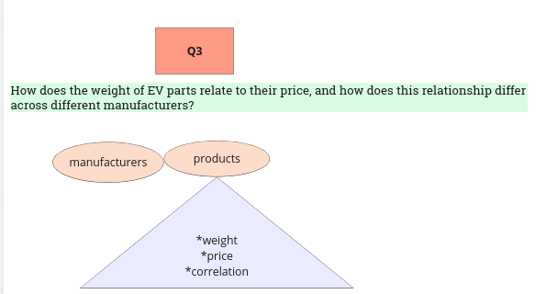
In this question we investigate the relationship in manufacturer’s products weight and price

Slide 29
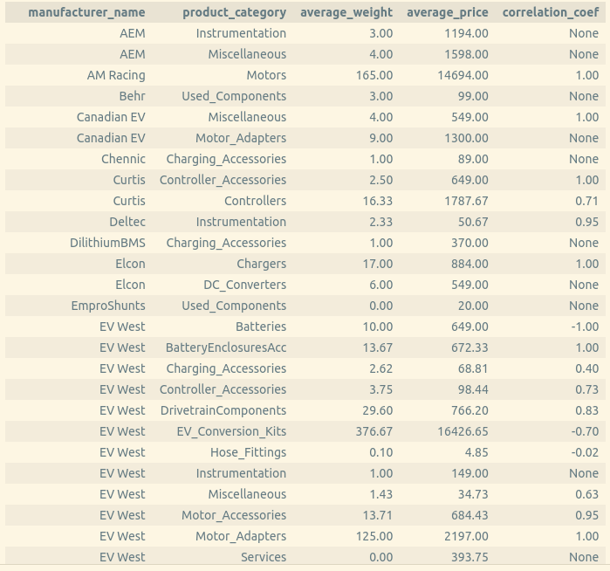
The query above show if there is a relationship and how strong is the relationship by analysing average weight and price

Slide 30
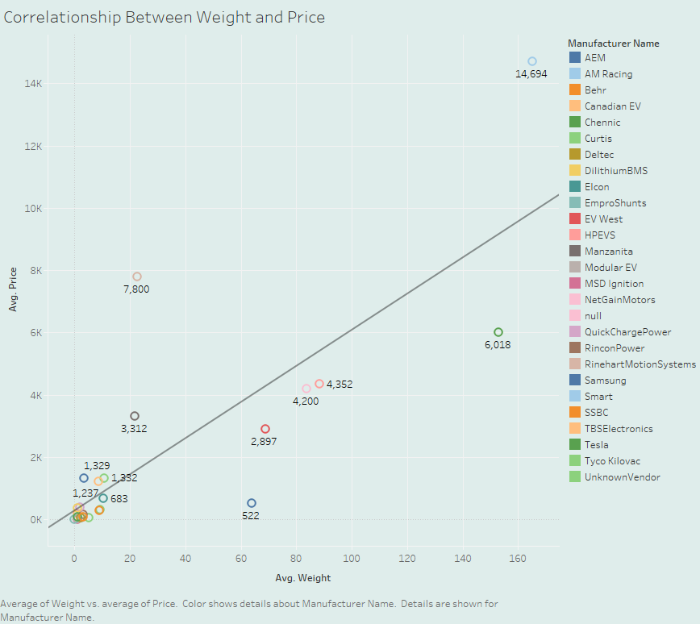

Slide 31
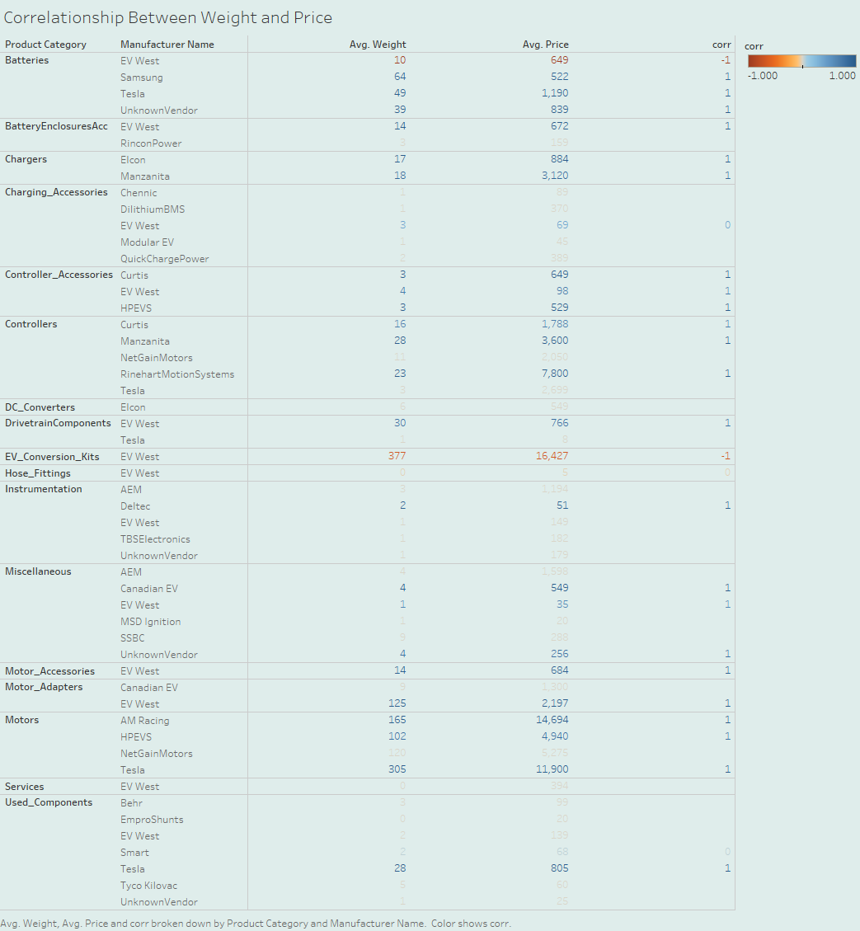
We can use Tableau to highlight what information is we need to pay attention. In here it is where the correlation is

Slide 32
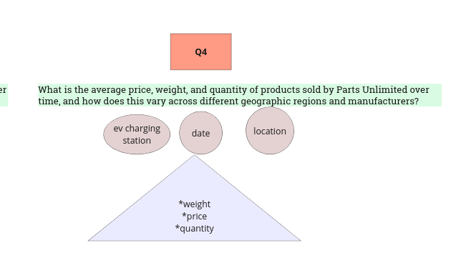
In question 4: we dive into the details of manufacturer region information

Slide 33
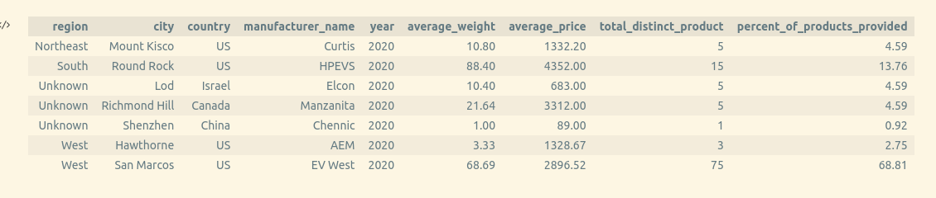
Below is the filtered query that show the details by region. With this information Parts Unlimited can see how they are operated in each region in 2020 and how much they depend on each vendor and so on

Slide 34
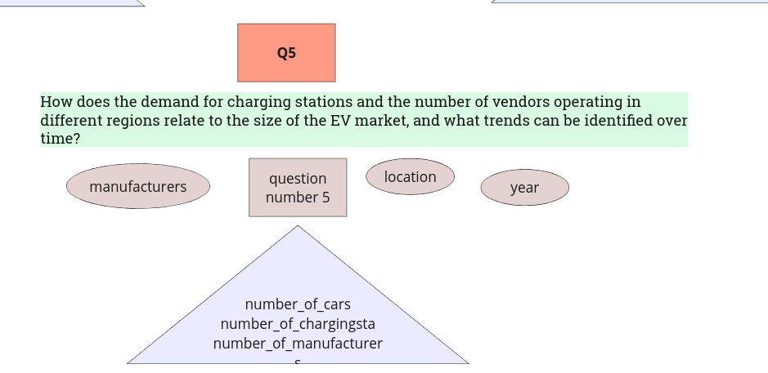
This question asks for a cumulative answer

Slide 35
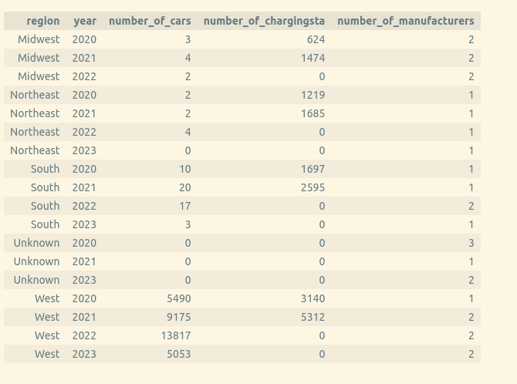
Using cumulative tables Parts Unlimited employees can get operation and research data together and their query time will be short.

Slide 36
Using cumulative table I was able to generate this map in a short time
When I tried the snapshot fact table each process took about 3 minutes to complete
So I ended up using the cumulative table

Slide 37
Conclusion
Connecting the Data together : The data I worked on was very difficult to connect to each other. It was challenging but I believe business are going through the same challenge trying to find the useful information and connecting with their day to day operation
Data was missing dimensionality : Since I extract data from a website and different sources the did not include like time end geography dimension, I had to add some data to meet project requirements
The designing part was challenging but it made me realise how important to design a database that can adapt changes overtime
Pandas and Python was very helpful in the cleaning part of the data but I used sql in my queries because I could directly connect the data and extract information that I needed for my business question without an extra step.

