Slide 1
Software Design & Production Methodologies
STRUCTURED & OBJECT-ORIENTED
METHODS for SYSTEMS ANALYSIS & DESIGN
Vassilka Kirova
Computer & Information Science Department
New Jersey Institute of Technology

Slide 2
SOFTWARE PRODUCTION
DEVELOPMENT
Product Creation
Means:
Methods & Heuristics
Measure of Success:
Quality
f(Fitness of Use)
MANAGEMENT
Efficient & Effective Production
Means:
Methods & Heuristics
Measure of Success:
Productivity
Output= f(Effort)

Slide 3
BASIC CONCEPTS
Analysis and Design
as Elements of a larger
Software Engineering Framework

Slide 4
Beyond Programming ...
ANALYSIS
DESIGN
Programming
QUALITY ASSURANCE
MAINTENANCE

Slide 5
Problems in System Development
Development costs:
  SW dominates HW
Software backlog:
  3 - 6 years
Software maintenance:
  60% - 70% of budget
====> SOFTWARE ENGINEERING

Slide 6


Slide 7
The Project Concept
A project is a set of ...
- activities, interactions and results,
- targeted to reach a given goal
- with limited resources
- and within a limited time-frame.
(Fruehauf, Ludewig, Sandmayr)

Slide 8
The Project
Restrictions
Quality Goals
Customer
Needs
Project
Product
Methods
Environ-
ments
Team

Slide 9
Project Influence Factors
Methods
  Development
  Management
Restrictions
  Time
  Money
Environment
  Tools
  Organization
Quality
  Specification
  Assurance

Slide 10
Where to improve?
A project is a set of ...
- activities, interactions and results
- targeted to reach a given goal
- with limited resources
- and within a limited time-frame.

Slide 11
Where the effort Goes
( Source – Boehm)
Requirements 2 – 15 % with mean of 7%
Design 17%
Programming:
  Detailed design 23-27%
  Code and unit test 29 – 37%
Integration and test 19 – 31%

Slide 12
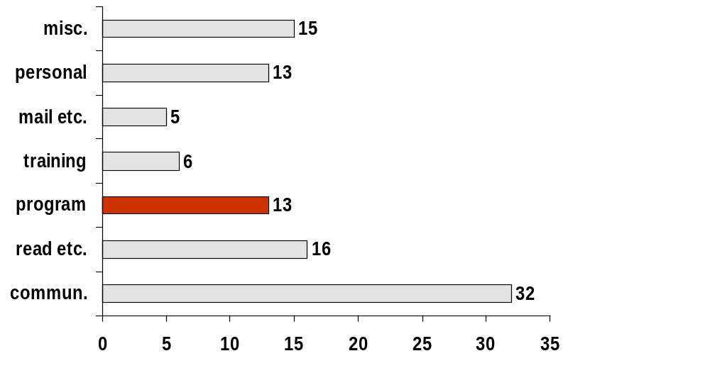
An illustration: What does a programmer do?
% of daily work volume

Slide 13
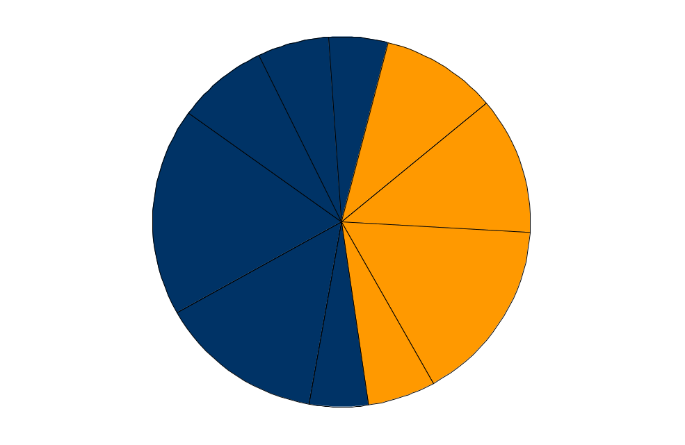
Software Projects are Tough
Only 28% of projects succeeded in 2000
  On time, on budget with all required features
  Up from 16% in 1994
  Process and tools are beginning to show results
Reasons project succeed:
Formal methodology
Reliable Estimates
Standard software infrastructure
6%
5%
Minimized scope
8%
10%
Clear business objectives
12%
Executive support
18%
16%
Clear customer
requirements and
user involvement
Experienced Project Manager
14%
6%
5%

Other
Firm basic requirements
Source: “Extreme Chaos” The Standish Group - 2001. www.standishgroup.com

Slide 14
Can you afford not to?
As much as a 200:1 cost savings results from finding errors in the requirements stage versus finding errors in the maintenance stage of the software life-cycle.
Barry Boehm- ‘76, 88
56% of all bugs can be traced to errors made during the requirements stage


Slide 15
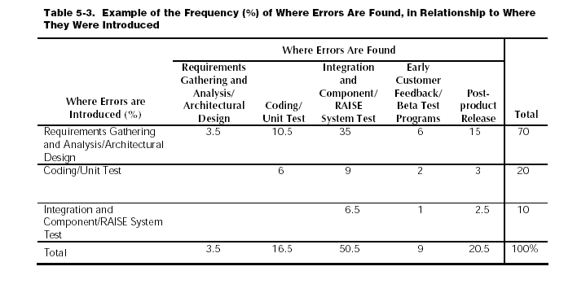
Distribution of Errors

Slide 16
The Effect of Software Best Practices
Cost of Software Defects
  Bugs are costly: 80% of software development cost is spent on identifying and fixing bugs (Source: NIST, 2002)
  Bugs delivered to the customer are even costlier
Detect & Fix Bugs Early
  Cost savings as much as 200:1, from finding errors in requirements versus in the maintenance stage
  (Source: B. Boehm, 76,88,01)
  Cost of Bug Fixes
    $1 on a programmer desktop
    $100 in a complete (integrated software) program
    Many thousand of dollars if identified in the field.
  (Source: The Economist “Building a Better Bug-Trap” 06/19/03)
Rate of Discovery
Proposed
Current
Requirements
Design &
Build
Release
to Test
Release
to Field
TIME
100X Decrease in Cost of Removing Defects
Common knowledge…
but it doesn’t make it any less true
Notes:
Software defects are costly, the earlier you find bugs, the more you save. Most of software best practices are focused on early defect detections and prevention. So adopt software best practices as a best way to reduce cost.

Slide 17
The Effect of Disciplined Quality Frameworks
SEI CMM Level | Defect Potential | Removal Efficiency % | Delivered Defects
1 | 5.00 | 85% | .75
2 | 4.00 | 89% | .44
3 | 3.00 | 91% | .27
4 | 2.00 | 93% | .14
5 | 1.00 | 95% | .05
Defect Removal vs. SEI CMM Level (Source: Caper’s Jones)
Software Quality Results:
Field Fault Density
Mobility has the foundation to achieve similar results
The Impact of CMM
Low Software maturity results in:
  Reduced productivity (35%)*
  Late detection of defects (22%)*
  Longer time to market (19%)*
  Higher post-release defect rates (39%)*
  *median annual improvement of companies with Software Improvement Efforts
QMO
Compliance
ISO 9001
Certification
(All Business Units)
50
40
ISO 9001
Certification
(Phase I)
30
CMM
Level 3
CMM
Level 5
Faults Per Thousand Function Points
20
10
0
1q
2q
3q
4q
1q
2q
3q
4q
1q
2q
3q
4q
1q
2q
3q
4q
1q
2q
3q
4q
1q
2q
3q
4q
1q
Actual results from a telecom company
Notes:
Jumping a single CMM level can reduce software development costs from 4 % to 11% based on a recent Ph.D. dissertation done by Brad Clark at the University of California. It also reduce defects if you move up a CMM level. Data shows that the higher the maturity level of a software development organization, the higher the quality of software produced.
An example of what can be achieved with a disciplined, data-driven approach.

Slide 18

End of Section 0

