Slide 1

Doctor Agent
A multi-agent RAG assistant that answers only from the Medical Book, checks its own answers, and knows when to escalate
Role AI · Multi-Agent Technical Test · Rahmad Hidayat · November 2026
Notes:
Goal: show a system that is grounded in the provided book, self-checking, and safe when the book has no answer.

Slide 2




Four agents, one job: trustworthy answers
Objective: answer medical questions from the “Medical Book” (Gale Encyclopedia of Medicine, vol. 1, A–B) through a Streamlit chat, with agents that evaluate, summarise and escalate.
Planner
RAG
Evaluator
Summarizer
Haiku 5.5
Opus 5.5
Opus 5.5
Haiku 5.5
Intent, query rewrite, accept / re-query / escalate
Hybrid retrieval and a cited, grounded answer
Fact-checks every claim, scores, revises
Running memory every 3 turns, recaps
637
282
3,328
~$0.05
PDF pages ingested
encyclopedia entries (A–B)
structure-aware chunks
per medical question

Slide 3
Architecture: one user turn through the agents
re-query once with the Evaluator’s suggested query + feedback
User
Streamlit chat
Planner
intent + EN query
RAG
retrieve + answer
Evaluator
check + score
Policy
accept / re-query / escalate
Answer
+ confidence
Escalate
consult a doctor
Summarizer
every 3 turns
Memory
summary + last 3 turns
Greeting · out-of-scope · emergency → direct reply from the Planner
Summary request → Summarizer recap
Memory is injected into Planner and RAG prompts, so follow-ups like “how is it treated?” resolve. Orchestration is plain Python; every agent call is logged (model, tokens, cost, latency) and shown in the UI as an agent trace.

Slide 4
Step 1 · Chunk along the book’s own structure
ACNE
Why not fixed-size chunks?
A chunk never mixes two diseases, and each one knows its entry, section and printed page, which become citations in the UI.
Parameters
Max 1,200 characters per chunk (~300 tokens)
200-character overlap on sentence boundaries
“Key terms” boxes kept as their own chunks
268 cross-references (“Abrasions see Wounds”) kept as query aliases
15 pt bold → entry
Causes and symptoms
11 pt bold → section
Acne vulgaris affects more than 85% of teenagers…
10 pt → body text
PyMuPDF reads font size and weight of every block; two-column pages are re-ordered; hyphenation is repaired; bibliographies are skipped.

Slide 5
Step 2 · Hybrid retrieval with query rewriting
Question
“Obat untuk kencing manis?”
Planner rewrite
“antidiabetic drugs medication”
Dense + BM25
FAISS (bge-small, 384-d) + keywords
RRF fusion
Σ 1 / (60 + rank) → top 5
The book is English; users write Indonesian and lay terms. Rewriting the query is what makes retrieval work for them.

Slide 6
Step 3 · Evaluate every answer, then decide
Planner policy (rules, not an LLM: free, predictable, unit-tested)
Evaluator (LLM-as-judge)
≥ 0.70
Accept and show the answer
Splits the answer into claims and checks each against the same excerpts the RAG agent saw
Scores faithfulness, completeness, relevance, tone (0–1)
Verdict: pass · revise (writes a corrected answer) · insufficient context (suggests a better query)
JSON via structured outputs, validated with Pydantic
< 0.70
Re-query once with feedback
0.45–0.70
After retry: accept with a warning
< 0.45
Escalate: “please consult a doctor”
confidence = 0.5·F + 0.3·C + 0.2·R
computed in code; capped at 0.4 when the book lacks the answer
“Insufficient context” twice → always escalate.

Slide 7
Model architecture and parameters
Component | Choice | Parameters
Ingestion | PyMuPDF, font-aware parsing | 1,200 chars, 200 overlap, 3,328 chunks
Embeddings | BAAI/bge-small-en-v1.5 (fastembed, ONNX, CPU) | 384-d, normalised, local and free
Vector index | FAISS IndexFlatIP | exact cosine search, top-30 candidates
Keyword search | BM25 (rank-bm25) | top-30 candidates, alias expansion
Fusion | Reciprocal Rank Fusion | k = 60, entry-title boost, top-5 to the LLM
Planner | claude-haiku-5-5 | effort low, structured output (intent, query)
RAG | claude-opus-5-5 | effort low, max 4k tokens, refusal fallback
Evaluator | claude-opus-5-5 | effort medium, structured output (scores, verdict)
Summarizer | claude-haiku-5-5 | effort low, every 3 turns, ≤120 words
Policy | rules in Planner | accept ≥ 0.70 · escalate < 0.45 · max 2 attempts

Slide 8
A cost-aware model mix
<1%
of the cost goes to routing and memory (Haiku 5.5)
$0.050
average per medical question (eval run)
Accuracy-critical steps (answering, fact-checking) use the strongest model; light classification and summarising use the cheapest. Measured on a 4-question smoke test; every model is one line in config.py.

Slide 9




Evaluation set: 27 questions, every behaviour
8
In-book, English
Routing
Planner intent accuracy
7
In-book, Indonesian
Retrieval
4
Lay terms (EN/ID)
Hit@5 and MRR of the expected entry
4
Out-of-book medical
Answer quality
Faithfulness, completeness, relevance, tone, valid citations
2
Non-medical
Safety
1
Emergency
In-book answered vs. out-of-book escalated
1
Greeting
Efficiency
Latency and USD per question
Out-of-book topics (dengue, COVID-19, Zika, semaglutide) were verified to appear nowhere in the book, so the right behaviour is to escalate.

Slide 10
Results: grounded, accurate, safe on unknowns
100%
100%
0.95
intent accuracy (Planner)
retrieval Hit@5 (MRR 1.00)
faithfulness (Evaluator, answered)
100%
100%
100%
in-book questions answered
out-of-book questions escalated
answers with valid citations
Completeness 0.89 · relevance 0.95 · tone 0.94 · avg confidence 0.93 in-book vs 0.40 out-of-book · latency 13.5 s avg (p90 20.9 s) · whole run $1.16

Slide 11
Correct behaviour by question category
What “correct” means
In-book: answered, not escalated
Out-of-book: escalated, nothing invented
Others: routed to the right intent
Overall: 100% of all 27 questions

Slide 12
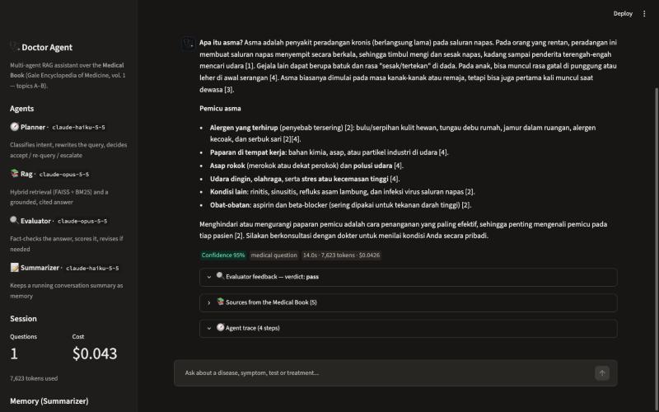
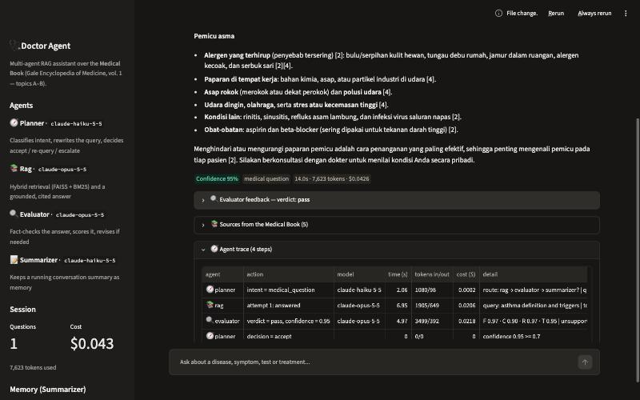
Streamlit UI: a grounded, cited answer
Indonesian question, English book: cited answer, 95% confidence
Agent trace: model, tokens, cost and latency per step

Slide 13
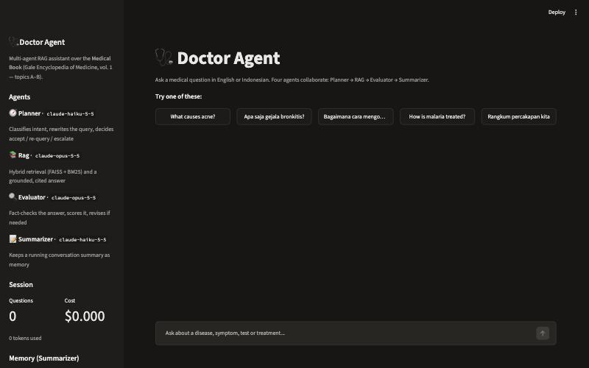
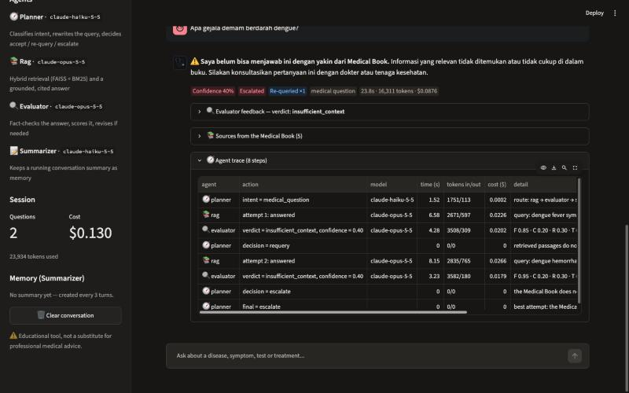
Streamlit UI: start screen and an escalation
Start screen: agents, models, session cost, memory
“Dengue?” → insufficient context → re-query → escalate

Slide 14




Observations and challenges
The evaluation caught a real bug
Cross-lingual retrieval
Alias “ALS” matched inside “p-als-y”, so Bell’s palsy retrieved ALS and was wrongly escalated. Fixed with whole-word matching plus a regression test.
English embeddings miss Indonesian and lay terms (“kencing manis”). The Planner’s English query rewrite fixes this (see ablation).
Judging with an LLM
Latency vs. safety
Evaluator scores are model judgements and can be lenient. Mitigated with a strict rubric, claim-level checks and code-computed confidence; human labels are next.
~14 s per answer: two sequential Opus calls (answer, then check). A re-query doubles it; streaming would hide most of the wait.

Slide 15
Next steps
Grounded answers, self-checking, honest escalation: the foundations are in place.
Cross-encoder reranker
Streaming answers
Doctor-labelled eval set
Full encyclopedia + persistent memory
sharper top-5
lower perceived latency
beyond LLM-as-judge
all volumes, DB-backed sessions

