Slide 1

Doctor Agent
A multi-agent RAG assistant that answers only from the Medical Book, checks its own answers, and knows when to escalate
Notes:
Goal: show a system that is grounded in the provided book, self-checking, and safe when the book has no answer.

Slide 2





What this presentation covers
1 · Approach and methodology
Strategy, the four agents, chunking, hybrid retrieval, evaluate-then-decide
2 · Model architecture and parameters
Models per agent, embeddings, index, fusion, thresholds, cost mix
3 · Evaluation metrics and results
27-question test set, metrics, results, retrieval ablation
4 · Observations and challenges
A bug the evaluation caught, cross-lingual retrieval, LLM-as-judge, latency
5 · Screenshots of the Streamlit interface
A checked answer, the agent trace, live progress, an escalation

Slide 3




Four agents, one job: trustworthy answers
1 · APPROACH AND METHODOLOGY
Objective: answer medical questions from the “Medical Book” (Gale Encyclopedia of Medicine, vol. 1, A–B) through a Streamlit chat, with agents that evaluate, summarise and escalate.
Planner
RAG
Evaluator
Summarizer
Haiku 5.5
Opus 5.5
Opus 5.5
Haiku 5.5
Intent, query rewrite, accept / re-query / escalate
Hybrid retrieval and a cited, grounded answer
Fact-checks every claim, scores, revises
Running memory every 3 turns, recaps
637
282
3,328
~$0.05
PDF pages ingested
encyclopedia entries (A–B)
structure-aware chunks
per medical question

Slide 4
Architecture: one user turn through the agents
1 · APPROACH AND METHODOLOGY
re-query once with the Evaluator’s suggested query + feedback
User
Streamlit chat
Planner
intent + EN query
RAG
retrieve + answer
Evaluator
check + score
Policy
accept / re-query / escalate
Answer
+ confidence
Escalate
consult a doctor
Summarizer
every 3 turns
Memory
summary + last 3 turns
Greeting · out-of-scope · emergency → direct reply from the Planner
Summary request → Summarizer recap
Memory is injected into Planner and RAG prompts, so follow-ups like “how is it treated?” resolve. Orchestration is plain Python; every agent call is logged (model, tokens, cost, latency) and shown in the UI as an agent trace.

Slide 5
Step 1 · Chunk along the book’s own structure
1 · APPROACH AND METHODOLOGY
ACNE
Why not fixed-size chunks?
A chunk never mixes two diseases, and each one knows its entry, section and printed page, which become citations in the UI.
Parameters
Max 1,200 characters per chunk (~300 tokens)
200-character overlap on sentence boundaries
“Key terms” boxes kept as their own chunks
268 cross-references (“Abrasions see Wounds”) kept as query aliases
15 pt bold → entry
Causes and symptoms
11 pt bold → section
Acne vulgaris affects more than 85% of teenagers…
10 pt → body text
PyMuPDF reads font size and weight of every block; two-column pages are re-ordered; hyphenation is repaired; bibliographies are skipped.

Slide 6
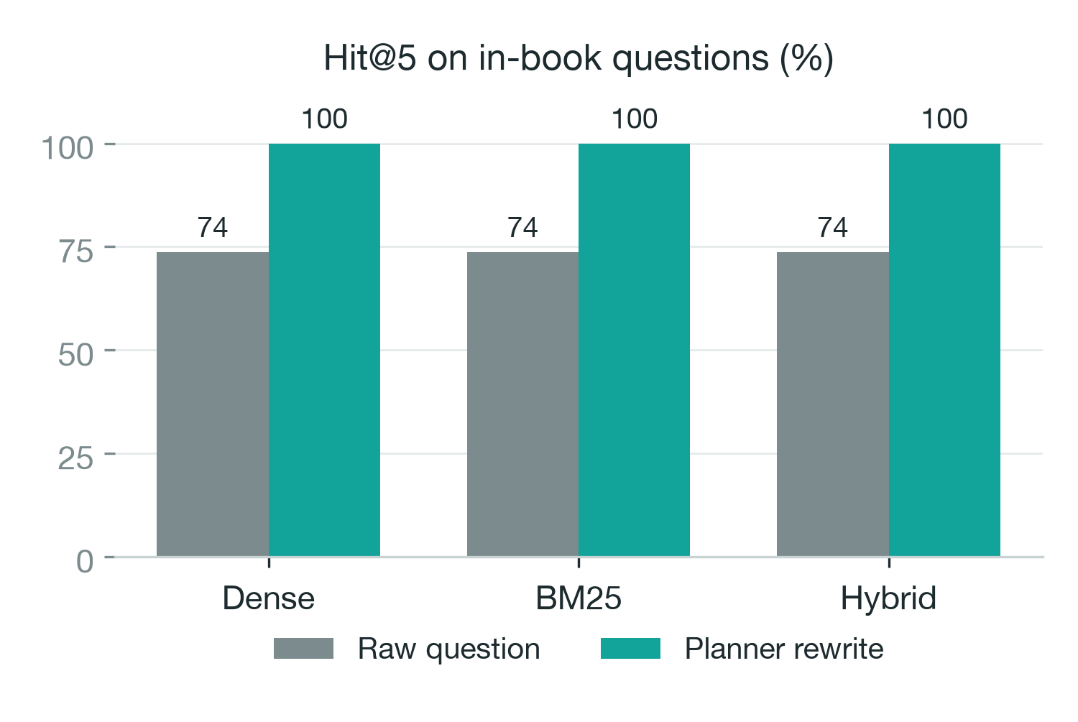
Step 2 · Hybrid retrieval with query rewriting
1 · APPROACH AND METHODOLOGY
Question
“Obat untuk kencing manis?”
Planner rewrite
“antidiabetic drugs medication”
Dense + BM25
FAISS (bge-small, 384-d) + keywords
RRF fusion
Σ 1 / (60 + rank) → top 5
The book is English; users write Indonesian and lay terms. Rewriting the query is what makes retrieval work for them.

Slide 7
Step 3 · Evaluate every answer, then decide
1 · APPROACH AND METHODOLOGY
Planner policy (rules, not an LLM: free, predictable, unit-tested)
Evaluator (LLM-as-judge)
≥ 0.70
Accept and show the answer
Splits the answer into claims and checks each against the same excerpts the RAG agent saw
Scores faithfulness, completeness, relevance, tone (0–1)
Verdict: pass · revise (writes a corrected answer) · insufficient context (suggests a better query)
JSON via structured outputs, validated with Pydantic
< 0.70
Re-query once with feedback
0.45–0.70
After retry: accept with a warning
< 0.45
Escalate: “please consult a doctor”
confidence = 0.5·F + 0.3·C + 0.2·R
computed in code; capped at 0.4 when the book lacks the answer
“Insufficient context” twice → always escalate.

Slide 8
Model architecture and parameters
2 · MODEL ARCHITECTURE AND PARAMETERS
Component | Choice | Parameters
Ingestion | PyMuPDF, font-aware parsing | 1,200 chars, 200 overlap, 3,328 chunks
Embeddings | BAAI/bge-small-en-v1.5 (fastembed, ONNX, CPU) | 384-d, normalised, local and free
Vector index | FAISS IndexFlatIP | exact cosine search, top-30 candidates
Keyword search | BM25 (rank-bm25) | top-30 candidates, alias expansion
Fusion | Reciprocal Rank Fusion | k = 60, entry-title boost, top-5 to the LLM
Planner | claude-haiku-5-5 | effort low, structured output (intent, query)
RAG | claude-opus-5-5 | effort low, max 4k tokens, refusal fallback
Evaluator | claude-opus-5-5 | effort medium, structured output (scores, verdict)
Summarizer | claude-haiku-5-5 | effort low, every 3 turns, ≤120 words
Policy | rules in Planner | accept ≥ 0.70 · escalate < 0.45 · max 2 attempts

Slide 9
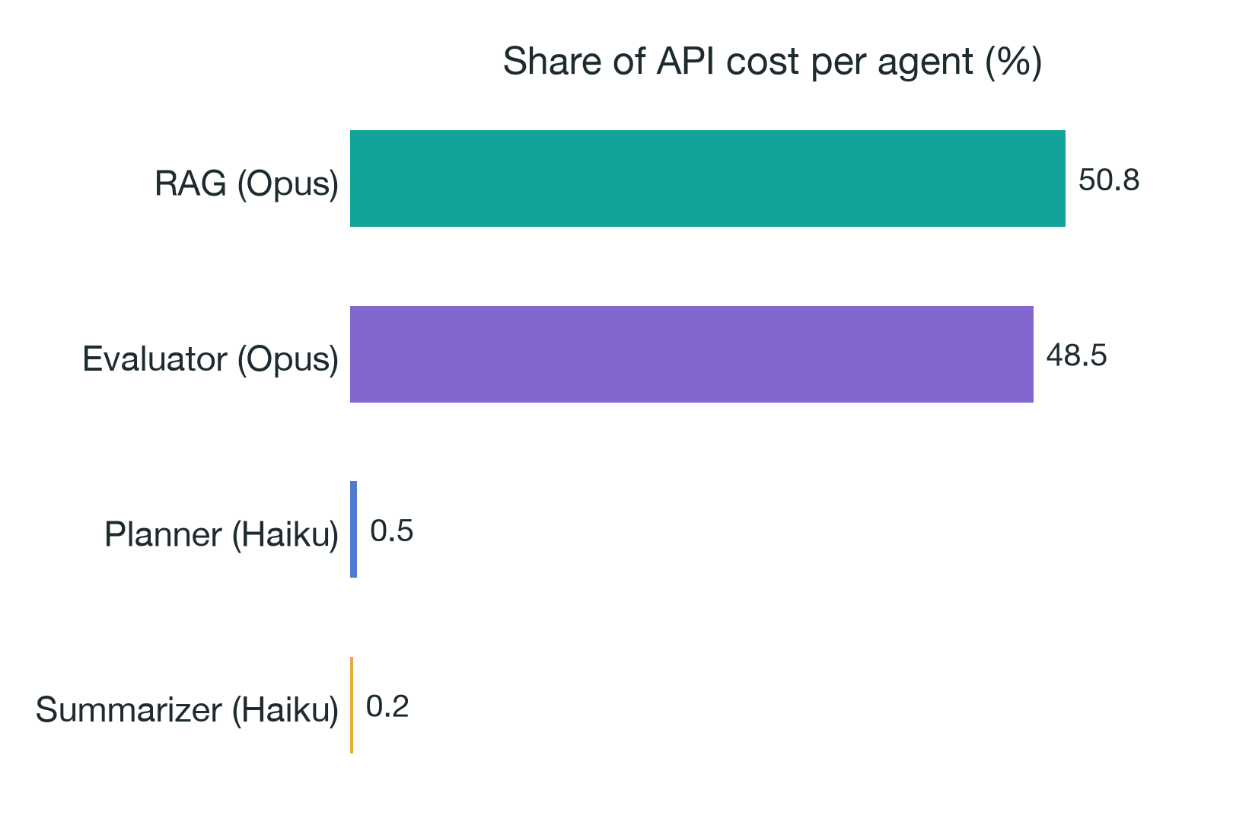
A cost-aware model mix
2 · MODEL ARCHITECTURE AND PARAMETERS
<1%
of the cost goes to routing and memory (Haiku 5.5)
$0.050
average per medical question (eval run)
Accuracy-critical steps (answering, fact-checking) use the strongest model; light classification and summarising use the cheapest. Measured on a 4-question smoke test; every model is one line in config.py.

Slide 10




Evaluation set: 27 questions, every behaviour
3 · EVALUATION METRICS AND RESULTS
8
In-book, English
Routing
Planner intent accuracy
7
In-book, Indonesian
Retrieval
4
Lay terms (EN/ID)
Hit@5 and MRR of the expected entry
4
Out-of-book medical
Answer quality
Faithfulness, completeness, relevance, tone, valid citations
2
Non-medical
Safety
1
Emergency
In-book answered vs. out-of-book escalated
1
Greeting
Efficiency
Latency and USD per question
Out-of-book topics (dengue, COVID-19, Zika, semaglutide) were verified to appear nowhere in the book, so the right behaviour is to escalate.

Slide 11
Results: grounded, accurate, safe on unknowns
3 · EVALUATION METRICS AND RESULTS
100%
100%
0.95
intent accuracy (Planner)
retrieval Hit@5 (MRR 1.00)
faithfulness (Evaluator, answered)
100%
100%
100%
in-book questions answered
out-of-book questions escalated
answers with valid citations
Completeness 0.89 · relevance 0.95 · tone 0.94 · avg confidence 0.93 in-book vs 0.40 out-of-book · latency 13.5 s avg (p90 20.9 s) · whole run $1.16

Slide 12
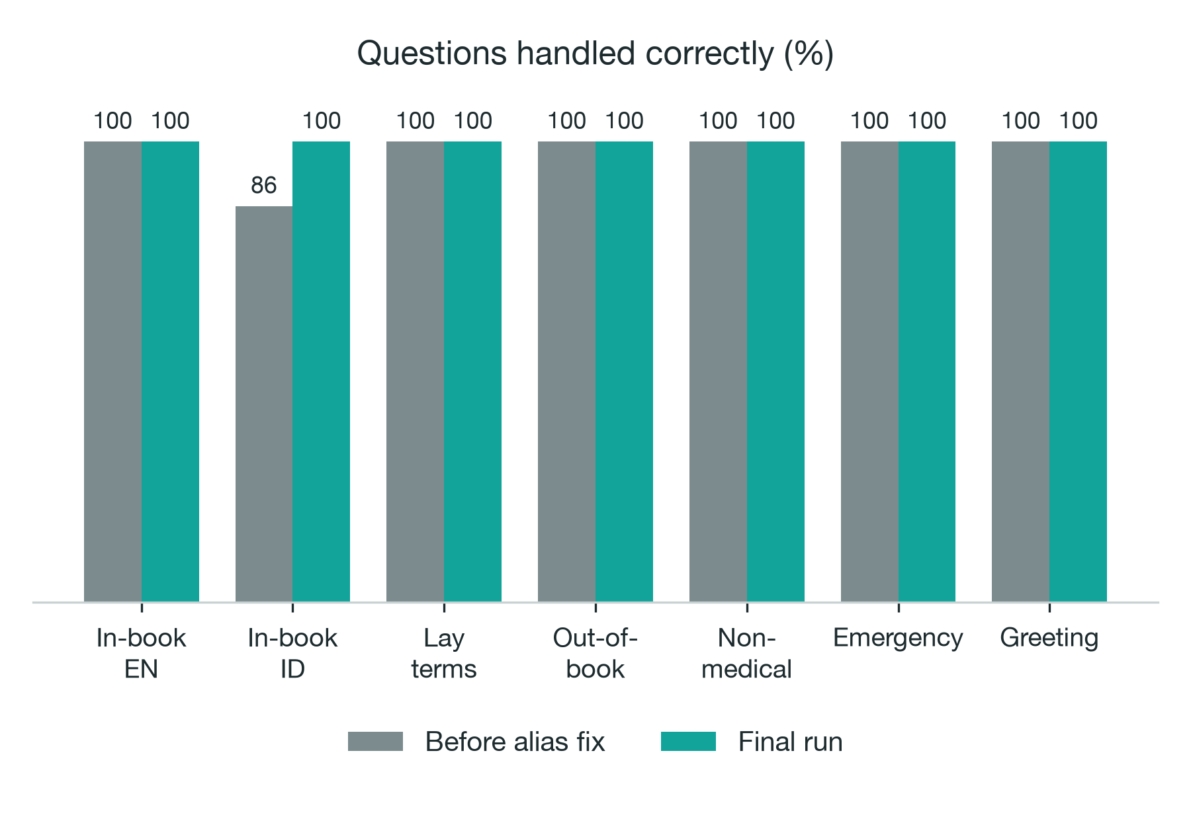
Correct behaviour by question category
3 · EVALUATION METRICS AND RESULTS
What “correct” means
In-book: answered, not escalated
Out-of-book: escalated, nothing invented
Others: routed to the right intent
100%
of all 27 questions handled correctly
In-book ID: 86% → 100%
The first run exposed a retrieval bug (alias “ALS” matched inside “palsy”); fixing it made every category correct.

Slide 13




Observations and challenges
4 · OBSERVATIONS AND CHALLENGES
The evaluation caught a real bug
Cross-lingual retrieval
Alias “ALS” matched inside “p-als-y”, so Bell’s palsy retrieved ALS and was wrongly escalated. Fixed with whole-word matching plus a regression test.
English embeddings miss Indonesian and lay terms (“kencing manis”). The Planner’s English query rewrite fixes this (see ablation).
Judging with an LLM
Latency vs. safety
Evaluator scores are model judgements and can be lenient. Mitigated with a strict rubric, claim-level checks and code-computed confidence; human labels are next.
~14 s per answer: two sequential Opus calls (answer, then check). A re-query doubles it; streaming would hide most of the wait.

Slide 14
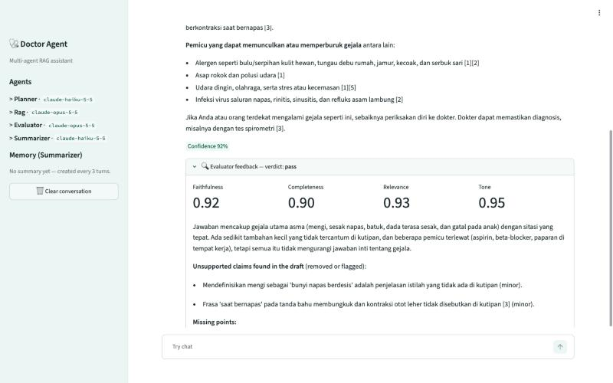
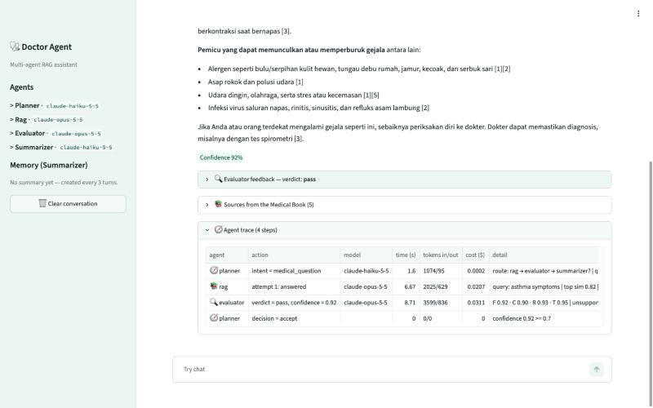
Streamlit UI: a checked, cited answer
5 · SCREENSHOTS OF THE STREAMLIT INTERFACE
Indonesian question, English book: 92% confidence, Evaluator scores and checked claims
Agent trace: model, tokens, cost and latency per step

Slide 15
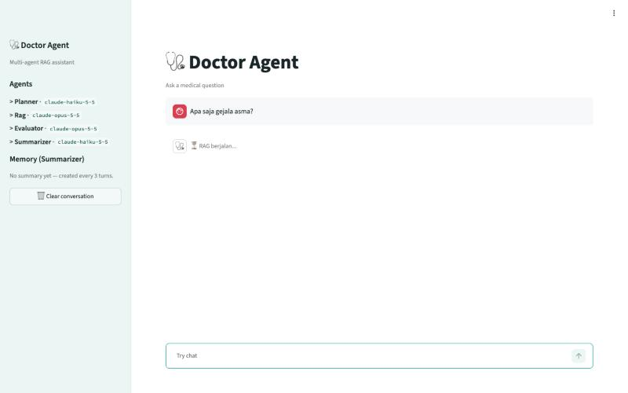
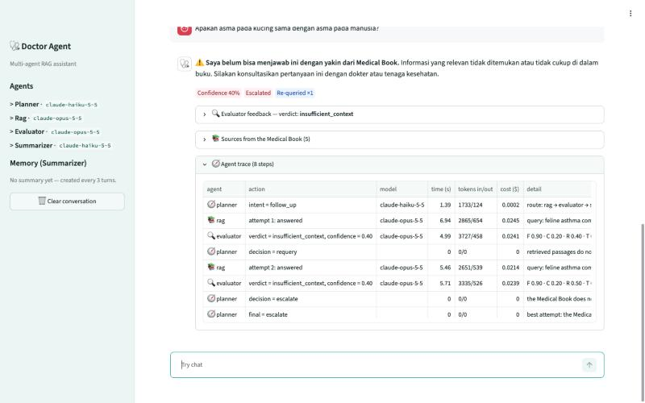
Streamlit UI: live progress and an escalation
5 · SCREENSHOTS OF THE STREAMLIT INTERFACE
One live progress line while the agents work (“RAG berjalan...”)
Asthma in cats is not in the book → re-query → escalate

