Slide 1
Detecting Phishing attack using ensemble machine learning method

Slide 2
Team Members
Hidayat ur Rehman (211833)
Nabeel Fakhar (211847)
Muhammad Sangeen (211822)

Slide 3
Topics
Problem Definition
Introduction
Related Work
Proposed Solutions
Results and Discussion
Conclusion and Future Work

Slide 4

Problem Definition
Detecting phishing attempts in a timely manner has become more important than ever.

Slide 5
Introduction
Phishing has three different types in practice:
Digital spoofing is when a website is cloned and used to trick clients into submitting sensitive information.
Email-based phishing, in which an attacker sends an email to an endless number of recipients, claiming that there is a database issue, and some of them fall for it.
Malware-based spoofing, in which dangerous code is placed into a legitimate site, as well as the virus is inserted into the browser when the customer accesses that homepage.

Slide 6
Introduction
Our paper contributes to the solution by
Using machine learning approach, develop a unique ensemble approach for detecting phishing attempts.
Conduct comprehensive literature study on phishing attempts. evaluating the suggested model’s accuracy and efficiency in compared to other methodologies.
Through using ensemble model, improves overall the phishing attack detection rate.

Slide 7
Related Work
Employment of NLP-based characteristics in seven classification methods.
A strategy based on a page layout characteristic and used 49 Phishtank.com phishing website datasets. In the study, over 20000 messaging samples were used.
A research based on the Random Forest algorithm as a binary classifier and the reliefF method as a forward selection strategy.
SMOTE approach to increase the model’s detection coverage.
A comparison based on model content and characteristics on the 11055-item PhishTank dataset.
A hybrid ensemble feature selection (HEFS) features selection methodology for detecting phishing websites using machine learning techniques

Slide 8
Proposed Solution
We offer a unique ensemble model that we proposed to improve the detection of online phishing attempts.
The models are developed using a phishing website dataset with 30 characteristics.
Data collection, pre-processing, and ensemble modelling are the three primary processes in the proposed model.
Detecting Phishing attack using ensemble machine learning method

Slide 9
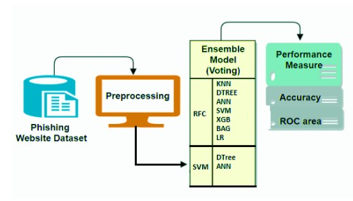
Detecting Phishing attack using ensemble machine learning method

Slide 10

Results and Discussion
We employed
Precision,
Recall,
F-Measure, and
Accuracy
to compare the performance of the suggested approach to that of others.

Slide 11
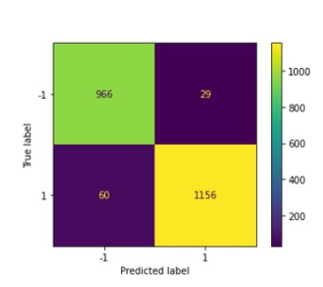
Confusion Matrix of RFC and KNN ensemble Model
The ensemble of RFC and KNN gives the highest precision of 0.97.

Slide 12
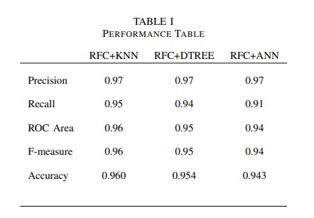

Slide 13
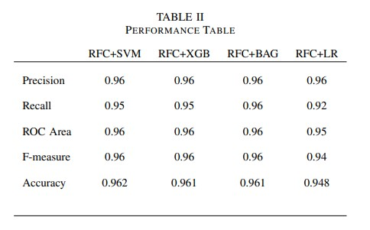
The accuracy of RFC + SVM is 0.962 that is the highest accuracy in all the ensemble models.

Slide 14
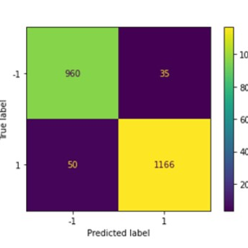
Confusion Matrix of RFC and KNN ensemble Model
We used SVM as a based classifier and the ensemble of SVM and decision tree shows the precision rate is 0.97 that is high as the previous models.
Recall is high of the ensemble of SVM and ANN. Roc Area, F-measures and Accuracy are same in both the ensemble techniques.

Slide 15
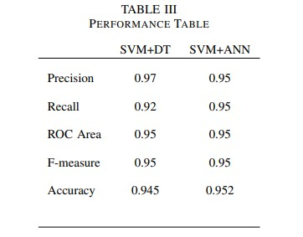

Slide 16
Discussion
In all the ensemble model used in this experiment RFC and SVM gives the highest Accuracy as 0.962.
01
These experimental results demonstrate that through the ensemble model, a phishing attack can be detected with better accuracy and the proposed model is robust and scalable with no processing.
02
At the end we show all the factors such as accuracy, precision, recall and ”F score” of all the models on the same graph.
03

Slide 17
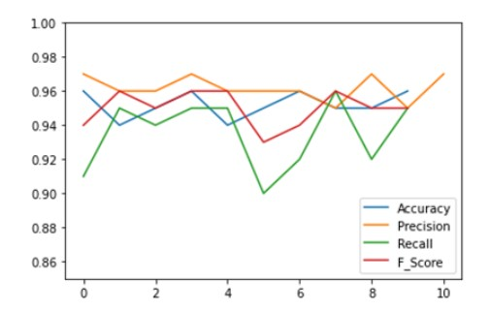
Compression Graph

Slide 18
Scenario based techniques | ML based techniques | Proposed techniques
Theoretical approaches | Traditional model was used | Ensemble approach is use
Time consuming | Low accuracy | High accuracy and efficiency
No dataset | Dataset is used | Realtime Dataset is used

Slide 19
Conclusion
& Future work
We present a unique ensemble of machine learning classifiers in this research to improve attack detection accuracy.
Work on New datasets
Adversarial Defense of proposed Model

Slide 20
Thank you

