Slide 1
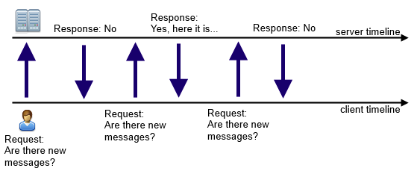
Push updates: AJAX polling
Problems:
- have to create new TCP connection every time
- can only receive data when connected
http://stackoverflow.com/questions/12941826/ajax-in-turn-based-game

Slide 2
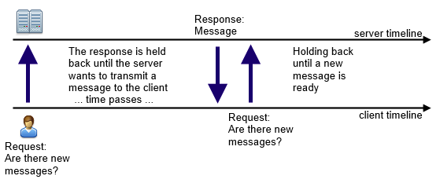
Push updates: Comet
A small improvement over, but still polling
http://stackoverflow.com/questions/12941826/ajax-in-turn-based-game

Slide 3
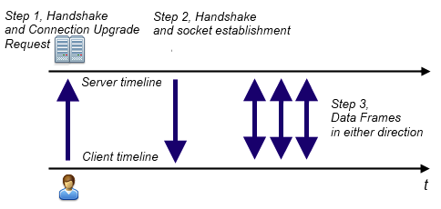
Push updates: WebSockets
Bi-directional, no polling needed!
http://stackoverflow.com/questions/12941826/ajax-in-turn-based-game

Slide 4
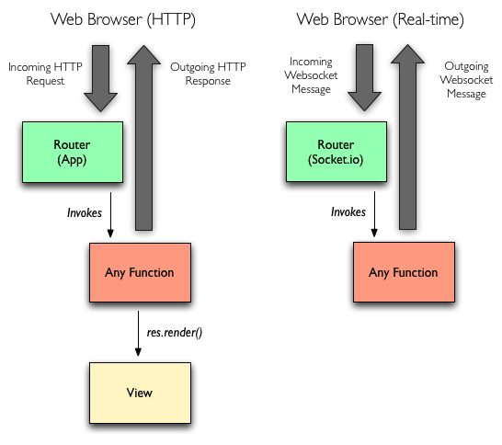
Express + Socket.IO
“Socket.IO server runs in same process”
https://blog.nodejitsu.com/scaling-isomorphic-javascript-code

