Slide 1
2023/XX/YY
Restricted
information
NGS analysis
1st Report
ID XXX
IMS-UT Hospital
Hematology/Oncology
Hidehito Fukushima
Takamori Hiroyuki
Kazuaki Yokoyama

Slide 2
XX病院よりNGS依頼(2023年XX月YY日検体採取）
診断：
検体：骨髄液、口腔粘膜

Slide 3
臨床経過：症例 XX歳 性
google spreadsheetから病歴をコピーを作成

Slide 4
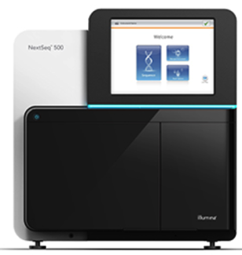
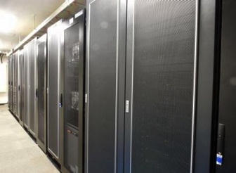

Clinical sequencing
Sample Prep BMA, Buccal Swab
Library-prep/ Magnis Sureselect XT HS Reagent Kit
Sequence/ Whole Exome/Genome seq on Nextseq/Novaseq
Variant Annotation by Imoto lab’s pipeline
Manual curation
Super
computer
Sample
Prep
NextSeq
MiSeq
DNA/library-prep
+ Sequence
by Team NGS
Bioinformatic
analysis
by Imoto-lab
Manual
curation by
Team NGS

Slide 5
Quality Report

Slide 6
結果:変異アレル (%) summary
Genomon
mutation call
Yokomon
curation
Manual
curation
アミノ酸変異 | Date | Sample source
変異アレル | 2024 | BMA
頻度 (%) | 2024 | Swab

Slide 7
IGV
tumor
swab

Slide 8
GENE

Slide 9
CNV

Slide 10
SV

Slide 11
Comments

