Slide 1
Path of Ascension
CSC 4370 — WEB PROGRAMMING
Project 1 — Quest Explorer
HTML & CSS Website Showcase
Hien Dao & Trajuan Smith

Slide 2
Project Purpose & Audience
Project Purpose
Create an immersive cultivation-themed adventure experience where visitors can:
Explore fantasy regions
Discover available missions
Follow a journey toward ascension
Target Audience
Designed for:
Fans of xianxia and cultivation stories
Fantasy and adventure enthusiasts
Visitors interested in interactive quest exploration
Our goal: Make exploring a cultivation world intuitive, engaging, and accessible

Slide 3
Quest Explorer & Adventure Pack
Quest Explorer Track
Four interconnected pages
Region exploration and mission details
Consistent navigation and status indicators
Responsive layouts using CSS Grid and Flexbox
Adventure Pack Extension
Journey timeline with checkpoint states
Available, ongoing, completed, and locked styling
Motion cues to emphasize progression
Visual feedback for exploration
Together, these features turn a static website into a guided fantasy adventure experience

Slide 4
Website Structure & Navigation
01
Home
02
World
Introduces the cultivation journey and guides visitors toward exploration.
Displays explorable regions, difficulty levels, and available missions.
03
Mission
04
Team
Provides mission details, objectives, and progression states.
Introduces the cultivator, the developers and highlights their contributions.
Consistent navigation connects all four pages into one experience.

Slide 5


HTML Structure & File Organization
Path-of-Ascension/
index.html
world.html
mission.html
Team.html
css/
  styles.css
  home.css
  world.css
  mission.css
  team.css
images/
Adventure Pack Extension
Semantic HTML5 structure
Shared CSS for consistent styling
Page-specific CSS files
Reusable navigation and components
Organized images and assets
Modular styling keeps the website consistent and easier to maintain.

Slide 6



CSS Layout, Responsiveness & Animations
Grid & Flexbox
Region card layouts
Navigation alignment
Organized page sections
Responsive Design
CSS media queries
Two-column to single-column layouts
Flexible spacing and sizing
CSS Motion
Hover transitions
Cultivation-themed effects
Visual interaction feedback
Responsive layouts and purposeful motion improve usability across devices

Slide 7
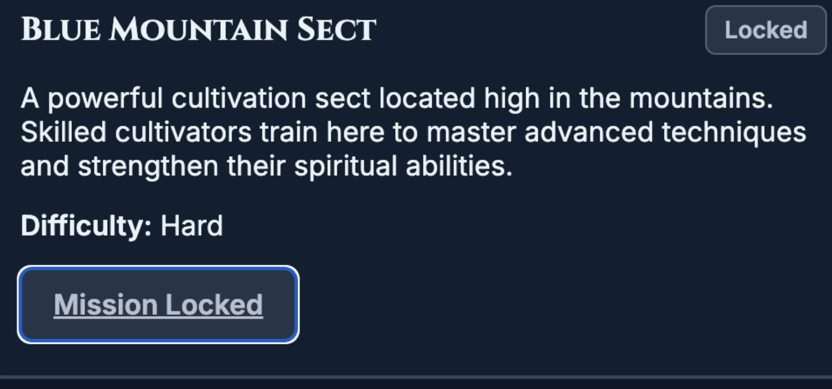
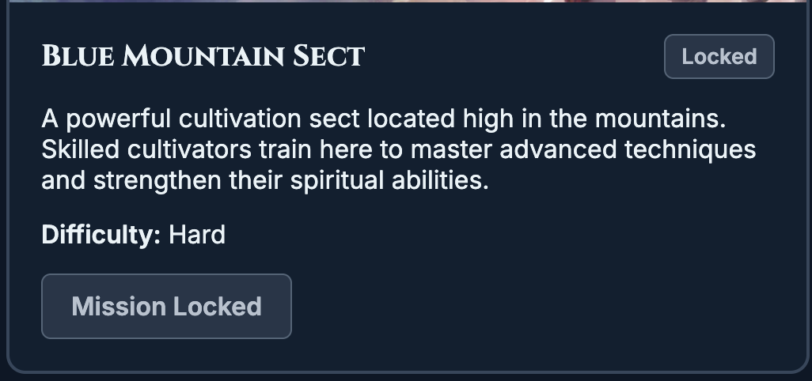
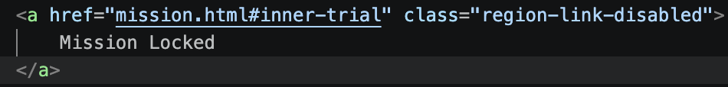
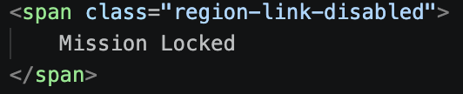



Accessibility, Testing & Debugging
Before — Locked Link Issue
After — Noninteractive Span
Locked control still appeared in keyboard navigation.
Locked control is no longer a keyboard Tab stop.
Additional Accessibility & Testing
Keyboard focus
Responsive Grid
Reduced motion
Accessibility improvement: Disabled-looking controls should not behave like active links.

Slide 8
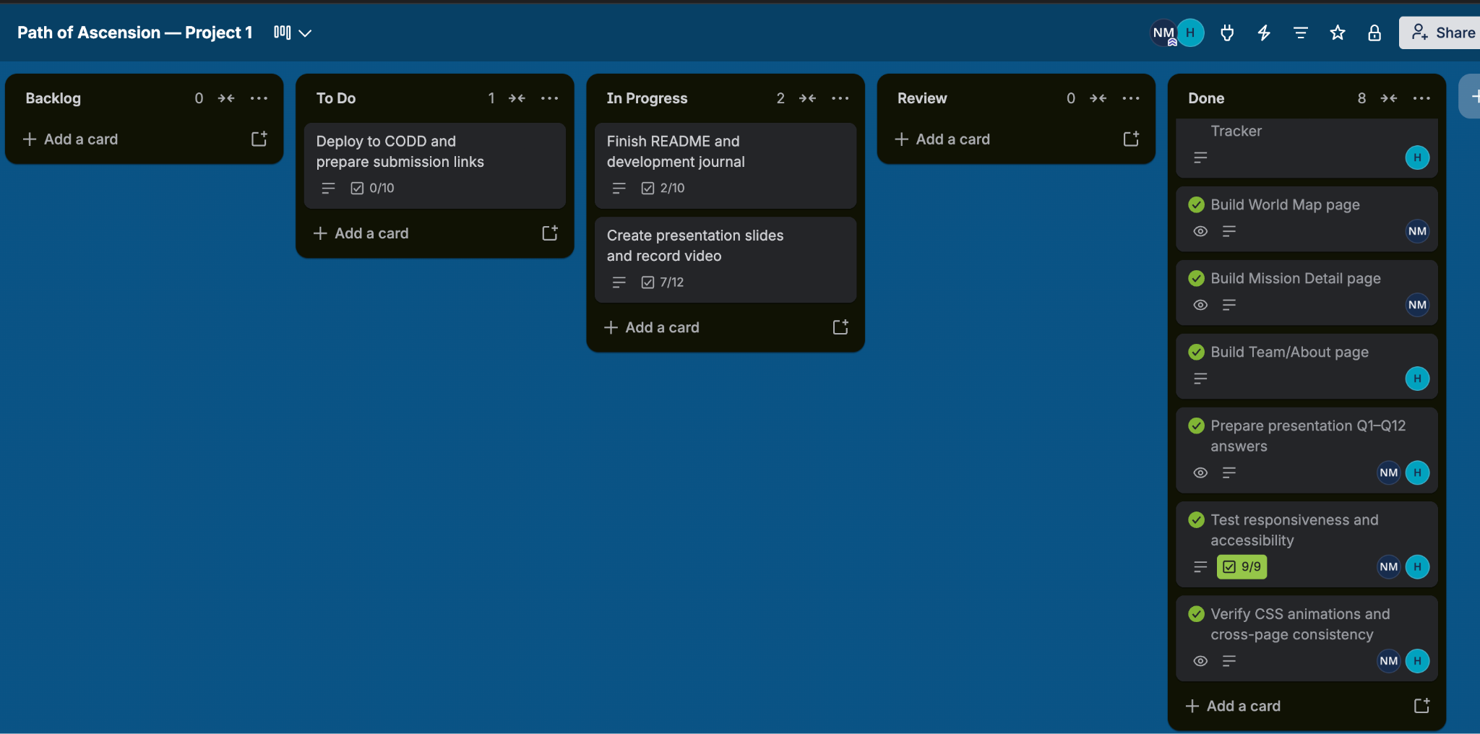
Kanban Board & Team Collaboration
Our Trello Kanban Board
Task Responsibilities
Development Workflow
Hien Dao
Home Page & Team Page
Trajuan Smith
World Page & Mission Page
Track tasks using Trello
Work on separate Git branches
Merge completed features
Review shared navigation and styling

Slide 9



Challenges, Lessons & Future Improvements
Lessons Learned
Future Improvements
Challenges
Keyboard accessibility for locked regions.
Use semantic HTML for correct behavior
Persistent mission progress
Coordinating shared styles across pages.
Separate shared CSS from page-specific CSS
Reusable navigation components
Building mission interactions without JavaScript.
Test with keyboard and mobile layouts
Expanded quests and region unlocking
Path Of Ascension
A responsive, cultivation-themed Quest Explorer built with HTML and CSS

