Slide 1

HERE HELP
WE ARE HERE TO HELP

Slide 2

Problem
Issue: Damage car/motobike suddenly, out of gas, tore tires
Find
Check
Negotiate
Rent
Where?
When?
How?
What?
Dispersed!
Not Confidence!
Slow!
Are you sure you get what you want?

Slide 3

Our Solution
A mobile platform where users/service provider can find, track and notification locations of people in crash.
Nomal search:
+Nomal points
+Guaranteed service provider
Notiffication:
+Points are available
+Guaranteed service provider

Slide 4
Our Solution
Fast
Easy
Helpful

Slide 5
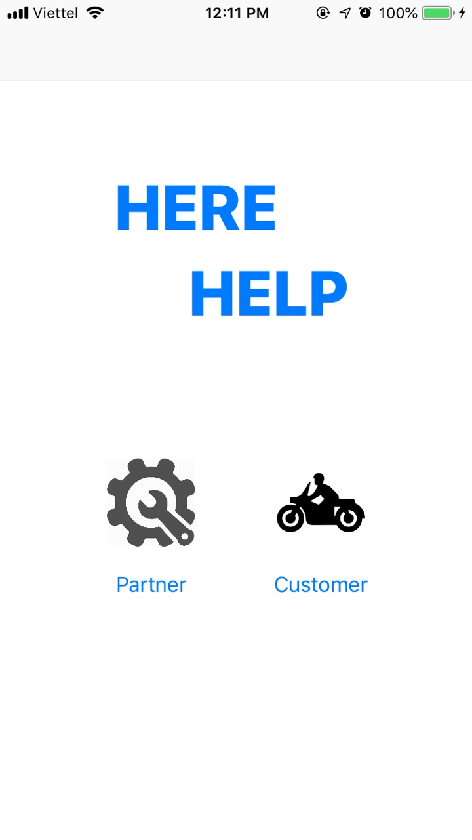
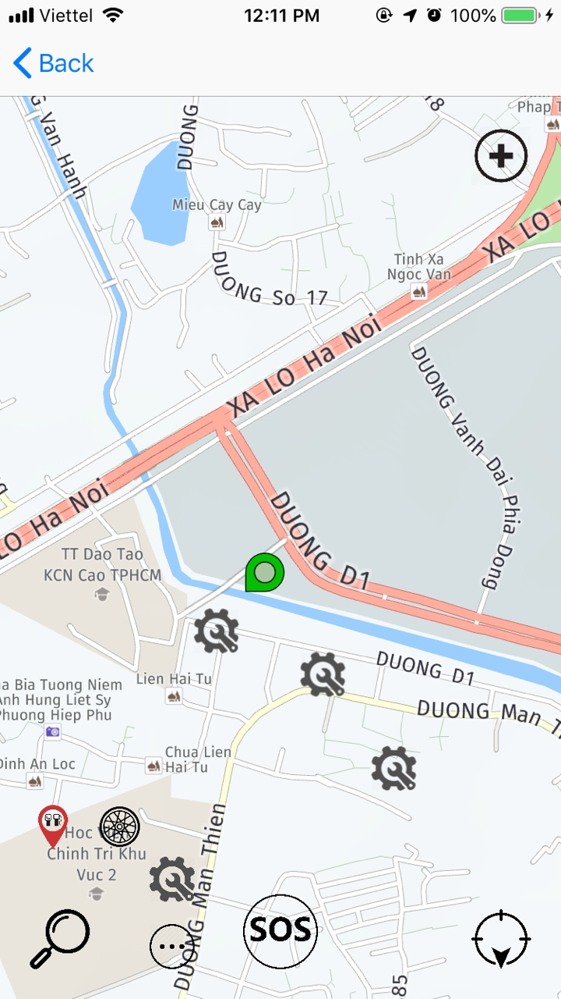
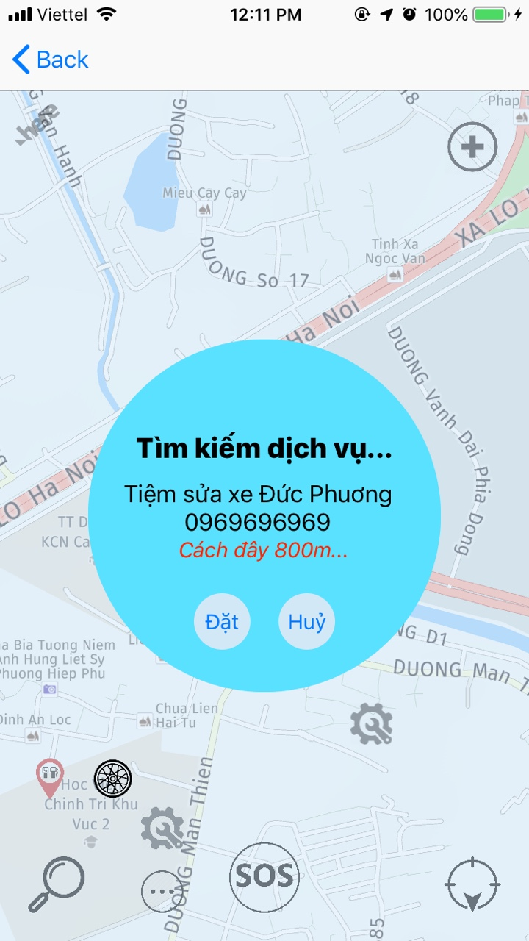
Our Product
Online suport
More Info
Less time
Rating system
HERE HELP

Slide 6
Value Proposition
social values, community
HERE HELP
Normalize the rescue
Guaranteed service provider

Slide 7
Future features
Development Orientation
Multi Service:help health,
Help home appliances,
Help moving,
Analysis, support with chatbot
Evaluation/Review service
Notice to friends
Tracking

Slide 8
Thank You
HERE HELP
Lê Đức Phương
Hoàng Văn Tần
Nguyễn Văn Hiên
WE ARE HERE TO HELP ☺

