Slide 1
HOME BACKUP IN LINUX
Students: Pham Thi Thu Hien
Nguyen Dong Son

Slide 2
The reasons for choosing the project
Linux is an “almost perfect” OS ,but data is sometimes lost.
Data in home directory is obviously something important to user. So backing up important data is something we should all do and know how to do.
Because of the changing of the home directory everyday, we get lazy for doing the same thing all day, we need a program run automatically to backup our data.
With making a shell script by ourselves, we can easily adjust the program according to our purpose.

Slide 3
Short description for the program
There are many ways to backup data in linux, but the two most common ones using script are:
Using TAR is the traditional way
Using RSYNC is a very common way recently
We choose using TAR for our project.
The TAR command in Linux can quickly create archives of entire directories
The home directory of a user needs to be archived for backup purposes.
And then we compress the contents of this archive using compression algorithms as ZIP, GZIP, BZIP2, LZMA,….

Slide 4
Short description for the program
The feathers:
Accepting different compression algorithms as argument:
-zip, -gz, -lzma, -xz, -bz2
The default one is GZIP.
Sending an email informing to user if it finds something different in today’s home folder from yesterday’s.
Running automatically at 5pm everyday.
Github respository: https://github.com/hienhp/linagora-backuphome

Slide 5
Requirements and notes
Configure Postfix to use Gmail to able to send email (in Debain).
Installing the Postfix package
Configuring Gmail authentication
Configuring Postfix
Process password file
Restart Postfix
Make sure that the script has the execute permission set by 700 or 755
Set the backup_dir variable to a dir on a separate dir than the one we are backing up.
Notes:
1. apt-get update && apt-get install postfix mailutils
2. vi /etc/postfix/sasl_passwd
Add the line:
[smtp.gmail.com]:587 username@gmail.com:password
# chmod 600 /etc/postfix/sasl_passwd (Save and close the file. Your Gmail password is stored as plaintext, so make the file accessible only by root)
- 3. Edit the main Postfix configuration file:
vi /etc/postfix/main.cf
Add or modify the following values:
relayhost = [smtp.gmail.com]:587 smtp_use_tls = yes smtp_sasl_auth_enable = yes smtp_sasl_security_options = smtp_sasl_password_maps = hash:/etc/postfix/sasl_passwd smtp_tls_CAfile = /etc/ssl/certs/ca-certificates.crt
4. Use postmap to compile and hash the contents of sasl_passwd. The results will be stored in your Postfix configuration directory in the file sasl_passwd.db.
postmap /etc/postfix/sasl_passwd
5. Restart the Postfix service, putting your changes into effect.
systemctl restart postfix.service

Slide 6
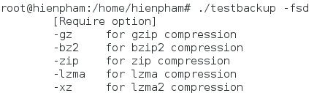
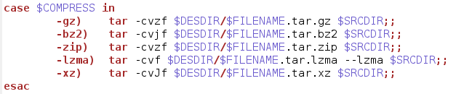
Accepting different compression algorithms
These are options we can use for different compression algorithms:
Using TAR to archive and compress data:

Slide 7
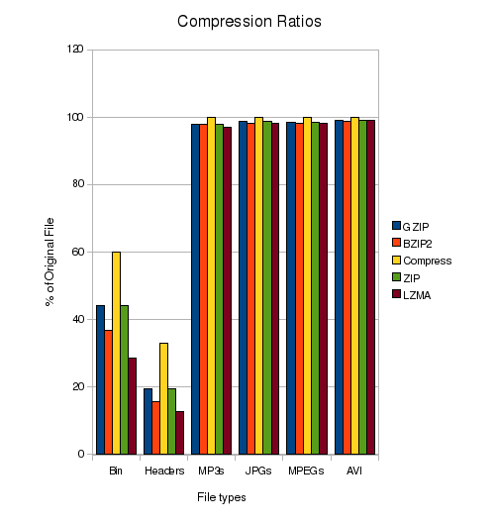
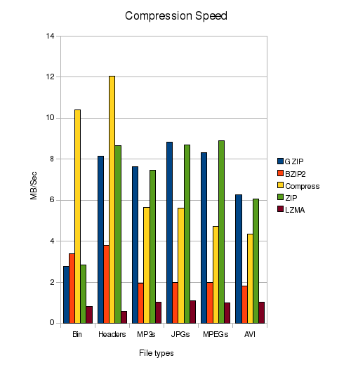
The ‘best’ compression algorithm
Depending on the needs of the user
Compression ratios
Compression speed
If you need heavy compression and are willing to wait for it, use LZMA. If you want to squash things a little, but don’t have much time, GZIP and ZIP will work just fine.
Notes:
Although there are many compression tools available, I decided to use the 5 that I consider the most common. GZIP, BZIP2, ZIP, LZMA, and the Linux tool Compress. One of the reasons for this test is to find the best compression, so where there was an option, I have chosen to use the most aggressive compression offered by each tool. The clear winner here though is LZMA.
-This graph show the size of the compressed file as a percentage of the original, so the smaller, the better.
-So now we know how will these tools compress, how long do they take to function? Notice that these speeds are in MB / Second, so the larger, the better. As good as LZMA is at it’s job though, it likes to take it’s time about things running at just 1MB/Sec or less.

Slide 8
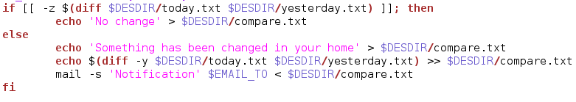
Informing to user by email
Comparing the size of today’s home folder to yesterday’s
Creating a file named today.txt to store all information of today’s home folder.
Creating a file named yesterday.txt to store all information of yesterday’s home folder.
Creating a file named compare.txt to store the differences between two above files.
Sending an email to user
Using command DIFF to know if there are the changes, send an email containing file compare.txt ’s content to user

Slide 9
Running the program daily
Cron jobs allow you to schedule your tasks and run automatically.
Open cronab editor utility: crontab –e
It has 6 parts: Minutes Hours Day of Month Month Day of Week Command
Running this backup process everyday at 5:pm. In this condition our crontab file should be like this.
# M H DOM M DOW CMND
00 17 * * * /bin/bash /home/hienpham/linagora-backuphome/backup_home.sh

Slide 10
Conclusion of all
Knowing how to use bash script basically
Knowing how to back up home directory basically and simply
Still one requirement left that we can not complete.
The program is very simple and may be has some shortcomings.
-Good points
-Bad points

Slide 11
THE END

