Slide 1

School Management System
GROUP 3
1
Nguyễn Tiên Hiên
2
Nguyễn Đặng Thành Đạt
3
Nguyễn Trần Huy
Instructor:Nguyen Duc Thao

Slide 2
1
Rationale
2
Introduction
TABLE OF CONTENTS
3
Design
4
GUI

Slide 3
1. RATIONALE
The development of information technology
Management process
The importance of education

Slide 4
2. INTRODUCTION
School Management is software that helps you
Manage your information
Add,edit,delete information
Make management process easier and more efficient

Slide 5
3. FUNCTIONALITY
1
Login
2
Show Management Form
3
Enter Information
4
Manage Information

Slide 6
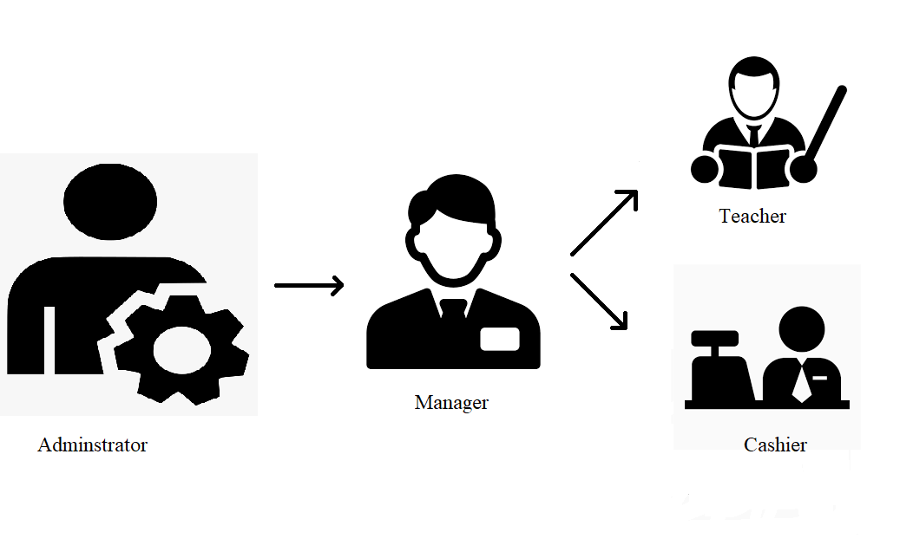
4. DESIGN

Slide 7
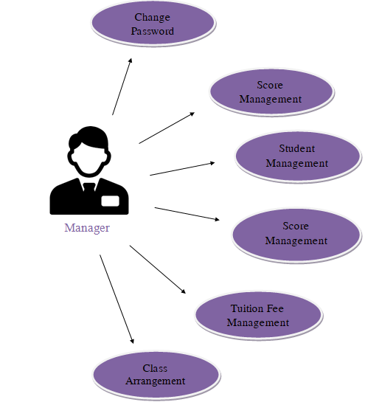
4. DESIGN
Manager Use Case Diagram

Slide 8
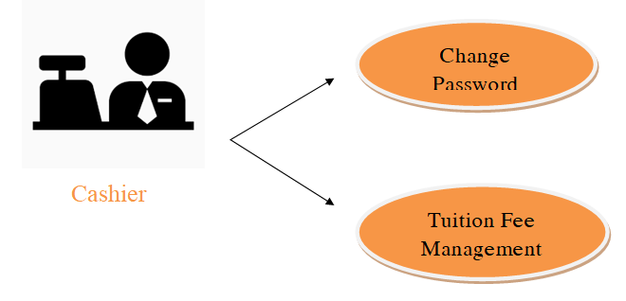
4. DESIGN
Cashier Use Case Diagram

Slide 9
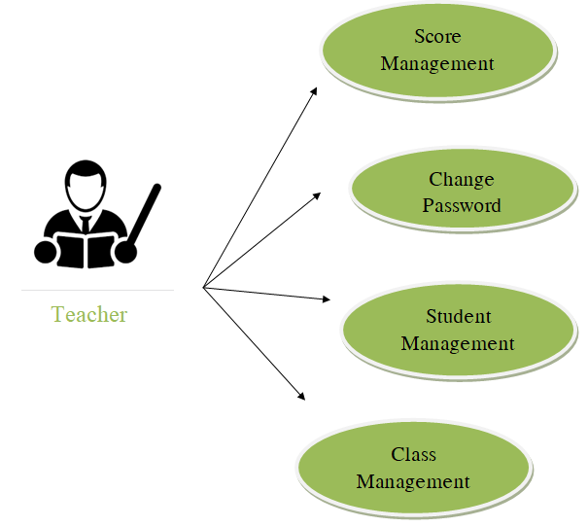
4. DESIGN
Teacher Use Case Diagram

Slide 10
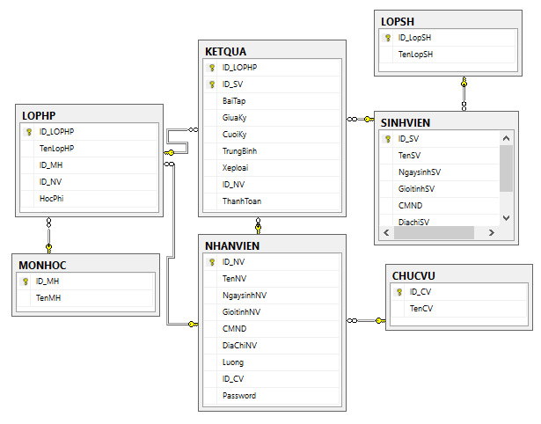
4. DESIGN
Entity Relationship Diagram

Slide 11
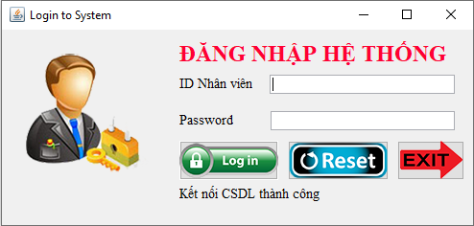
5. GUI

Slide 12
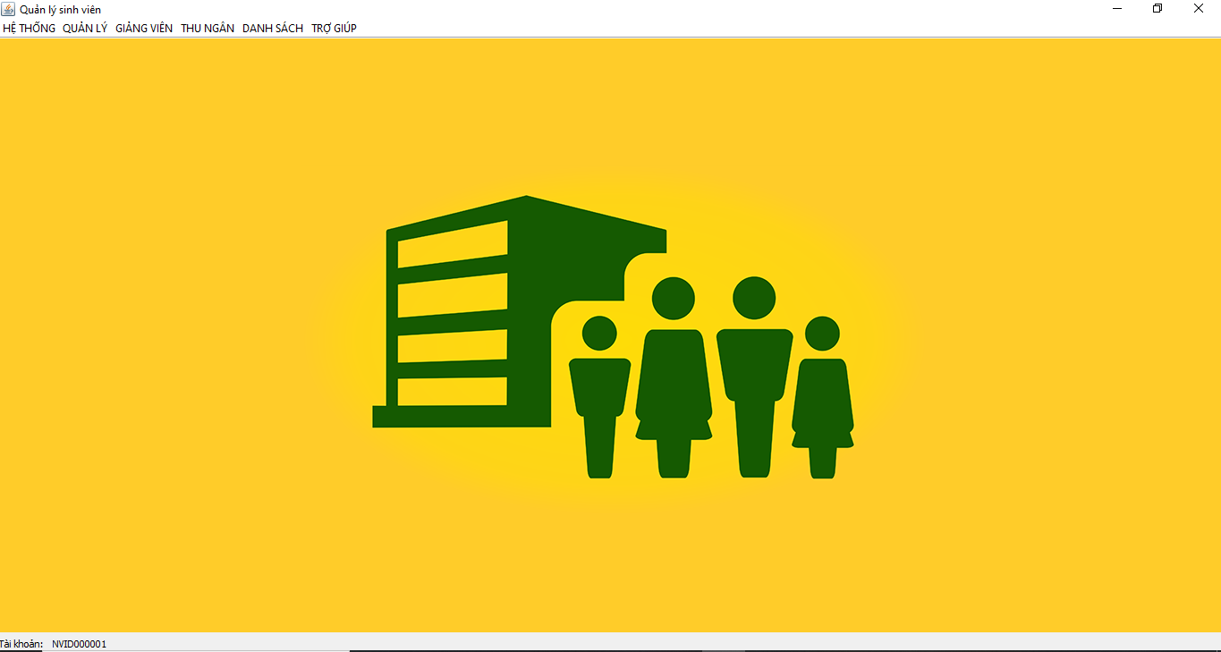
5. GUI

Slide 13
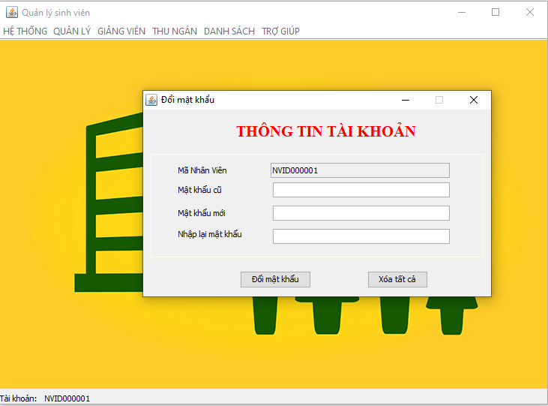
5. GUI

Slide 14
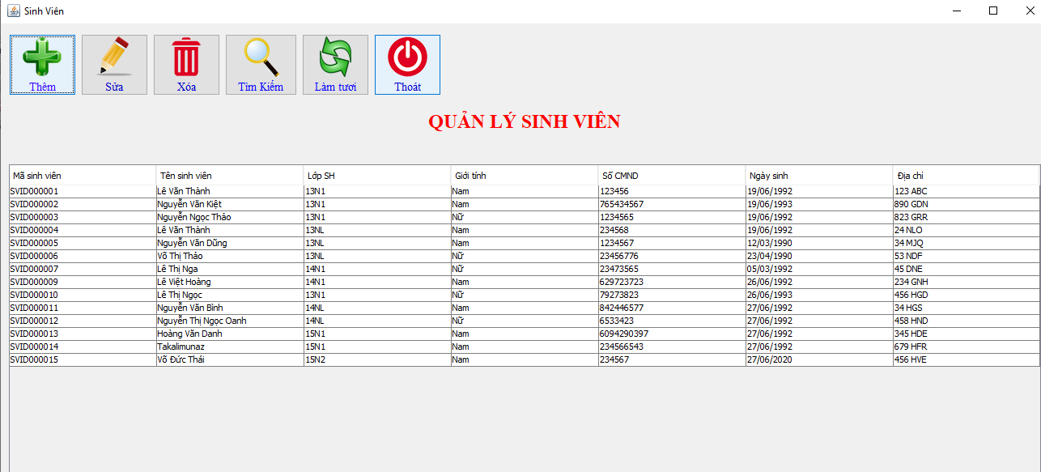
5. GUI

Slide 15
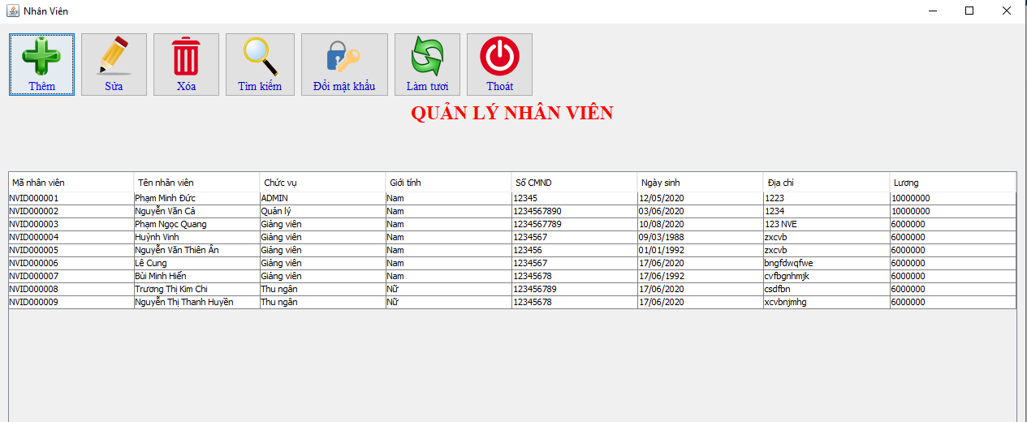
5. GUI

Slide 16
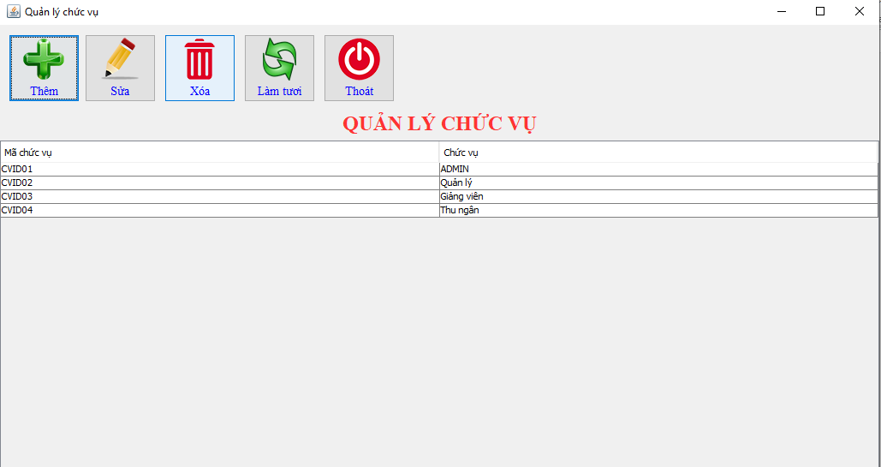
5. GUI

Slide 17
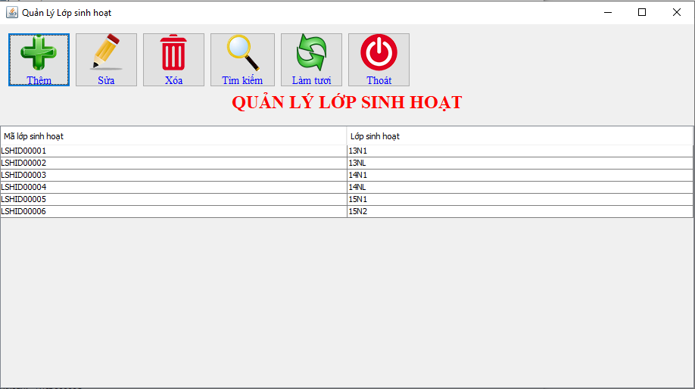
5. GUI

Slide 18
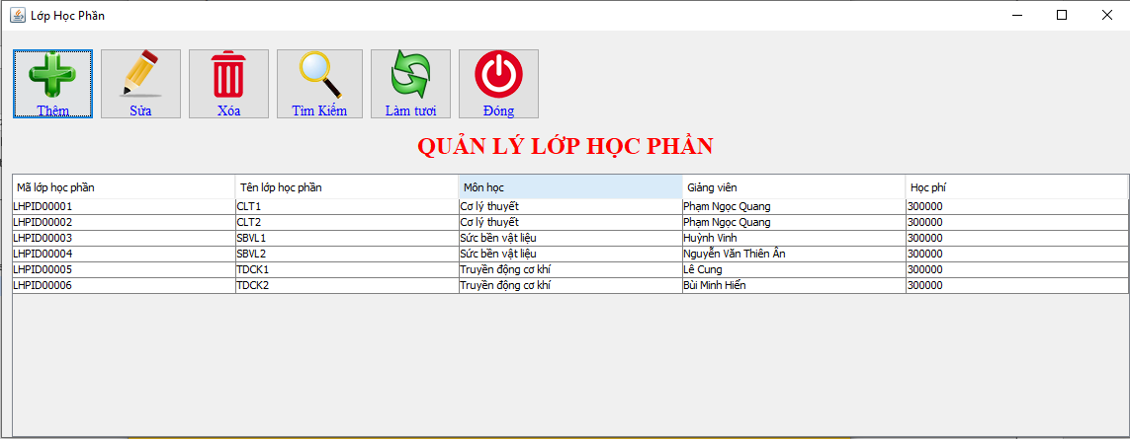
5. GUI

Slide 19
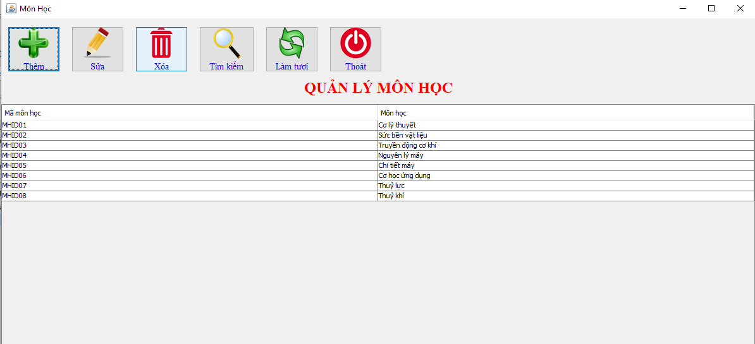
5. GUI

Slide 20
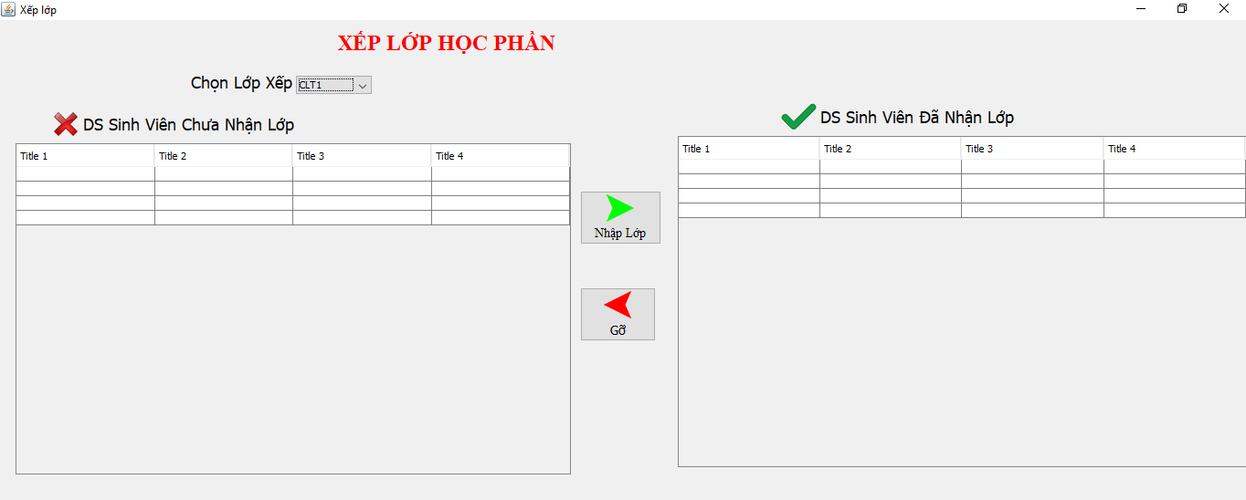
5. GUI

Slide 21
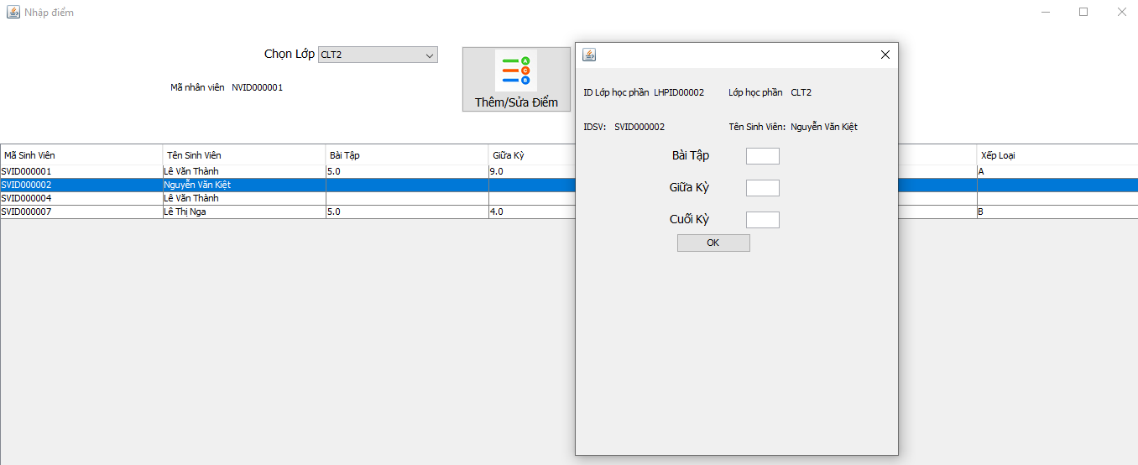
5. GUI

Slide 22
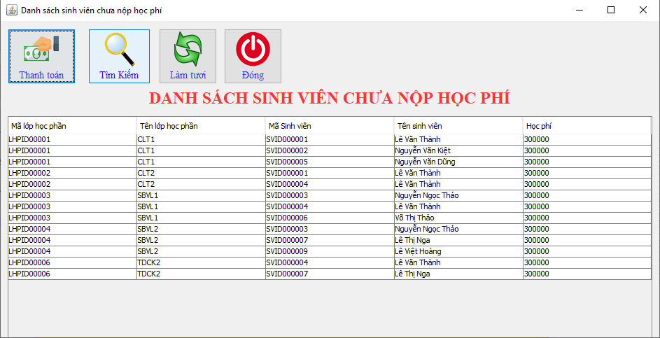
5. GUI

Slide 23
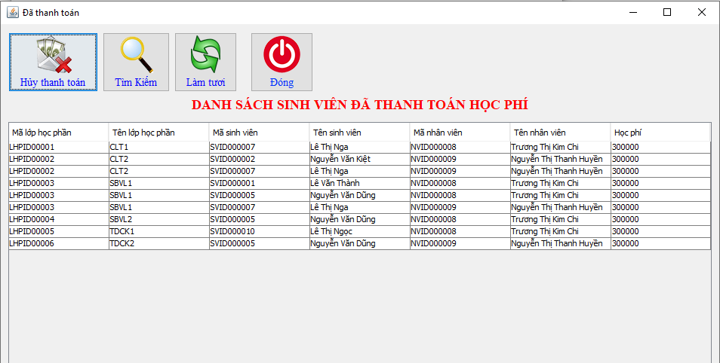
5. GUI

Slide 24


