Slide 1

Serverless
Hien Tran
01/16/2024
IT Solution Architect & Engineering

Slide 2
What is serverless ?
IaaS
PaaS
SaaS
BaaS
FaaS * AaaS
NaaS
DaaS
….
XaaS – Everything ”as a Service”

Slide 3

Serverless computing?
Azure Virtual Machines (VMs)
Azure Kubernetes service (AKS)
Azure Functions
Notes:
https://azure.microsoft.com/en-us/resources/cloud-computing-dictionary/what-is-serverless-computing

Slide 4
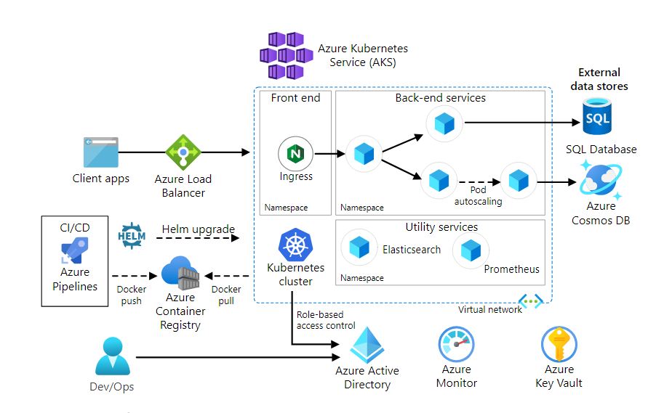
Azure Kubernetes Architecture
Notes:
https://azure.microsoft.com/en-us/products/kubernetes-service

Slide 5
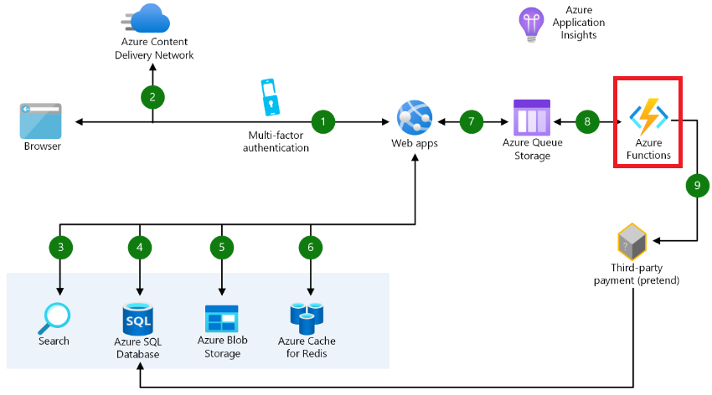
Azure Functions Architecture
Notes:
https://azure.microsoft.com/en-us/products/functions

Slide 6

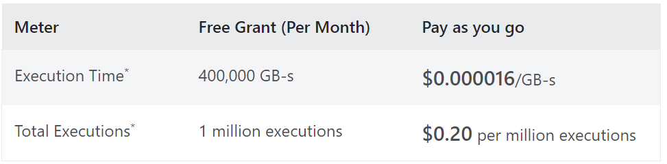
Cost
Notes:
https://azure.microsoft.com/en-us/pricing/details/functions/

Slide 7
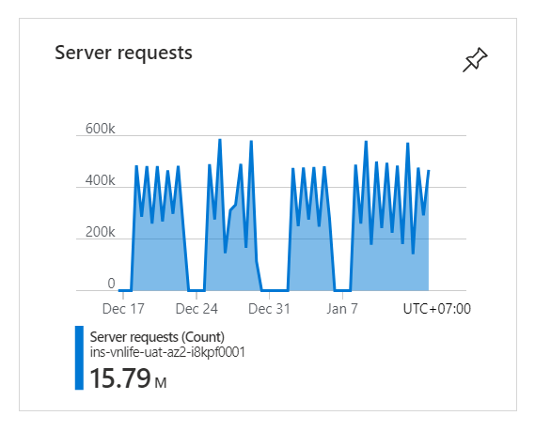
Cost
Notes:
https://azure.microsoft.com/en-us/pricing/details/functions/

Slide 8
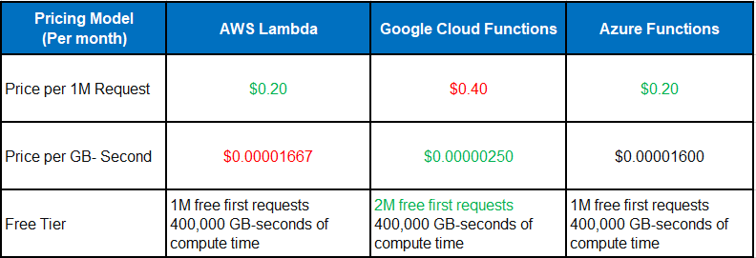
Cost comparation

Slide 9
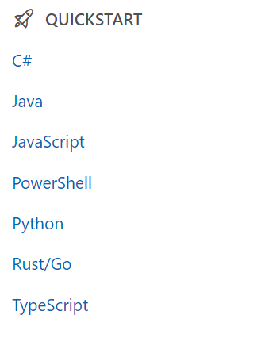
Overview
Notes:
https://learn.microsoft.com/en-us/azure/azure-functions/

Slide 10
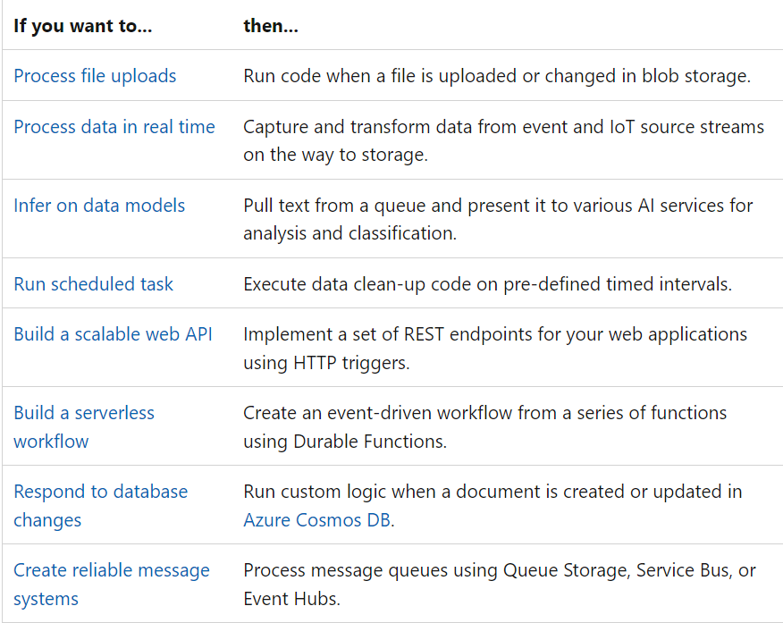
Overview
Notes:
https://learn.microsoft.com/en-us/azure/azure-functions/functions-overview?pivots=programming-language-java

Slide 11
DEMO
mvn archetype:generate "-DarchetypeGroupId=com.microsoft.azure" "-DarchetypeArtifactId=azure-functions-archetype“ "-DjavaVersion=17"
mvn clean package
azure-functions:run
az login
azure-functions:deploy
Notes:
https://learn.microsoft.com/en-us/azure/azure-functions/functions-create-maven-eclipse

Slide 12
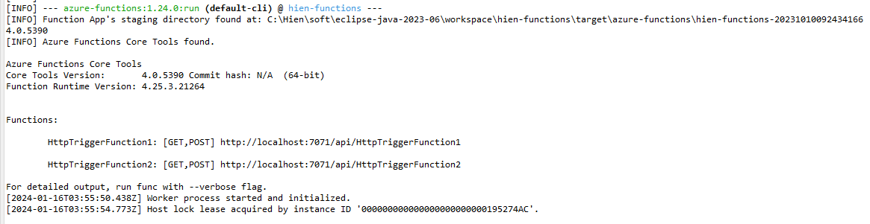
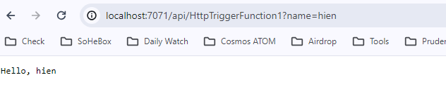
DEMO
Notes:
https://learn.microsoft.com/en-us/azure/azure-functions/functions-create-maven-eclipse

Slide 13
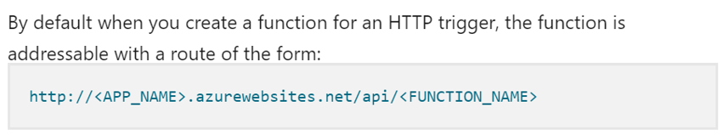
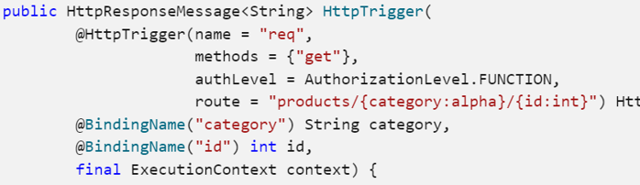
Customize the HTTP endpoint
Notes:
https://learn.microsoft.com/en-us/azure/azure-functions/functions-bindings-http-webhook-trigger?tabs=python-v2%2Cisolated-process%2Cnodejs-v4%2Cfunctionsv2&pivots=programming-language-java

Slide 14
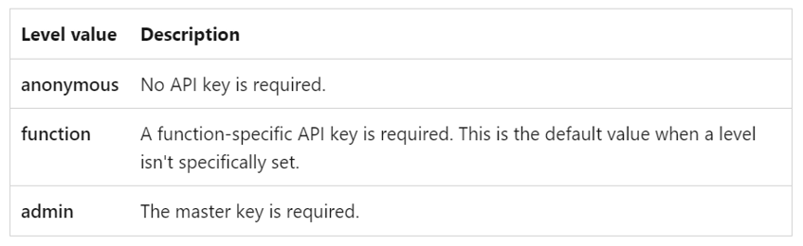
Authorization level
Notes:
https://learn.microsoft.com/en-us/java/api/com.microsoft.azure.functions.annotation.authorizationlevel?view=azure-java-stable

Slide 15
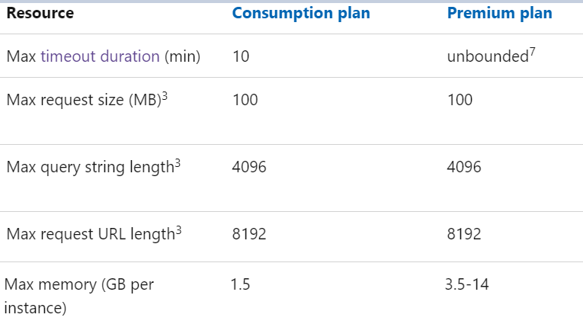
Limitation
Notes:
https://learn.microsoft.com/en-us/azure/azure-functions/functions-scale

Slide 16
Observation
Development
- Follow azure/java version update, roadmap
- Follow azure structure, definition
- Need master dev to optimize source performance + design
- “Github”
- “Lụt nghề”
Operation
- Impossible to migrate to other cloud
- Monitoring/alerting hotachs
- Manage too many repository and configuration
Notes:
Latest version ➔ https://github.com/Azure/azure-functions-java-library/releases
Latest version ➔ https://mvnrepository.com/artifact/com.microsoft.azure/azure-functions-maven-plugin
https://learn.microsoft.com/en-us/azure/azure-functions/functions-reference-java?tabs=bash%2Cconsumption
https://learn.microsoft.com/en-us/azure/azure-functions/migrate-version-3-version-4?tabs=net8%2Cazure-cli%2Cwindows&pivots=programming-language-java

Slide 17
Thank you !
Notes:
https://learn.microsoft.com/en-us/azure/azure-functions/migrate-version-3-version-4?tabs=net8%2Cazure-cli%2Cwindows&pivots=programming-language-java

