Slide 1

ROBOTIC PROCESS AUTOMATION
+91 9010769088
contact@etrainingsindia.com
www.etrainingsindia.com

Slide 2

RPA Use Cases
Calculators : Initial practice- Calculate Manually – complex tasks- Invention of calculators. But we are still feeding numbers in calculator manually. This is now implemented by bots
Data Entry Employee Job: Data entry employees repeatedly gets data from different sources and aggregates them in an excel file.
Premium Provider Insurance Company : To process multiple invoices everyday.
Banking Sector : To process different loan application

Slide 3
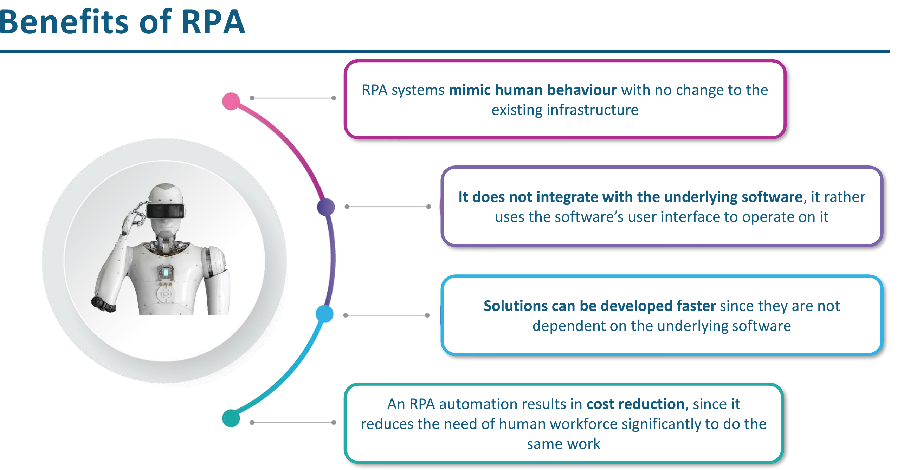

Slide 4
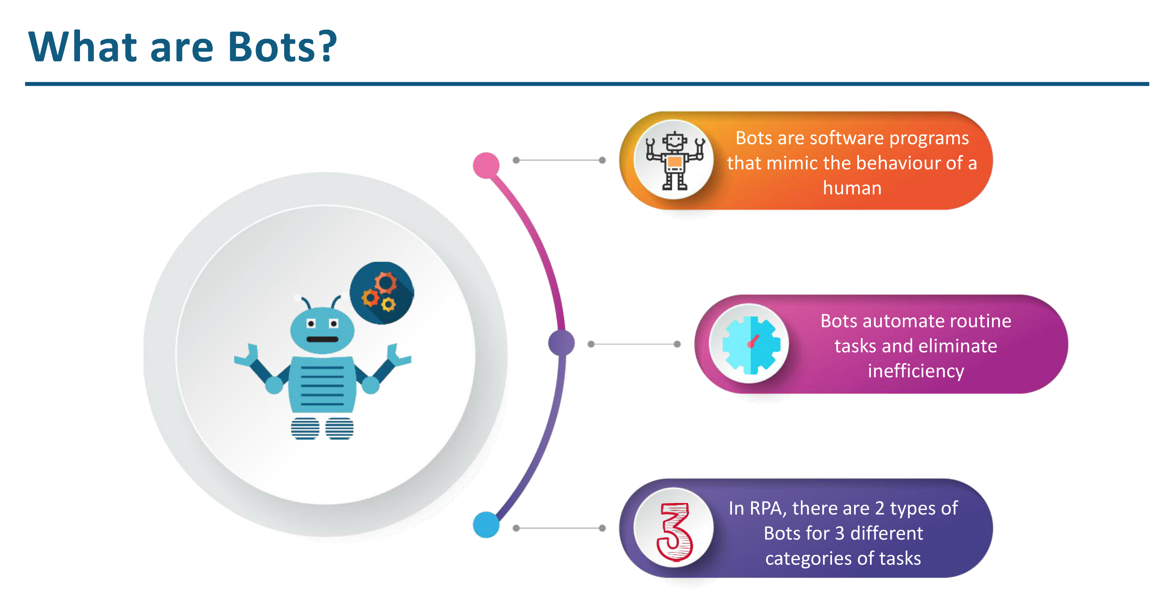

Slide 5
Types Of Bots
Front Office Robots : An Attended Bot executes its automation on the users local work station and need a human to trigger or schedule them.
Back Office Robots : An Unattended Bot runs on a virtual machine and executes automation that do not require user interaction.

Slide 6
Interesting, right?
This is just a sneak preview of the full presentation. We hope you like it! To see the rest of it, just click here to view it in full on PowerShow.com. Then, if you’d like, you can also log in to PowerShow.com to download the entire presentation for free.

