Slide 1

1. Background
Around 500 tools, equipment ~ 2 PICs
➔ Very high q’ty
Manual operation
➔ Waste time, paper using
Download & print Control list
Check and tick in list
Input result on system

Slide 2
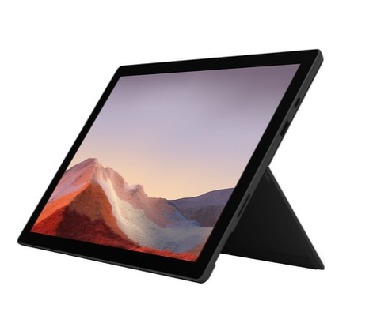
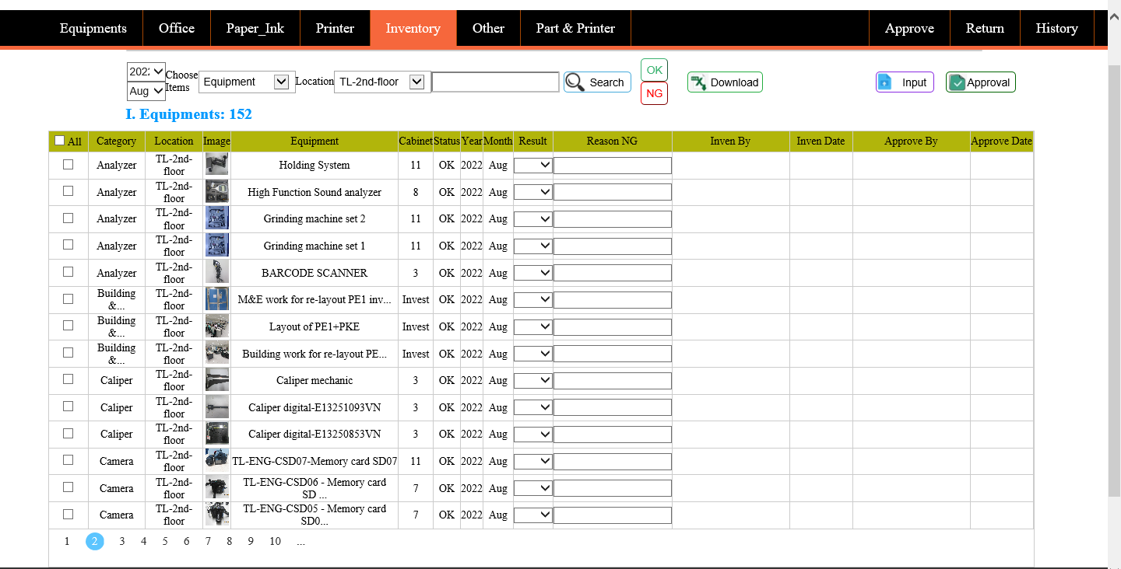
2. Action
1st idea
Half automation inventory with Surface pro
Checking results
Asset system
Strong point
No paper using
Input data directly
Weak point
Hard when check many same items
Hard when searching items in system to input data
Need kaizen

Slide 3

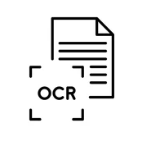
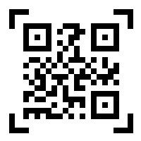
2. Action
Apply OCR
(Optical Character Recognition)
Advantage:
Simplify operation
Save time
No paper-using
Disadvantage:
OCR reader/ software:
High cost (~$3,000)
Cannot apply latest version of Visual studio
2nd idea
Scan image/ letter/ character
OCR reader
Auto update data
Asset system
Change concept
Apply QR code
Merit
Scan QR code
QR reader
Auto update data
Low cost : $0
Easier to develop App
Asset system
QR

Slide 4

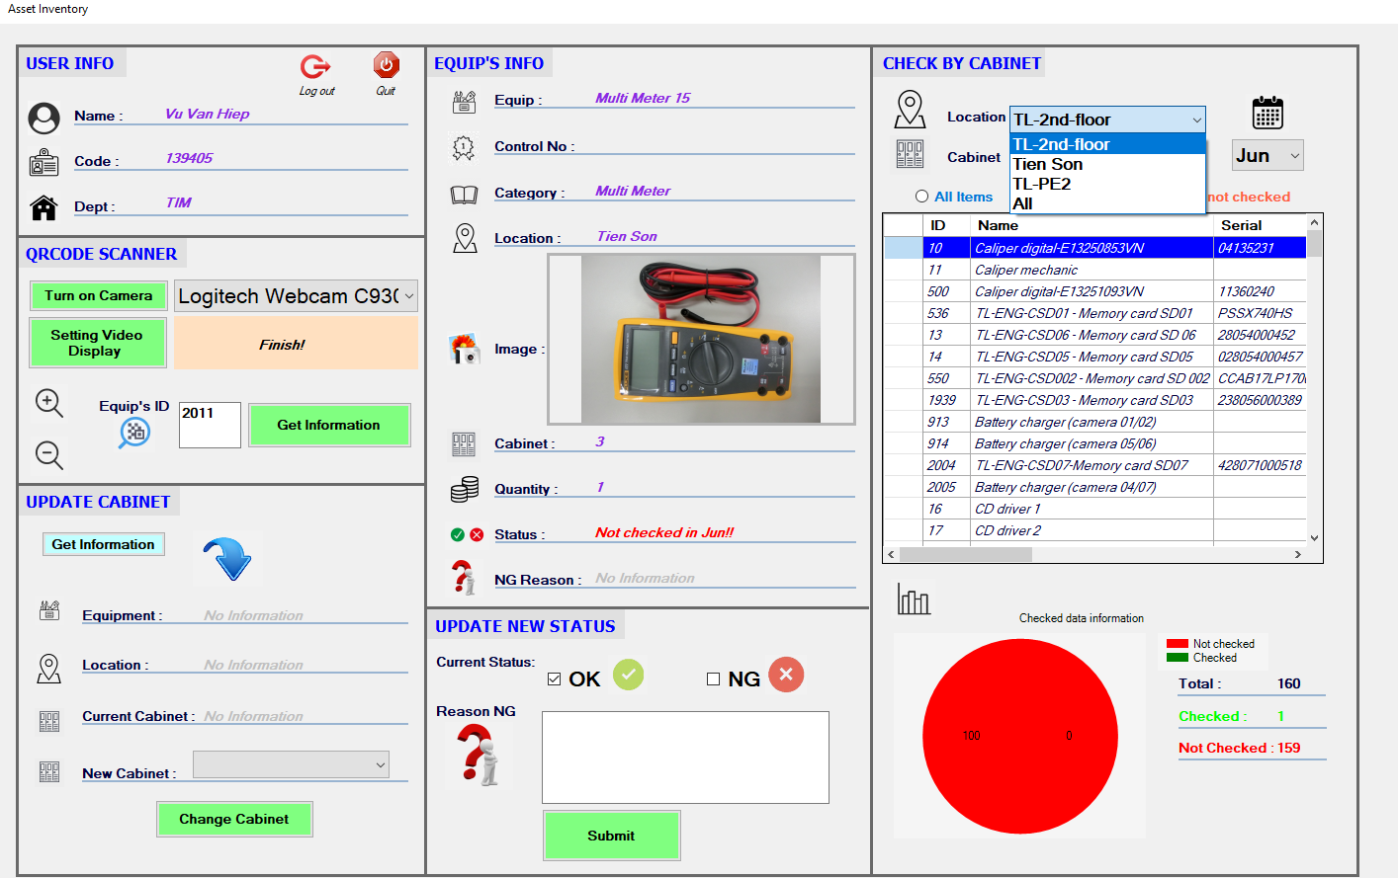
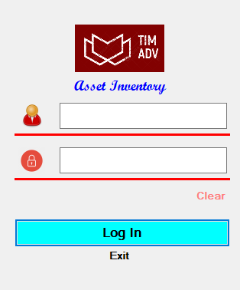

3. Result
Asset Inventory Application
App’s Icon
User information
Filter equipments by cabinet
QRCode scan Function
Login Area
Update new cabinet Function
Visualize data checking
Same account as in Asset Management system
(User: only TIM member have permission to login)
Show Equipment information and update status
PIC comment: - Easy to use
Convenient
Useful

