Slide 1
FACE RECOGNITION

Slide 2
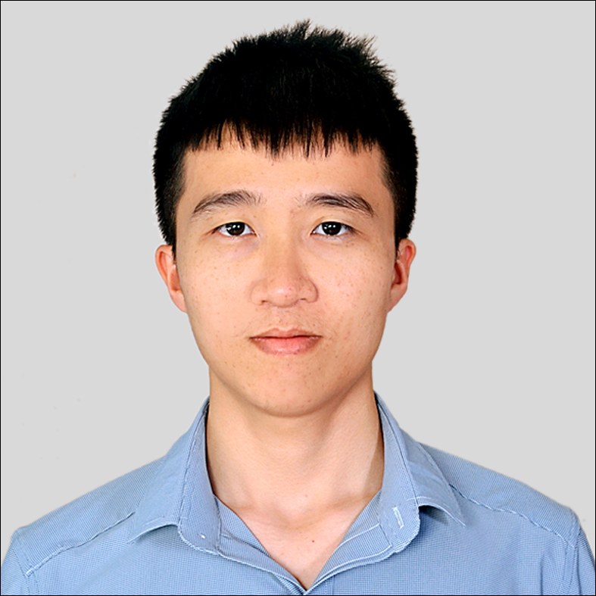
Pipeline
ResNet50/
SSR-Net
Age (85%)
on IMDB-WIKI Dataset
Gender (>90%)
MTCNN/
OpenCV
BK-Net
Emotion
Low accuracy
Smile (>90%)

Slide 3
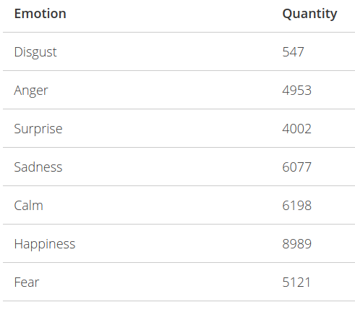
Emotional recognition
Problems | Solutions
BKNet is multi-task learning model, but not really good for emotional recognition | - Develop a new CNN - Combine with facial landmark detection
Not enough data (FER data set) | - Collect more data - Use GAN ( Generative Adversarial Networks) to generate more data

