Slide 1

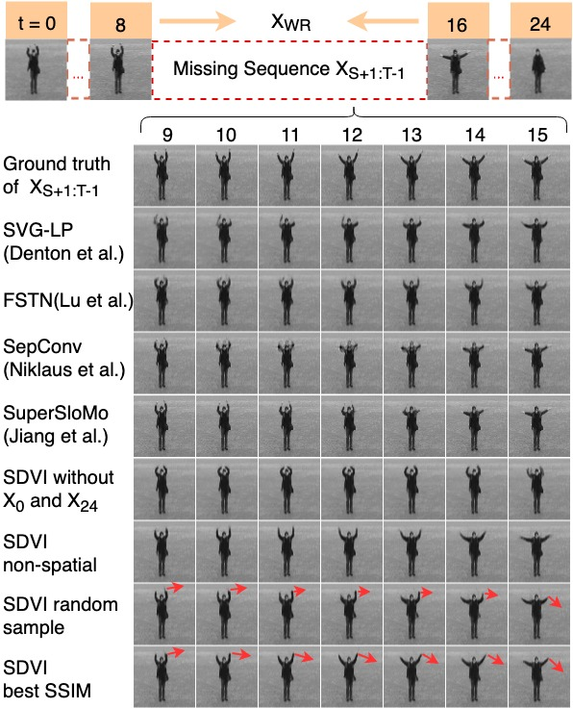
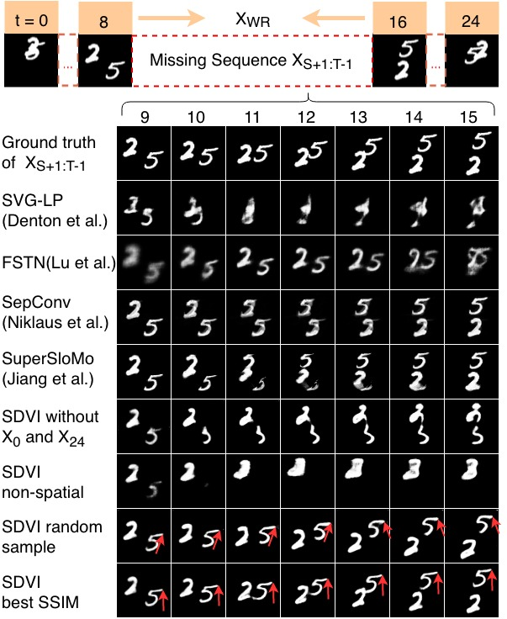
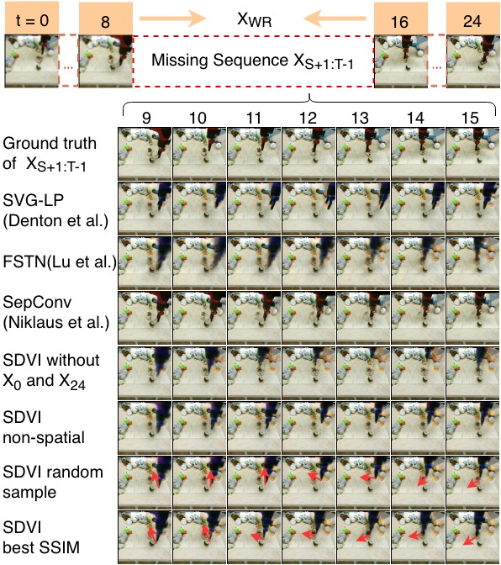
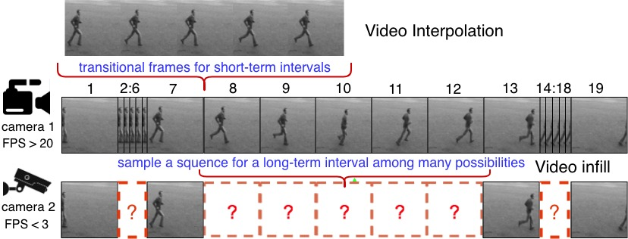
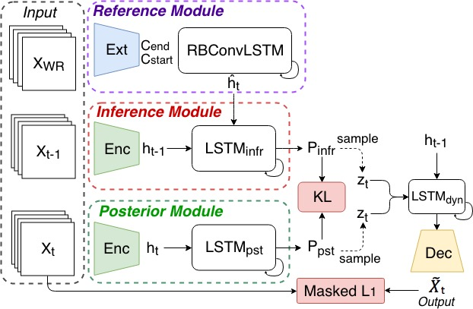
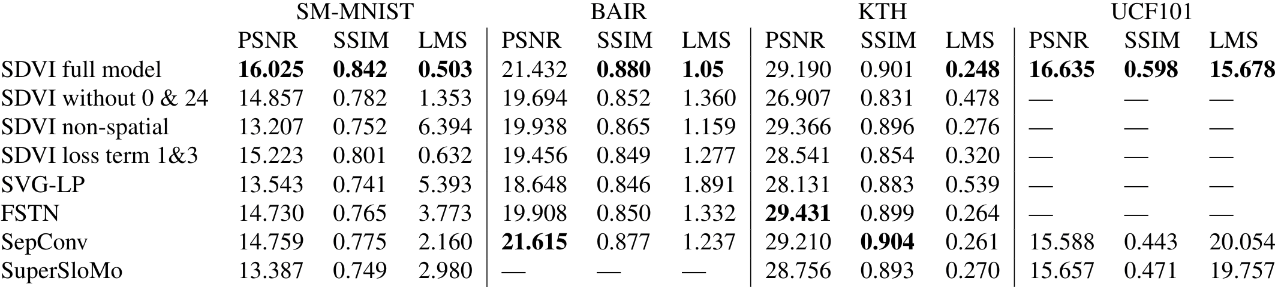
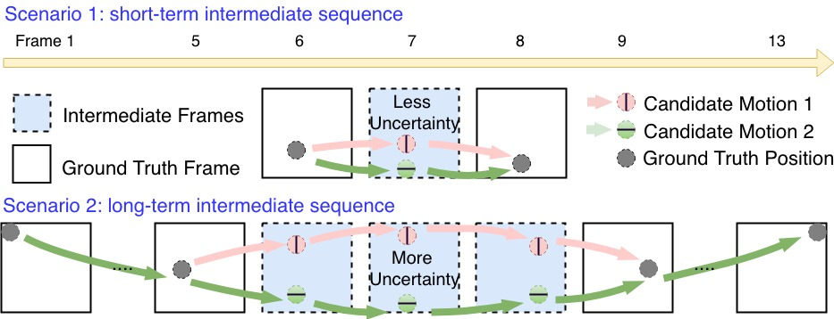
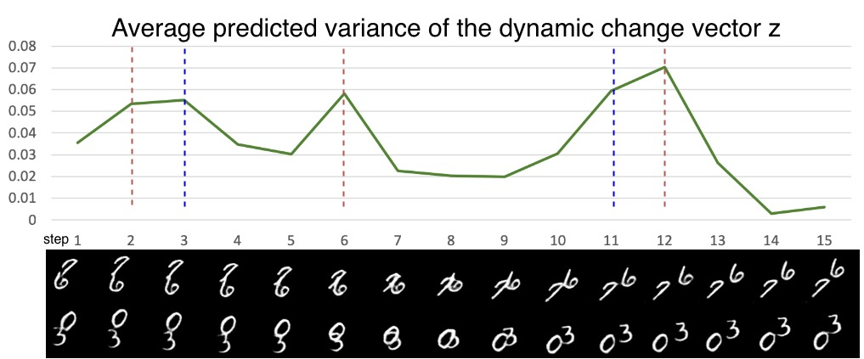
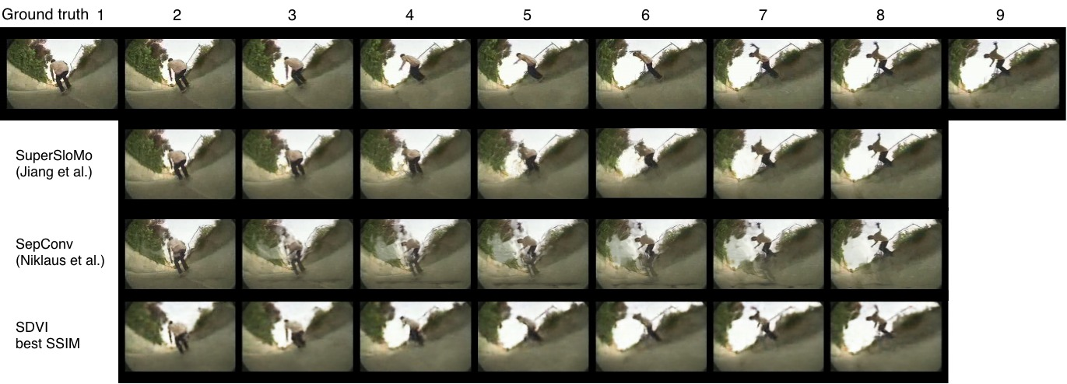
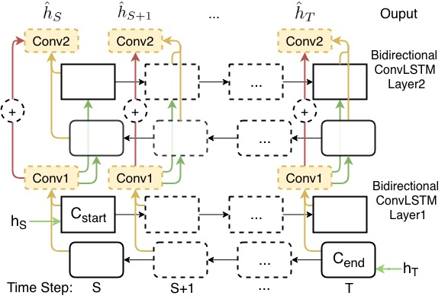
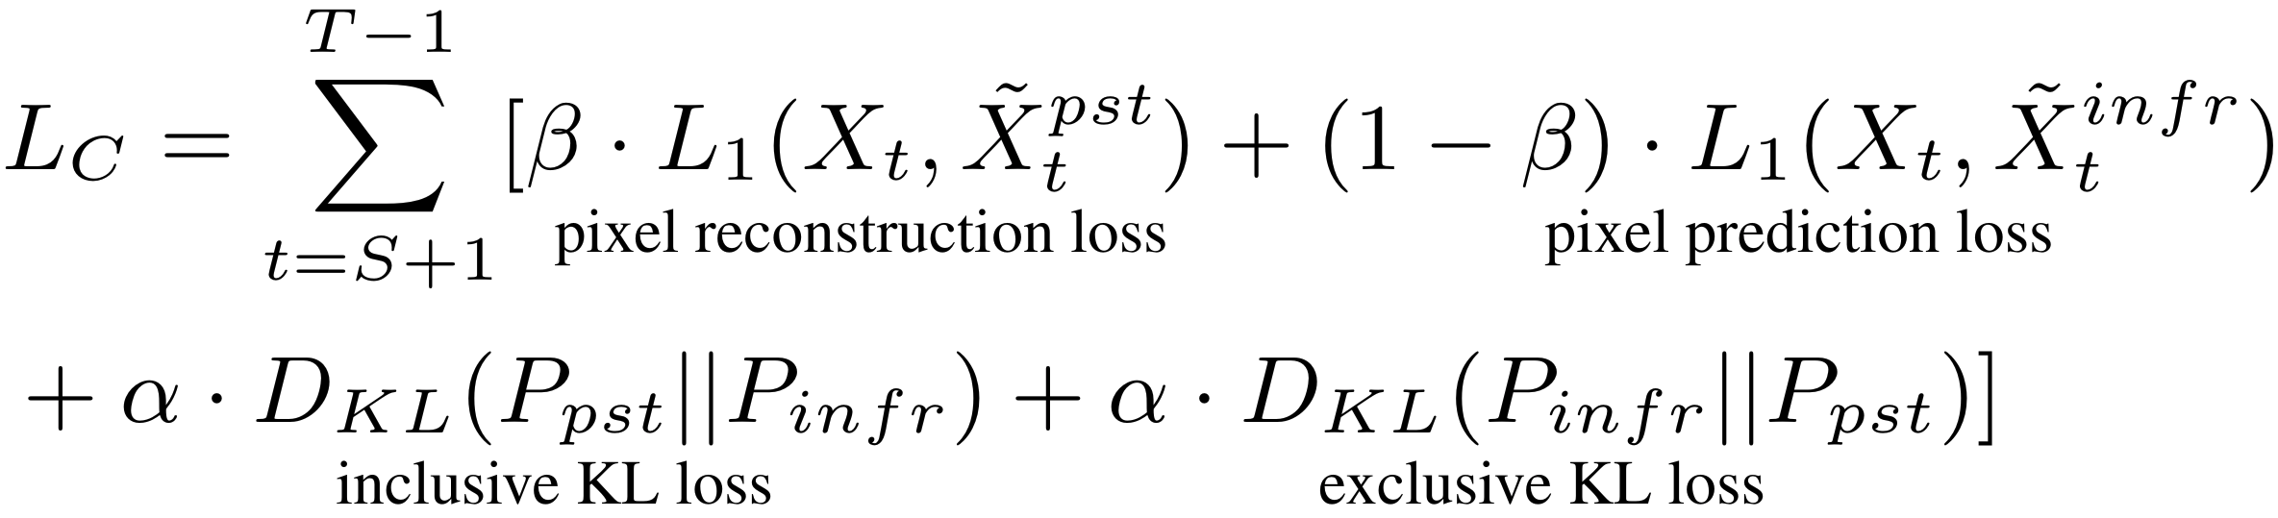
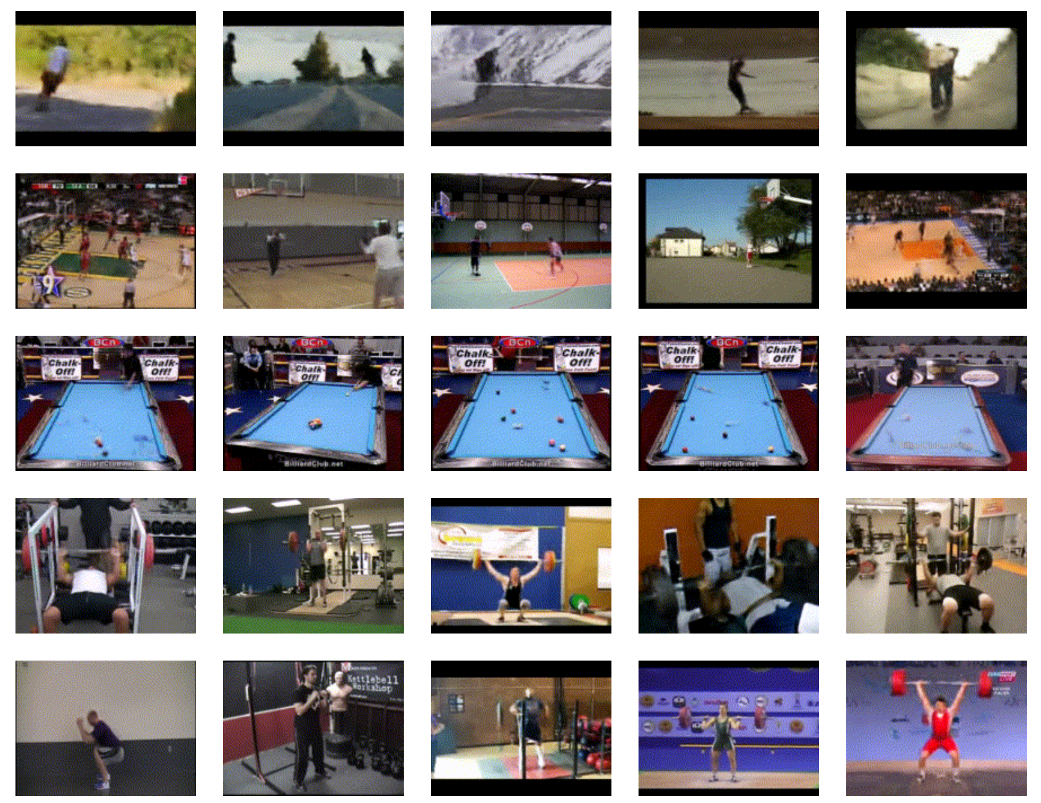

Stochastic Dynamics for Video Infilling
Qiangeng(Charlie), Hanwang, Weiyue, Peter, Ulrich
Task Introduction:
Video infilling/inbetweening: aims to infill long intervals with plausible frame sequences.
Video interpolation: aims to produce transitional frames for a short interval between every two frames.
Model and Objective
Results and Evaluations
Task and Challenges
Overview:
SDVI models the infilling as a constrained stochastic generation process and sequentially samples dynamics from the inferred distribution.
KTH
SMMNIST
BAIR robot arm
Initial and final momentum: we expose extended reference frames both from the past.
Long-term coherence: RBConvLSTM, a multi-layer bi-directional ConvLSTM with residual connections between adjacent layers.
Model uncertainty:
At step t, a distribution for an embedding vector is inferred, conditioned on previously generated frames and the reference frames. We sample an embedding vector from the distribution and use a decoder to generate the frame at step t.
Conditioned on frame 7 and 8, video interpolation generates transitional frames with similar content. However, video infilling generates frames in a long-term interval (from frame 8 to 12) and requires the model to produce varying content.
The camera in scenario 1 can capture every other frame and the camera in scenario 2 captures 1 frame for every 4 frames. The red and the green trajectories indicate two possible motions in each scenario.
UCF101
RBConvLSTM
Objective Function
Three Challenges:
The inputs of the video prediction are consecutive frames so the initial momentum is given. However, the inputs of video infilling are sparse and discontinuous.
The observation of the last frame becomes a long-term coherence requirement, so an infilling model is required to guarantee the coherence between the previous sequence.
compare with interpolation models, an interval our model needs to infill has more uncertainties, even with more reference frames.
SDVI generates higher variances coincident to the "wall bouncing" event, indicated by the two dash lines
Inclusive KL divergence is sampled on P_{pst,}it will penalize more when P_{pst,} is large and P_{infr} is small. Therefore lead to a P_{infr} with higher diversity.
On the other hand, exclusive KL divergence will make the inference more accurate when P_{infr} is large.
For more video examples, please visit our website athttps://xharlie.github.io/projects/project_sites/SDVI/video_results.html
Or scan the QR code.
Last momentum similarity (LMS)
M square distance between the ground truth optical flow from X_{T-1}to X_{T} and the optical flow from the last generated frame to X_{T.}
the dynamics from both sides are gradually propagated to the middle steps and create dynamic constraint vectors to guide the inference step by step.
Notes:
<number>

