Slide 1

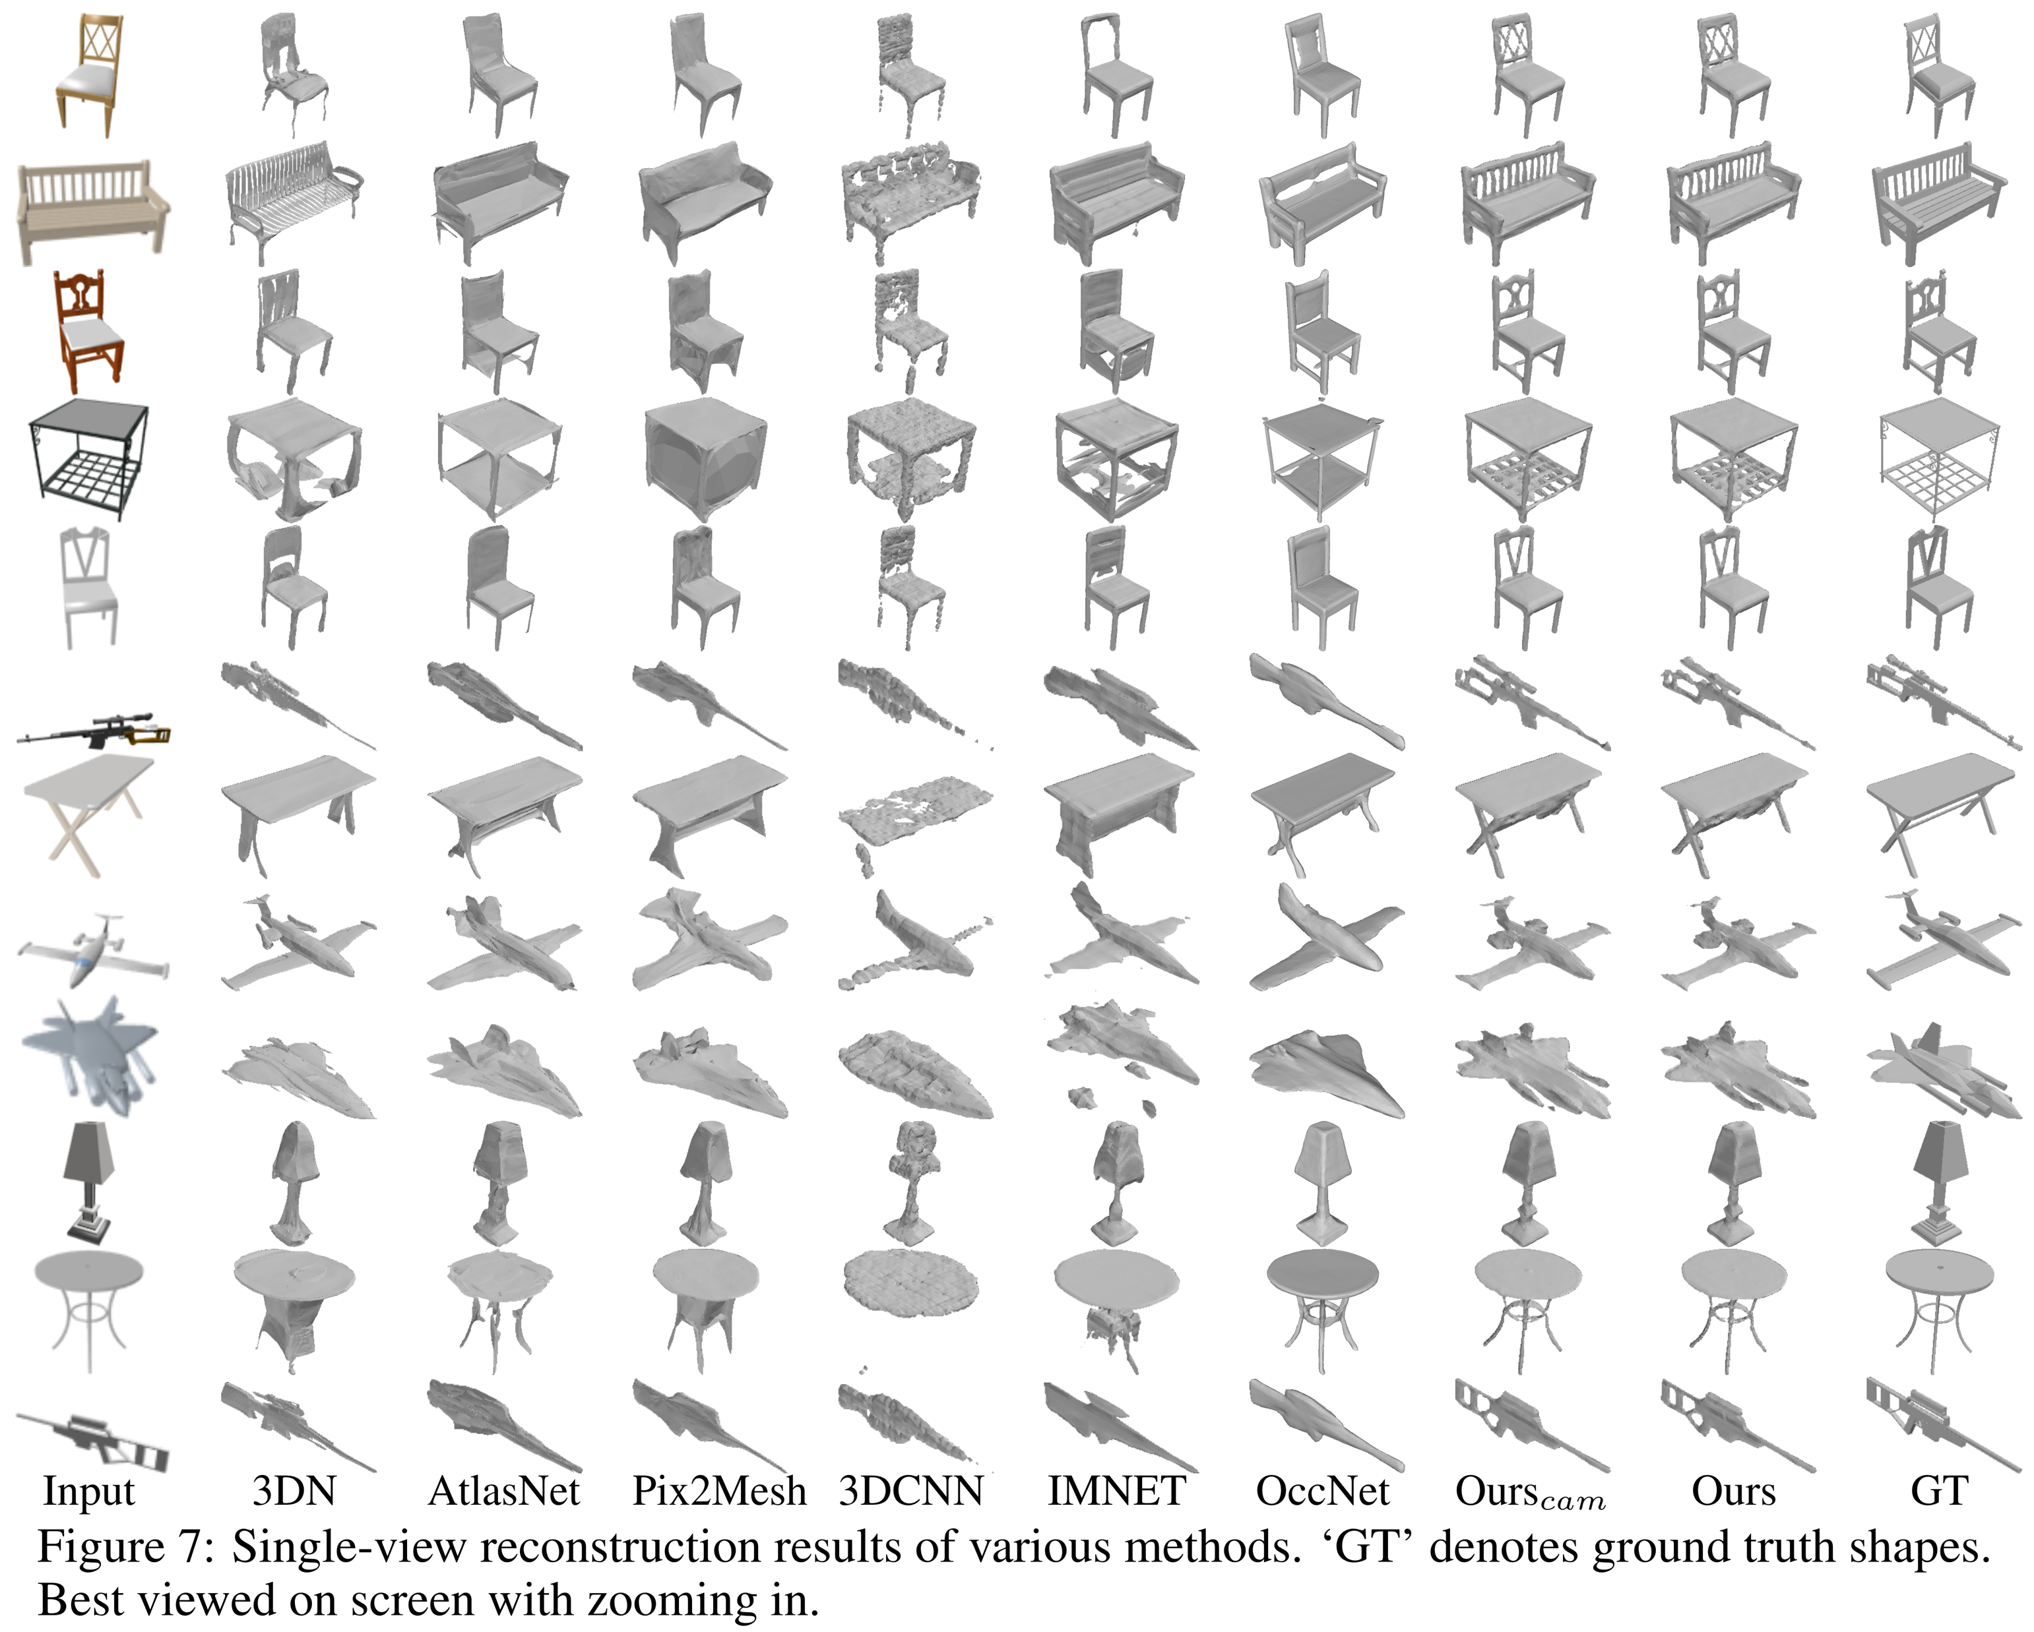
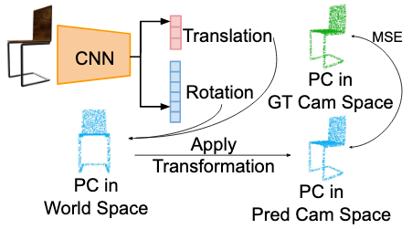
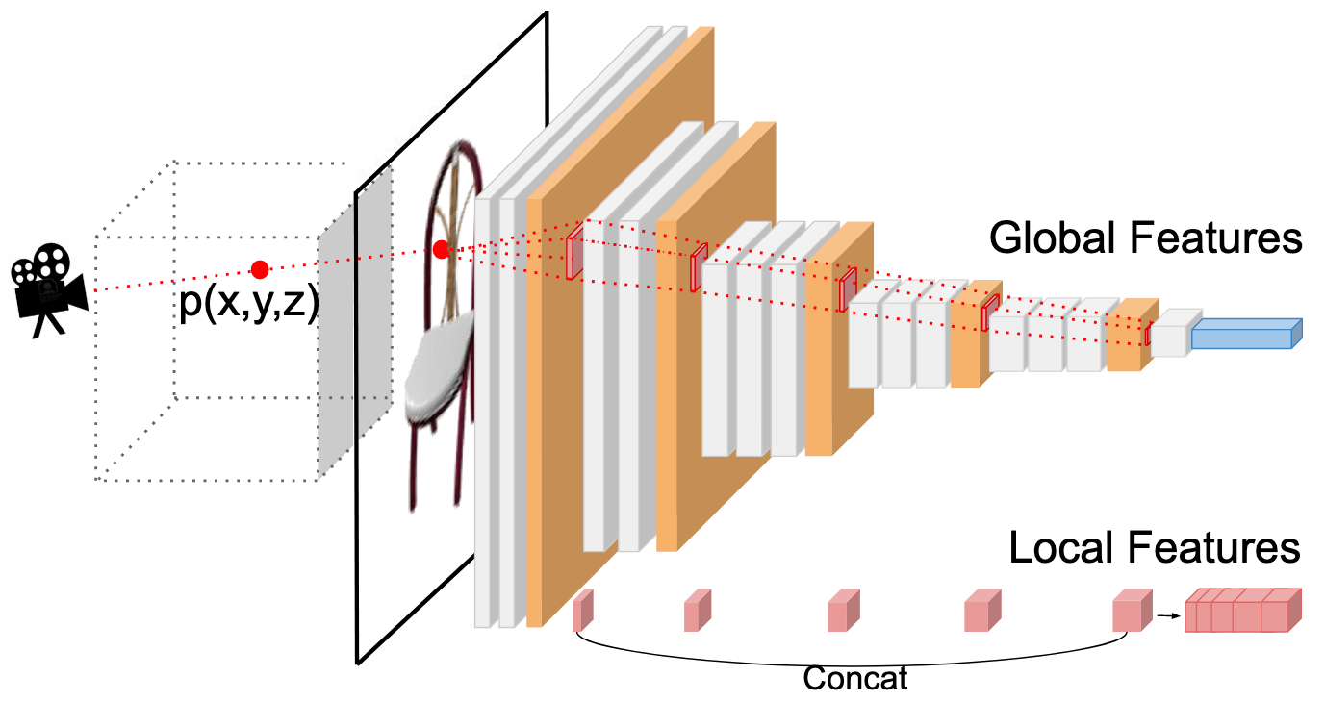
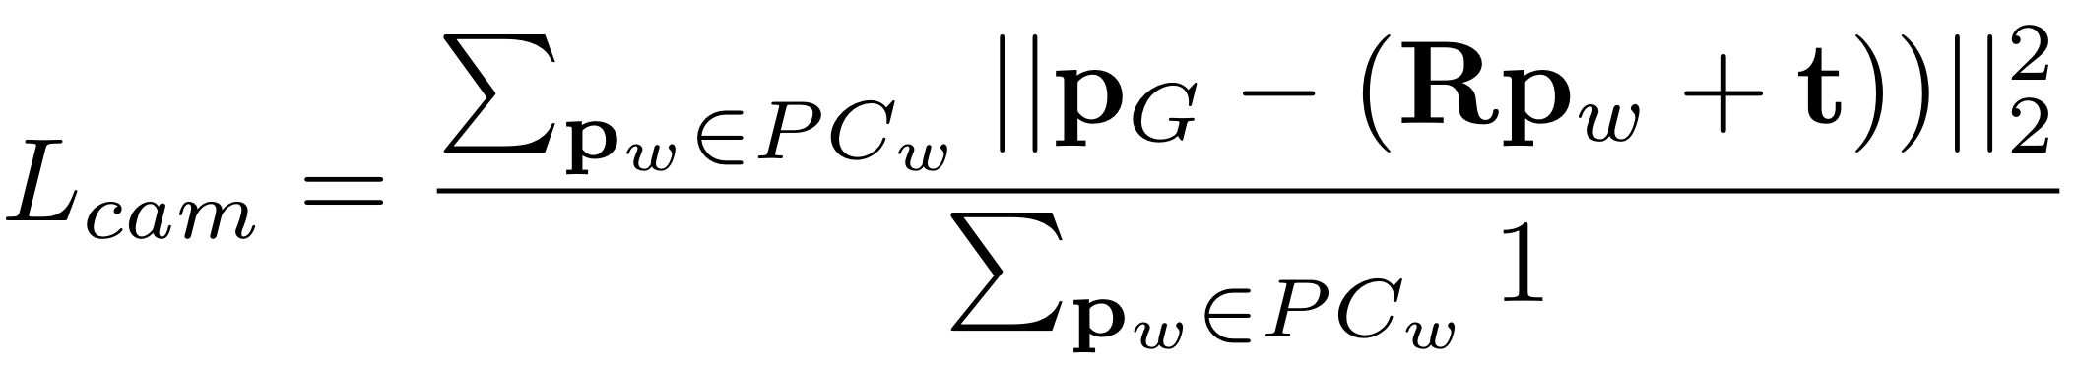
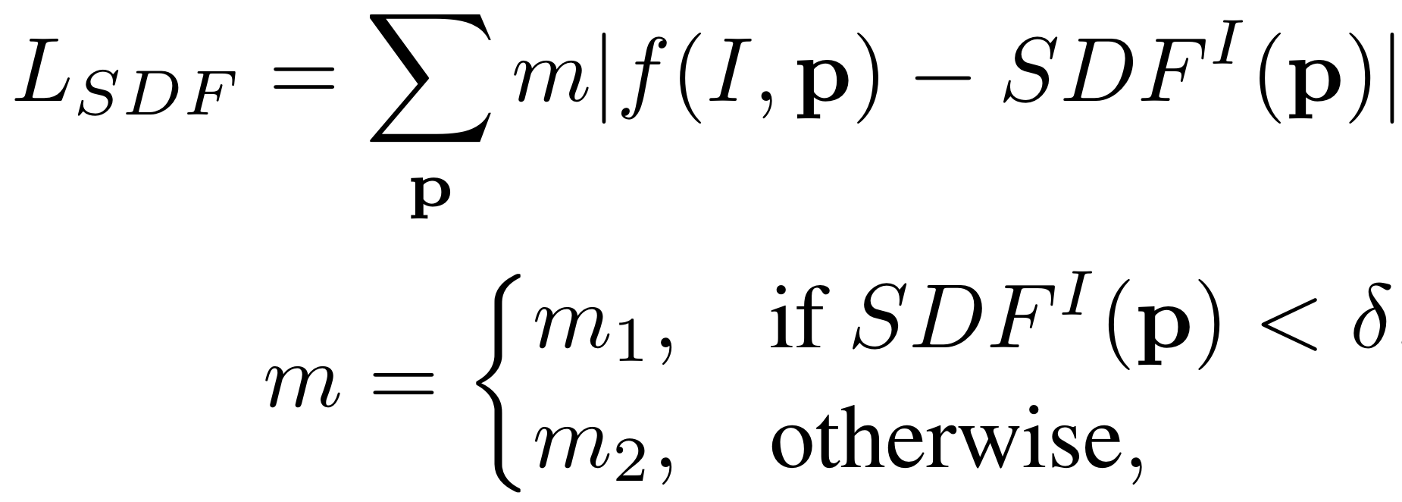
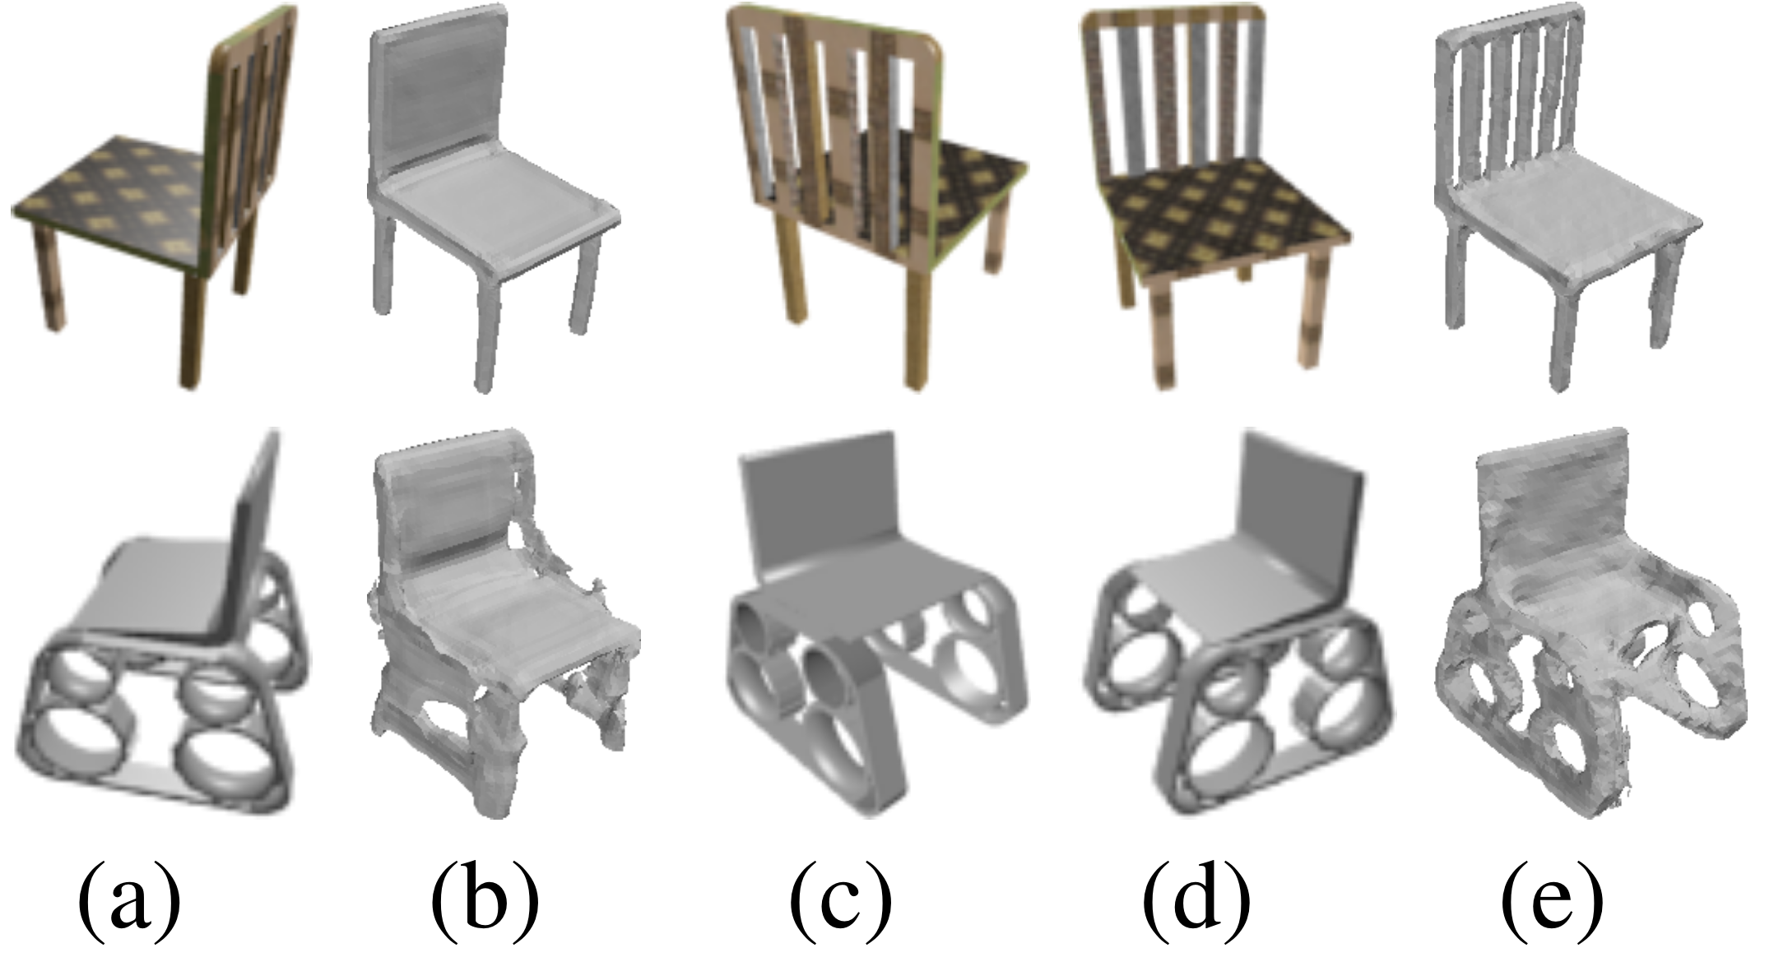
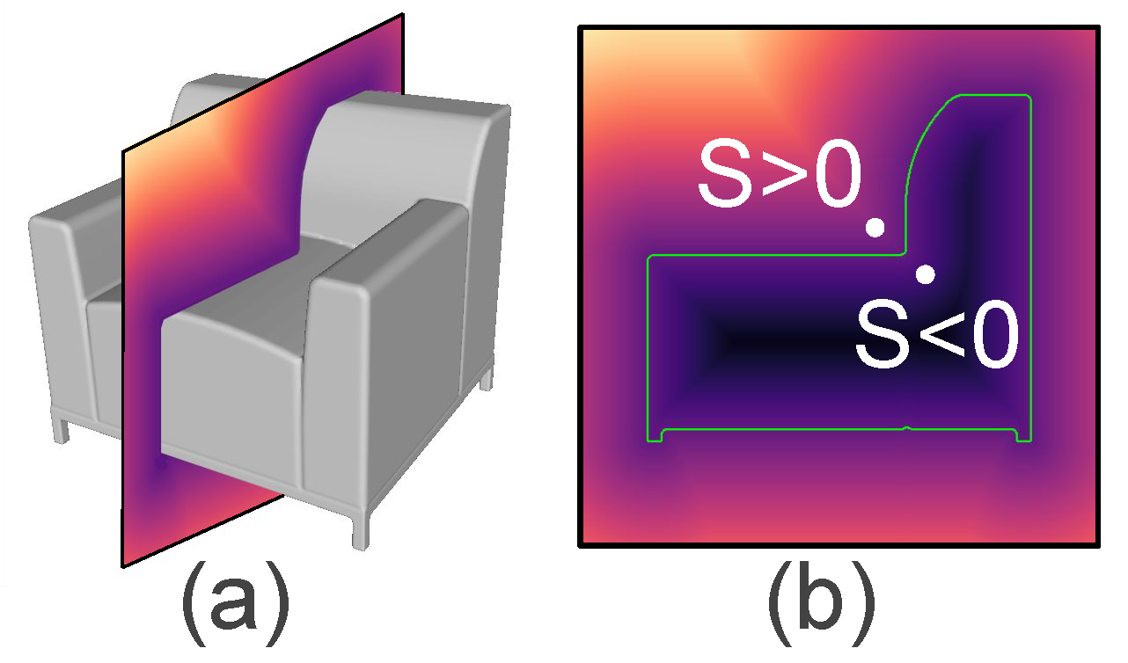
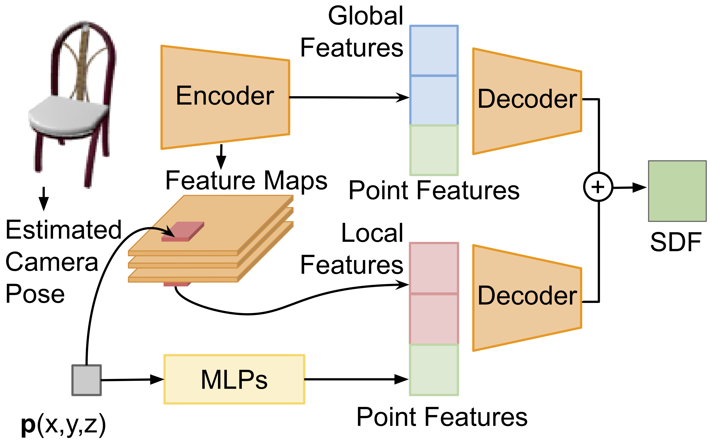
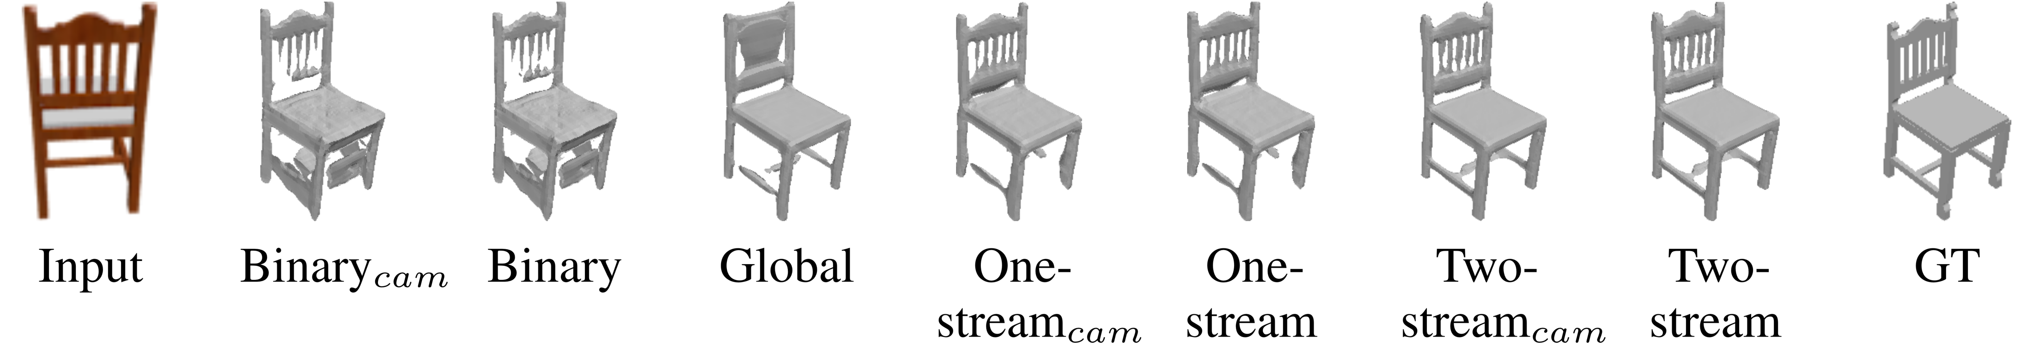
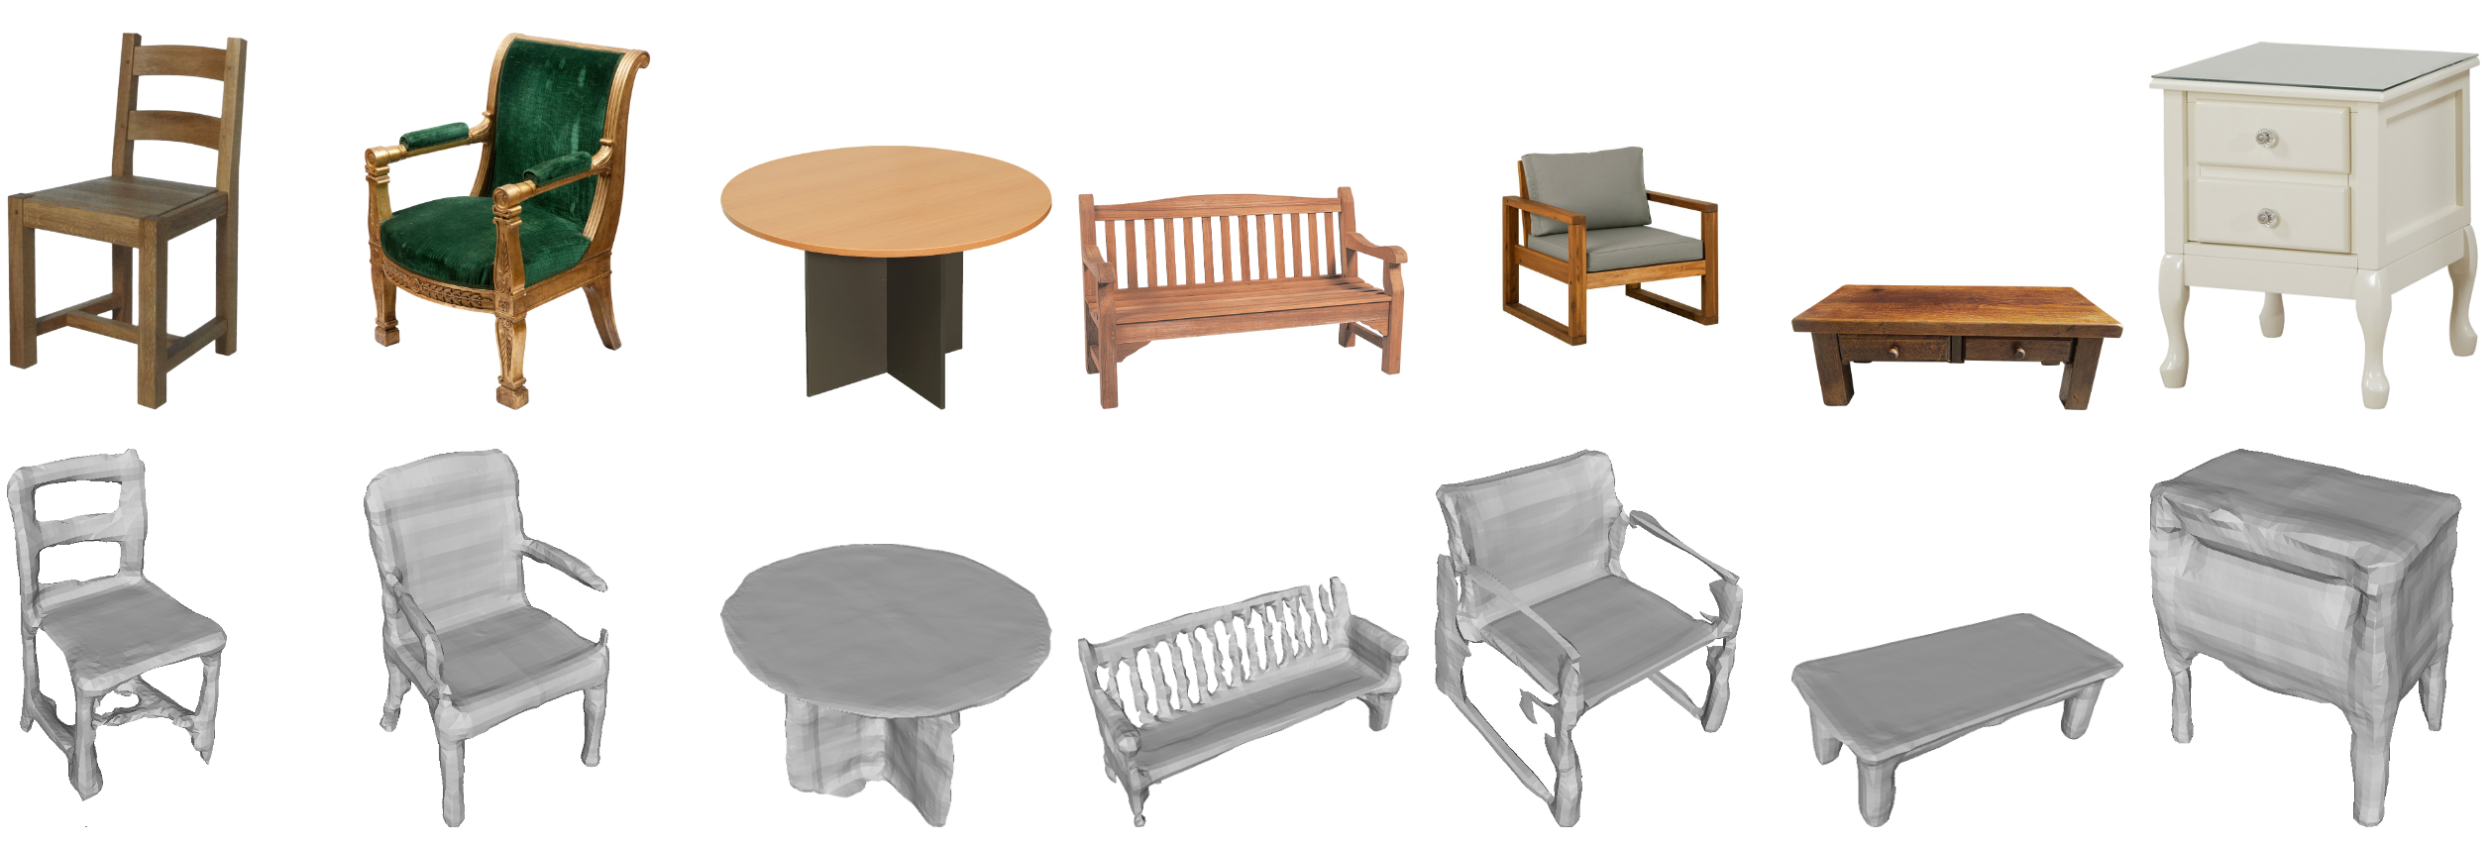

DISN: Deep Implicit Surface Network for High-quality Single-view 3D Reconstruction
Weiyue Wang*, Qiangeng Xu*, Duygu Ceylan, Radomir Mech, Ulrich Neumann
Task and Motivations
Camera Pose Estimation and SDF Generation
Task: Generate a high-quality detail-rich 3D mesh from a single 2D image
Estimate the camera pose, the 6 DoF transformation from the camera coordinate to world coordinate.
Extract local features: We use the camera pose to find a 3D point’s 2D location on the image and extract local feature patches from multiple network layers.
Motivations:
Mesh surface is the most desired 3D representation for 3D object reconstruction.
2. Voxels and point clouds have limited resolution. Modeling explicit surfaces (e.g. mesh) is constrained by fixed topology.
3. Generation loss such as Chamfer Distance (CD) and Earth-mover Distance (EMD) penalize mostly on overall shape. The details are usually missing.
Camera Pose Network. ‘PC’ means point cloud. ‘GT and Pred Cam’ denote the ground truth and predicted cameras.
Local Feature Extraction. Project 3D point p onto the image plane and extract features on the location from multiple layers.
Solutions
Objective Functions
1. DISN predicts Signed Distance Function (SDF) for locations in the space. SDF has no topology restriction, no limitations on resolution. Then uses Marching cubes to generate meshes.
2. DISN uses the local features at the projected location, the global features, and the point features to predict the SDF. Global features preserve overall shape, local features preserve fine-grained details.
Qualitative results on ShapeNet single-view 3D reconstruction benchmark. DISN is the only one that can preserve both the overall shape and the fine-grained details.
DISN can be extended for Multi-view reconstruction:
: Single-view input.
: Reconstruction result from (a).
(c)&(d): Two other views input.
(e): Multi-view reconstruction results from (a), (c) and (d).
Camera Pose Estimation: PC_{w} ∈ R^{N×3} is the point cloud in the world space. Each P_{w} , P_{G} is the ground truth location in the camera space.
SDF Generation: |·| is the L1-norm. m₁, m₂ are weights for points whose signed distance is below or above a certain threshold δ. m₁ > m₂
Results and Evaluations
We train DISN on rendered images of ShapeNet and test it on real online images on the first row.
Illustration of SDF:
A point is outside the surface if s > 0, inside if s < 0, and on the surface if s= 0.
Ablation studies: ‘GT’ denotes ground truth, ‘cam’ denotes using estimated camera pose. ’Binary’ denotes prediction of inside or outside the surface instead of a distance value. “One-stream” denotes concatenate global and local features instead of adding them in the network.
Model Overview
Notes:
1

