Slide 1
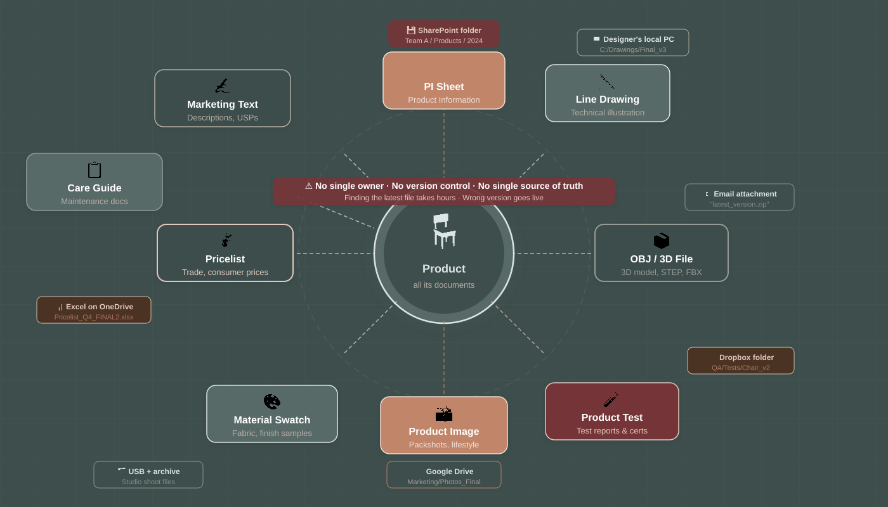
PRODUCT INFORMATION MANAGEMENT
One place for all
your product content.
PIM + Social Campaign Module
ASP.NET Core · React · Python AI
Today, a single product has 6+ document types stored in 6+ different places:
📄 PI Sheet
🧪 Product Test
📐 Line Drawing
📸 Product Image
📦 OBJ / 3D File
🎨 Swatch / Material
→ No version control · No single owner · Hours wasted searching
Product Manager · Business Analyst · Technical Manager | May 2026

Slide 2
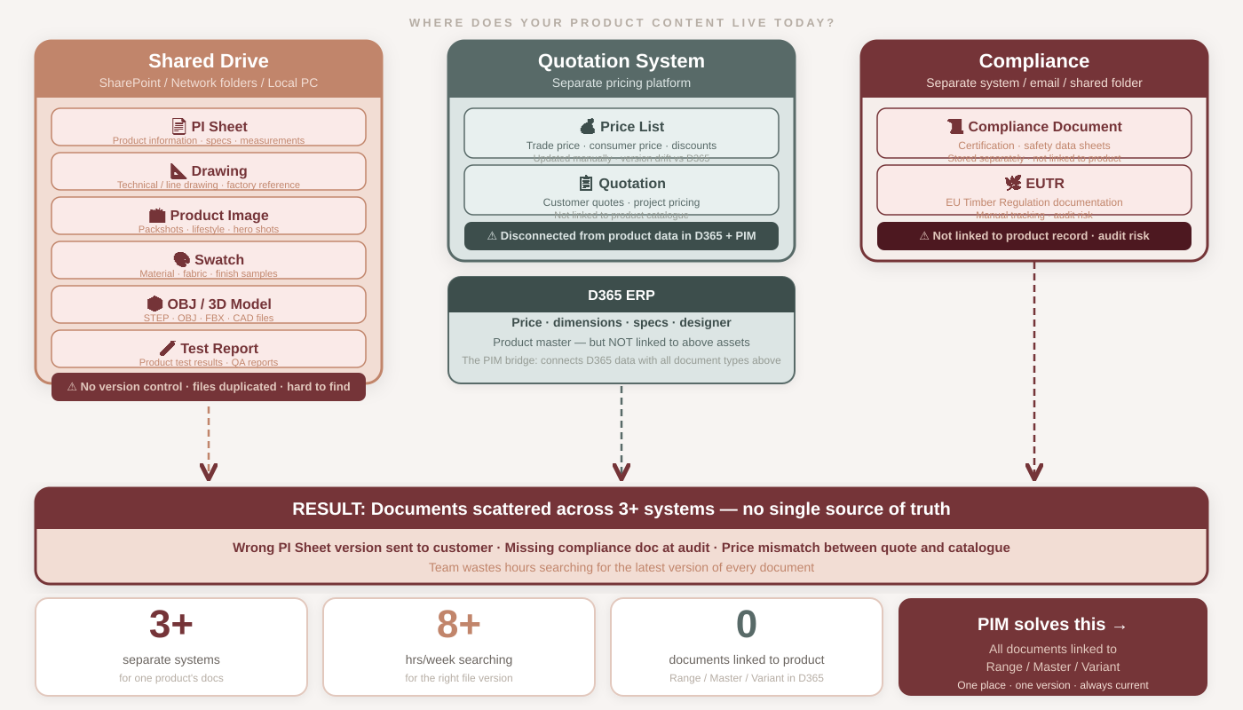
The Problem
Documents scattered across 3+ systems — no link to product in D365

Slide 3
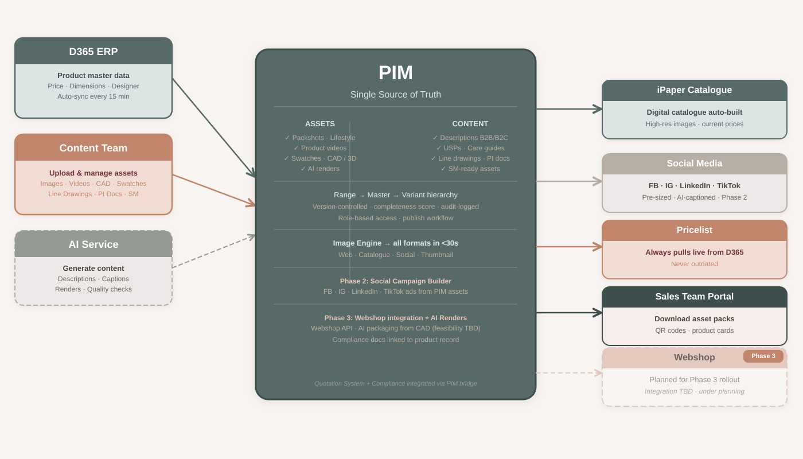
The Solution
PIM = one place for everything · push to every channel automatically

Slide 4












What content lives in PIM?
Every asset linked to Range / Master Number / Variant — structured like D365
Packshots
Videos
Swatches
CAD / 3D Files
Hero · pack · lifestyle
all angles
Product · lifestyle
Reels · tutorials
Material · color
fabric samples
STEP · OBJ · FBX
source for AI render
Line Drawings
PI Documents
AI Renders
SM Assets
Technical illustrations
for catalogue
Product info sheets
spec sheets · PDFs
Auto-generated from CAD
all material variants
Social-ready formats
FB · IG · LI · TT
Text Content
Price Data
Lifestyle Scenes
360° Spin Sets
Descriptions · USPs
Care guides (AI-drafted)
From D365 · auto-sync
always current
Room shots · mood boards
lifestyle contexts
Interactive views
for webshop (Phase 3)

Slide 5
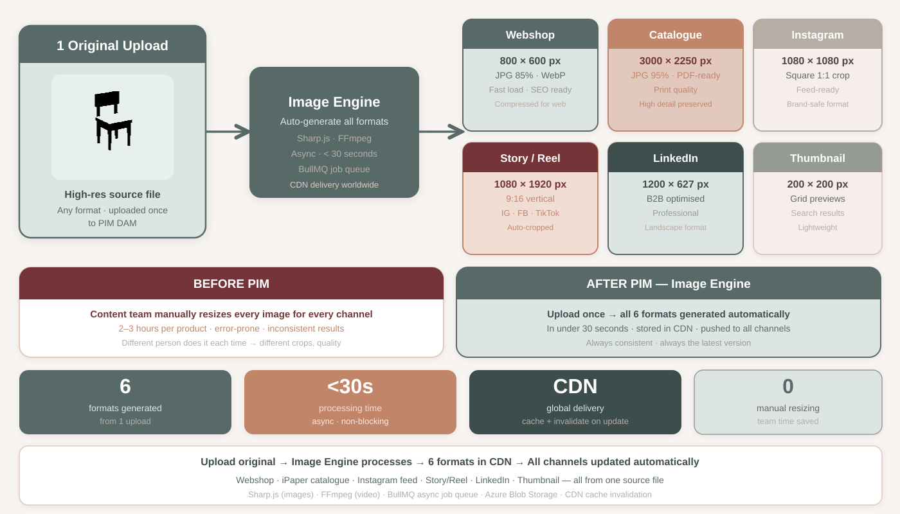
Image Engine — Upload once, get every size
No more manual resizing · Auto-generate all formats for web, print and social in < 30 seconds

Slide 6
How it works — 7 steps
From D365 to published — automated, traceable, fast
1
D365 Syncs
2
Upload Assets
3
Image Engine
4
AI Writes Text
Product data every 15 min
Images, video, CAD to DAM
Auto-resize for all channels
Descriptions, USPs, care
5
Review & Approve
6
Completeness
7
Publish
Human always reviews first
Score check before publish
iPaper · Social · Pricelist

Slide 7
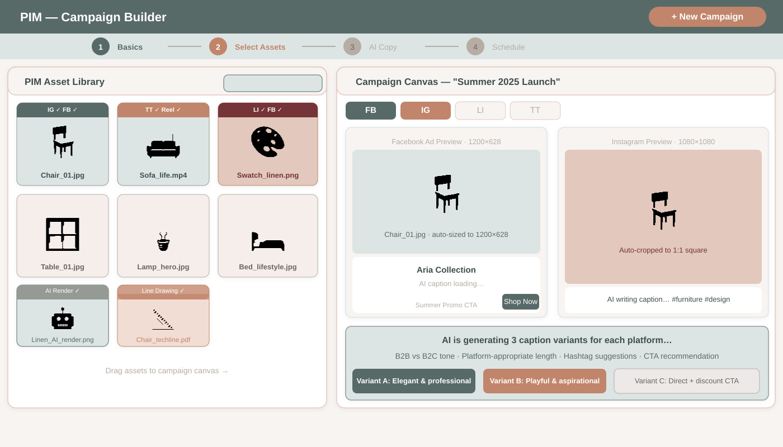
Social Campaign Builder
Pick PIM assets · AI writes captions · Schedule and publish to all platforms in one flow

Slide 8
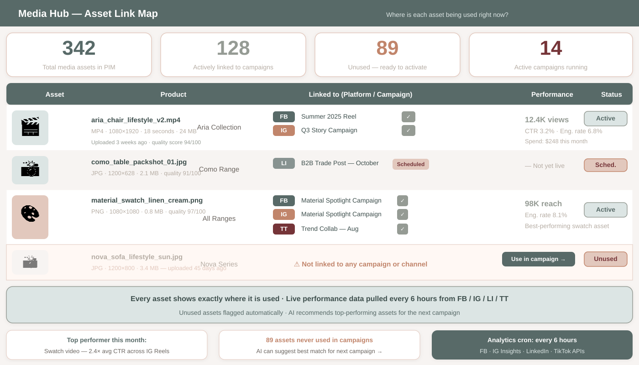
Asset Link Map — Know exactly where every asset is
See which campaigns, platforms, and channels use each asset — with live performance data

Slide 9
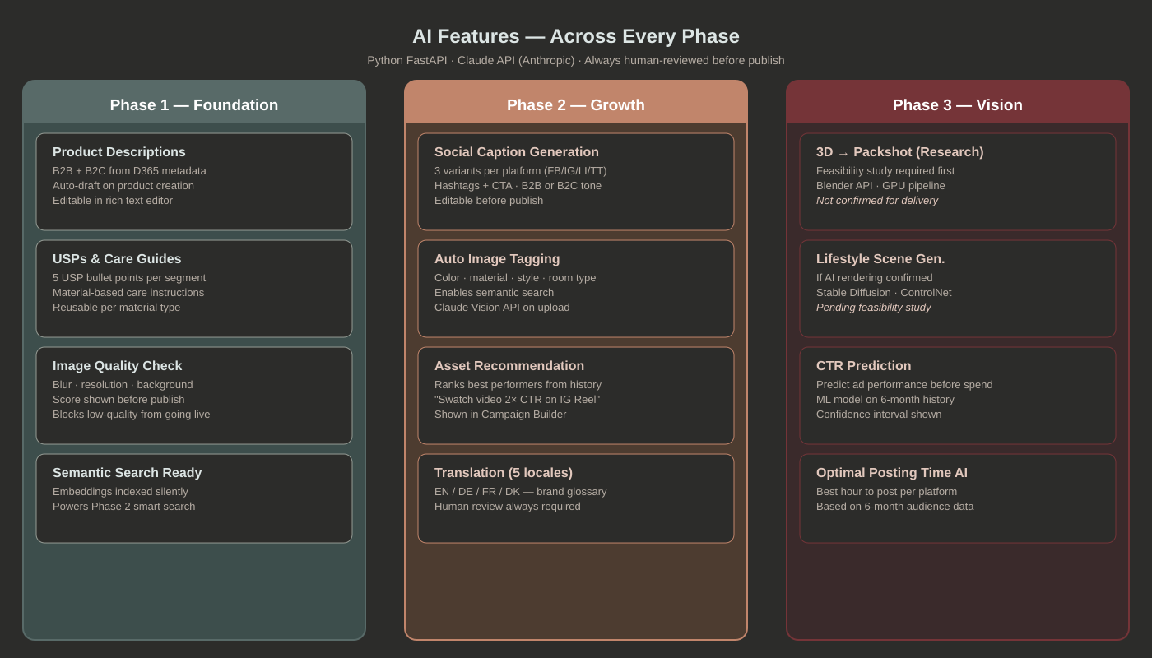
AI does the heavy lifting
Content team focuses on review + approval — not typing from scratch

Slide 10
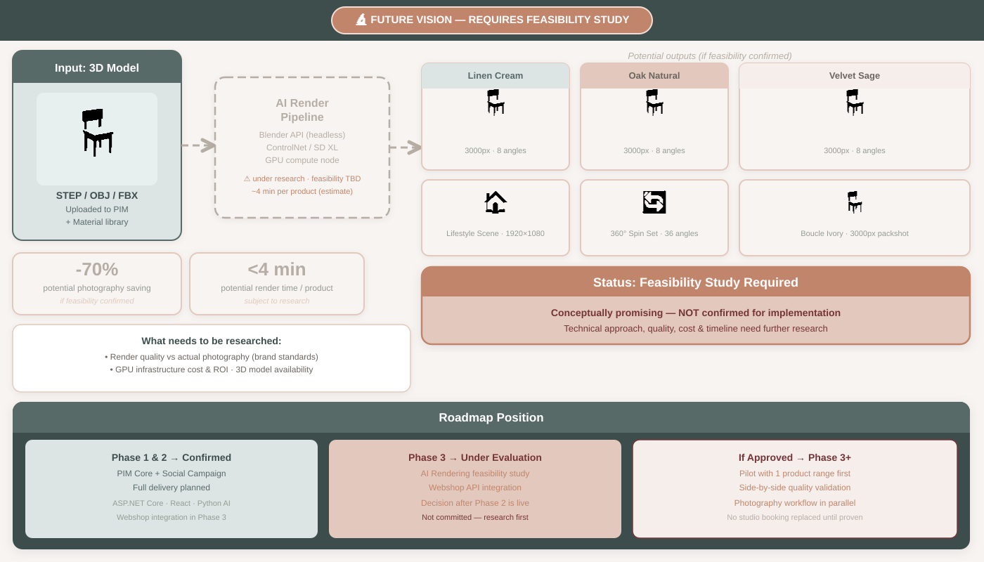
AI Rendering — Future Vision Under Research
Conceptually promising · feasibility study required before committing to implementation

Slide 11
Tech Stack — built to scale
Three independent services · each deploys and scales on its own
ASP.NET Core 8
React 18 + TypeScript
Python FastAPI
Backend API
Frontend
AI Service
› REST endpoints + Hangfire jobs
› Admin UI · Media Hub
› Claude API (Anthropic)
› D365 sync · Platform publish
› Campaign Builder (drag-drop)
› Text · Caption · Quality check
› Publish to iPaper / Pricelist
› Asset Link Map dashboard
› Image tagging · Embeddings
› PostgreSQL + Redis + Typesense
› Analytics with Recharts
› ML + Render pipeline (Phase 3)
Shared: Azure Blob + CDN · RabbitMQ · TimescaleDB · Redis · Docker / Kubernetes · GitHub Actions CI/CD

Slide 12
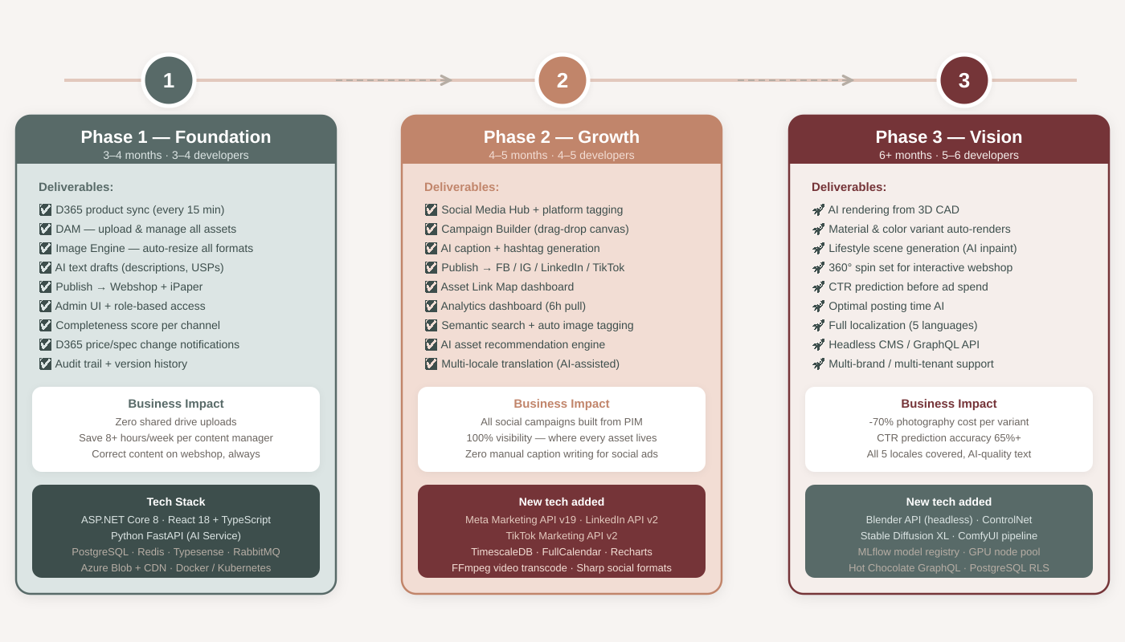
3-Phase Roadmap
Start small, deliver value fast, grow over time

Slide 13



Why build this now?
Time wasted
Wrong content live
Content team spends 8+ hours/week searching for the right file version. Every hour saved = direct cost reduction.
Outdated PI sheet, wrong drawing version, incorrect image go live. PIM enforces completeness score before publish.
AI is ready now
Social = growth
Claude API generates production-quality product descriptions and captions today. Starting early = competitive advantage.
100% of campaign assets from PIM. No local copies. Asset Link Map shows what's working in real-time.

Slide 14
Next Steps
1
Stakeholder sign-off
Review this deck · Confirm scope · Approve Phase 1 budget
2
Technical spikes (Week 1–2)
Validate D365 API access · Validate Meta API sandbox with test ad account
3
Environment setup (Week 2)
Docker Compose: ASP.NET Core + React + Python + PostgreSQL + Redis + RabbitMQ
4
Sprint 1 kick-off (Week 3)
Repo · CI/CD pipeline · DB schema migrations · API scaffold
5
Phase 1 launch (Month 3–4)
Content team live · Zero shared drives · iPaper pulls from PIM
Questions? Let's discuss → Product Manager / Business Analyst / Technical Manager

