Slide 1
Android Kernel Extensions
Karthik Dantu and Steve Ko

Slide 2
Administrivia
Assignment 4 is out and due in two weeks.
Please stop by during our office hours for your project discussions.
Don’t wait until the next Friday meeting!

Slide 3
Today: Android Kernel Extensions
Why?
Android “OS” is not just a kernel (as we all know).
What changes were made to the kernel then?
Goal
Introduction to some of the interesting kernel extensions of Android

Slide 4
Today: Android Kernel Extensions
Resources:
AOSP
Linux code
“Embedded Android”
http://elinux.org
http://source.android.com
http://developer.android.com

Slide 5
Kernel Changes
Binder (last time)
Wakelock
Low memory handler a.k.a. OOM Killer
Logger
Anonymous shared memory (ASHMEM)
Process memory allocator (PMEM)
Etc.

Slide 6
User-Kernel Interfaces
System calls
/sys (wakelock, low memory killer)
/dev (logger)
/proc (wakelock)

Slide 7
WakeLock

Slide 8
Wakelock
/kernel/power/wakelock.c
A mechanism to control “opportunistic suspend” or “autosleep” i.e., aggressively going to low-power states
Why?
Obviously to save power
What do we need to make this possible?
Can we just go to sleep whenever?

Slide 9
Wakelock
A mechanism to prevent the system from entering into the suspend or other low-power states.
Telling the system that there’s something important going on, i.e., the system shouldn’t go to low-power states.
Can be used from the user space as well as the kernel space.

Slide 10
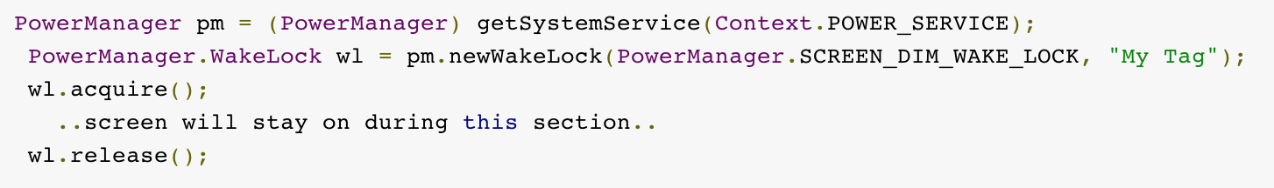
Wakelock Android App Example
PowerManager provides the APIs.

Slide 11
Android App Wakelock Types
Flag Value | CPU | Screen | Keyboard
PARTIAL_WAKE_LOCK | On | Off | Off
SCREEN_DIM_WAKE_LOCK | On | Dim | Off
SCREEN_BRIGHT_WAKE_LOCK | On | Bright | Off
FULL_WAKE_LOCK | On | Bright | Bright

Slide 12
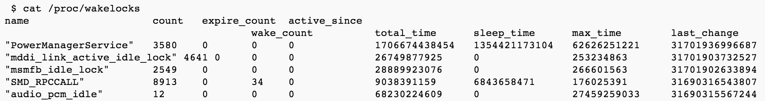
User Space Wakelock
Any user space process can lock/unlock by writing to
/sys/power/wake_lock
/sys/power/wake_unlock
PowerManager does this.
/proc/wakelocks shows all the wakelock status

Slide 13
Kernel Space Wakelock
#include <linux/wakelock.h>
void wake_lock_init(struct wake_lock *lock, int type, const char *name)
void wake_lock_destroy(struct wake_lock *lock)
void wake_lock(struct wake_lock *lock)
void wake_unlock(struct wake_lock *lock)

Slide 14
Wakelock Controversy
Many pieces of Android kernel changes are not merged to the mainline Linux source (e.g., “staging” mostly means it’s a temporary directory).
It also took much time to merge currently-merged pieces, e.g., wakelocks, with a lot of initial objections from the Linux maintainers.
“Wakelocks and the embedded problem”
http://lwn.net/Articles/318611/

Slide 15
Initial Objections
Code mostly developed behind closed doors.
Shipped first before getting into the mainline kernel
Much duplication with an existing API (pm_qos)
No way to recover if a user process exits while holding a wakelock
Etc.

Slide 16
Low Memory Killer

Slide 17
Memory Management
Android wants to keep apps around as much as possible.
Why?
Multi-tasking, fast context switch, etc.
What’s the problem with this?
Memory size is limited, so we can’t keep everything around.
How does a typical OS handle this?
Swapping out applications
Bad news: Android doesn’t have any swap space.

Slide 18
Memory Management
How can we do this?
Android does two things.
Android app heap size is limited, which prevents an app to grow arbitrarily, e.g., 16MB – 48MB (depending on the device & AndroidManifest.xml config)
When memory gets tight, the kernel kills processes.

Slide 19
Low Memory Killer
Low memory killer (also called oom killer) does the job.
/drivers/staging/android/lowmemorykiller.c
~200 LoC
Low memory killer kills processes according to priorities.

Slide 20
Low Memory Killer
/init.rc defines priority values & minimum free memory size for each priority.
ActivityManagerService updates priority values for the processes in the memory.

Slide 21
Priority examples
Foreground application: A process that contains a running Activity (highest priority)
Visible application: A process that holds a paused but still visible Activity or a service
…
Hidden Application: A process that is no longer visible
Empty applications: Process that contains no active applications (lowest priority)

Slide 22
Logger

Slide 23
Android Logging System
Android has a separate logging system different from Linux’s (e.g., dmesg & /proc/kmsg).
A typical user’s point of view
android.util.Log API
Logcat
Kernel-side
/drivers/staging/android/logger{.c, .h}

Slide 24
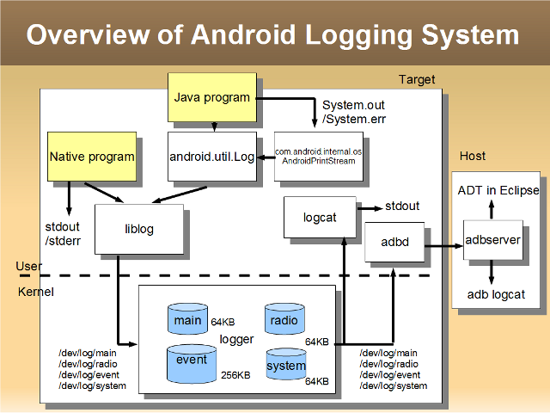
Architecture
http://elinux.org/Android_Logging_System (image by Tetsuyuki Kobabayshi, of Kyoto Microcomputer Co.)

Slide 25
Log Buffers
Main: main app log
android.util.Log
Event: system event information
android.util.EventLog
System: system components
android.util.Slog
Radio: radio and phone-related events
/dev/log

Slide 26
Paranoid Networking
Another potentially interesting change
GID-based network restrictions
#define | GID | Capability
AID_NET_BT_ADMIN | 3001 | Can create an RFCOMM, SCO, or L2CAPP Bluetooth socket
AID_NET_BT | 3002 | Can create a Bluetooth socket
AID_INET | 3003 | Can create IPv4 or IPv6 socket
AID_NET_RAW | 3004 | Can create raw sockets
AID_NET_ADMIN | 3005 | Allow CAP_NET_ADMIN permissions for process

Slide 27
Summary
Wakelock is a mechanism to tell the kernel that it shouldn’t go to sleep because there’s some interesting stuff going on.
Low memory killer manages app processes memory usage.
Logger has a few buffers for different types of events.

