Slide 1

Nlp researchs & applications

Slide 2
introduction
We are using State of the art NLP Research for our product, include:
Sentences Analytics
Passage Understanding
Intelligence chatbot

Slide 3
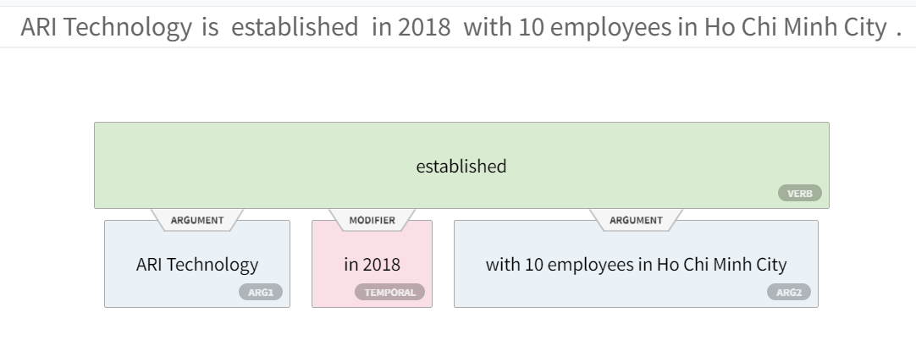
Sentences analytics
Semantic Role Labeling

Slide 4
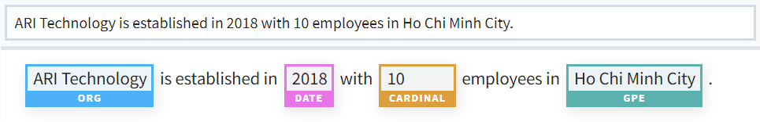
Sentences analytics
Named Entity Recognition

Slide 5
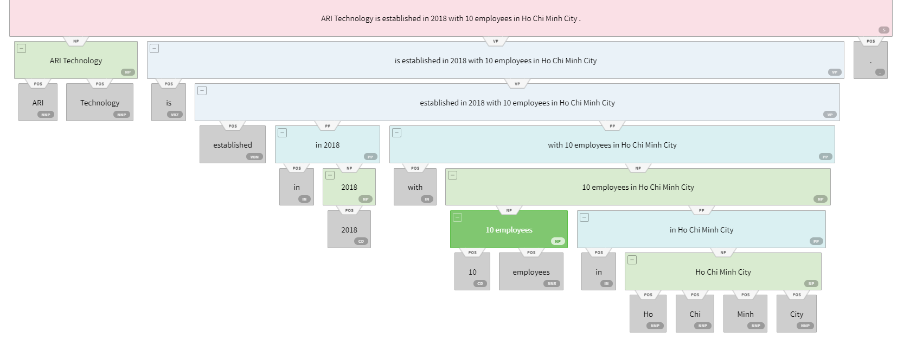
Sentences analytics
Constituency Parsing

Slide 6
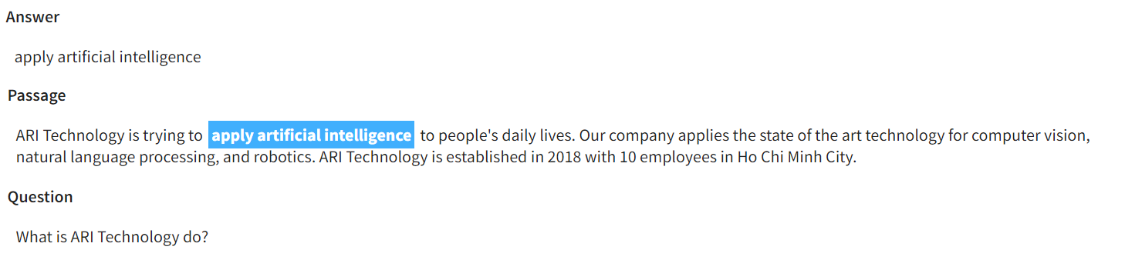
Passage understanding & QA

Slide 7
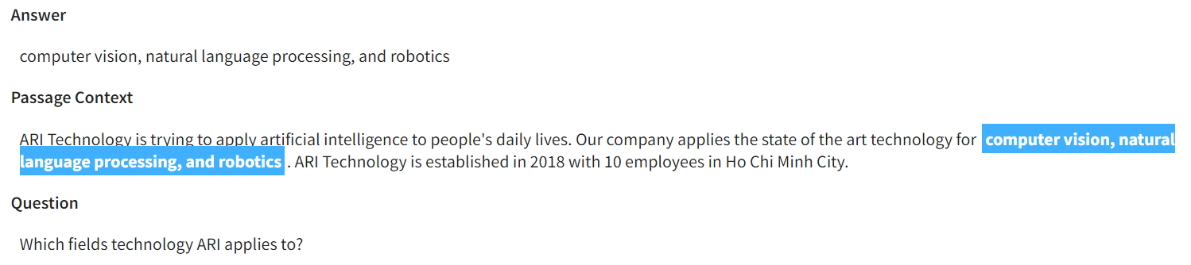
Passage understanding & QA

Slide 8
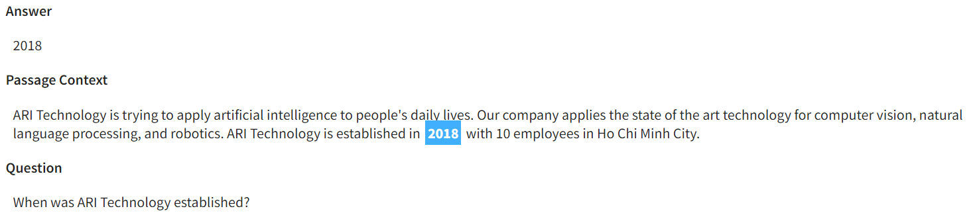
Passage understanding & QA

Slide 9
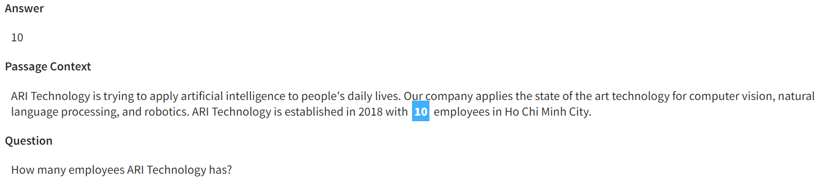
Passage understanding & QA

Slide 10
Intelligence chatbot
ARI Chatbot using SOTA NLP Model to:
Recognize Intents
Extract Entities
Manage Contextual Conversations
Take Action to API, CRM and Database

Slide 11
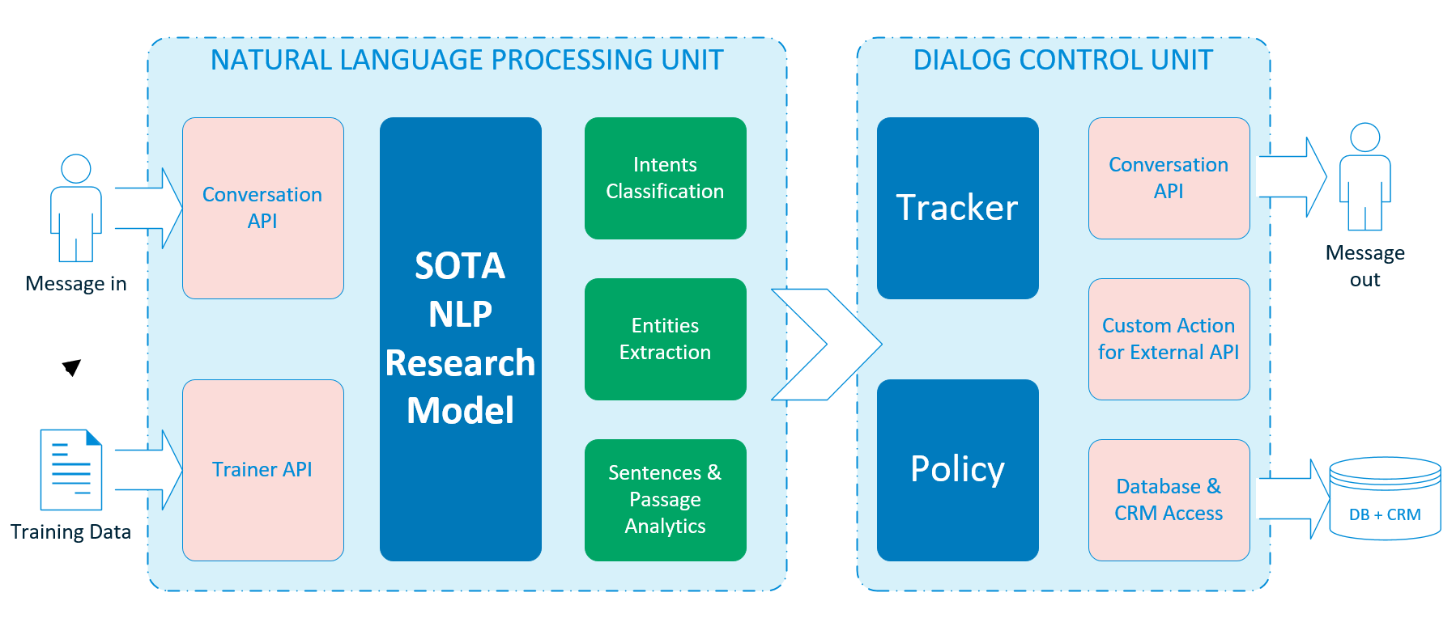
System Architecture

Slide 12
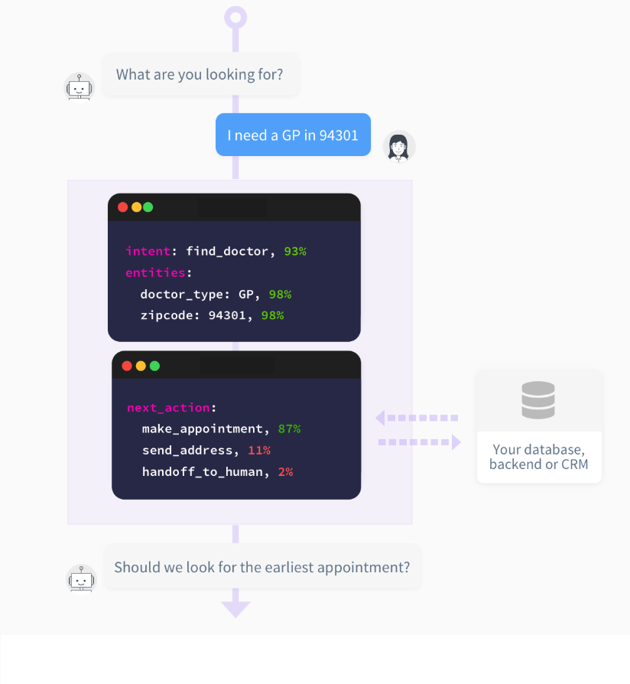
Workflow
NLP Unit
Dialog Unit

Slide 13
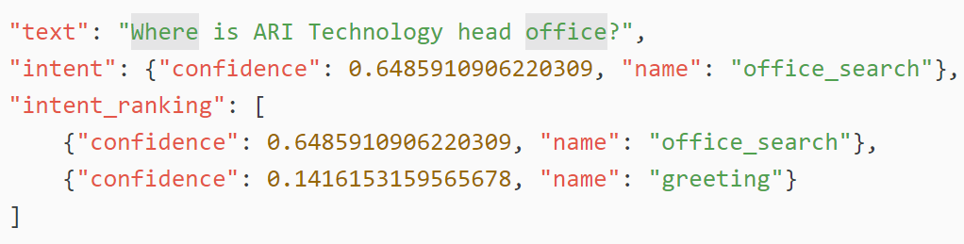
Recognize intents

Slide 14
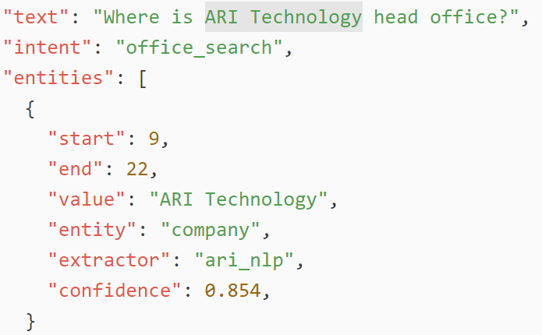
Extract entities

Slide 15
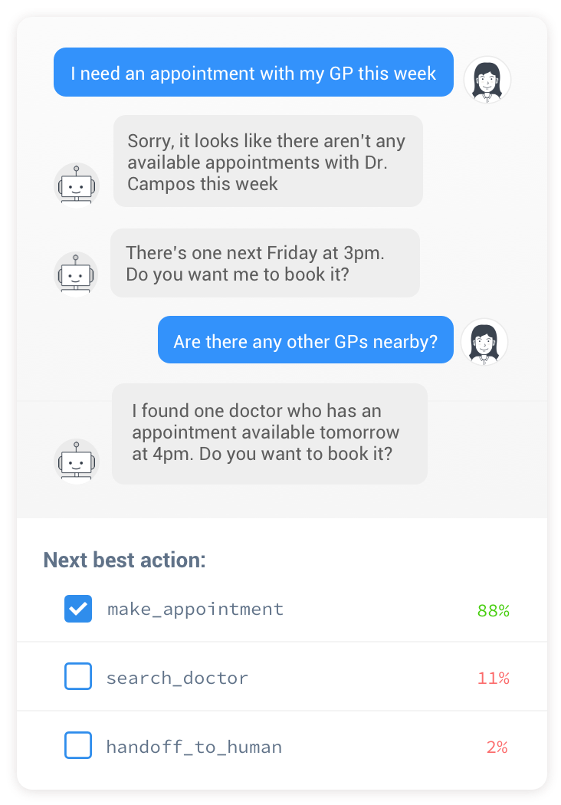
Manage Contextual Conversations
Forget if - else statement and hardcoded.
Smarter Dialog
Use Machine Learning technique for stories control

Slide 16
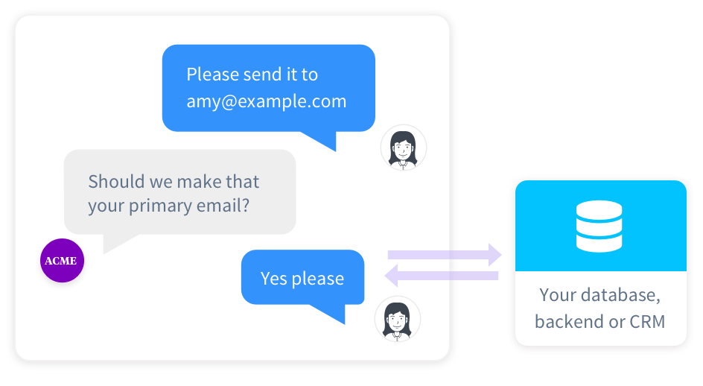
Take Action to API, CRM and Database

Slide 17
Nlp researchs & applications

