Slide 1

Creator: Hiệp Vũ
Phan Sơn

Slide 2
IPv6 – What is it and why?
IPv6 (Internet Protocol version 6): New IP addressing Structure
128-bit address represented as 32 hex digits
Address is composed of 8 groups of 4 hex digits
Provide 2²¹⁸ IP addresses
IPv6 is a “separate Internet” than the IPv4 Internet

Slide 3
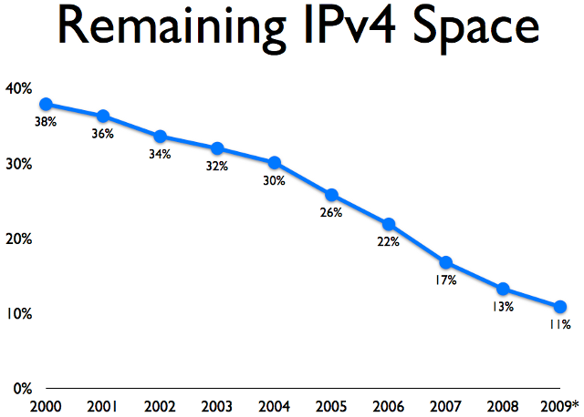
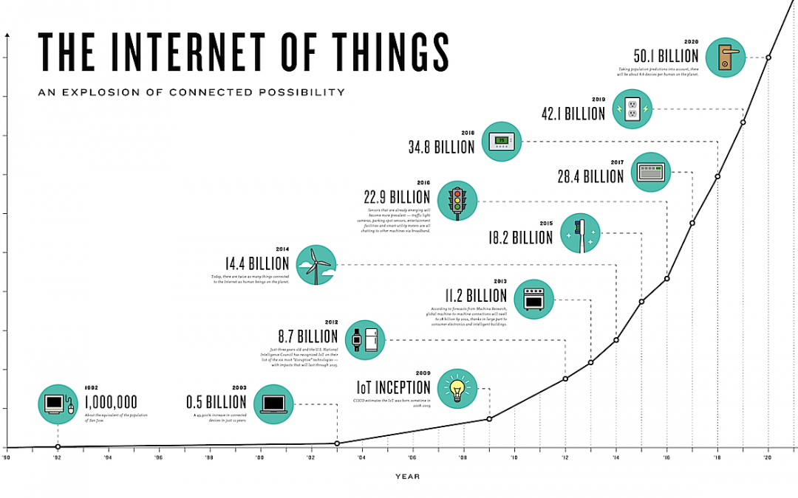
Why have to be IPv6?
The Internet need room to grow

Slide 4
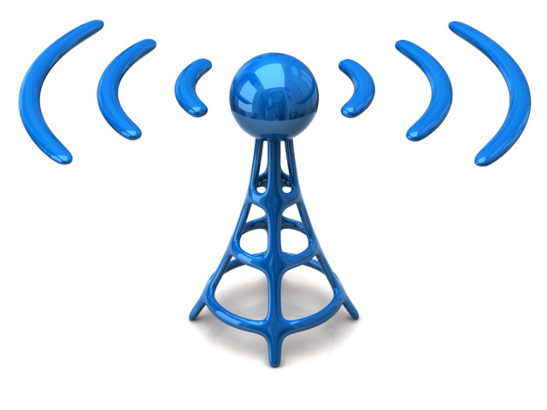
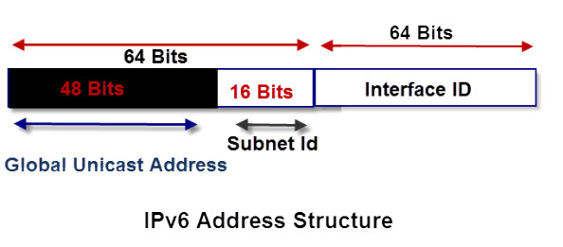
Benefits and improvements
Does not use Broadcast messages
Unicast Multicast Anycast
Simple and efficient addressingstructure
Integrated security and better support for Quality of Service

Slide 5
Address Abbreviation
Rules :
Drop leading zeros
A group of 4 zeros can be replaced with a single zero
Contiguous groups of zeros can be replaced with a
:: but that can only done once in an address
Loopback:
IPv6 loopback is ::1

Slide 6
Something we should know about IPv6
Ipv6 addresses are 128-bit length
The prefix for a link-local address is FE80
The first 64 bits represent the network and the last 64 bits represent the host
IPv6 host address subnet masks are always /64
An automatic host address can be assigned automatically or manually
To get on the internet a computer needs a link-local IPv6 address and a global IPv6 address
The world is still transitioning to IPv6 and will continue to run IPv4 and IPv6 side by side

