Slide 1
IMDb Lite
Honest reviews you can trust

Slide 2
Critics
Dislike/Like
Notes:
When it comes to movie reviews, you can’t alway trust a critic. It’s not that they’re bad at reviewing movies. They have a particular preference and standard for movies. This may not line up with what your own preference and standard.

Slide 3
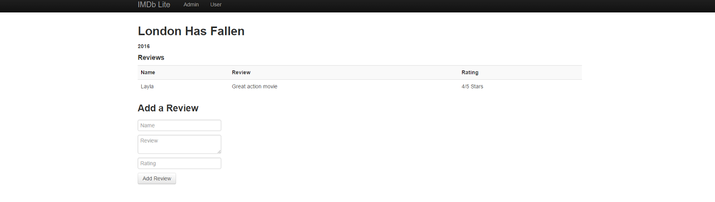
IMDb Lite
Notes:
IMDb Lite was built for the movie goers in mind. The reviews are all done by your peers. Read all the reviews, from multiple perspective. We’re building a community where movie lovers can go and share their experience with everyone.

Slide 4

Highlights
Notes:
IMDb Lite was built using a MEAN stack. It comprises of Mongo DB, Express, Angular, and Node. Bootstrap was use to style the site.

Slide 5
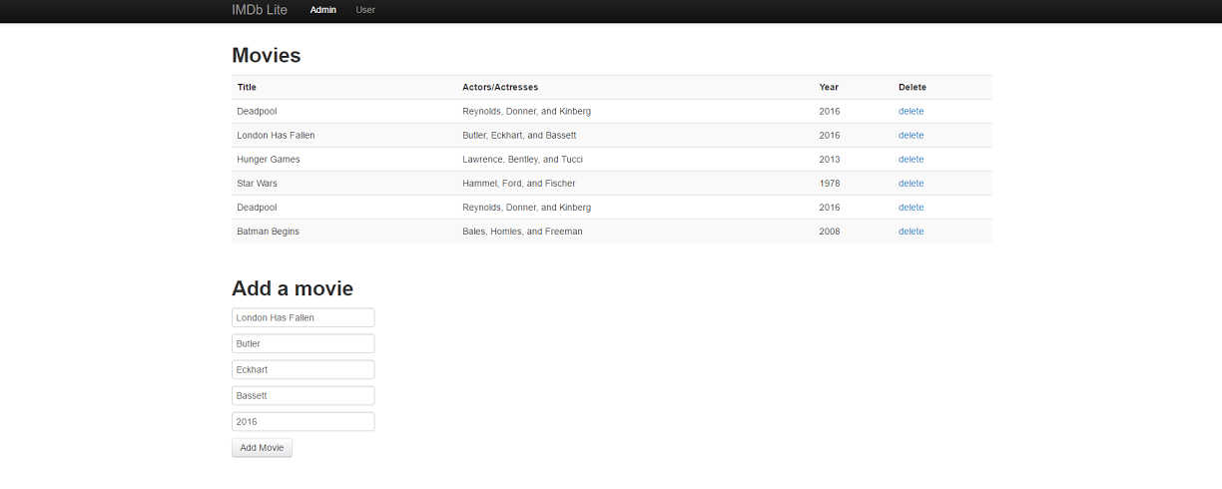
Highlight
Notes:
Here are some of the highlighted features. This is the admin page, where the movies are being manage. Here you can add/delete movies.

Slide 6
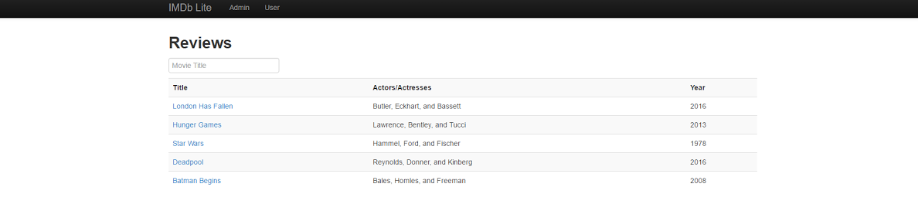
More Highlights
Notes:
The second feature is for the user. Here user can search for a movie and click on the link that will bring them to the review page. Here users can view and add reviews.

Slide 7
Challenges/Learning
Express API Definition Angular http Calls
Express get: Data VS View Render
Angular partials
Notes:
There were a few challenges I faced during this project. Overcoming these challenges allowed me to learn and gain more insight.
When I started working with Express and Angular, I was confused between Express API Definition and Angular http calls. They are similar in structure. Looking at them carefully and separating what each component is used for. I was able to understand them. Express is used in the backend for setting up the api and Angular is the front end that calls the api with the http command.
In Express, I use the get command to render an html view and to retrieve data. As of this point I’m using Angular to get the data and store it into a scope variable which can be bind to any html view.
Thinking back to the old days, partials can be thought of as a header/footer file that keeps a site looking consistent without having to rewrite those html code on every single page. With Angular partial, I was to dynamic change the body of the index page. I did this by putting a scope variable in the html and changing that variable to the view I want with Angular functions.

Slide 8
Questions
?

