Slide 2
File submissions
“cp destructors.cpp modifyDestructors.cpp”
Don’t submit .o files.
Make destructors virtual

Slide 3
Compilers

Slide 4
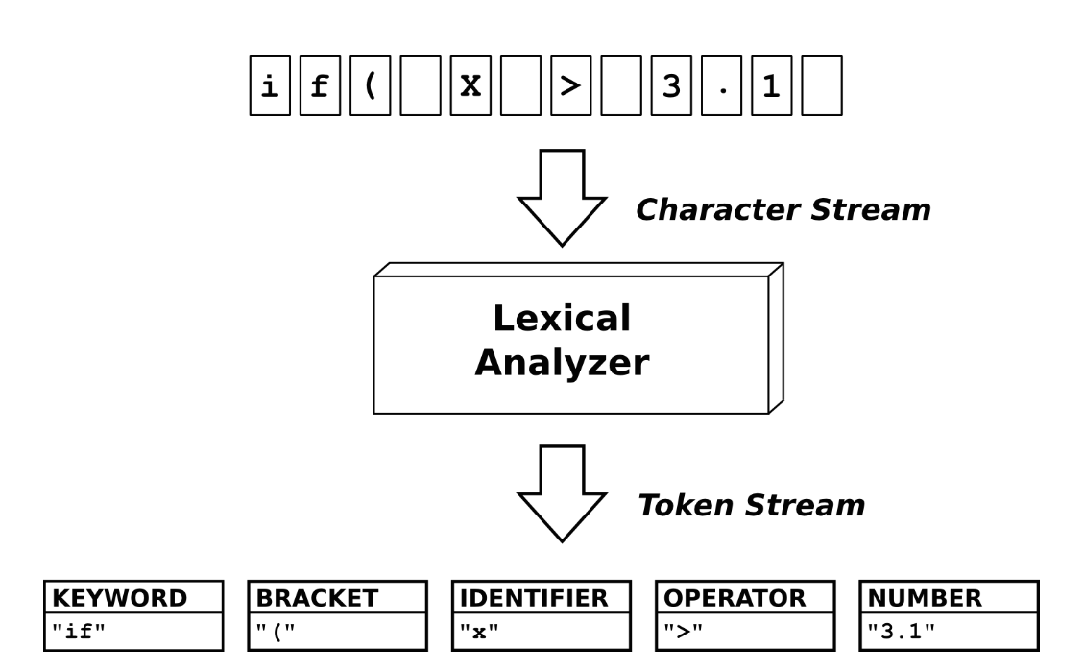
Scanner – Lexical Analyzer

Slide 5
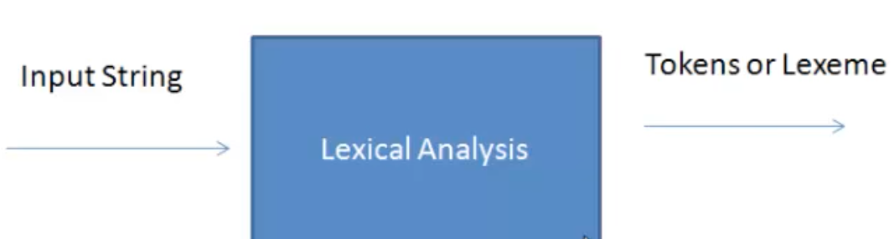
Scanner
Scanning = Pattern matching
E.g. identifier token, double literal
Patterns defined by using Regular Expressions
(will utilize a tool called JFlex)

Slide 6
JFlex Regular Expressions
Notation | Name | Meaning | Example | Match
[ …. ] | Character class | Any of a set | [a – zA – Z] | any letter
* | Kleene Closure | 0 or more occurrences | a* | 0 or more a’s
+ | Positive Closure | 1 or more occurrences | a+ | 1 or more a’s
? | Optional | 0 or 1 occurrences | a? | a or ε
| | Alternative |  | a | b | a or b
( … ) | Grouping |  | a (b | c) | a followed by b or c

Slide 7
Regular Definition
A named regular expression is a regular definition
Example:
letter = [a – zA – Z]
digit = [0 – 9]
id = { letter } ( { letter } | { digit } | _ ) *
num = ( + | - )? { digit }+ . { digit }+
Regular Language vs. Context Free Language

Slide 8
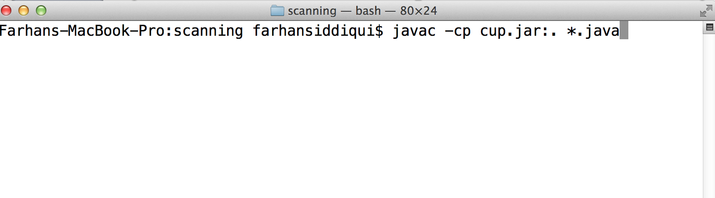
JFlex and CUP
cup.jar contains JFlex and CUP programs
Set classpath

Slide 9
JFlex Scanner
Goal: Construct a JFlex Scanner
Calculator Language:
<exprList> → <exprList> <expr> ; | ε
<expr> → num | <expr> addop <expr> |
<expr> mulop <expr> | (<expr>)
Example strings:
55.7+23 (2*5.1)-3.1

Slide 10
JFlex Scanner
Token | Numeric Code
eof | 0
addop | 1
( | 2
mulop | 3
num | 4
) | 5
; | 6

Slide 11
JFlex Scanner
Token | Numeric Code
eof | 0
addop | 1
( | 2
mulop | 3
num | 4
) | 5
; | 6
Input: String from the Calculator Language
Output: List of Token – Value pairs
Input: 5+4.8;
token 4, value 5
token 1, value +
token 4, value 4.8
token 6

Slide 12
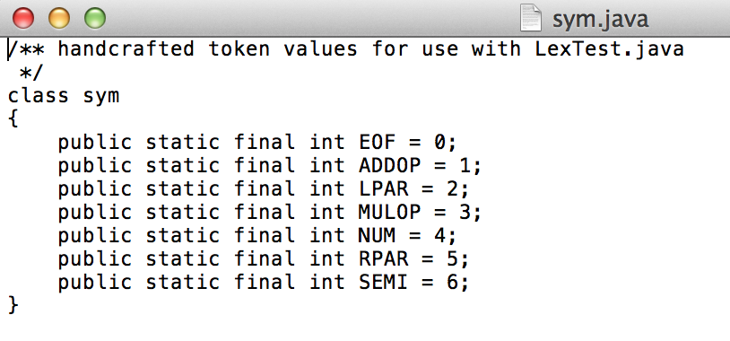
JFlex Scanner
Token | Numeric Code
eof | 0
addop | 1
( | 2
mulop | 3
num | 4
) | 5
; | 6
Specifying Numeric Codes
sym.java

Slide 13
JFlex Scanner
Write a JFlex specification to describe Lexemes
DIGIT = [0 – 9]
NUM = { DIGIT }+( “.” { DIGIT }+)?
.lex extension for file containing the specification
example.lex (shown next)

Slide 14
JFlex Specification Files
usercode
%%
Jflex Directives
%%
regular expressions rules and actions

Slide 15
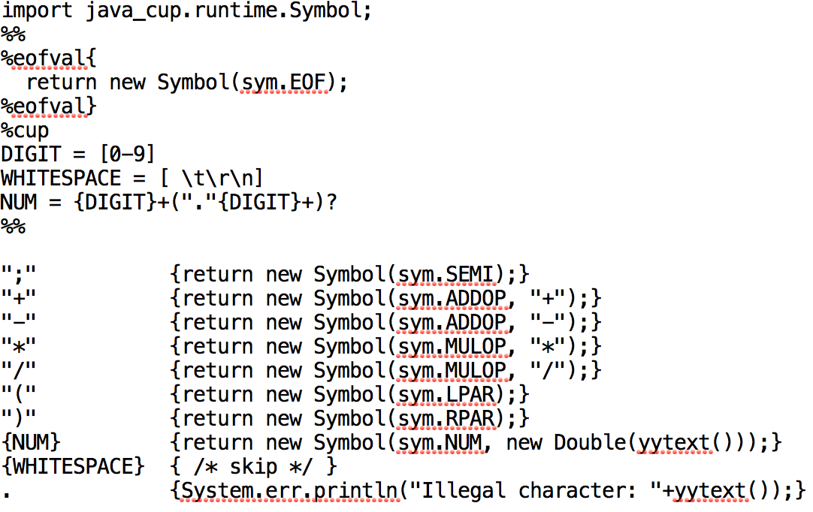
JFlex Specification

Slide 16
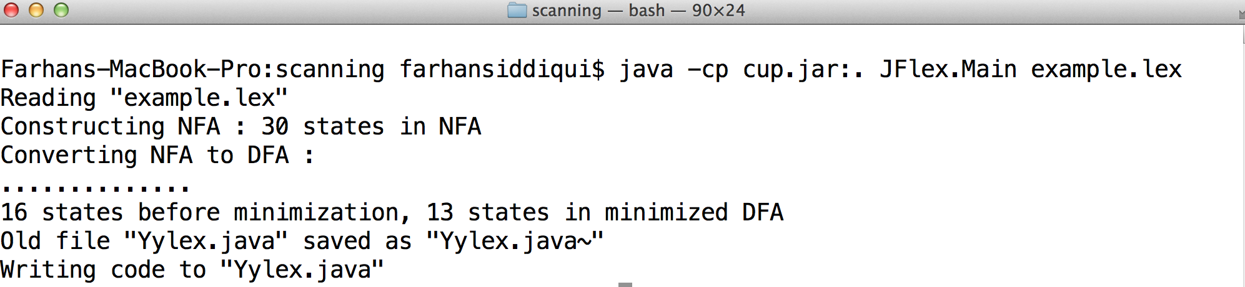
JFlex Scanner
Generate Yylex.java – the Scanner class
use example.lex as input

Slide 17
Yylex.java – the scanner class

Slide 18
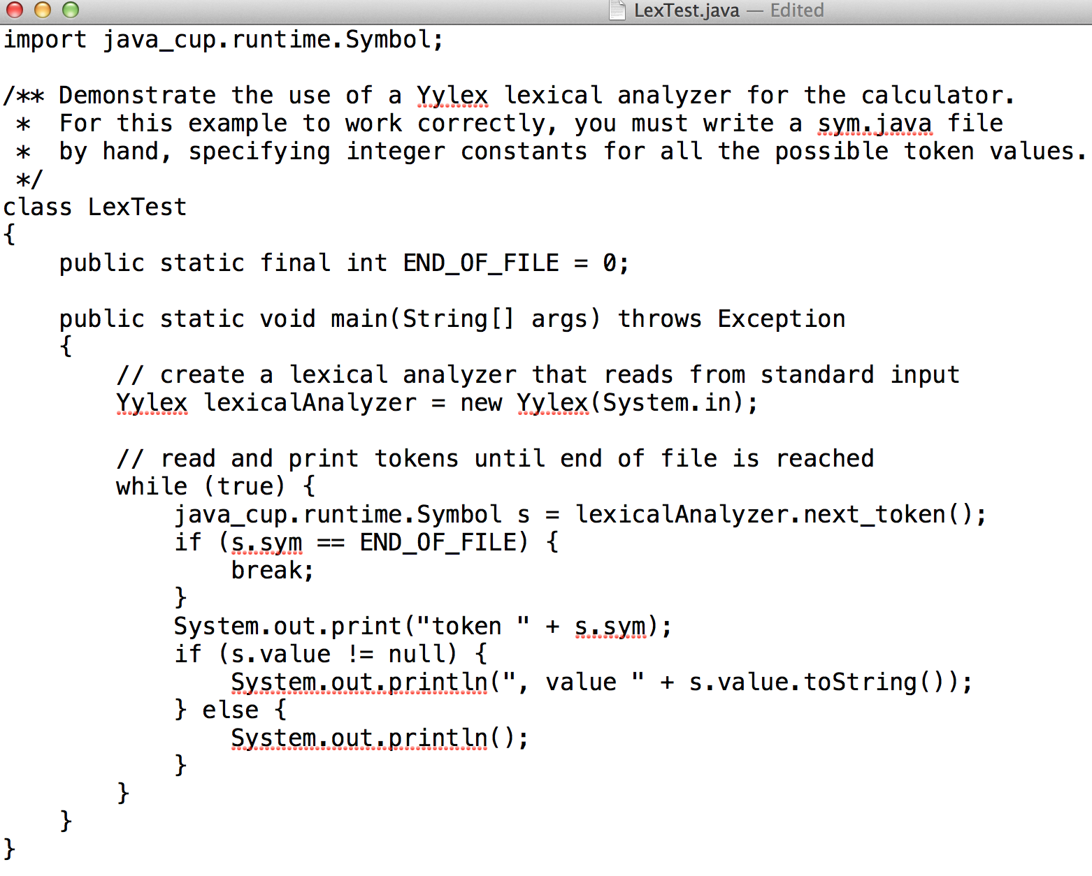
Scanner Program: LexTest.java

Slide 19
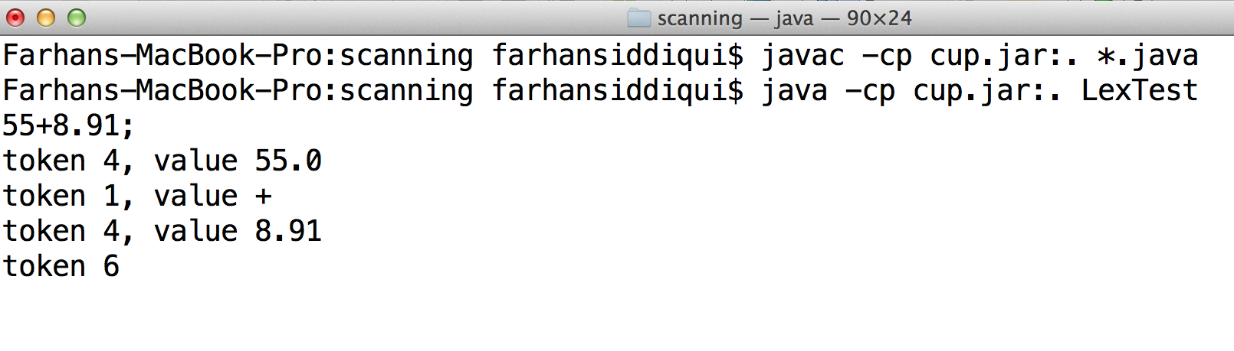
JFlex Scanner
Token | Numeric Code
eof | 0
addop | 1
( | 2
mulop | 3
num | 4
) | 5
; | 6

