Slide 1
Program Variables
A variable is an abstraction of a memory cell or a collection of cells
Reserved Word
  cannot be a user-defined name
E.g. reserved words in C: if, else, for
Keyword
Copyright © 2015 Pearson. All rights reserved.
1-<number>

Slide 2
Variables
Variables can be characterized by attributes:
  Name
  Address
  Type
  Value
  Lifetime
  Scope
Copyright © 2015 Pearson. All rights reserved.
1-<number>

Slide 3
Variables Attributes (continued)
Type - determines the range of values of variables and the set of operations that are defined for values of that type;
Value - the contents of the location with which the variable is associated
- The l-value of a variable is its address
- The r-value of a variable is its value
Copyright © 2015 Pearson. All rights reserved.
1-<number>

Slide 4
Variables Attributes (continued)
Lifetime
  The time during which a variable is bound (associated) with a certain address
Scope
  The region of the program from which the variable is visible (can be accessed)
Copyright © 2015 Pearson. All rights reserved.
1-<number>

Slide 5
The Concept of Binding
A binding is an association between an entity and an attribute, such as between a variable and its type or value, or between an operation and a symbol
Binding time
  is the time at which a binding takes place
Copyright © 2015 Pearson. All rights reserved.
1-<number>

Slide 6
Possible Binding Times
Language design time
  bind operator symbols to operations
Compile time
  bind a variable to a type in C or Java
Load time
  bind a C or C++ static variable to a memory cell
Runtime
  bind a non-static local variable to a memory cell
Copyright © 2015 Pearson. All rights reserved.
1-<number>

Slide 7
Binding - example
int x;
x=1;
x = x + 10
Type of x is bound to x at compile time
+ is bound with addition at compile time
Value of x is bound to x at execution time
Copyright © 2015 Pearson. All rights reserved.
1-<number>

Slide 8
Static and Dynamic Binding
static
  A binding is static if it first occurs before run time and remains unchanged throughout program execution.
dynamic
  A binding is dynamic if it first occurs during execution or can change during execution of the program
Copyright © 2015 Pearson. All rights reserved.
1-<number>

Slide 9
Explicit/Implicit Type Declaration
An explicit declaration is a program statement used for declaring the types of variables
Binding of values to constants in C
Copyright © 2015 Pearson. All rights reserved.
1-<number>
Notes:
In Perl, variable names beginning with $ store values, beginning with @ specifies an array

Slide 10
Explicit/Implicit Type Declaration
An implicit declaration is a default mechanism for specifying types of variables through default conventions, rather than declaration statements
Basic, Perl, Ruby, JavaScript, and PHP provide implicit declarations
Copyright © 2015 Pearson. All rights reserved.
1-<number>

Slide 11
Explicit/Implicit Declaration (continued)
Some languages use type inferencing to determine types of variables (context)
  C# - a variable can be declared with var and an initial value. The initial value sets the type
  var sum = 0;
  var total=0.0;
  var name = “Fred”;
  Advantage: writability (a minor convenience)
  Disadvantage: detrimental to reliability
1-<number>

Slide 12
Variable Attributes (continued)
Storage Bindings & Lifetime
  Allocation - getting a cell from some pool of available cells
  De-allocation - putting a cell back into the pool
The lifetime of a variable is the time during which it is bound to a particular memory cell
Copyright © 2015 Pearson. All rights reserved.
1-<number>

Slide 13
Categories of Variables by Lifetimes
Static--bound to memory cells before execution begins and remains bound to the same memory cell throughout execution
e.g., C and C++ static variables in functions
Copyright © 2015 Pearson. All rights reserved.
1-<number>

Slide 14
Categories of Variables by Lifetimes
Stack-dynamic
  Storage bindings are created for variables when their declaration statements are elaborated.
(A declaration is elaborated when the executable code associated with it is executed)
  e.g. local variables in C subprograms
Copyright © 2015 Pearson. All rights reserved.
1-<number>

Slide 15
Categories of Variables by Lifetimes
Explicit heap-dynamic -- Allocated and de-allocated by explicit directives, specified by the programmer, which take effect during execution
Referenced only through pointers or references, e.g. dynamic objects in C++ (via new and delete)
Copyright © 2015 Pearson. All rights reserved.
1-<number>

Slide 16
Categories of Variables by Lifetimes
Implicit heap-dynamic--Allocation and de-allocation caused by assignment statements
  all strings and arrays in Perl, JavaScript, and PHP
  lowScores = [1, 2, 3, 4, 5]
Copyright © 2015 Pearson. All rights reserved.
1-<number>

Slide 17
Type Checking
Type Checking- Checking that the types of operands are compatible with the types expected by the operators
Operators
  arithmetic, relational, boolean, assignment, other functions (user-defined or built-in)
When are two types compatible?
  Operand types match exactly to what the operator expects
  one type can be coerced to the other
  Examples?
Copyright © 2015 Pearson. All rights reserved.
1-<number>

Slide 18
Type Checking
Type Error
  Application of an operator to an operand of incompatible type
Strongly Typed Language
  Type errors are always detected (statically or dynamically)
  Type of each name can always be determined at compile time and cannot change at runtime
Copyright © 2015 Pearson. All rights reserved.
1-<number>

Slide 19
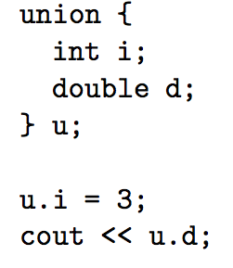
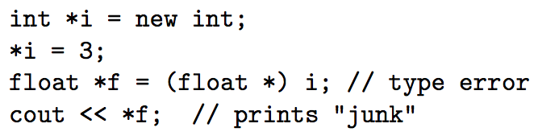
Type Checking
C, C++?
1-<number>

Slide 20
Type Checking
Type compatibility rules impact the reliability of programs
C++: Flexible type compatibility rules, does many coercions
  Integer division instead of floating point division not detected
  int sum = 45.0/6.0;
    (no type error in C/C++)
  int sum = 45.0/6.0;
    (Type error in Java)
1-<number>

Slide 21
Type Checking
Java?
  No implicit ways that type errors could go undetected
  Some Explicit casts allowed
Ada: No coercions
  explicit type casts needed (e.g. to add int to float)
Copyright © 2015 Pearson. All rights reserved.
1-<number>

Slide 22
Type Checking
Which assignments are allowed by the Type system? (Compatible Types)
int x; float y;
Is x = y allowed?
  Issues?
int y; float x;
Copyright © 2015 Pearson. All rights reserved.
1-<number>

Slide 23
Type Inference
The interpreter/ compiler infers the Type of an expression
int x, float y;
  x + y ?
    Float in C
    Error in some other languages
String x, int y;
  x * y ?
    Error in most languages
    String in Python
Copyright © 2015 Pearson. All rights reserved.
1-<number>

Slide 24
Type Compatibility Rules
Name Type Compatibility
Structural Type Compatibility
Copyright © 2015 Pearson. All rights reserved.
1-<number>

Slide 25
Type Declaration
Basic Types
  Included in the Programming Language
Type Constructor
  Allows programmers to define new types (an operator that builds new types)
Copyright © 2015 Pearson. All rights reserved.
1-<number>

Slide 26
Type Constructor
Declare New Types
  typedef int points[10];
  points students;
  typedef struct {
    int s_id;
    float s_score;
    } student;
Copyright © 2015 Pearson. All rights reserved.
1-<number>

Slide 27
Type Compatibility
typedef int mile;
typedef int km;
mile x;
km y;
x = y ?
Copyright © 2015 Pearson. All rights reserved.
1-<number>

Slide 28
Name Type Compatibility
Types must have the exact same type name to be considered compatible
typedef int mile;
typedef int km;
mile x;
km y;
x == y ?
/* Error!*/
1-<number>

Slide 29
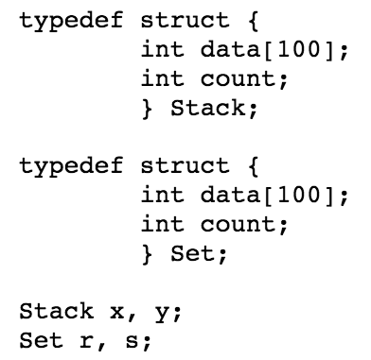
Name Type Compatibility
1-<number>

Slide 30
Name Type Compatibility
int x[10];
int y[10];
Is x == y under Name Compatibility? NO
int *i1;
int *i2;
i1 == i2 under Name Compatibility? NO
Copyright © 2015 Pearson. All rights reserved.
1-<number>

Slide 31
Name Type Compatibility
typedef int points[10];
points a;
points b;
a == b?
/* Permitted – Why? */
/* Both a, b have the same Type name */_x000f_
Copyright © 2015 Pearson. All rights reserved.
1-<number>

Slide 32
Structural Type Compatibility
Two types are compatible if they have the same structure
Copyright © 2015 Pearson. All rights reserved.
1-<number>

Slide 33
Structural Type Compatibility
Equivalent built-in Types (int = int, float=float, etc)
Pointers to Structurally Compatible Types
typedef int mile;
typedef int km;
mile x;
km y;
x = y ?
Copyright © 2015 Pearson. All rights reserved.
1-<number>

Slide 34
Structural Type Compatibility
int *x
float *y
Is x == y?
/* Not structurally compatible
        Internal types are not compatible */
Copyright © 2015 Pearson. All rights reserved.
1-<number>

Slide 35
Structural Type Compatibility
Structural compatibility in structs
struct1 {a₁: Ta₁, a₂: Ta₂, .., a_{n}: Ta_{n}}
struct1 {b₁: Tb₁, b₂: Tb₂, .., b_{n}: Tb_{n}}
struct1 and struct2 are structurally compatible iff
  all Ta_{i} structurally compatible with Tb_{i}
Copyright © 2015 Pearson. All rights reserved.
1-<number>

Slide 36
Structural Type Compatibility
struct A {x:int, y: float}
struct B {y:int, x: float}
A foo; B faa;
foo == faa ?
  YES
struct A {x:float, y: int}
struct B {y:int, x: float}
A foo; B faa;
foo == faa ?
      NO
1-<number>

Slide 37
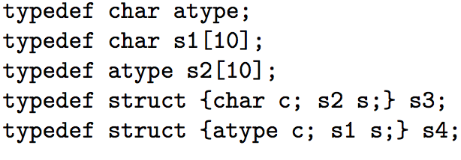
Structural Type Compatibility
s1 and s2?
s3 and s4?
Name Type Compatible?
1-<number>

Slide 38
Structural Type Compatibility
When are Arrays Structurally compatible?
  Equal dimensions
  Array Types should be structurally equivalent
When are Functions Structurally compatible?
  F₁: return Type T₁, Formal Parameters: t₁, .., t_{n}
  F₂: return Type T₂, Formal Parameters: p₁, ..p_{m}
  Return types should be structurally compatible
  Formal parameters should be structurally compatible
Copyright © 2015 Pearson. All rights reserved.
1-<number>

Slide 39
Type Compatibility
C, C++: structural equivalence except for structs
Java: structural equivalence for scalars, name equivalence for arrays
Copyright © 2015 Pearson. All rights reserved.
1-<number>

Slide 40
Scope
Scope
Scope and Lifetime
Referencing Environments
Named Constants
Copyright © 2015 Pearson. All rights reserved.
1-<number>

Slide 41
Variable Attributes: Scope
The scope rules of a language determine how references to names are associated with variables
The scope of a variable is the range of statements over which it is visible
The local variables of a program unit are those that are declared in that unit
The nonlocal variables of a program unit are those that are visible in the unit but not declared there
Global variables are a special category of nonlocal variables
Copyright © 2015 Pearson. All rights reserved.
1-<number>

Slide 42
Static Scope
Based on program text
To connect a name reference to a variable, you (or the compiler) must find the declaration
Search process: search declarations, first locally, then in increasingly larger enclosing scopes, until one is found for the given name
Enclosing static scopes (to a specific scope) are called its static ancestors; the nearest static ancestor is called a static parent
Some languages allow nested subprogram definitions, which create nested static scopes (e.g., Ada, JavaScript, Common Lisp, Scheme, Fortran 2003+, F#, and Python)
Copyright © 2015 Pearson. All rights reserved.
1-<number>

Slide 43
Scope (continued)
Variables can be hidden from a unit by having a "closer" variable with the same name
function big() {
function sub1(){
var x = 7;
sub2();
}
function sub2() {
var y = x;
}
var x = 3;
}
Copyright © 2015 Pearson. All rights reserved.
1-<number>

Slide 44
Blocks
  A method of creating static scopes inside program units-
  C compound statement:
if (list[i] < list[j]) {
int temp;
temp=list[i];
list[i]=list[j];
list[j]=temp;
}
Copyright © 2015 Pearson. All rights reserved.
1-<number>

Slide 45
Blocks
  Example in C:
void sub() {
int count;
while (...) {
int count;
count++;
...
}
…
}
- Note: legal in C and C++, but not in Java and C# - too error-prone
- Scope operator (::) used to access hidden global variables in the inner scope
Copyright © 2015 Pearson. All rights reserved.
1-<number>

Slide 46
Declaration Order
C99, C++, Java, and C# allow variable declarations to appear anywhere a statement can appear
  In C99, C++, and Java, the scope of all local variables is from the declaration to the end of the block
  In C#, the scope of any variable declared in a block is the whole block, regardless of the position of the declaration in the block
    However, a variable still must be declared before it can be used
Copyright © 2015 Pearson. All rights reserved.
1-<number>

Slide 47
Declaration Order
C#
  { int x;
  ….
  { int x;
  Illegal
  ….
  }
  ….
  }
Copyright © 2015 Pearson. All rights reserved.
1-<number>

Slide 48
Declaration Order
C#
  { ….
  { int x;
  Illegal
  ….
  }
  int x;
  ….
  }
Copyright © 2015 Pearson. All rights reserved.
1-<number>

Slide 49
Declaration Order
JavaScript local variables
  can be declared anywhere in a function
  scope is entire function
  If used before declaration, value of variable is “undefined”
  Reference is legal
Copyright © 2015 Pearson. All rights reserved.
1-<number>

Slide 50
Declaration Order
In C++, Java, and C#, variables can be declared in for statements
  void fun() {
  . . .
  for (int count = 0; count < 10; count++) {
  . . .
  }
  . . .
  }
  The scope of such variables is restricted to the for construct
Copyright © 2015 Pearson. All rights reserved.
1-<number>

Slide 51
Global Scope
C, C++, PHP, and Python support a program structure that consists of a sequence of function definitions in a file
  These languages allow variable declarations to appear outside function definitions
Copyright © 2015 Pearson. All rights reserved.
1-<number>

Slide 52
Evaluation of Static Scoping
Works well in many situations
Used by most modern programming languages
Efficient and easy to understand
Copyright © 2015 Pearson. All rights reserved.
1-<number>

Slide 53
Dynamic Scope
Based on calling sequences of program units, not their textual layout
References to variables are connected to declarations by searching back through the chain of subprogram calls that forced execution to this point
Copyright © 2015 Pearson. All rights reserved.
1-<number>

Slide 54
Dynamic Scope Example
function big() {
function sub1() {
var x = 7;
}
function sub2() {
var y = x;
var z = 3;
}
var x = 3;
}
  Static scoping looks for static parent
    Reference to x in sub2 is to big's x
  Dynamic scoping looks for the dynamic parent
    Reference to x in sub2 is to sub1's x
big calls sub1
sub1 calls sub2
sub2 uses x
Copyright © 2015 Pearson. All rights reserved.
1-<number>

Slide 55
Scope and Lifetime
Scope and lifetime are sometimes closely related, but are different concepts
public void calculate() {
int side = 5;
int area;
area = side * side;
}
Copyright © 2015 Pearson. All rights reserved.
1-<number>

Slide 56
Scope and Lifetime
Consider a static variable in a C or C++ function
Copyright © 2015 Pearson. All rights reserved.
1-<number>

Slide 57
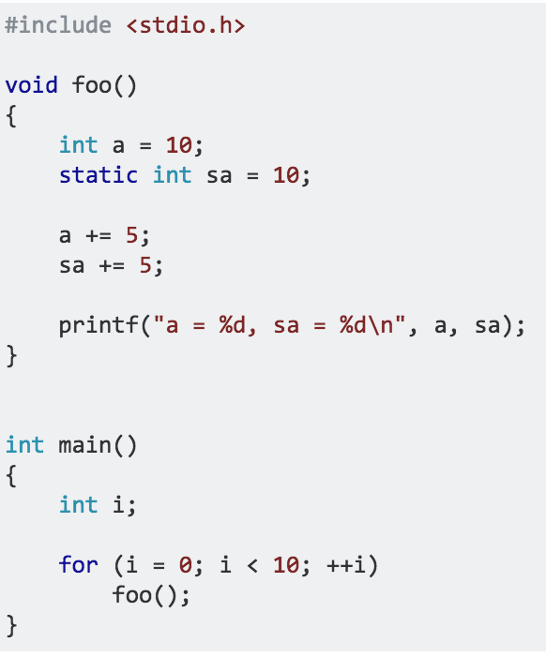
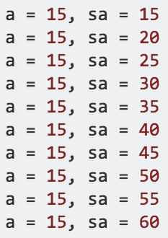
1-<number>

Slide 58
Scope and Lifetime
Sub-program calls
void printheader () {
. . .
} /* end of printheader */
void compute () {
int sum;
. . .
printheader ();
} /* end of compute */
Copyright © 2015 Pearson. All rights reserved.
1-<number>

Slide 59
Referencing Environments
The referencing environment of a statement is the collection of all names that are visible in the statement
In a static-scoped language, it is the local variables plus all of the visible variables in all of the enclosing scopes
In a dynamic-scoped language, the referencing environment is the local variables plus all visible variables in all active subprograms
A subprogram is active if its execution has begun but has not yet terminated
Copyright © 2015 Pearson. All rights reserved.
1-<number>

Slide 60
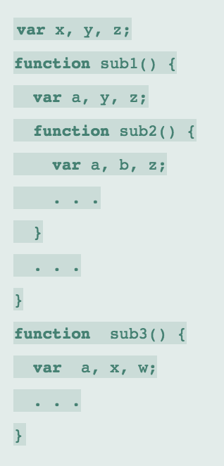
Referencing Environments
Identify variables
and where they are declared
under static scope
Copyright © 2015 Pearson. All rights reserved.
1-<number>

Slide 61
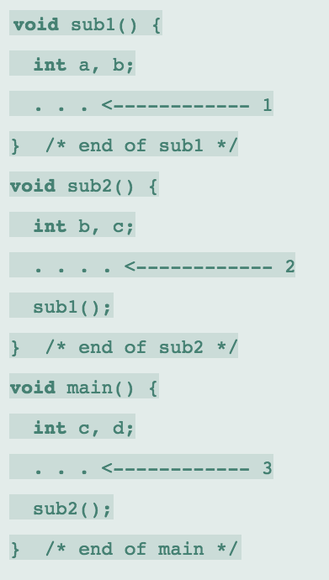
Referencing Environments
Identify referencing environments
under dynamic scope
Assume main() calls sub2() which calls sub1()
1-<number>
Copyright © 2015 Pearson. All rights reserved.

Slide 62
Summary
Variables are characterized by the attributes: name, address, value, type, lifetime, scope
Binding is the association of attributes with program entities
variables are categorized as: static, stack dynamic, explicit heap dynamic, implicit heap dynamic
Strong typing means detecting all type errors
Copyright © 2015 Pearson. All rights reserved.
1-<number>

