Slide 1
Logic Programming with Prolog

Slide 2
Syntax
Basic unit – term
Simple term - (number, variable, atom)
atom- begins with a lower case letter
Compound term – atom (term1, term2…).
isMember(1, [1, 2]).
isMember is an atom called functor
parenthesized terms are called arguments

Slide 3
First Order Logic
Propositional Logic (PL) :
A and B
(A or B) and C
FOL / Predicate Logic / Predicate Calculus :
Extends PL to include
objects : progLang, seniorSemi, joanne
relations : student (joanne) takingCourse(joanne,compNetworks)
quantifiers - there exists, for all
variables – X, A, Y

Slide 4
Prolog Conventions
objects and relations – begin with lower case
Variables – begin with upper case
Unary relation – p(q) : q is p
white(board).
Binary relation – p(q,r) : q is p w.r.t r
warmer(inside, outside).

Slide 5
Prolog Conventions
Knowledge base- set of FOL statements
Given a query, the Prolog interpreter consults the KB and tells us if it can prove the query true.

Slide 6
Rules
General Form –
P :- Q1,Q2,…Qn (Prolog)
Q1 ∧ Q2 ∧ Q3 ….. Qn ➔ P (FOL)
Horn Clause
P ⬅ Q1 ∧ Q2 ∧ Q3 ….. Qn

Slide 7
Horn Clauses
Prolog Program = list of Horn clauses
⬅ :-
∧ ,
All variables in a rule are universally quantified (for all)
likes(john, X) :- likes(mary,X).
All variables in a query are existentially quantified (there exists)
likes(john, X).

Slide 8
Example
instructor (joe).
taking (X,seniorSemin) :- senior (X) , csMajor(X).
FOL-
instructor (joe)
For all X:
senior (X) ∧ csMajor(X) ➔taking (X,seniorSemin)

Slide 9

Rules
Rules with the same L.H.S:
P :- Q1,Q2,…Qn
P :- K1,K2,…Km
Same as :
(Q1 ∧ Q2 ∧ Q3 ….. Qn ➔ P ) ∨
(K1 ∧ K2 ∧ K3 ….. Km ➔ P )
E.g.-
Goals vs. sub-goals

Slide 10
Unification
Rule LHS :- RHS
LHS : Goal
RHS : Sub-goals
taking (maurice,comp131).
taking (carly, proglang).
Query: taking (X,proglang),taking(carly,Y).
X = carly,
Y = proglang.

Slide 11
Rules
Variables in a goal are universally quantified
Variables appearing only in sub-goals are existentially quantified
suffix(A,B) :- append(X,A,B).
For all, A,B, there exists X: append(X,A,B) => suffix(A,B)
grandparent(X,Y) :- parent(X,Z),parent(Z,Y).
For all X,Y, there exists Z: parent(X,Z) and parent(Z,Y) => grandparent(X,Y)

Slide 12
Procedural Interpretation
A Prolog interpreter:
considers goals in a query from left to right
considers rules in the order they are listed in the program
considers sub-goals from left to right

Slide 13
Unification
When a rule is applied, the current sub-goal is unified against the rule’s goal. As a result, substitution takes place:
E.g. member(3,[1, 2, 3]) unifies with member(X, [Y | Z]) and the resulting substitution is:
X→3 Y→1 Z→[2,3]

Slide 14
Unification
Matching of two terms in Prolog
studies(charlie, comp135).
studies(olivia, comp135).
?- studies(charlie, comp135).
unifies with the following fact because terms match
studies(charlie, comp135).
?- studies(charlie, X).
first unification takes place - terms are matched then variable X gets instantiated to comp135.

Slide 15
Lists
myList([a,b,c,d]).
myList([joe,jacky,jammy,justin]).

Slide 16
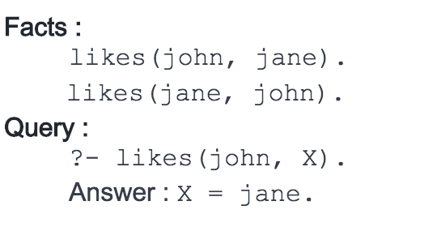
Unification and Instantiation
Notes:
Here upon asking the query first prolog starts to search matching terms in 'Facts' in top-down manner for 'likes' predicate with two arguments and it can match likes(john, ...) i.e. Unification. Then it looks for the value of X asked in query and it returns answer X = jane i.e. Instantiation - X is instantiated to 'jane'

Slide 17
Backtracking
Prolog repeatedly tries to find a match and satisfy the goals by looking to the knowledge base in top-down manner.
When goals are given as conjunction, Prolog finds the match and satisfy sub-goals in conjunction, in left-to-right manner.
query ?- likes(john, mary), likes(mary, john).
prolog will first match and satisfy the left most sub-goal i.e. likes(john, mary)
and then the second goal.

Slide 18
Not Proven (\+)
Negates the meaning of the argument
\+ (student (carly) ) returns true if Prolog cannot prove that carly is a student
not( )

Slide 19
Numerical Comparison Predicates
Built-in Predicates for numerical comparison-
< less than
> greater than
= equal to
\= not equal
=< less than or equal to
=> greater than or equal to
sameage(X,Y) :- X=Y.

Slide 20
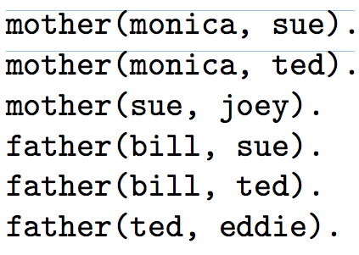
Examples
Goal vs Sub-Goals ?
Rule for ancestor(X,Y) ?
Notes:
ancestor(X,Y):-parent(X,Y).
ancestor(X,Y):-parent(Z,Y),ancestor(X,Z).

Slide 21
Relations for Data Structures
Build, and Query a sorted Binary Tree
node (L, D, R)
L: Left sub-tree
R: Right sub-tree
D: Data value
a tree could also be “empty”

