Slide 1
Parsing

Slide 2
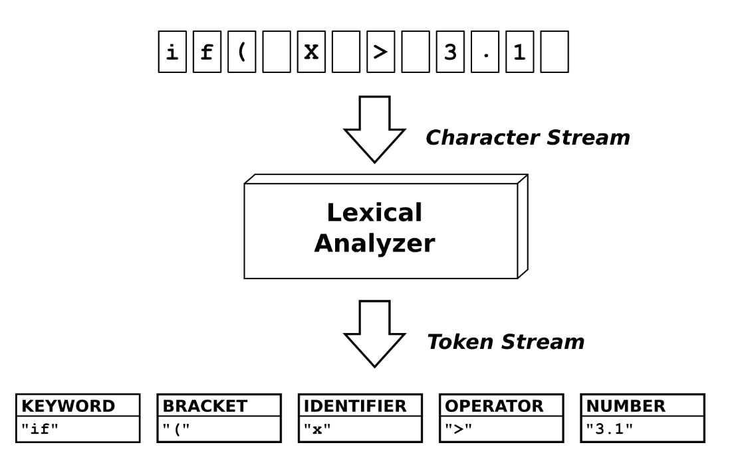
Phases in a Compiler

Slide 3
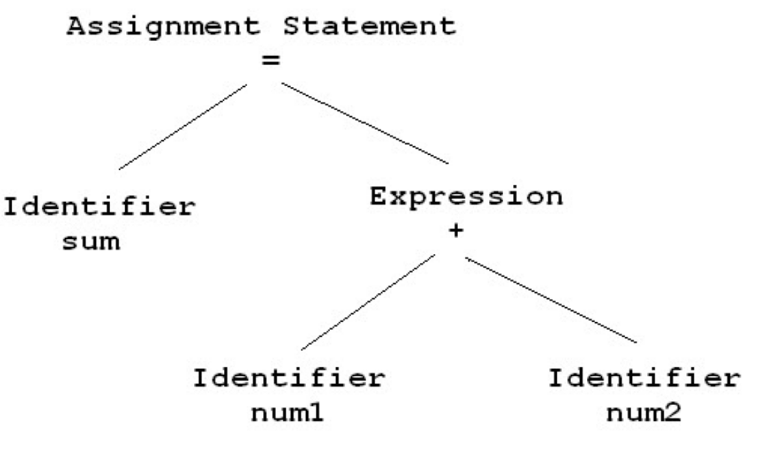
Syntax Analyzer (Parser)

Slide 4
Scanning
Input: 5 + 4.8 ;
token 4, value 5
token 1, value +
token 4, value 4.8
token 6

Slide 5
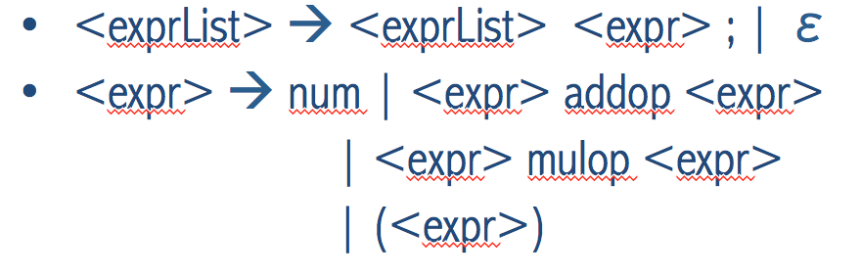
Implementing a Parser
Parser for an Attribute Grammar
One synthesized attribute called “calcVal”
Parser computes “calcVal” for every node in the parse tree (Leaves to Root)
calcVal = actual numeric result
“ 5 + 4.8 ; ” calcVal = 9.8
“ 2 * ( 5 + 4 ) ; ” computed in two steps
(5 + 4) = 9
2 * 9 = 18

Slide 6
Parser for Computing calcVal
CUP – Construction of Useful Parsers
Ambiguous grammars with “disambiguating rules” permitted
Generates a Java-based parser using an Attribute Grammar specification
Works well with synthesized attributes
When a rule is used in a reduction, the attribute of LHS is computed using attributes of RHS

Slide 7
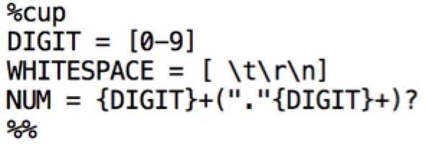
Parser for Computing calcVal
JFlex Scanner can be made to interface with a CUP parser

Slide 8
CUP
CUP specification placed in a file with a .cup extension
Generate the Parser code
java –cp cup.jar:. java_cup.Main example.cup
Following files are generated:
parser.java (contains parser code)
sym.java (contains token definitions as integer constants – must match tokens used in the scanner)

Slide 9
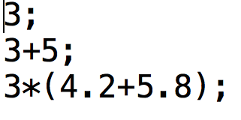
Compile and Run the Parser
Yylex.java should exist
Compile the parser
javac –cp cup.jar:. parser.java
Run the parser
java –cp cup.jar:. parser < input.txt

Slide 10
CUP specification
File format
imports
directives
declarations of tokens and non-terminals
grammar rules and actions

Slide 11
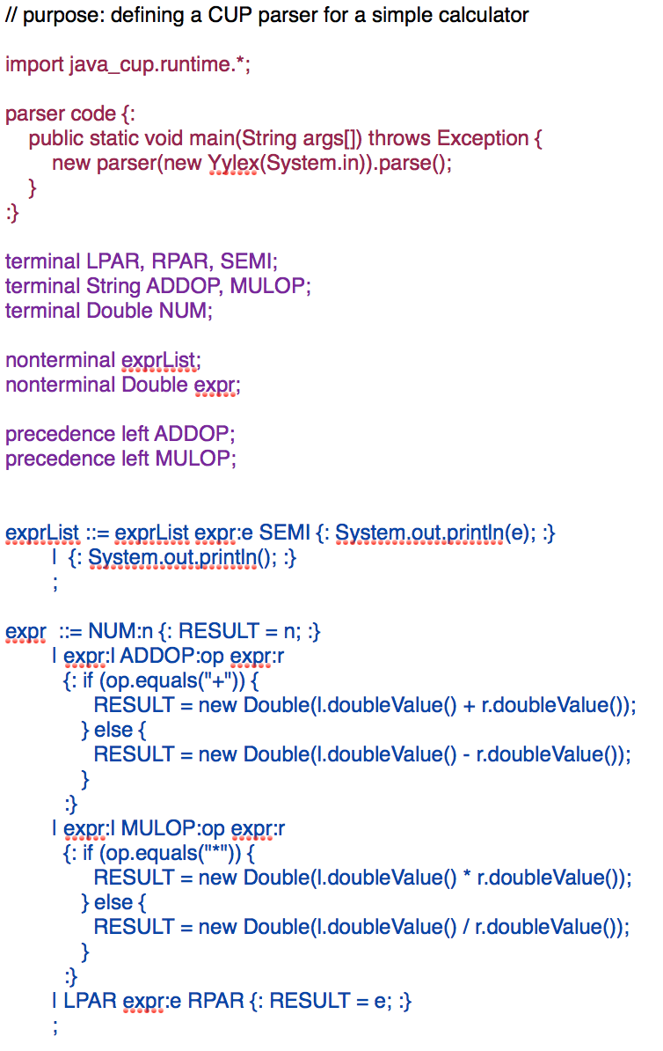

Slide 12
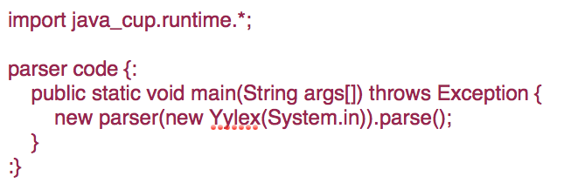
Imports and Directives

Slide 13
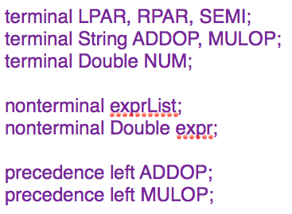
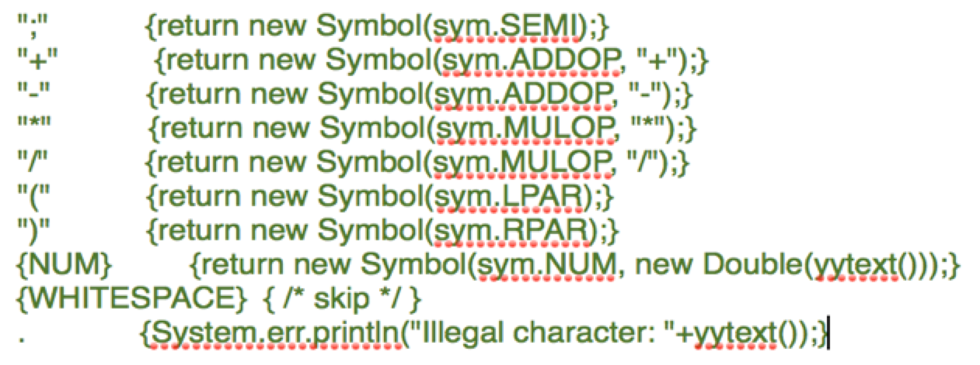
Declaration of Tokens and Non-Terminals

Slide 14
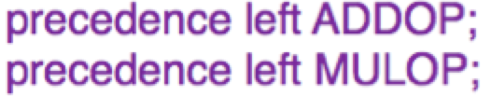
Declaration of Tokens and Non-Terminals
precedence <spec> terminal {, terminal}
<spec> → left | right | nonassoc

Slide 15
Next… Grammar Rules and Actions

Slide 16
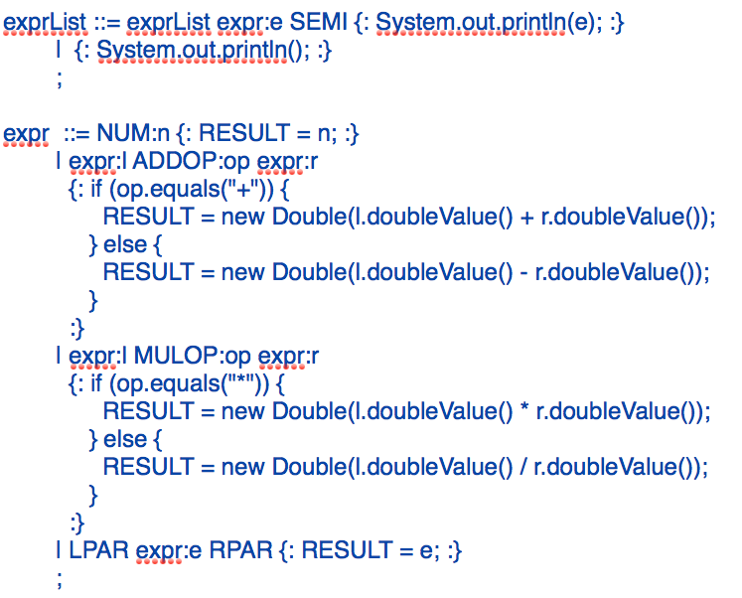

Slide 20
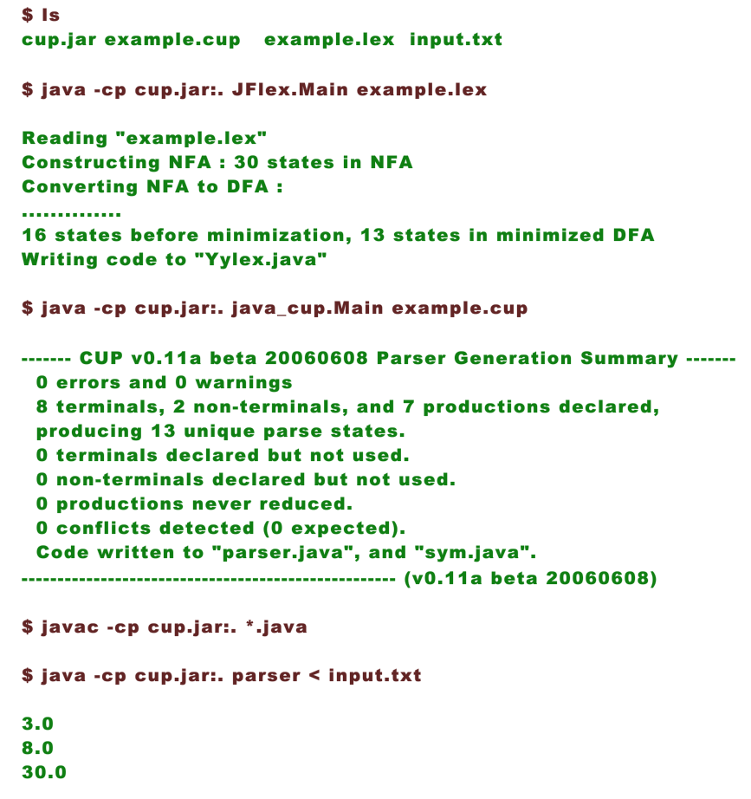
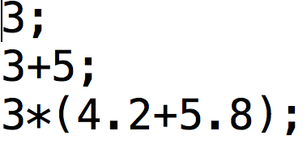

Slide 21
Adding “repeat” functionality to the calculator

Slide 22
REPEAT Functionality
Repeats the digits of a given integer before evaluating the integer as a number.
Functionality triggered by the letter “r”
r235 = 235235
4.5 + r4 = ?
= 48.5

Slide 23
