Slide 1
COMP 356
PROGRAMMING LANGUAGE STRUCTURES
1-<number>

Slide 2
COMP 356: Information
Instructor: Michael Skalak
Course Website: via Moodle
Email: skalakm@Dickinson.edu
Office Location: Tome 246
Office Hours: TBD
Schedule https://docs.google.com/spreadsheets/d/1ogxWlp0NiWgdxNnLQXGTVlqGFmRlp9aeNHjZKpSRcDk/edit?usp=sharing
https://github.com/skalakm/programmingLanguages
1-<number>

Slide 3
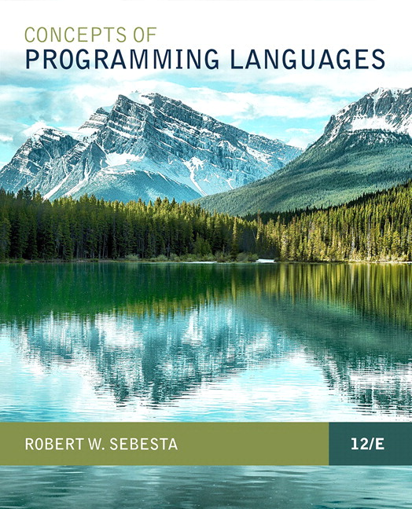
COMP 356: Textbook
Concepts of Programming Languages (12th edition) by Robert Sebesta, 2019 Publisher: Pearson
1-<number>

Slide 4
COMP 356: Evaluation [550 points]
12 to 14 Homework and Programming Assignments (200 total points)
Mid-term Exam 1 (75 points)
Mid-term exam 2 (75 points)
Final Exam (150 points)
In-class Labs, activities, & class participation (50 total points)
1-<number>

Slide 5
COMP 356: More Information
Late Work Policy
Academic Integrity and Conduct
  http://wwwdickinson.edu/info/20273/dean_of_students/8.dickinson.edu/info/20273/dean_of_students/867/community_standards/2
  http://www.dickinson.edu/info/20273/dean_of_students/867/community_standards
  http://www.dickinson.edu/homepage/69/student_conduct
Special Needs
1-<number>

Slide 6
Goals
Understand how compilers and run-time systems for Imperative Programming Languages Work
Gain an understanding of the ways in which programming language design and implementation influence software development
Be able to design and implement programs in languages representing multiple programming paradigms- Imperative, Object-Oriented, Functional, and Logic paradigms
1-<number>

Slide 7
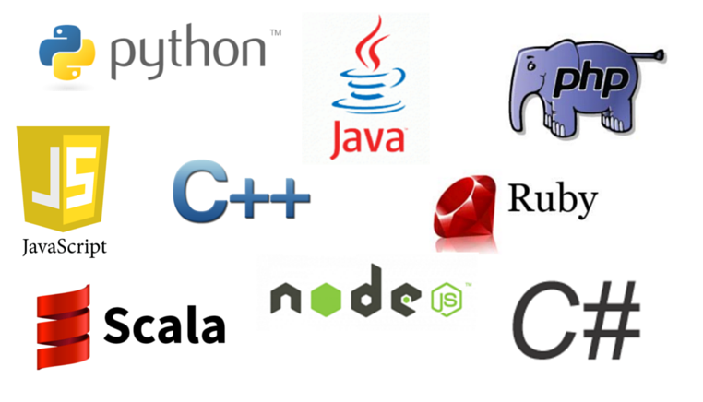
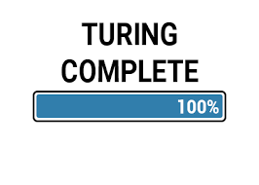
Modern Programming Languages
1-<number>

Slide 8
Topics
Reasons for Studying Concepts of Programming Languages
1-<number>

Slide 9
Why Study Concepts of Programming Languages
Increased capacity to express ideas
Improved ability to choose a language
Increased ability to learn new languages
Improved understanding of implementation issues
Improved use of known languages and advancement of computing
1-<number>

Slide 10
Language Categories
Imperative
  Central features are variables, assignment statements, and iteration
  Include languages that support object-oriented programming
  Include scripting languages
  Include the visual languages
  Examples: C, Java, Perl, JavaScript, Visual BASIC .NET, C++
Functional
  Main means of making computations is by applying functions to given parameters
  Examples: LISP, Scheme, ML, F#
Logic
  Rule-based (rules are specified in no particular order)
  Example: Prolog
Markup/programming hybrid
  Markup languages extended to support some programming
  Examples: JSTL
Copyright © 2015 Pearson. All rights reserved.
1-<number>

Slide 11
Topics
Terminology
The General Problem of Describing Syntax
Formal Methods of Describing Syntax
Copyright © 2015 Pearson. All rights reserved.
1-<number>

Slide 12
Terminology
Syntax: the form or structure of the expressions, statements, and program units
Semantics: the meaning of the expressions, statements, and program units
Ex: if (a > b) a = a + 1;
else b = b + 1;
Why define syntax and semantics of language?
1-<number>

Slide 13
Terminology
A sentence is a string of characters over some alphabet
A language is a set of sentences. E.g.?
Syntax rules?
A lexeme is the lowest level syntactic unit of a language (e.g., +, if, num1, 12.9)
A token is a category of lexemes (e.g. identifier) Other E.g.?
Copyright © 2015 Pearson. All rights reserved.
1-<number>

Slide 14
Describing Syntax
Tokens specified using Regular Expressions
Lexical Analyzer determines tokens in source program
Validity of token sequence (syntax) checked
Copyright © 2015 Pearson. All rights reserved.
1-<number>

Slide 15
Formal Method of Syntax Description
Backus-Naur Form (BNF)
  Invented by John Backus to describe the syntax of Algol 58
  meta-language
  can be found in language-reference manuals
  BNFs describe context-free languages
  BNF descriptions: CFGs or Grammars
Copyright © 2015 Pearson. All rights reserved.
1-<number>

Slide 16
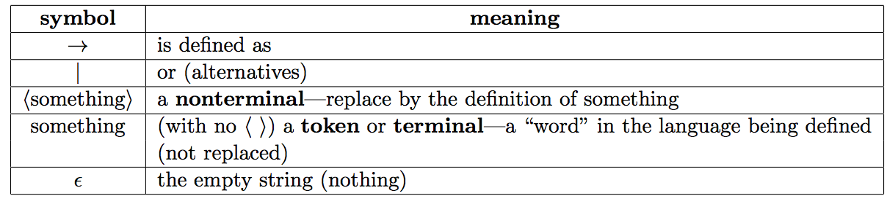
BNF Fundamentals
Copyright © 2015 Pearson. All rights reserved.
1-<number>

Slide 17

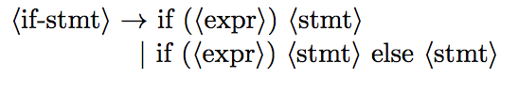
BNF Fundamentals – Rule/ Production
E.g. if statements in C language
Each definition is a “rule” or “production”
Full BNF Definition?
Copyright © 2015 Pearson. All rights reserved.
1-<number>

Slide 18

Full BNF Definition
E.g.: expressions in C language
Recursive BNF Definition?
1-<number>

Slide 19
BNF Fundamentals
In BNF, abstractions are used to represent classes of syntactic structures--they act like syntactic variables (also called nonterminal symbols)
Terminals are lexemes or tokens
A rule has a left-hand side (LHS), which is a nonterminal, and a right-hand side (RHS), which is a string of terminals and/or nonterminals
Copyright © 2015 Pearson. All rights reserved.
1-<number>

Slide 20
BNF Fundamentals (continued)
  Examples of BNF rules:
  <if_stmt> → if <expr> then <stmt>
Grammar: a finite non-empty set of rules
A start symbol is a special element of the nonterminals of a grammar
Copyright © 2015 Pearson. All rights reserved.
1-<number>

Slide 21
BNF Rules
An abstraction (or nonterminal symbol) can have more than one RHS
<stmt> → <single_stmt> | begin <stmt_list> end
Copyright © 2015 Pearson. All rights reserved.
1-<number>

Slide 22
Derivation
A sequence of replacements using the grammar rules
Can be used to check if a specific sequence of tokens belongs to a language (that the grammar defines)
Begins with a Start Symbol in the grammar
Start Symbol: LHS non-terminal of rule # 1
Copyright © 2015 Pearson. All rights reserved.
1-<number>

Slide 23

Grammars and Derivations
A grammar for C expressions:
Derivation to check id + num is a valid expression
id < (num / num)

Slide 24
Derivations
Every string of symbols in a derivation is a sentential form
➔: derives
A sentence is a sentential form that has only terminal symbols
A leftmost derivation is one in which the leftmost nonterminal in each sentential form is the one that is expanded
Rightmost derivation?
Derivation order does not matter

Slide 25
Describing Lists
Syntactic lists are described using recursion
<ident_list> -> ident
| ident, <ident_list>
Copyright © 2015 Pearson. All rights reserved.
1-<number>

Slide 26


BNF Recursive Rules
Left Recursive Definition
Right Recursive Definition
1-<number>

Slide 27
Example Grammar
<program> → <stmts>
<stmts> → <stmt> | <stmt> ; <stmts>
<stmt> → <var> = <expr>
<var> → a | b | c | d
<expr> → <term> + <term> | <term> - <term>
<term> → <var> | const
Is a = b + const a valid statement?

Slide 28
Example Derivation
<program> => <stmts> => <stmt>
=> <var> = <expr>
=> a = <expr>
=> a = <term> + <term>
=> a = <var> + <term>
=> a = b + <term>
=> a = b + const
1-<number>

Slide 29
Try This Now - Individually
Construct a BNF grammar for even numbers in decimal notation. Use only two tokens ed (even digit) and od (odd digit). Use start symbol <evennum>
Hint: Define nonterminals <digit>, <number>
Now, show that 132 (od od ed) is even by writing the derivation
1-<number>

