Slide 1
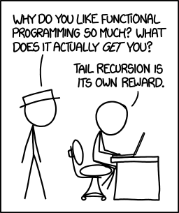
1-<number>

Slide 2
Tail Recursion in Scheme
Definition: A function is tail recursive if its recursive call is the last operation in the function
Copyright © 2015 Pearson. All rights reserved.
1-<number>

