Slide 1
Mạng thông tin di động 3G
UMTS / W-CDMA
(Universal Mobile Telecommunications System)
ξ 1. Khái quát về UMTS

Slide 2
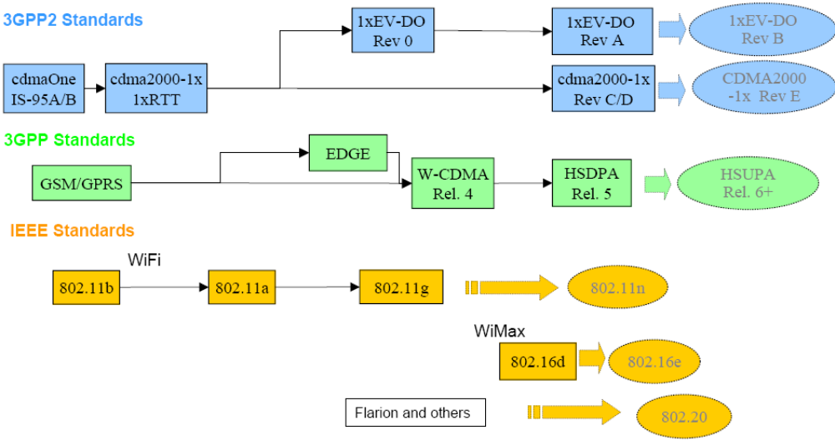
Rel.99, Rel.4
IMT-2000 : ITU’s umbrella name for 3G which stands for International Mobile Telecommunications 2000
IMT-DS Direct Spread CDMA: W-CDMA / UMTS
  New from 3GPP; UTRAN FDD

Slide 3
WCDMA Background and Evolution
3GPP Rel -99
12/99
3GPP Rel 4
03/01
3GPP Rel 5
03/02
3GPP Rel 6
2H/04
3GPP Rel 7
06/07
Further Releases
2000
2001
2002
2003
2004
2005
2006
2007
Japan
Europe
(pre-commercial)
Europe
(commercial)
HSDPA (commercial)
HSUPA (commercial)

Slide 4
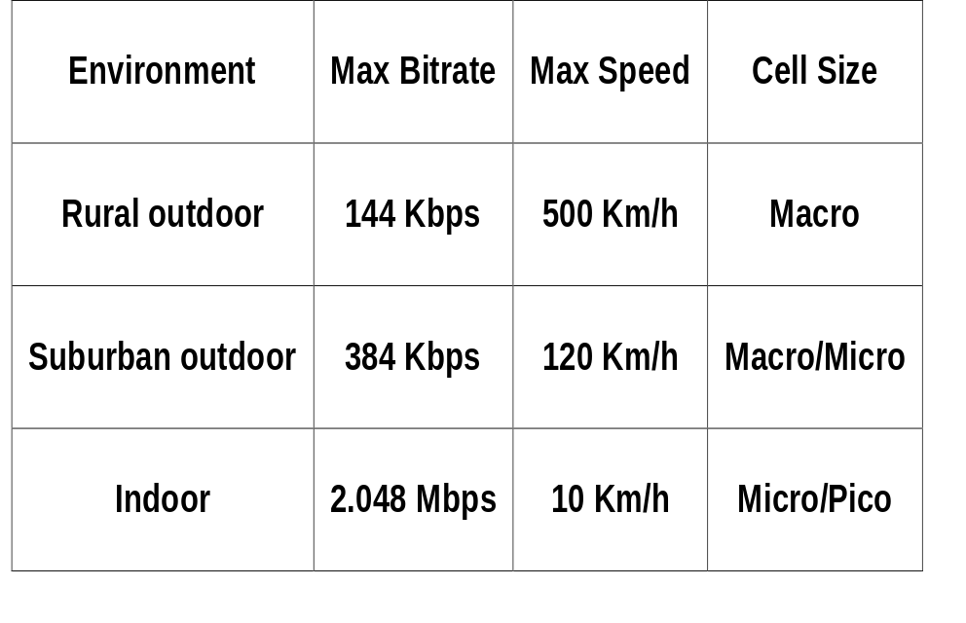
UMTS general characteristics
Multimedia Service & high data rates:
  WCDMA radio access
  Support of QoS mechanisms
  Volume-based pricing scheme
Service flexibility, wide bit-rate range and granularity:
  Packet- and Circuit- oriented services,
  “always on” connectivity, multiple services on one connection,
Additional requirements:
  Dual- mode/ coexistence with GSM & inter-system Hand Off,
  Channel characteristics negotiation.

Slide 5


IMT-2000 Vision Includes
LAN, WAN and Satellite Services
Global
Satellite
Suburban
Urban
In-Building
Microcell
Picocell
Macrocell
Basic Terminal
PDA Terminal
Audio/Visual Terminal

Slide 6
UMTS Characteristics
UMTS FDD (Frequency Division Duplex)
  Uplink: 1920 - 1980 MHz
  Downlink: 2110 - 2170 MHz
  190 MHz duplex distance
  ≈ 5MHz (variable) carrier spacing
  12 bands in Uplink & Downlink
12 Uplink Bands
12 Downlink Bands
…
…
≈5 MHz
Frequency
190 MHz

Slide 7
UMTS Specifications
Duplex method: FDD
Channel spacing: 5 MHz
Carrier chip rate: 3.84 Mcps
Timeslot structure: 15 slots/frame
Framelength: 10 ms
Modulation: QPSK
Detection: based on pilot symbols
Intra-frequencyHandover: soft
Inter-frequencyHandover: hard
Spreading Factors: 4, 8, 16, 32, 64, 128, 256, 512

Slide 8
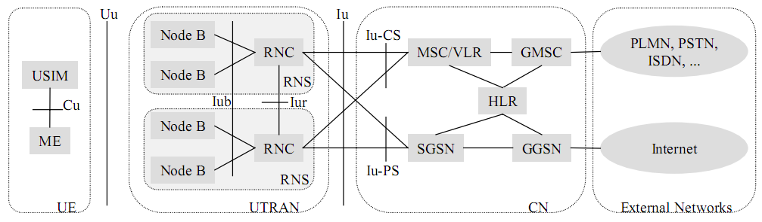
UMTS Network Architecture Rel.99

Slide 9
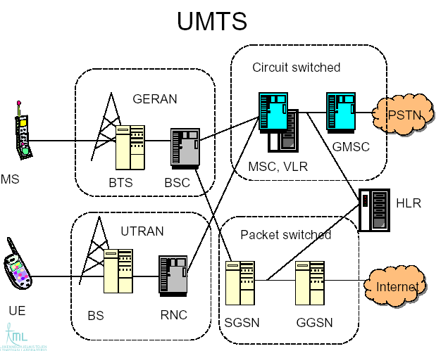
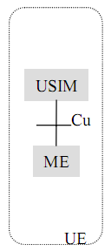

UMTS Network Architecture Rel.99
GERAN - GSM /GPRS/ Edge Radio Access Network
G_{b}
I_{u-CS}
U_{u}
I_{ub}
NodeB
I_{ur}
I_{u-PS}

Slide 10
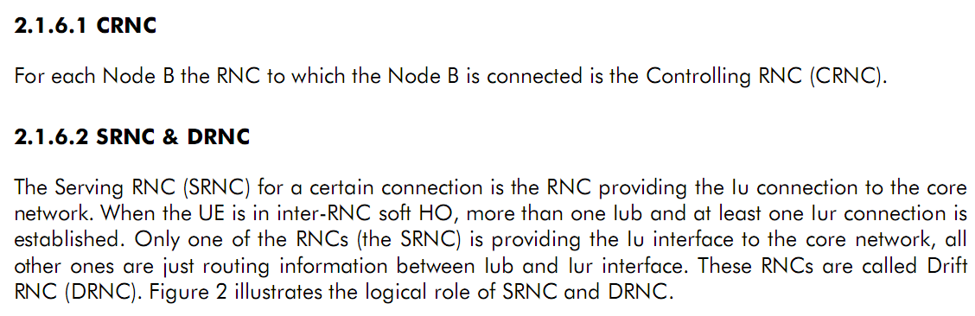
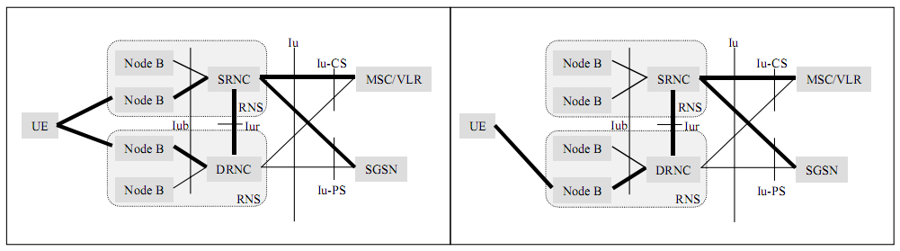
Logical Roles of RNC

Slide 11
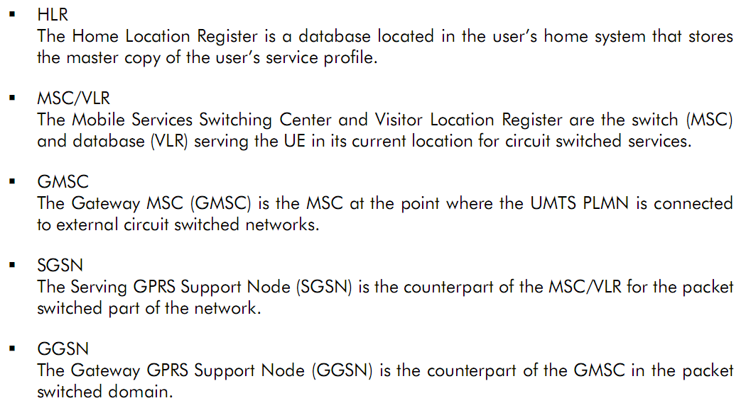
UMTS Network Architecture Rel.99
CN - Core Network

Slide 12
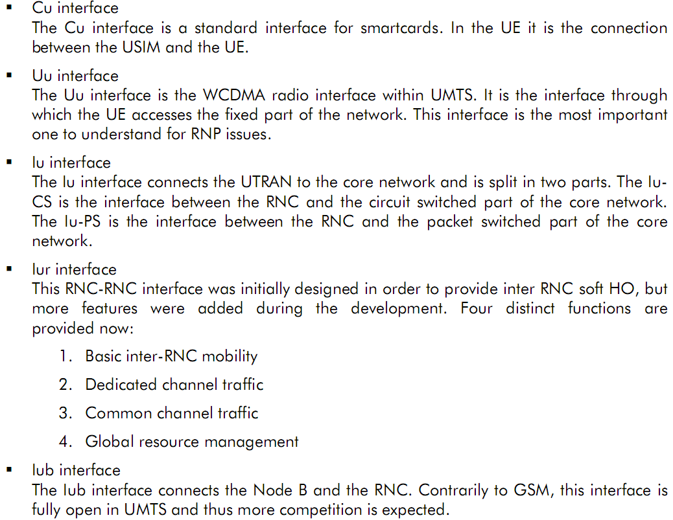
Interfaces

Slide 13

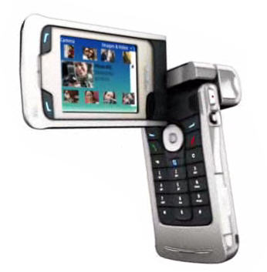
UTRAN Architecture
U_{u} interface
I_{ub} interface
RNC
UE
NodeB
CN
I_{ur} interface
NodeB
UE
RNC
NodeB
UTRAN
UTRAN: UMTS Terrestrial Radio Access Network

Slide 14
UTRAN Architecture
New Radio Access network needed mainly due to new radio access technology
Core Network (CN) is based on GSM/GPRS
Radio Network Controller (RNC) corresponds roughly to the Base Station Controller (BSC) in GSM
Node B corresponds roughly to the Base Station in GSM
U_{u} interface
I_{ub} interface
RNC
UE
NodeB
CN
I_{ur} interface
NodeB
UE
RNC
NodeB
UTRAN
UTRAN: UMTS Terrestrial Radio Access Network

Slide 15
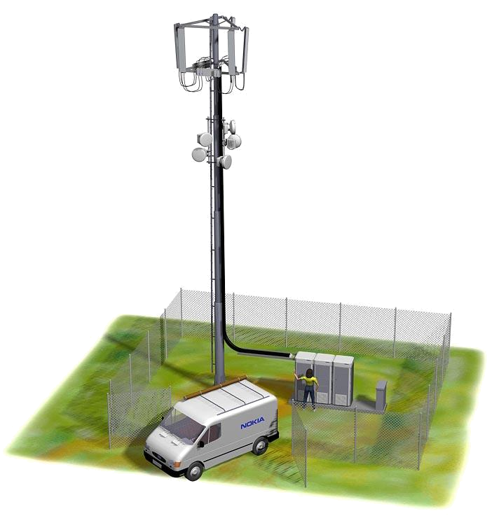
UTRAN Architecture
Node B
  Main function to convert the data flow between U_{u} and I_{ub} interfaces
  Some Radio Resource Management (RRM) tasks:
    Measurements
    Innerloop power control

Slide 16
UTRAN Architecture
RNC – Radio Node Controller
  Controls the radio resources in its domain
  Radio Resource Management (RRM) tasks include e.g. the following
    Mapping of QoS Parameters into the air interface
    Air interface scheduling
    Handover control
    Outer loop power control
    Admission Control
    Initial power and SIR setting
    Radio resource reservation
    Code allocation
    Load Control

Slide 17
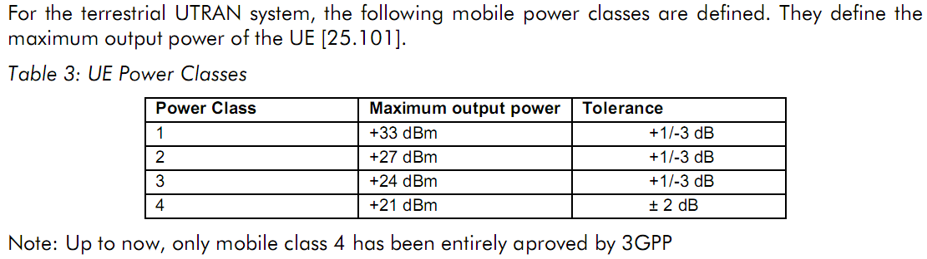
UE Class
Độ nhạy thu: là công suất thu tối thiểu sao cho BER không vượt quá một giá trị tiền định (BER ≤ 0.001):
  + UE: S = - 117 dBm
  + BTS : S = - 121 dBm.
UE: User Equipement
UE = ME + USIM

Slide 18
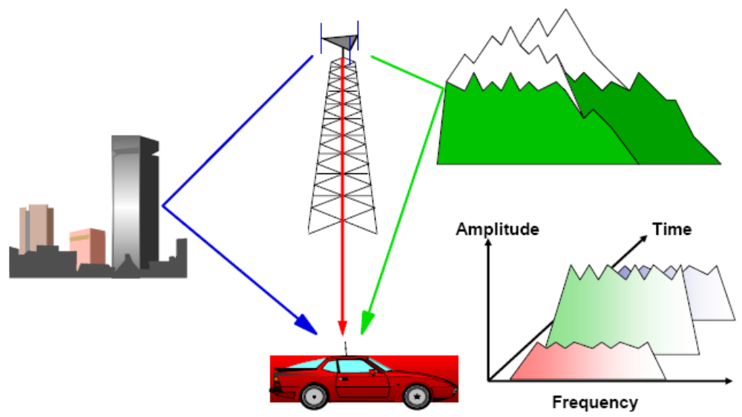
Rake Receiver

Slide 19
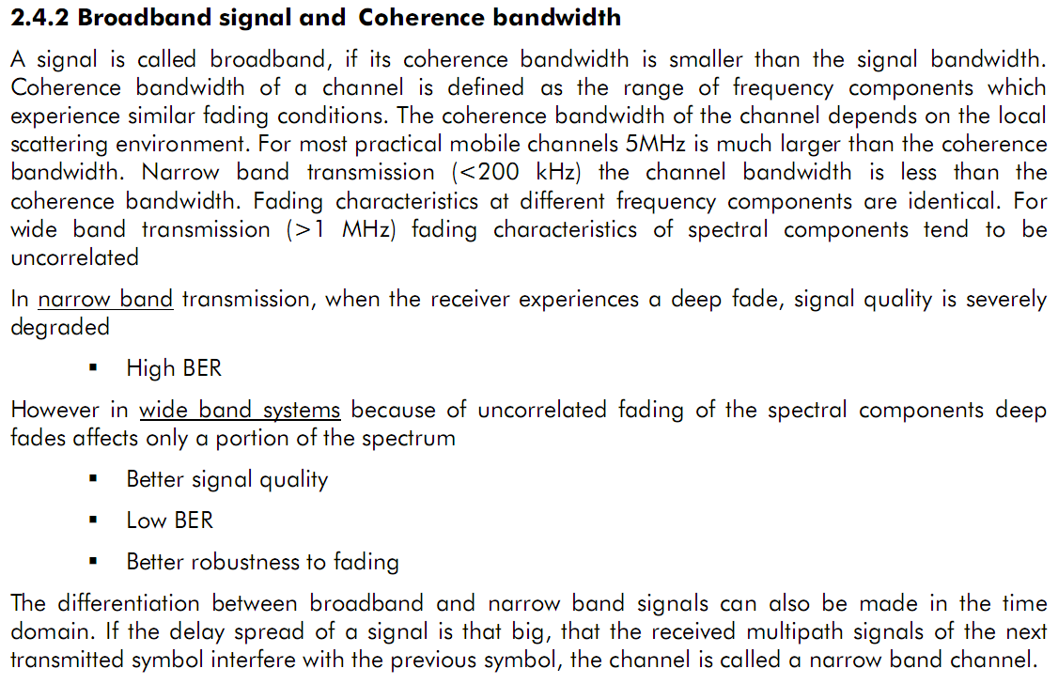

Slide 20
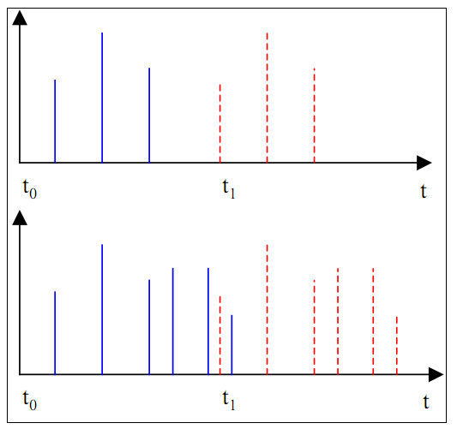

Slide 21
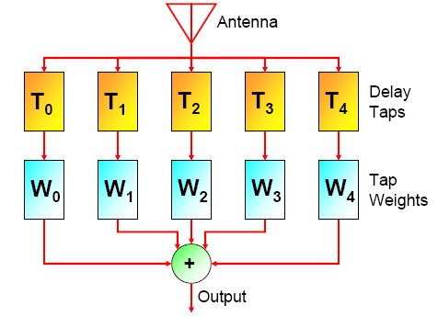
Rake Receiver

Slide 22
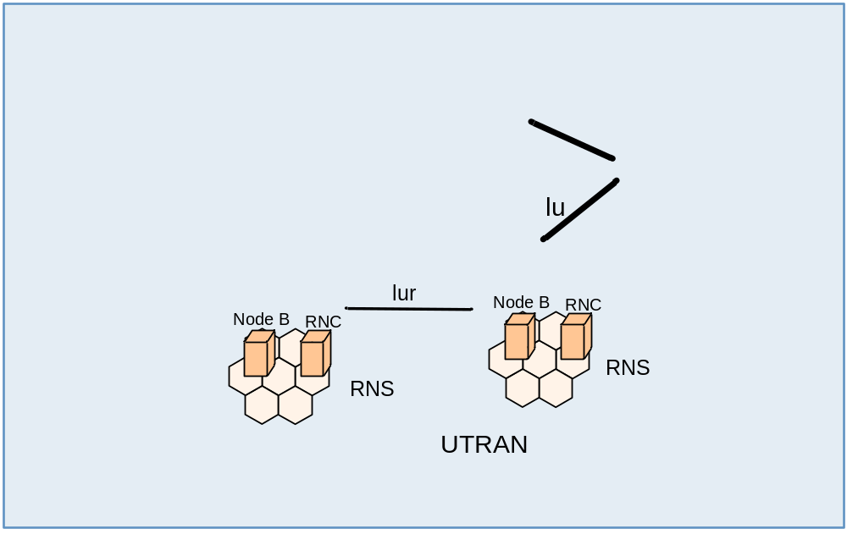
UMTS Network Architecture
RNS: Radio Network Subsystems UTRAN: UMTS Radio Access Network
GERAN: GSM /GPRS/ Edge Radio Access Network

Slide 23



GPRS Network Architecture
ISP - External Network
NSS
HLR
GPRS Core Network
MSC/VLR
Gc
Gr
Gi
Gs
SGSN
DNS
GGSN
A
Gn
Gn
BSS
GPRS
IP Backbone
Gb
Transcoder
Gn
Gn
Ater
Charging
Border
Gateway
Gateway
BSC
Um
Gp
Abis
Inter PLMN
Backbone
BTS

Slide 24
GPRS - General Packet Radio Service
Modulation - GMSK
Symbol Rate - 270 ksym/s
Modulation bit rate - 270 kbps
Radio data rate per time slot - 22.8kbps
User data rate per time slot - 21.4 kb/s (CS4)
User data rate (8 time slots) - 171,2 kb/s.
Applications are required to provide their own error correction scheme as part of carried data payload.

