Slide 2
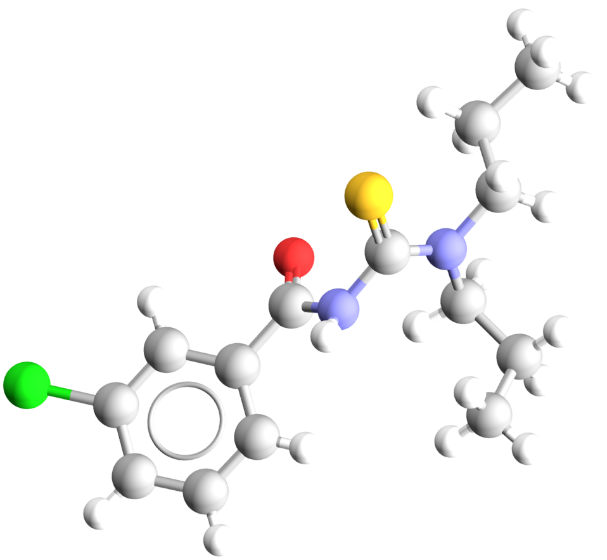
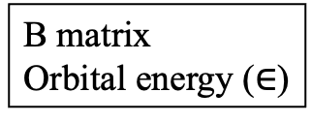
Database (CCDC)
or IQmol
Molecular coordinates
Basis specification
QChem (HF)
B matrix
Orbital energy ($∈$)
Implement +
Parallelize
MP2 correction

