Slide 1
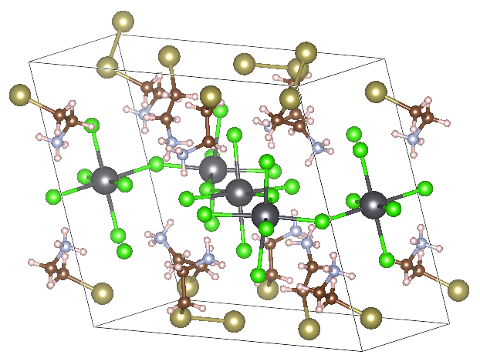
Perovskite structure (C₂H₇N)₂PbTe₂Cl₄
2,2,1 supercell with direct band gap at Gamma point
(108-atom cell)
Band gap convergence with PBE, def2-svp basis
kmesh | Band gap (eV)
1,1,1 | 2.364
2,2,2 | 2.362
3,1,2 | 2.366
3,2,2 | 2.367
5,1,4 | 2.365

Slide 2
Perovskite structure (C₂H₇N)₂PbTe₂Cl₄
Band gap convergence with HSE, def2-svp basis
2,2,1 supercell with direct band gap at Gamma point
(108-atom cell)
kmesh | Band gap (eV)
1,1,1 | 3.273
3,1,2 | 3.228
5,1,4 | 3.228
Band gap convergence with HSE, def2-tzvp basis
kmesh | Band gap (eV)
1,1,1 | 3.319
3,1,2 | 3.276

