Slide 1
COS20031
Computing Technology Design Project
Week 02 - Project Planning and Task Management with Jira

Slide 2
Database Development Lifecycle
Planning
Requirement gathering
Conceptual design
Logical design
Physical design
Construction
Implementation and rollout
Ongoing support

Slide 3
Project Planning

Slide 4

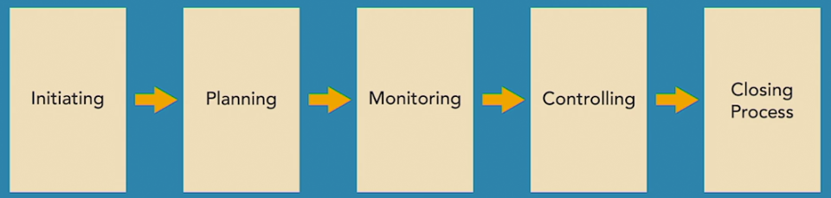
Traditional vs. Agile Project Management
Traditional (waterfall):
  works well when goals are clearly defined
  complete one step then move to the next
Suitable projects:
  clear solution
  simplicity
  low risk
  familiar technology
  experienced resources

Slide 5

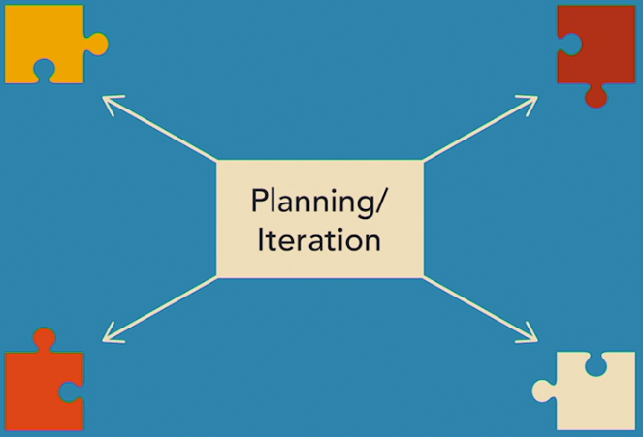
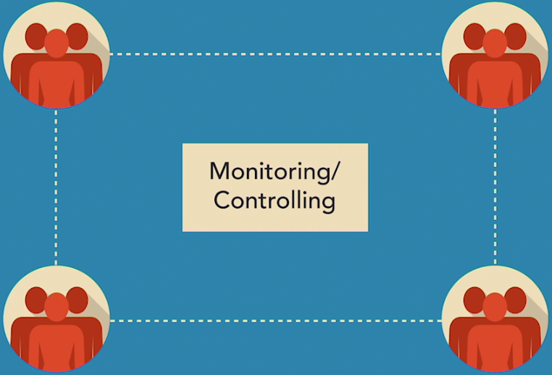
Traditional vs. Agile Project Management
Agile approach:
  iterations produce deliverables at regular intervals
  value delivered sooner
  more customer involvement
  small independent teams
Suitable projects:
  unclear solution
  (most today’s projects!)

Slide 6
PM process (basic)
Choose an PM approach
Identify stakeholders
Identify project goal
Identify project objectives
Identify project deliverables and success criteria
Prepare project scope statement
Create risk management plan
Create a risk chart
Learn to use milestones

Slide 7
Identify Stakeholders
Customer
  person or group with a problem to solve
  funds the project
  informs what needs to be done
  approves deliverables
Project sponsor
  wants project to succeed
  prioritise objectives
  talk to stakeholders
  suggest improvements
Functional managers:
  run departments to achieve department goals
  manage team members
Team members
  jobs depend on performance in the projects
Department:
  invested and affected by project outcomes

Slide 8
Identify the Project Goal
Defines the end result
  Solves the problem, or
  Takes advantage of opportunity
Problem statement:
  clearly defines the problem or opportunity
  E.g. (hospital schedule system - HSS)
  “Hospital resources aren’t being utilised efficiently, because scheduling doesn’t ensure that the necessary equipment, staff and facilities are available. Fund is available to address scheduling issues.”
Project goal: e.g. (hospital schedule system - HSS):
  “The project will deliver scheduling improvements so hospital resources can be scheduled efficiently. The project will take advantage of funding available for productivity and technology enhancements”

Slide 9
Identify the Project Objectives
Objectives specify what needs to achieve to support organisational goal
Business objectives
  increase market share to 25%
  provide world-class health care
Financial objectives
  increase revenue by 15%
  cut costs by 10%
Quality objectives
  decrease staph infections by 80%
  decrease readmittance by 75%
Technical objectives: similar to technical specifications for equipment
  introduce mobile equipment for hospital, ambulance and emergency site
Performance objectives:
  finish project before grant expires
Specific
Measurable
Achievable
Realistic
Time-related

Slide 10

Identify Project Deliverables & Success Criteria
Deliverables: expected results
  help define project scope
  help measure progress
  tangible: e.g. new product, service
  intangible (abstract) deliverables: e.g. improved customer relationship
Identify deliverables:
  identify end deliverable
    e.g. a new product/service launched
  identify intermediate deliverables
    achievable between status reports
    e.g. sign a contract with a vendor
Identify clear, quantifiable success criteria
  signed contracts, certificate of occupancy, 4/5 survey rating

Slide 11
Prepare a Project Scope Statement
Defines the boundary of project
  specifies what is included (in) and what is excluded (out)
Benefits:
  help avoid scope creep (unexpected deliverables)
  remind stakeholders of what was agreed upon
  track for change management
Scope statement: defines the scope
  documents all the elements defined so far (goal, objectives, deliverables, success criteria, assumptions, risks, constraints)
  boundary: what is within scope, out of scope

Slide 12
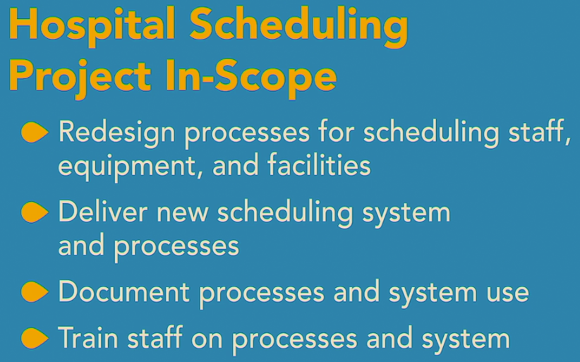
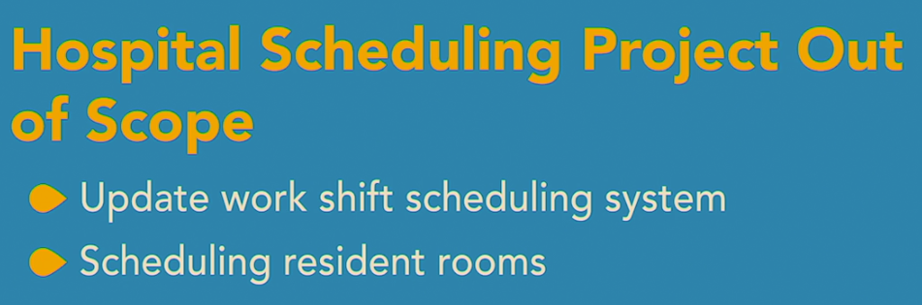
Scope example: HSS

Slide 13
Create a Risk Management Plan
Document the relevant risks and how we plan to handle them
Evaluate risks:
  probability or likelihood (1-5)
  severity of impact (1-5)
  risk score = probability x impact
Rank risks in descending order of score
  unlikely and not serious: 1 x 1 = 1
  medium likely and serious: 3 x 3 = 9
  very likely an serious: 5 x 5 = 25
Plan for risks that are medium or higher (i.e. score >= 9)
  response action to handle when a risk occurs
Response actions: should reflect the risk
  accept: for low risks
  avoid: e.g. change project scope to avoid
  mitigate: reduce impact (e.g. performs feasibility study)
  transfer: to someone else (e.g. insurance)
Risk log: document risk evaluation, response and status
  update regularly
  risk scores may change over time

Slide 14
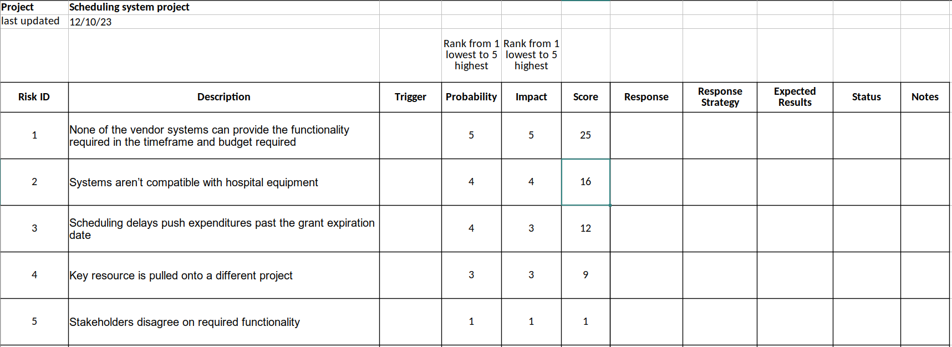
Risk log example: HSS

Slide 15
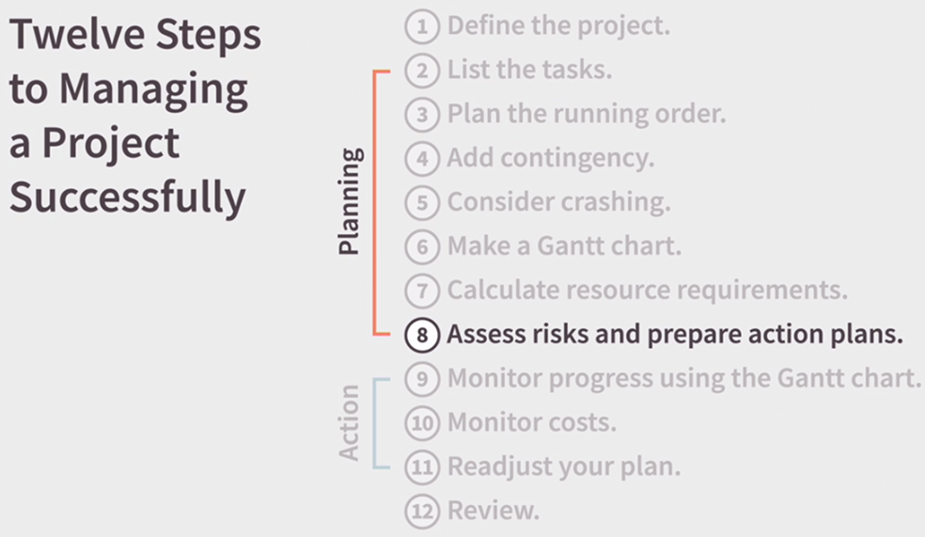
How to Create a Risk Chart
Identify risks:
  from previous projects
  team brainstorming meeting
Plan for risks with score > 5
Actions:
  prevention
  protection
Revise risk score
  aim score <= 5
Benefits:
  informs stakeholders upfront
  helps reduce risk

Slide 16
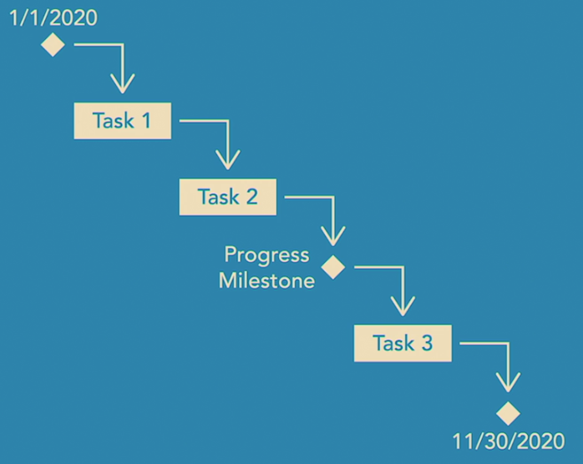
Learn to Use Milestones
Milestone:
  shows project progress
  when key tasks have been completed
  how much has been completed
  when project is finished
Helps easily reschedule the project
  all tasks dependent on the milestone are rescheduled automatically
Starts and ends project with a milestone
Mark key progress points with a milestone:
  key events, e.g:
    wait for vendor delivery of equipment
    plan approved
Link tasks to milestones (before and after)

Slide 17
(B) Task management with Jira

Slide 18
Terms: basic
Scrum
  most popular frameworks for implementing agile: product is built in a series of small fixed-length iterations, called sprints, that can regularly be delivered
Backlog:
  prioritised list of ongoing tasks to complete, derived from requirements/roadmap
User stories:
  tasks or other work items => software features
  a.k.a issues in Jira
  As a {type of user}, I want {goal} so that I {receive benefit}
Epic:
  a body of work that can be broken down into user stories, having flexible scope based on the needs/requests of customers/end-users
  usually consists of a set of sprints
  can involve multiple teams and span multiple projects

Slide 19
Terms: Sprint (1)
A set of user stories or other work items to be completed during a fixed time duration:
  1, 2 or 4 weeks
Planning:
  a meeting held at beginning of a sprint for entire team
  duration: 2-hour for a 2-week sprint
  discuss sprint goal
  determine sprint backlog
    refine stories (by creating substories)
    estimate time for each story using story point
    story point: relative work effort (fibonacci-like): 0, 0.5, 1, 2, 3, 5, 8, 13, 20, 40, 100
Start a sprint:
  start, end date
Monitor sprint progress:
  move items between to-do, in-progress and done columns

Slide 20
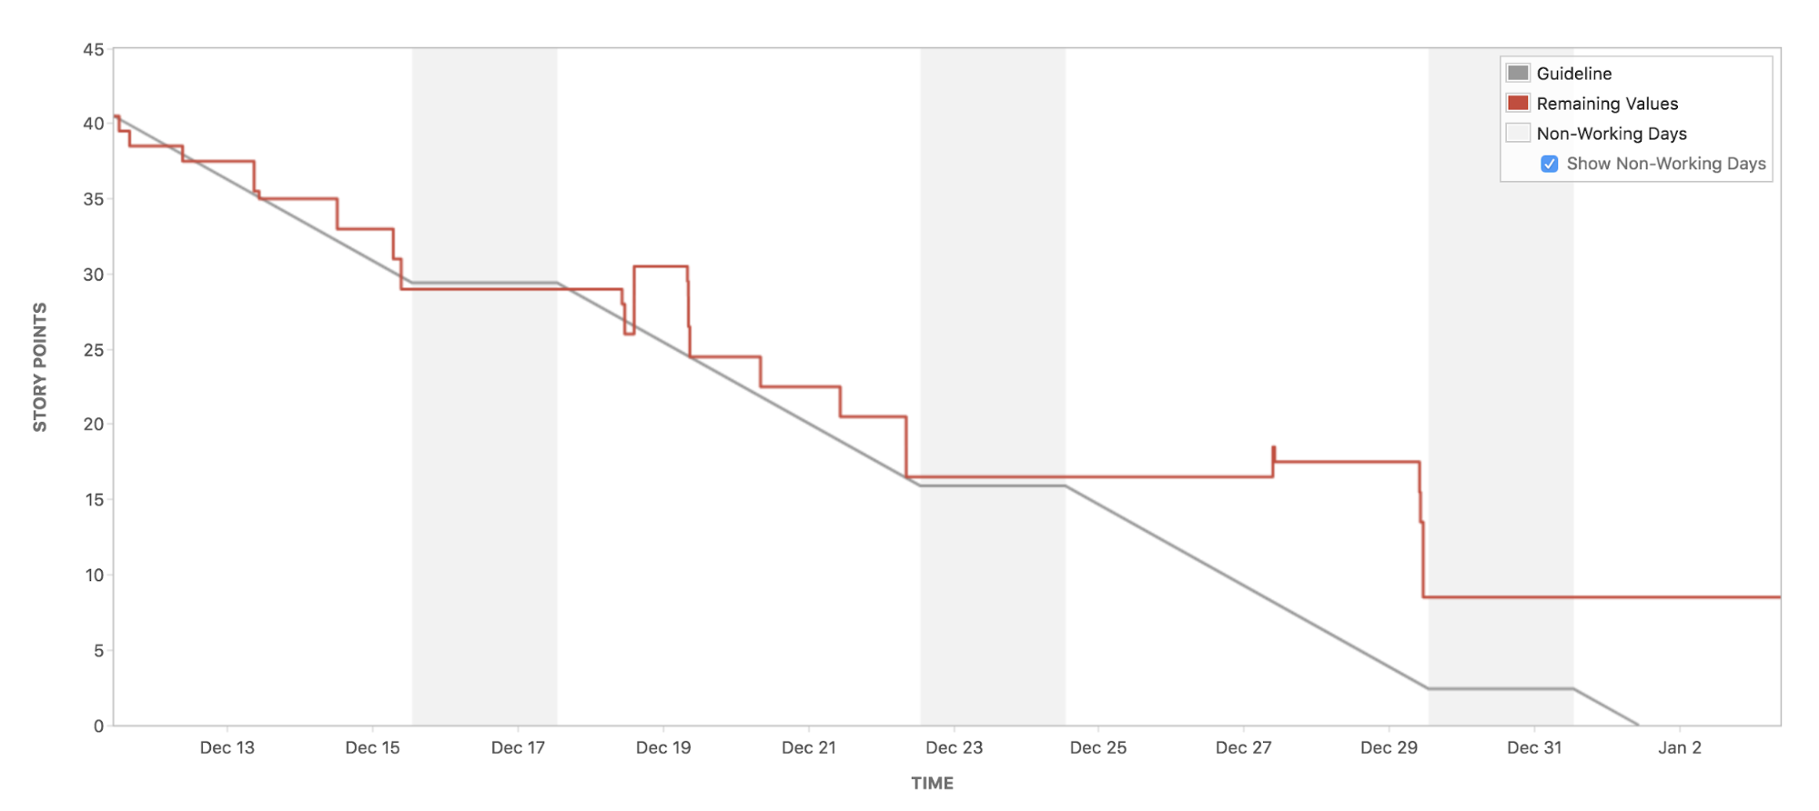
Terms: Sprint (2)
Standup meetings:
  one daily, starting meeting
  duration: <= 15 minutes
  usually informal (standup)
  to update and check progress, resolve issues
  questions for each member:
    what did I do?
    what will I work on today?
    am i blocked by anything?
View the Sprint report:
  shows actual & estimated work effort left
    Reports > Burndown Chart
  x-axis: time
  y-axis: story points (effort)

Slide 21
Terms: Sprint (3)
Review meeting:
  sprint review a.k.a sprint demo
  typically on the last day of a sprint
  duration: 2 hours for 2-week sprint
  demonstrate what was completed in the sprint (a prototype or product increment) & update the product backlog
  Questions to ask:
    Did the team meet the sprint goal?
    Any work added or removed during the sprint?
    Did any work not get completed? If so, why?
  Brainstorming on what’s next
    move unfinished stories to product backlog or a future sprint

Slide 22
Terms: Sprint (4)
Retrospective meeting:
  end of iteration
  duration: 1.5 hours for 2-week sprint
  team inspects itself for continuous improvement
  Questions to ask:
    What did we do well during the sprint?
    What could we have done better?
    What are we going to do better for next time?
Complete the sprint
  Click the “Complete sprint” button to close it

Slide 23
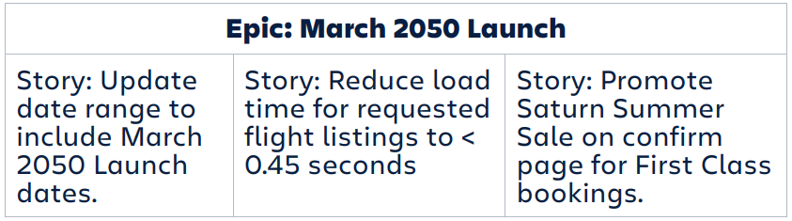
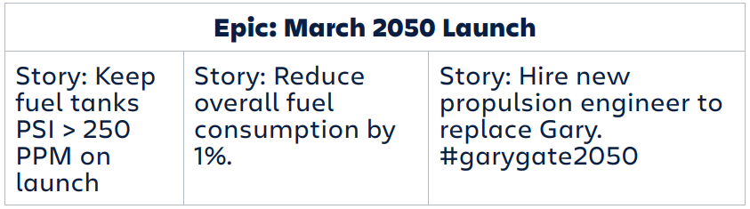
Terms: Epic
A body of work that can be broken down into user stories, having flexible scope based on the needs/requests of customers/end-users
usually consists of a set of sprints
can involve multiple teams and span multiple projects
Example: “March 2050 Space Tourism Launch”
  various stories:
    routine stories + stories for improving shuttle launch
    e.g. space travel ticket purchase, rocket launch
  multiple teams

Slide 24
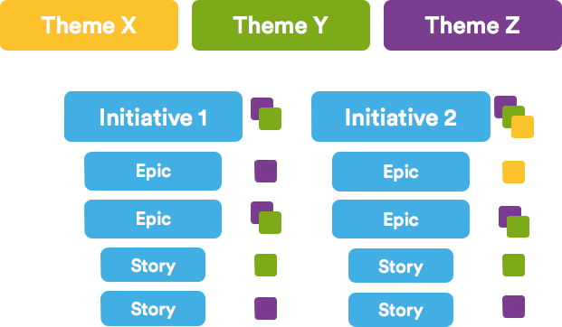
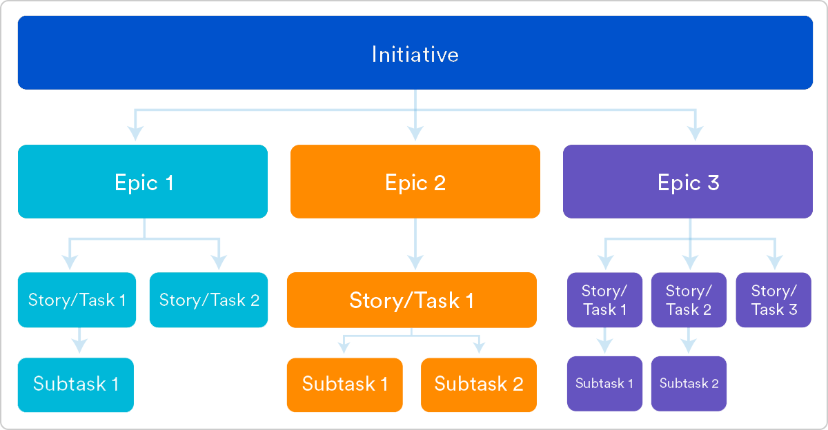
Terms: Theme, Initiative, Epic, Story (url)
Product road map
  Theme: an organisational goal
    Initiative: a component of goal
      Epic:
        Story

Slide 25
Additional Sprint management with Jira
URL: https://www.atlassian.com/agile/tutorials/sprints
Optimise sprint with automation
  send weekly Slack message on open issues
  assign unfinished stories to the next sprint
  move in-progress stories of an empty sprint to the next active sprint

Slide 26
Sprint Planning with Confluence and Jira
Jira:
  creates and manages the actual project plan (based on Agile)
Confluence:
  provides a documentation space for the project
  provides templates for documenting the Sprint’s activities (meetings, risks, etc.)
Create Jira Project
  can automatically create (and link) a new Confluence space
Create a Scrum project with sample data:
  read this
  timeline: change Timeline setting to timebox each issue on the timeline
Link Confluence space to Jira project
  read this tutorial

Slide 27
Tutorial & Workshop
See Canvas.

