Slide 1
MGT10009 Contemporary Management Principles
Lecture 4 Communication
Dr David Qian dqian@swin.edu.au
Peter Moran pmoran@swin.edu.au
Notes:
1

Slide 2
Learning Objectives
15-1 Discuss important advantages of two-way communication.
15-2 Identify communication problems to avoid.
15-3 Describe when and how to use the various communication channels.
15-4 Summarize ways to become a better sender and receiver of information.
15-5 Explain how to improve downward, upward, and horizontal communication.
15-6 Summarize how to work with the company grapevine.
15-7 Understand transparency and what it means to be “boundaryless.”

Slide 3
Management in Action Communication During Difficult Times
Effective communication is never a bad thing but –
is a sign of managerial competence during turbulent times.
This was particularly the case during the COVID-19 pandemic.
Slack’s C E O wanted his employees to know that he:
understood and
empathized with the fear and upheaval they were experiencing.
His memo expressed that: “We got this. Take care of yourselves, take care of your families, be a good partner.
It is fine to work irregular or reduced hours. It is fine to take time out when you need it.” His prevailing message to this workforce: “Don’t stress about work.”
Notes:
Examples of how organizations like Slack communicate with employees during difficulty times continues later in the chapter.

Slide 4
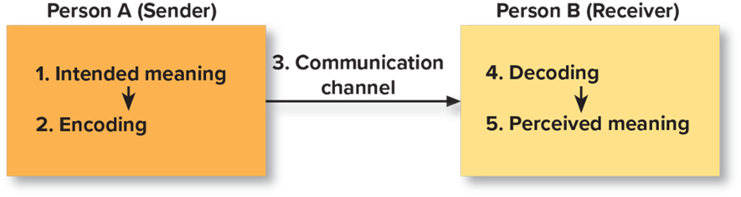
Exhibit 15.1 A General Model of Communication
Access the text alternative for slide image
Notes:
Communication is the transmission of information and meaning from one party to another through the use of shared symbols. Exhibit 15.1 shows a general model of how one person communicates to another.

Slide 5
One-Way versus Two-Way Communication
One-way communication:
A process in which information flows in only one direction—from the sender to the receiver, with no feedback loop.
Two-way communication:
A process in which information flows in two directions—the receiver provides feedback, and the sender is receptive to the feedback.
Notes:
True two-way communication means not only that the receiver provides feedback but also that the sender is receptive to the feedback. In these constructive exchanges, information is shared between both parties rather than merely delivered from one person to the other. Because it is faster and easier for the sender, one-way communication is very common. A busy executive finds it easier to dash off an email message than to discuss a problem in person with a subordinate.

Slide 6
Communication Pitfalls
Perception:
The process of receiving and interpreting information.
Filtering:
The process of withholding, ignoring, or distorting information.
Notes:
Senders don’t convey information effectively, and people’s perceptual and filtering processes create misinterpretations. Senders filter when they tell the boss what they think the boss wants to hear, or give unwarranted compliments rather than honest criticism. Receivers also filter information; they may fail to recognize a message's importance or attend to some aspects of it but not others.

Slide 7
Verbal and Written Channels
Verbal communication:
Includes face-to-face discussion, phone conversations, meetings, and formal presentations and speeches.
Written communication:
Includes email, memos, letters, reports, spreadsheets, product brochures, and other documents.
Notes:
Communication move through a variety of channels including verbal, written, and digital. Each channel has advantages and disadvantages.
Advantages of verbal communication are that questions can be asked and answered, feedback can be immediate and direct, receivers can sense the sender’s sincerity or lack thereof, and it's often more persuasive than written. However, verbal communication has disadvantages too: It can lead to spontaneous, ill-considered statements (and regret), and there is no permanent record of it unless you make an effort to record it.
Advantages of written communication are that you can revise and perfect them and save them in a permanent record. Your message stays the same even if relayed through many people, and receivers have more time to analyze the message. Disadvantages are that the sender has no control over where, when, or if the message is read; the sender does not receive immediate feedback; the receiver may not understand parts of the message; and the message might not contain all the information others need.

Slide 8
Verbal Communications
Advantages:
Questions can be asked and answered.
Feedback is immediate and direct.
Receiver senses sender’s sincerity.
Oral communication is more persuasive.
Disadvantages:
Can lead to spontaneous, ill-considered statements (and regret).
There is no permanent record of it.
Notes:
Verbal communication includes face-to-face discussions, phone conversations, meetings, and formal presentations and speeches. Its advantages are that questions can be asked and answered, feedback can be immediate and direct, receivers can sense the sender’s sincerity or lack thereof, and it's often more persuasive than written. However, verbal communication has disadvantages too: It can lead to spontaneous, ill-considered statements (and regret), and there is no permanent record of it unless you make an effort to record it.

Slide 9
Written Communication
Advantages:
A message can be revised.
It provides for a permanent record.
The message is unchanged, even if relayed.
The receiver has more time to analyze the message.
Disadvantages:
Sender has no control over where, when, or if the message is read.
Sender does not receive immediate feedback.
Receiver may not understand parts of the message.
Notes:
Written communication includes emails, texts, memos, reports, spreadsheets, brochures, etc.
You can always revise and perfect written communications, and once relayed to others, it remains consistent. The received has more time to analyze and comprehend the message.
However, there are drawbacks: The sender has no control over where, when, or if the message is read. Once it is read, there is not immediate feedback for the sender. And the receiver may not understand the message, and it might be incomplete.

Slide 10
Digital Communication and Social Media
Employers are making strides and catching up with consumers in their use of social media.
Advantages:
More information is shared.
There is speed and efficiency in delivering routine messages to large numbers of people.
It saves paper, postage, meetings, travel budgets, and conference calls.
Disadvantages:
It may not be able to solve complex problems.
There is an inability to pick up subtle, nonverbal, or inflectional clues.
It invites misinterpretations and improper messages.
Notes:
Guidelines for social media:
Use reasonable etiquette and treat people respectfully,
Identify and represent yourself (usually you are not representing your employer),
Be factual and don’t violate company disclosure policies, and
Review the message before posting it (remember, it will become a permanent record).

Slide 11
The Virtual Office
A mobile office in which people can work anywhere, as long as they have the tools to communicate with customers and colleagues:
There are numerous benefits associated with virtual offices.
The longer-term impact on productivity and morale is still in question.
The virtual office requires changes in how human beings work and interact and presents technical challenges.
Notes:
Based on the philosophy that management’s focus should be on what people do, not where they are, the virtual office is a mobile office in which people can work anywhere—their home, car, airport, coffee houses, customers’ offices—as long as they have the tools to communicate with customers and colleagues.

Slide 12


Exhibit 15.2 Differences in Media Richness
More rich Face-to-face conversation, videoconference, and phone call
Less rich Email, text, blog post, and memo
Notes:
Some communication channels convey more information than others. The degree to which a communication channel conveys information is called media richness.

Slide 13
Management in Action Communicating, SoundCloud Style
SoundCloud has grown to be the largest music and audio platform, but this growth came with significant growing pains:
What is your intuitive assessment analysis of the cost/benefit ratio for SoundCloud's multiple different communication channels?
What communication content is missing? What would you most want to make sure the company isn't overlooking or neglecting?
Notes:
Questions:
What is your intuitive assessment analysis of the cost/–benefit ratio for SoundCloud's multiple different communication channels?
Students may offer as benefits how the multiple platforms not only allow but encourage communication across multiple locations. The All Hands meeting allows for all employees to hear the same message and the manager surveys provide immediate feedback. However, the multiple methods have higher costs in terms of financial and time costs. Student ratios will vary based on their assessment of the benefits relative to the costs.
What communication content is missing? What would you most want to make sure the company isn't overlooking or neglecting?
Student’s answers will vary. Look for example of new technologies or those reaching more widespread adoption. They might also point to the need for smaller group meetings or even one-on-one meeting with managers to clarify what the new information means for an employee’s day to day work.

Slide 14
Writing Skills
Requires clear, logical thinking
Strive for clarity, organization, readability, brevity
Email:
Specific subject lines.
Put main point at beginning of message.
Limit paragraph length.
Avoid sarcasm or caustic humor.
Notes:
Recall that your first draft rarely is as good as it could be. If you have time, revise it. Go through your entire message and delete all unnecessary words, sentences, and paragraphs. Use specific, concrete words rather than abstract phrases.

Slide 15
Language Skills
Things to consider:
Word choice, such as avoiding jargon.
Receiver’s cultural and technical background.
Meaning of chosen words.
Learn host country’s language and customs.
Notes:
Whether speaking or writing, you should consider the receiver’s background—cultural as well as technical—and adjust your language accordingly. Learning host country languages and customs will give you an edge over competitors who do not.

Slide 16
Nonverbal Skills
Use time appropriately.
Make your office arrangement conducive to open communication.
Remember your body language.
Notes:
People send and interpret signals other than those that are spoken or written. Nonverbal messages can support or undermine the stated message. Often nonverbal cues make a greater impact than other signals. In employees’ eyes, managers’ actions often speak louder than the words they choose.

Slide 17
SPOTLIGHT ON… Communicating to Create Change
Entrepreneurs use story telling when making pitches.
Compelling stories improve on facts, analyses, and data by personalizing the experience for both speaker and audience, making entrepreneurs more relatable and their visions more vivid and impactful.
Stories of success also help inform stakeholders about the work of the organization, build its commitment and advocacy, spread the word about the organization’s impact, and help secure funding.
How can stories offer a more powerful communication tool than a presentation of data and facts? What examples come to mind?
What does a social enterprise need to know about its audience to communicate stories of the organization’s success?
Notes:
Questions:
How can stories offer a more powerful communication tool than a presentation of data and facts? What examples come to mind?
A well-told story interests and informs stakeholders about the work of the organization, builds their commitment and advocacy, spreads the word about the organization’s impact, and can even help secure funding that contributes to its survival. Stories can establish a shared vision with readers or listeners and motivate them to join the social enterprise’s campaign or become part of its community.
2. What does a social enterprise need to know about its audience to communicate stories of the organization’s success?
While story elements will be the substantially the same, the target of the communication will call for different elements of the story to be emphasized. Ideally, the story will be customized to target the particular interest of the audience and are more likely to focus on impact versus profitability.

Slide 18
Listening
Reflection:
Process by which a person states what he or she believes the other person says or means.
Places a greater emphasis on listening rather than talking.
Notes:
Once you become effective at sending verbal, written, and nonverbal messages, you are halfway toward becoming a complete communicator. However, you must also develop adequate receiving capabilities. Receivers need good listening, reading, and observational skills.
Managers need good listening skills. Although people often assume that good listening is easy and natural, in fact it is difficult and not nearly as common as needed.
A basic technique called reflection helps people listen well. This technique places a greater emphasis on listening than on talking. When the listener reflects to the speaker, who then signals accuracy or corrects misunderstandings, the result is better understanding.

Slide 19
Exhibit 15.3 Ten Keys to Effective Listening
Exhibit 15.3 Ten Keys to Effective Listening
Find an area of interest.
Judge content, not delivery.
Hold your fire.
Listen for ideas.
Be flexible.
Resist distraction.
Exercise your mind.
Keep your mind open.
Capitalize on thought speed.
Work at listening.
SOURCE: Ralph G. Nichols, “Listening Is a 10-Part Skill,” in Readings in Interpersonal and Organizational Communication ed. R.C. Huseman, C.M. Logue, and D.L. Freshley (Boston: Allyn & Bacon, 19 77).
Notes:
Employers are dismayed by college graduates’ poor communication skills. A demonstrated ability to communicate effectively will make you a more attractive job candidate. You can do many things to improve your communication skills, both as a sender and as a receiver. Beyond this basic point, senders can improve their skills in persuasion, writing, language, and nonverbal signaling.
Exhibit 15.3 (abbreviated on this slide) offers some useful tips on formal presentations.

Slide 20
Reading
Illiteracy is a problem to a degree in the Australia and other countries.
Reading mistakes are common and costly.
Ways to improve:
Read messages as soon as possible.
Read important documents and messages slowly and carefully.
Note important points for later referral.
Consider courses to improve speed and comprehension.
Don’t limit your reading.
Notes:
Consider taking courses to increase your reading speed and comprehension skills. And don’t limit your reading to items about your particular job skills or technical expertise; read materials that fall outside your immediate concerns. You never know when a creative idea that will help you in your work will be inspired by a novel, a biography, a sports story, or an article about a problem in another business or industry.

Slide 21

Observing
People decode nonverbal signals to determine meaning:
A vital source of useful observations comes from personally visiting people, plants, and other locations to get a firsthand view.
You must accurately interpret what you observe.
Notes:
The best communicators are good also at observing and interpreting nonverbal communications. For example, by reading nonverbal cues, a presenter can determine how her talk is going and adjust her approach if necessary. People can decode nonverbal signals to determine whether a sender is being truthful or deceitful. Many corporate executives rely heavily on reports from the field and don’t travel to remote locations to observe firsthand what is going on. Reports are no substitute for actually seeing things happen in practice.

Slide 22

Downward Communication
Information that flows from higher to lower levels in the organization’s hierarchy
Often a lack of adequate information:
A lack of openness.
Message distortion.
Notes:
Communications travel downward, upward, horizontally, and informally.
Downward communication that provides relevant information can enhance employee identification with the company, supportive attitudes, and decisions consistent with the organization’s objectives.

Slide 23
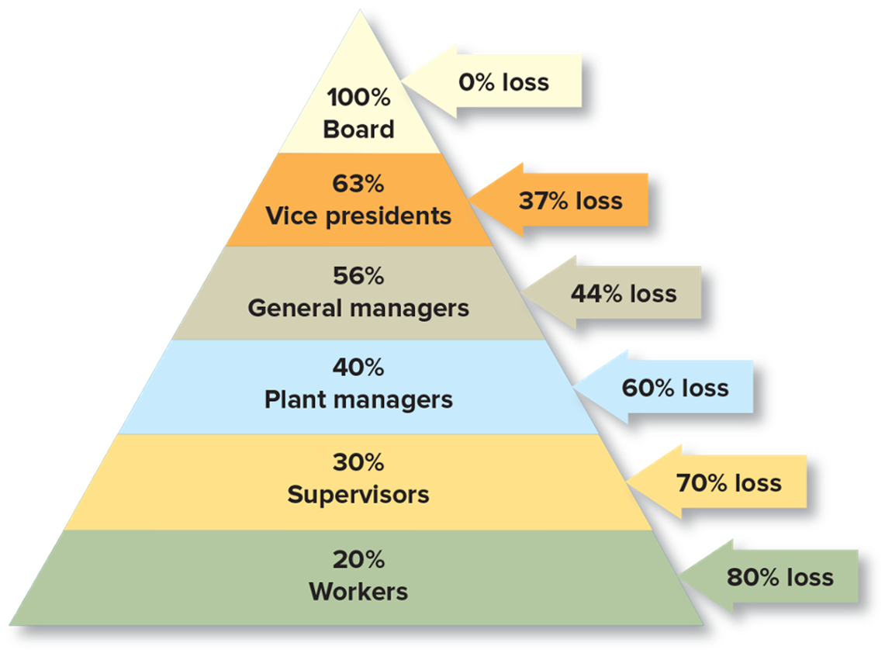
Exhibit 15.4 Information Loss in Downward Communication
Access the text alternative for slide image
Notes:
As communications cascade downward from one person to another through successive organizational levels, much information is lost. The hypothetical data in Exhibit 15.4 suggest that by the time messages reach lower levels, receivers may get very little useful information. The more authority levels through which communication pass, the more information will be lost or distorted. Flatter organizations with fewer hierarchical levels benefit from less filtering.

Slide 24

Coaching and Open-Book Management
Coaching:
Dialogue with a goal of helping another be more effective and achieve his or her full potential on the job.
Open-book management:
Practice of sharing with employees at all levels of the organization vital information previously meant for management’s eyes only.
Notes:
Good coaching helps you think through problems and opportunities, identify options, and learn from experience. Good coaches ask good questions, listen well, provide input, and encourage people to also think for themselves.
Open-book management is controversial because many managers prefer to keep such information to themselves. Sharing strategic plans and financial information with employees could lead to leaks to competitors or to employee dissatisfaction with their pay.

Slide 25
Upward Communication
Information that flows from lower to higher levels in the organization’s hierarchy:
The information may be facilitated by techniques such as management by wandering around (M B W A).
Management must not hold a grudge if they receive negative information.
Voice: when people speak up with good intentions about work-related issues, rather than remaining silent.
Notes:
Useful upward communication must be reinforced and not punished. The person who tries to talk to the manager about an important issue must not be brushed off repeatedly. An announced open-door policy must truly be open door. Ideally, people trust their bosses and know that they will not hold a grudge against whoever delivers negative information. Managers should truly listen and learn, not punish the messenger for being honest, and take action on valid ideas.

Slide 26

Horizontal Communication
Information shared among people on the same hierarchical level:
Allows sharing of information, coordination, and problem solving among units.
Helps to solve conflicts.
Provides social and emotional support to people.
Notes:
Much information needs to be shared among people on the same hierarchical level. Such horizontal communication can take place among people in the same work team or in different departments. For example, a purchasing agent discusses a problem with a production engineer, and a task force of department heads meets to discuss a widespread concern. Communicating with others outside the firm, including potential investors, is another vital type of horizontal communication.

Slide 27

Informal Communication
More unofficial than formal:
Provides people with information.
Helps them solve problems.
Teaches them how to do their work successfully.
Grapevine: informal communication network.
Notes:
Communications differ in their levels of formality. Formal communications are official, management-sanctioned episodes of information transmission. Informal communication is more unofficial. People gossip; employees complain about their bosses; friends talk about their favorite sports teams; work teams tell newcomers how to get by.
The grapevine is the social network of informal communications. You should develop a good network of people willing and able to help. However, the grapevine can be destructive when misinformation proliferates and harms people and operations.

Slide 28
Managing Informal Communication
How to manage the grapevine:
Don’t allow malicious gossip.
Prevent rumors from starting by providing facts.
Neutralize rumors once they have started.
Transparency:
People’s beliefs that the information their employer and others send them is of high quality, as defined by accuracy, timeliness, and full disclosure of relevant information.
Notes:
Consistency between words and action is one type of integrity, which creates trust. Transparency, too, strengthens people’s trust in an organization and in one another. These are vital contributors to personal, team, and organizational effectiveness.

Slide 29
Boundaryless Organization
An organization in which there are few major obstacles to information flow
Information is available as needed, moving quickly and easily enough so that the organization functions far better as a whole than as separate parts.
Transparency strengthens people’s trust in an organization and in one another.
Notes:
Some executives know how important it is to be more open with information than tradition used to dictate, and employees do want more information than less. You will often hear of a desire for more transparency: people’s receiving relevant, high-quality information defined by accuracy, timeliness, and full disclosure. This free flow does not imply a random free-for-all of unlimited communication and information overload. It implies information available as needed moving fast and easily enough that the organization functions far better as a whole than as separate parts.
Boundarylessness facilitates dialogue by turning psychological barriers into permeable membranes. GE’s famous Workout program is a series of meetings characterized by extremely frank, tough discussions among people of different units and hierarchical levels. Well over a million GE employees have attended Workout programs

Slide 30
Management in Action What Does Bumble Communicate? Ladies First!
Bumble, the dating app that puts women in the lead, is completely transparent about what it wants to communicate both inside the workplace and to the world at large: Ladies should in fact (and at long last!) come first.
What do you think of Bumble’s central message of “Ladies first"? What are its advantages? What are some potential drawbacks?
Bumble is trying to create a more collaborative environment for female employees. How can two-way communication be used to realize this goal?
Notes:
Questions:
What do you think of Bumble’s central message of “Ladies first"? What are its advantages? What are some potential drawbacks?
The advantage is in flipping the script in which party starts a two-way conversation. This make Bumble stand out providing a market advantage. A potential drawback would be if the size of the market preferring this approach is too small or less likely to lead to continued use of the service because the receiving party is less interested in continuing the communication.
Bumble is trying to create a more collaborative environment for female employees. How can two-communication be used to realize this goal?
Two-way communication is more difficult and time-consuming than one-way communication. However, it is more accurate: fewer mistakes occur, and fewer problems arise later. When receivers have a chance to ask questions, share concerns, and make suggestions or modifications, they understand more precisely what the sender is communicating and what they should do with the information and two-way communication is a prime contributor to performance. Bumble can mine the grapevine for information shared informally and turn it into a two-way communication channel with upper management.

Slide 31
In Review
Discuss important advantages of two-way communication.
Identify communication problems to avoid.
Describe when and how to use the various communication channels.
Summarize ways to become a better sender and receiver of information.
Explain how to improve downward, upward, and horizontal communication.
Summarize how to work with the company grapevine.
Understand transparency and what it means to be “boundaryless.”
Notes:
This slide may be used as a review of the lesson and to facilitate discussion.
Managerial Control is discussed in the next chapter.

Slide 32
End of Main Content
© 2023 McGraw Hill, LLC. All rights reserved. Authorized only for instructor use in the classroom. No reproduction or further distribution permitted without the prior written consent of McGraw Hill, LLC.

Slide 33
Accessibility Content: Text Alternatives for Images

Slide 34
Exhibit 15.1 A General Model of Communication – Text Alternative
Return to parent-slide containing images.
Step 1. Person A, the sender, has meaning he or she wants to convey.
Step 2. Person A encodes the meaning into symbols (chosen words).
Step 3. The message goes through the communication channel.
Step 4. Person B, the receiver, decodes the message.
Step 5. Decoding the message provides Person B with the perceived meaning.
Return to parent-slide containing images.

Slide 35
Exhibit 15.4 Information Loss in Downward Communication – Text Alternative
Return to parent-slide containing images.
A pyramid represents the hierarchy of an organization and shows the percentages of information loss that might occur at each level in this structure.
With the information starting from the top, the board of directors, there is 0 percentage loss of information—all information is 100 percent complete. As it moves down the hierarchy, information is lost: 37 percent loss at the vice president level, 44 percent loss at general managers level, 60 percent loss at plant managers level, 70 percent loss at supervisor level, and finally the workers miss 80 percent of the information communicated.
Return to parent-slide containing images.

