Slide 1
MGT10009 Contemporary Management Principles
Lecture 5 Teamwork
Dr David Qian dqian@swin.edu.au
Peter Moran pmoran@swin.edu.au
Notes:
1

Slide 2
Learning Objectives
14-1 Discuss how teams can contribute to an organization’s effectiveness.
14-2 Describe different types of teams.
14-3 Summarize how groups become teams.
14-4 Explain why groups sometimes fail.
14-5 Describe how to build an effective team.
14-6 List methods for managing a team’s relationships with other teams.
14-7 Identify ways to manage conflict.

Slide 3
Management in Action Teamwork at Whole Foods
Whole Foods has a purpose beyond profits:
a purpose beyond selling organic foods.
seeks to “nourish people and the planet.”
Their mission shape:
sell Animal Welfare Certified meats
sustainably wild-caught or farmed fish
organically grown produce and whole grains.
shapes the way it treats its employees.
Team spirit and empowerment have laid a strong foundation for business success. C E O John Mackey says living out the store’s values creates a climate that frees employees to innovate and be creative without fear.
Notes:
The chapter starts with the example of Whole Foods and this company is featured later in the chapter with some discussion questions.

Slide 4
The Contributions of Teams
Teams can:
be the building blocks for organizational structure
increase productivity, improve quality and reduce costs
enhance speed, promote innovation, creativity and change.
promote member growth and development via feedback, training coaching and mentoring.
.
Notes:
Companies use teams to achieve competitive advantage. Used properly, teams can be powerfully effective as a building block for organization structure. Teams improve the quality of decision making and are powerful forces for innovation, change, and creativity.

Slide 5
Types of Teams 1
Work:
that make / do things - manufacture, assemble, sell, provide service.
Project and development:
that work on long-term projects, then disband on completion.
Parallel:
that operate separately from the regular work structure
are temporary.
Management:
that coordinate and provide direction to the subunits.
Notes:
Your employer may have hundreds of groups and teams with many different types. This slide and the next give a few of the best-known examples. Teams may fit into more than one of these categories.

Slide 6
Types of Teams 2
Transnational:
Teams that differ from other work teams by being multicultural and by often being geographically dispersed, being psychologically distant, and working on highly complex projects having considerable impact on company objectives.
Virtual:
Teams that are physically dispersed and communicate electronically more than face-to-face.
Teaming:
A strategy of teamwork on the fly, creating many temporary, changing teams.
Notes:
Transnational teams tend to be virtual teams, communicating electronically more than face-to-face. Although other types of teams may operate virtually as well.

Slide 7
Exhibit 14.1 Best Practices of Virtual Team Leaders
Establish and maintain trust through the use of communication technology.
Ensure diversity in the team is understood, appreciated, and leveraged.
Manage virtual work cycle and meetings.
Monitor team progress through the use of technology.
Enhance external visibility of the team and its members.
Ensure individuals benefit from participating in virtual teams.
SOURCE: Adapted from A. Malhotra, A. Majchrzak, and B. Rosen, “Leading Virtual Teams,” Academy of Management Perspectives, February 2007, pp. 60–70.
Notes:
Virtual teams face difficult challenges: building trust, cohesion, and team identity, and overcoming the isolation of virtual team members. Exhibit 14.1 (recreated on this slide) shows a few other tactics that managers can use to strengthen virtual teams.

Slide 8
Self-Managed Teams
Autonomous work groups in which workers are trained to do all or most of the jobs in a unit, have no immediate supervisor, and make decisions previously made by frontline supervisors
Autonomous work groups:
Groups that control decisions about and execution of a complete range of tasks.
Self-designing teams:
Have responsibilities of autonomous work groups, plus control over hiring, firing, and deciding what tasks members perform.
Notes:
Traditional work groups have no managerial responsibilities; the frontline manager plans, organizes, staffs, directs, and controls them, and other groups provide support activities, including quality control and maintenance. But one important trend is to give teams more autonomy so that workers are trained to do all or most of the jobs in the unit, and they make decisions previously made by their bosses.

Slide 9
Management in Action Self-Managed Teams at Whole Foods
Company:
known for team member involvement in hiring decisions
but employees support rather than control the process.
HR screen job applications and selects those with the skills.
Those passing screening are interviewed by store leaders.
What are the advantages of this teamwork?
Why do you HR conduct the initial screening?
List the consequences of having the store teams carry out the entire process?
Notes:
Questions:
What advantages does teamwork offer to Whole Foods?
Whole Foods uses teamwork to push decision-making authority downward. This could make the jobs more motivating, so employees deliver higher quality and productivity. Sharing authority for decision making also could result in more innovation at Whole Foods. For team members, teamwork provides an opportunity to learn about the company and acquire new skills while satisfying personal needs such as affiliation and esteem. Team members also can contribute to one another’s learning and development by providing feedback. Students should be able to give examples of how teamwork leads to improved decision making, creativity, innovation, ability to change and opportunities for growth and development of team members.
Why do you think human resource professionals conduct the initial screening process for new hires? What might be the consequences of having the store teams carry out the entire process of hiring and rewarding team members?
Student answers should point to the expertise of HR professionals in designing screening processes related to the skills and abilities required of the job along with qualities required by the team. HR should have a better sense of the big picture and how teams are interdependent on other teams. An HR professional has the specialized knowledge required to make screening and compensation decisions related to relevant qualifications and performance data. Besides working with greater efficiency in what can be a time-consuming process, this person also is more likely to be able to navigate the legal requirements and avoid discrimination. The team members then interview only people who are qualified, so they can focus on who is a good fit for the team. The consequences of having the team carry out the entire process would also mean more time away from serving customers and the risk of making decisions that could be viewed as discriminatory.

Slide 10
Work Groups and Real Teams
Group and team: not interchanged
A working group:
a collection of people who work in the same area
or have been drawn together to undertake a task
but do not necessarily come together as a unit
A real team:
formed of people with complementary skills
who trust one another and are
committed to a common purpose, performance goals, and approach holding themselves mutually accountable.
Notes:
The words group and team often are used interchangeably. Managers sometimes use the word teams to the point that it has become a cliché; often they talk about teams even when there is no real teamwork.
It’s useful to make a distinction between groups and teams. A working group is a collection of people who work in the same area or have been drawn together to undertake a task, but do not necessarily come together as a unit and achieve significant performance improvements. A real team is formed of people (usually a small number) with complementary skills who trust one another and are committed to a common purpose, common performance goals, and a common approach for which they hold themselves mutually accountable.

Slide 11
Exhibit 14.2 Stages of Team Development
Forming
Group members attempt to lay the ground rules for what types of behavior are acceptable.
Storming
Hostilities and conflict arise, and people jockey for positions of power and status.
Norming
Group members agree on their shared goals, and norms and closer relationships develop.
Performing
The group channels its energies into performing its tasks.
SOURCE: Adapted from B. W. Tuckman, “Developmental Sequence in Small Groups,” Psychological Bulletin 63 (19 65), pp. 384–99.
Notes:
Assume you are the leader of a newly formed group—actually, a bunch of people. What will you face as you attempt to develop your group into a high-performing team? If groups are to develop successfully, they will engage in various processes, including the broad categories detailed in Exhibit 14.2 (recreated on this slide).

Slide 12
Teaming Challenges
Helpful practices:
Emphasizing the team’s purpose.
Building psychological safety.
Embracing failure.
Putting conflict to work.
Notes:
Practices that are particularly helpful in the team context include:
(1) emphasizing the team’s purpose, including why we exists, what’s at stake, and what its shared values are;
(2) building psychological safety, making clear that people need to and can freely speak up, be honest, disagree, offer ideas, raise issues, share their knowledge, and ask questions;
(3) embracing failure, understanding that mistakes are inevitable, errors should be acknowledged, and learning as we go is a way to create new knowledge while we execute;
and
(4) putting conflict to work by explaining how we arrive at our views, expressing interest in one another’s thinking and analyses, and attempting fully to understand and capitalize on others’ diverse perspectives.

Slide 13

Building Effective Teams
Team effectiveness is defined by three criteria.
Team productivity.
Member satisfaction.
Member commitment.
Notes:
What does it really mean for a team to be effective? Team effectiveness is defined by three criteria.
Team productivity. The output of the team meets or exceeds the standards of quantity and quality expected by the customers, inside and outside the organization, who receive the team’s goods or services.
Member satisfaction. Team members realize satisfaction of their personal needs.
Member commitment. Team members remain committed to working together again; that is, the group doesn’t burn out and disintegrate after a grueling project. Looking back, the members are glad they were involved. In other words, effective teams remain viable and have good prospects to work well together in the future.

Slide 14

Performance Focus
Core of effective teamwork is commitment to a common purpose:
Work at developing a common understanding.
Be willing to try creative new ideas.
Translate the general into specific, measurable performance goals.
Define team-based performance goals.
Receive feedback on performance.
Notes:
The core of effective teamwork is commitment to a common purpose. The best teams are those that face an important performance challenge and share a common understanding and appreciation of their collective purpose. Without this, a group will be just a bunch of individuals.
The best teams also work hard at developing a common understanding of how they will work together to achieve their purpose. They discuss and agree on details such as how to assign tasks and how they will make decisions. The team should examine its performance strategies and be open to changing them when appropriate.
Teams usually standardize at least some processes, but they should be willing to try creative new ideas. With a clear, strong, motivating purpose and effective performance strategies, people pull together into a powerful force that has a chance to achieve extraordinary things.

Slide 15
Motivating Teamwork
Social loafing:
Working less and
being less productive when in a group.
Social facilitation effect:
Working harder in a group than alone.
Ultimately, teamwork is motivated by tying rewards to team performance.
Notes:
Sometimes individuals work less hard and are less productive when they are members of a group. Such social loafing occurs when a person believes that their contributions are not important, others will do the work for them, their lack of effort will go undetected, or they will be the lone sucker if they work hard but others don’t. Conversely, sometimes individuals work harder when they are members of a group than when they are working alone. This social facilitation effect occurs because individuals usually are more motivated when others are present, they are concerned with what others think of them, and they want to maintain a positive self-image.

Slide 16

SPOTLIGHT ON… Co-Working–Is It Here to Stay?
Work is becoming digital and portable
Co-working space may increase.
COVID-19 slowed the process.
Was interest in communal space increased?
Shutdowns/quarantines highlight that we are social animals.
Can co-working help entrepreneurs or remote workers feel like part of a team, how?
Do epidemics/pandemics impact the future of co-working spaces? How?
Notes:
Questions:
Can co-working help entrepreneurs or remote workers feel like part of a team, and if so, how?
Co-working provides the ability to communicate with others who can help with development via coaching and mentoring. It is also likely to lead to feelings similar to member satisfaction because of the common experience and ability to share the events and challenges of the days with others who face similar circumstances.
How do you think epidemics and pandemics will affect the future of shared co-working spaces?
Shared co-working spaces might transform in terms of the days and hours per week employees spend at these physical locations. It is possible more employees will use them as part of a hybrid work environment. If one considers the virtual shared co-working spaces, it is likely these shared spaces will increase in popularity as organizations and employees are learning how they can actually increase the productive of teams and the satisfaction of team members.

Slide 17
Norms and Roles
Norms:
Shared beliefs about how people should think and behave.
Roles:
Different sets of expectations for how different individuals should behave
Task specialist role.
Team maintenance role.
Notes:
Two important sets of roles must be performed.
Task specialist roles are filled by individuals who have particular job-related skills and abilities.
Team maintenance roles develop and maintain harmony within the team. They boost morale, give support, provide humor, soothe hurt feelings, and generally exhibit a concern with members’ well-being.

Slide 18
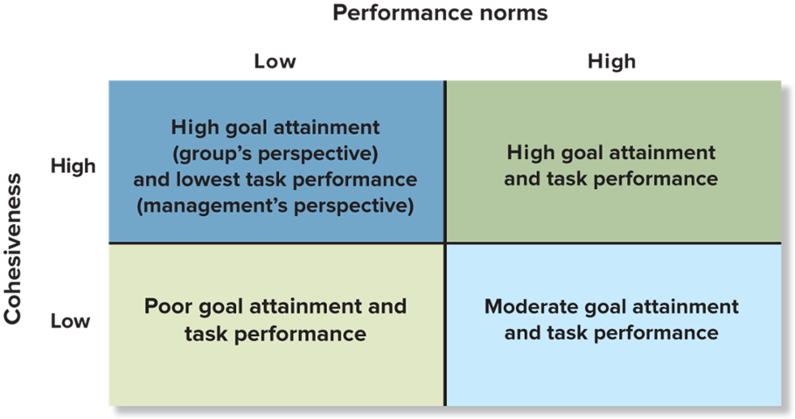
Exhibit 14.3 Cohesiveness, Performance Norms, and Group Performance
Notes:
One of the most important properties of a team is cohesiveness. Expanding the Chapter 13 description, cohesiveness refers to how attractive the team is to its members, how motivated members are to remain in the team, and the degree to which team members influence one another. In general, it refers to how tightly knit the team is.

Slide 19


Building Cohesiveness and High-Performance Norms
Recruit members with similar attitudes, values, and backgrounds.
Maintain high entrance and socialization standards.
Foster and practice empathy.
Keep the team small.
Help the team succeed and publicize its successes.
Be a participative leader.
Present a challenge from outside the team.
Tie rewards to team performance.
Notes:
Managers should build teams that are cohesive and have high-performance norms. The actions listed on the slide can help create such teams.

Slide 20
Lateral Role Relationships
Workflow relationships emerge as materials are passed from one group to another.
Service relationships exist when top management centralizes an activity to which a large number of other units must gain access.
Advisory relationships are created when teams with problems call on centralized sources of expert knowledge.
Audit relationships develop when people not directly in the chain of command evaluate the methods and performances of other teams.
Stabilization relationships involve auditing before the fact.
Liaison relationships involve intermediaries between teams.
Notes:
Teams do not function in a vacuum; they are interdependent with other teams. These interdependencies create conflicts both between and within teams, and therefore require coordination and leadership. To understand the process and make it more productive, it helps to know the different types of lateral role relationships.
Workflow relationships emerge as materials are passed from one group to another.
Service relationships exist when top management centralizes an activity to which a large number of other units must gain access.
Advisory relationships are created when teams with problems call on centralized sources of expert knowledge.
Audit relationships develop when people not directly in the chain of command evaluate the methods and performances of other teams.
Stabilization relationships involve auditing before the fact.
Liaison relationships involve intermediaries between teams.

Slide 21

Managing Conflict
Conflict can be:
Healthy or Unhealthy.
Productive or Unproductive
Foster creativity or not.
Ambiguities
Competition
Different perspectives,
can all lead to destructive conflict.
Notes:
Many factors cause great potential for destructive conflict: the sheer number and variety of interpersonal contacts, ambiguities in jurisdiction and responsibility, differences in goals, competition for scarce resources, different perspectives held by members of different units, and varying time horizons in which some units attend to long-term considerations and others focus on short-term need. Commonly, factions form along conflict fault lines.

Slide 22
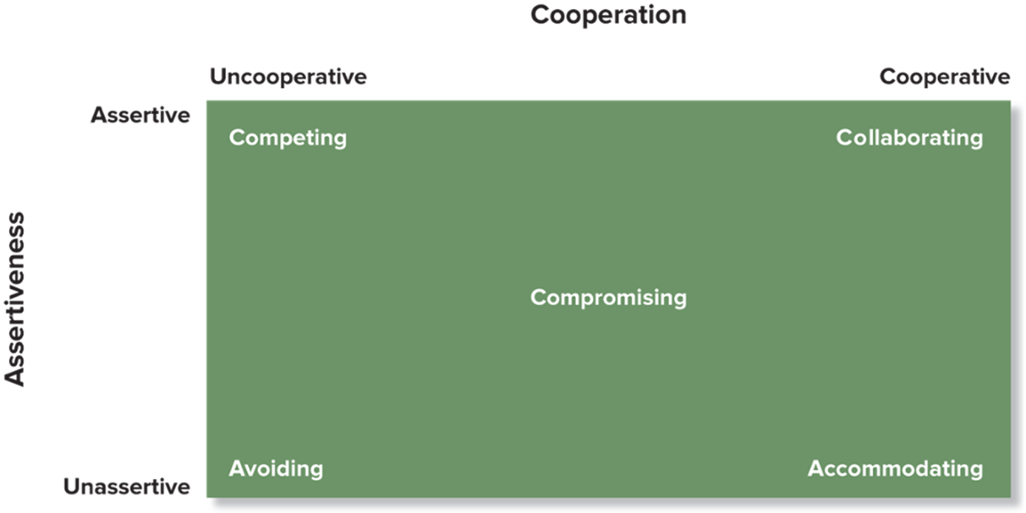
Exhibit 14.4 Conflict Management Strategies
SOURCE: K. Thomas, “Conflict and Conflict Management,” in Handbook of Industrial and Organizational Psychology, ed. M. D. Dunnette (Chicago: Rand McNally, 19 76).
Notes:
Avoidance: A reaction to conflict that involves ignoring the problem by doing nothing at all or deemphasizing the disagreement.
Accommodation: A style of dealing with conflict involving cooperation on behalf of the other party but not being assertive about one’s own interests.
Compromise: A style of dealing with conflict involving moderate attention to both parties’ concerns.
Competing: A style of dealing with conflict involving strong focus on one’s own goals and little or no concern for the other person’s goals.
Collaboration: A style of dealing with conflict emphasizing both cooperation and assertiveness to maximize both parties’ satisfaction.
An important technique is to invoke superordinate goals—higher-level organizational goals toward which everyone should be striving and that ultimately need to take precedence over personal or unit preferences

Slide 23
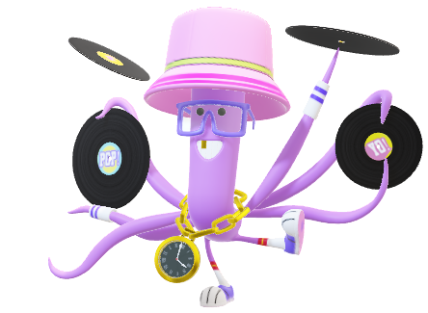
Virtual and E-conflict
When teams are geographically dispersed:
often the case for virtual teams
Team members tend to experience:
more conflict and
less trust.
To limit issues:
Monitor and reduce/eliminate negative issues.
Show a willingness to cooperate and
Be cooperative.
Notes:
When teams are geographically dispersed, as with virtual teams, team members tend to experience more conflict and less trust. One study showed how different conflict styles affect the success of virtual teams. Avoidance hurt performance. Accommodation—conceding to others to maintain harmony rather than assertively attempting to negotiate integrative solutions—had no effect on performance. Collaboration had a positive effect on performance.

Slide 24


Being a Mediator
Mediator:
third party who helps to manage conflict.
Four-stage model of dispute resolution:
Investigate.
Review findings.
Apply solutions.
Follow-up.
Notes:
You already may have served as a mediator, a third party intervening to help settle a conflict between other people. Third-party intervention, done well, can improve working relationships and help the parties improve their own conflict management, communication, and problem-solving skills.
Mediators may wish to follow a four-stage strategy, summarized in Exhibit 14.6 (recreated in text form on this slide.)
They investigate by interviewing the disputants and others and gathering more information.
They review the findings to determine how best to resolve the dispute, often in conjunction with the disputants’ bosses. They do not assign blame prematurely; at this point they explore solutions.
They take action by applying solutions and explaining their opinions and the reasoning and advise or train the disputants to avoid future incidents.
And they follow up by making sure everyone understands the solution, documenting the conflict and the resolution, and monitoring the results by checking back with the disputants and their bosses.

Slide 25
Management in Action: Balancing Teamwork and Diversity at Whole Foods
A sense of mission and shared values unifies employees.
The company stresses a commitment to diversity in hiring
posing a challenge to team cohesiveness.
Whole Foods empowers the individual to help bring a diverse workforce together.
What other strategies can be employed?
How does diversity pose a challenge to cohesive teams?
How can it be a benefit?
Notes:
Questions:
Whole Foods empowers the individual to help bring a diverse workforce together. What other strategies can be employed to reach this same end?
Whole Foods recruits team members who share its corporate values, despite coming from different backgrounds. Its hiring process, which includes team interviews and a probationary period followed by a vote, establishes fairly high entrance and socialization standards. It encourages team member participation in decisions and sets up competitions among teams. It also ties incentive pay to team performance. Whole Foods could consider using other measures associated with cohesiveness: keeping teams small, facilitating team success, publicizing team successes, and competing against threats outside the company. At the same time managers are promoting cohesiveness, they should be sure to allow room for team members to disagree over issues without personal conflict and animosity.
In what ways can diversity pose a challenge to cohesive teams and in what ways can it be a benefit?
Highly diverse teams may have more conflict at least initially when determining how to approach a challenge. As a result, it is important to teach conflict management skills and have mediators available. Many studies also find that diverse teams require more time for decision-making. However, the quality of team decisions tend to be superior, and diverse teams tend to be more innovative.

Slide 26
In Review
Discuss how teams can contribute to an organization’s effectiveness.
Describe different types of teams.
Summarize how groups become teams.
Explain why groups sometimes fail.
Describe how to build an effective team.
List methods for managing a team’s relationships with other teams.
Identify ways to manage conflict.
Notes:
This slide may be used as a review of the lesson and to facilitate discussion.
Chapter 15 discusses Communication, both interpersonal and organizational.

