Slide 1


COS30018 - Intelligent Systems Introduction

Slide 2
Unit Learning Outcomes
Aim: to introduce students to a range of artificial intelligence techniques
Learning Outcomes
Understand a range of techniques of intelligent systems
across artificial intelligence (AI) and intelligent agents (IA);
from theoretical & practical perspective
Apply different AI/IA algorithms to solve practical problems
Design/build simple intelligent systems based on AI/IA concepts

Slide 3
Recommended Reading
Reading
Russell, S. & Norvig, P. Artificial Intelligence: A Modern Approach. Prentice Hall, 3rd edition/4th edition, 2009
Negnevitsky, M., 2005. Artificial intelligence: a guide to intelligent systems. Pearson education, 3rd edition.
Wooldridge, M. An Introduction to Multi-Agent Systems. John Wiley & Sons, 2002
Lecture slides posted on Canvas + online Internet resources…

Slide 4

Content
Topics
Introduction to Intelligent Systems
Intelligent agents and multi-agent systems
Knowledge representation and reasoning
Learning and adaptation
Neural networks
Evolutionary computing
Collective intelligence
(Agent methodologies and applications)

Slide 5
Assessment
Project: Design and implementation of a simple intelligent system to solve a practical problem
Agent-based & Optimization or Machine Learning system: built using IS principles/algorithms
Working software - demonstration
Short project report (summary of work, architecture, interaction, algorithm/s, result analysis, example)
Video if applicable (s/w demo)
Assignment Release: on Canvas
Assignment Progress: will be checked by your tutor starting Week 3!
If you choose Option C, you will have Weekly Tasks due in Week 3!
Continuous Oral Defence: Individual Q&A (about the subject matter covered in the lectures)

Slide 6
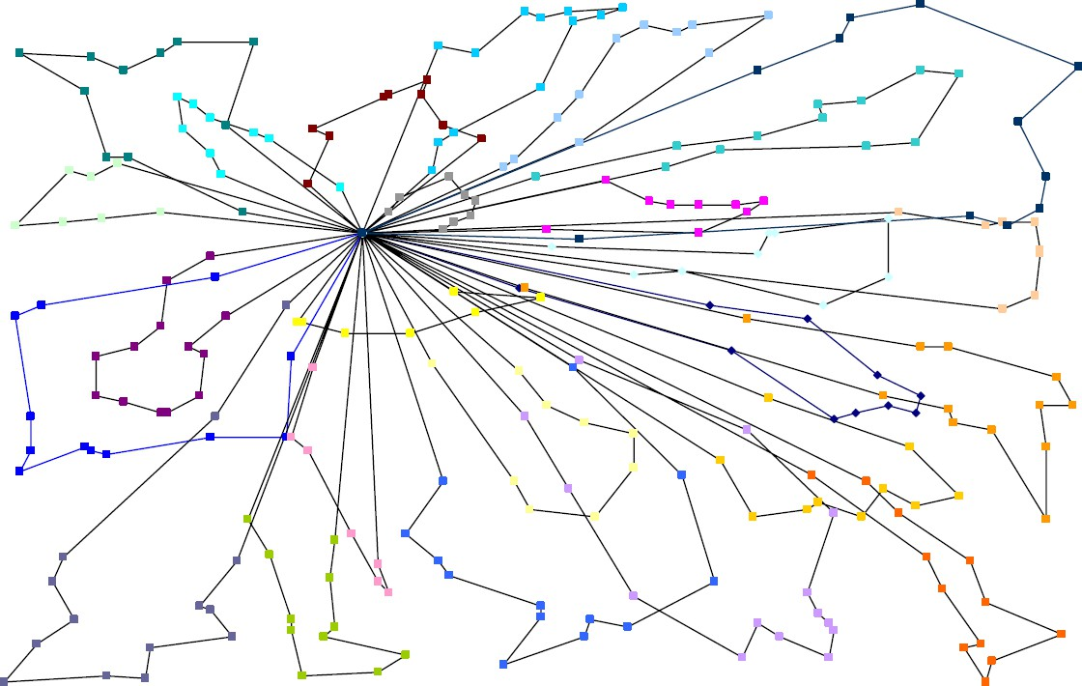
Project Option A:
Delivery Vehicle Routing System
Project: Design and implementation of a simple delivery vehicle routing system involving delivery agents and a master routing agent whose job is to find the optimal routes for the delivery vehicle agents to get their parcels to the receivers.
Interaction Protocols
Search/optimization
Dynamic adaptation
Automated negotiation

Slide 7


Project Option B:
Handwritten Number Recognition System
Project: Design and implementation of a simple machine learning system for recognising handwritten characters & symbols
Machine learning
Deep learning
Computer vision

Slide 8
Project Option C:
Stock Price Prediction System
Project: Design and implementation of a simple machine learning system for predicting stock price of companies on the stock market using real-world datasets.
You are going to work in a project led by a teaching staff. The project leader will give you starting code for this project. It is quite poor (in terms of programming and performance). We will give you weekly tasks to do to improve this code base (and in the process, you will learn about things such as data processing and deep learning).
Machine learning
Deep learning
Stock price prediction

Slide 9
Project Option D:
Large Language Model (LLM)-powered Autonomous Agents and Multiagent systems
This project aims to implement and demonstrate the capabilities of autonomous agents powered by large language models (LLMs) such as GPTs, Llama’s, or Gemini’s.
If you join this project, you will work under the supervision of your teaching staff of this unit and within a team of students (between 3 and 5 students).
Machine learning
NLP
Large language Models
Generative AI

Slide 10
Other Resources
Google OR-Tools/Vehicle Routing Problem:
https://developers.google.com/optimization/routing/vrp
Larry’s page on Traffic Flow Prediction with Neural Networks(SAEs, LSTM, GRU):
https://github.com/xiaochus/TrafficFlowPrediction
Google Machine Learning Crash Course: https://developers.google.com/machine- learning/crash-course/
AUTOMATED NEGOTIATING AGENT COMPETITION (ANAC):
https://www.ijcai-18.org/anac/index.html http://web.tuat.ac.jp/~katfuji/ANAC2018/
JADE tutorials, documentation and guidelines from
https://jade.tilab.com/documentation/tutorials-guides/
“Complete Guide to LLM Agents (2025)” by Sarah Chudleigh
https://botpress.com/blog/llm-agents

Slide 11
TODO this week (for you)
Form a team (if you choose Option A, B or D)
To help your tutor easily recognise the members of the team, please fill in the Google Form.
If you can’t find a team for yourself, please talk to us ASAP.
Feel free to use the Discussion Board on Canvas
Discuss within your team to choose a topic
Teams are to be finalized next week (or Week 3 the latest)
Topic is to be finalized in Week 3 (with your tutor’s approval)!
You can also choose Option C: You will work in a team with your tutor and complete weekly Tasks (first Task is due in Week 3).
NOTE: For Option D, please fill the form with your intention and explain why you will be able to do it. We will have at most 3 groups doing Option D. Those not selected will be notified to choose other options.

Slide 12
COS30018 - Intelligent Systems: Week 1 Introduction to Intelligent Systems

Slide 13
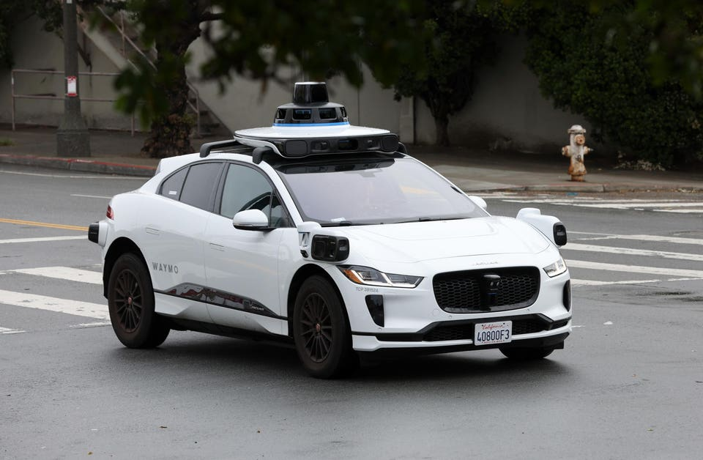
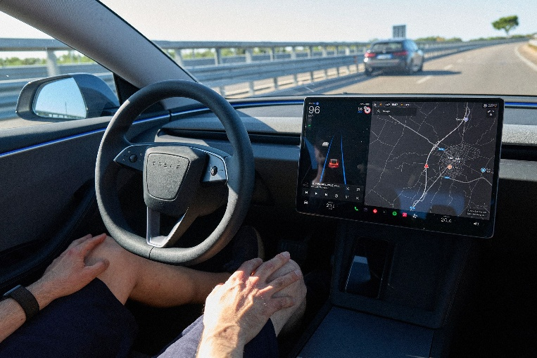
AI in Everyday Life
Voice assistants that understand context and plan (Siri)
Personalized recommendations (Netflix, TikTok, Spotify)
Self-driving car features (Tesla FSD, Waymo)
AI agents handling multi-step tasks autonomously: write code, analyze images, summarize meetings (ChatGPT, Gemini, Claude, Copilot, Grok, DeepSeek, Perplexity, Cursor...)
Notes:
Siri, Google, and Alexa now hold context across a conversation — not just keyword lookup
TikTok & Netflix models process billions of signals to surface what keeps you watching
Waymo completed 2M+ fully autonomous trips in 2025; Tesla FSD v13 handles city streets
GitHub Copilot writes ~46% of new code; Claude & GPT-4o can debug, test, and document
Google Lens, GPT-4o, and Gemini read images, diagrams, receipts — not just typed queries

Slide 14
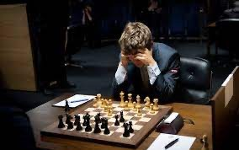

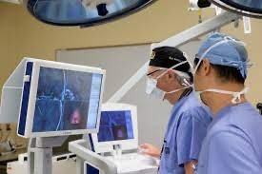
What is intelligence?
Intelligence can be characterized by the capability of:
Reason and solve complex problems
Learn and adapt from experience
Perform perceptual and creative tasks
Interact naturally with humans and the environment

Slide 15
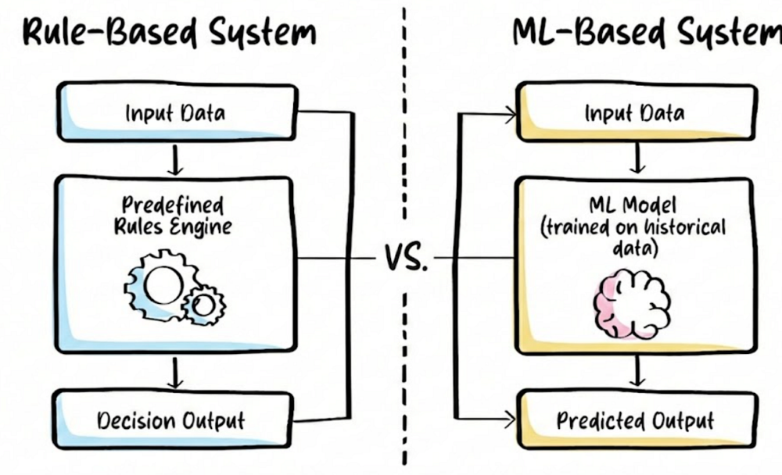
What is an intelligent system?
Systems that perform tasks requiring human intelligence: perceiving, reasoning, learning, and acting autonomously.
Classic (Minsky): “Programming computers to solve tasks that would require intelligence for people. (Rule-Based System)”
Today: Often powered by large foundation models + agents that learn and adapt automatically. (ML/DL/LLM-Based System)
Notes:
A system that perceives its environment, processes information, reasons under uncertainty, and acts autonomously to achieve goals.“
Perception: Video, text, and sensors.
Reasoning: Pattern recognition and logic.
Autonomy: Independent goal achievement.

Slide 16
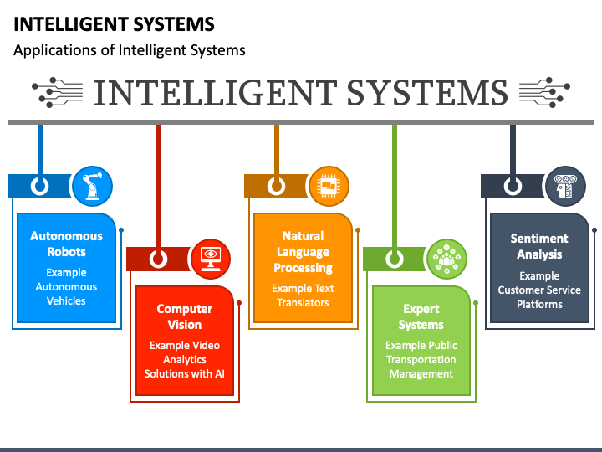
What is an intelligent system?

Slide 17
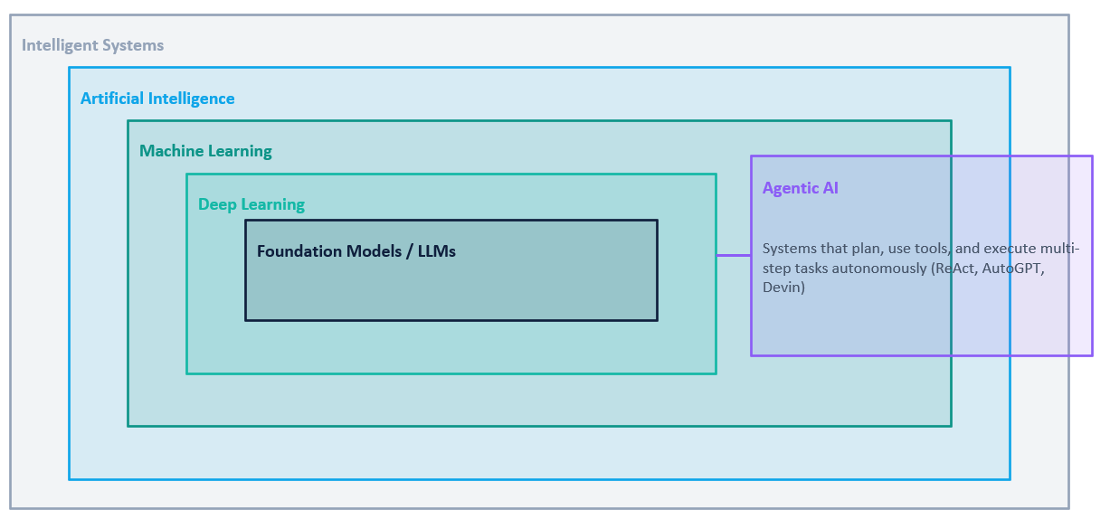
AI Hierarchy

Slide 18
Terminologies
Intelligent systems (IS): Broad umbrella for smart applications
Artificial Intelligence (AI): The science and engineering of intelligent systems
Machine learning (ML)/ Deep Learning (DL): Learning from data (dominant approach)
Foundation Models / LLMs / Multimodal: Large general-purpose models (GPT, Claude, Gemini, Grok, Llama,…)
Intelligent agents (IA) / Agentic AI: Autonomous systems that plan and act
Cognitive computing/modeling: Matching machines to human thought processes (psychology & cognitive science)
Computational intelligence, machine intelligence, soft computing, etc.
Intelligent systems vs AI vs Machine Learning vs …

Slide 19
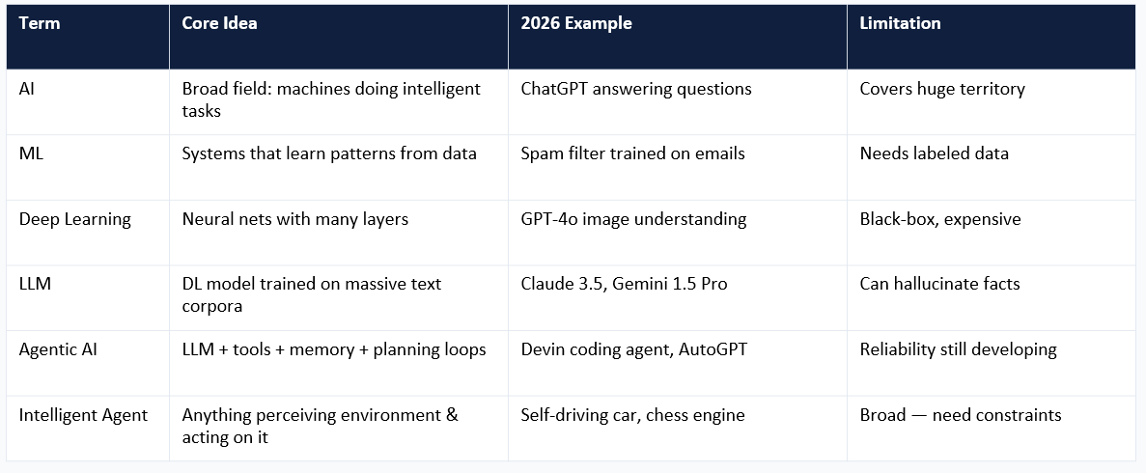
Terminologies
Intelligent systems vs AI vs Machine Learning vs …

Slide 20
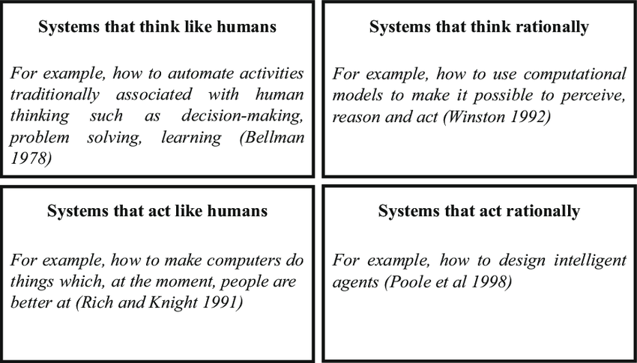
Four Main Paradigms of AI
Artificial Intelligence
(AI)

Slide 21
Four Main Paradigms of AI
Artificial Intelligence
(AI)
AI as a system that acts rationally = Intelligent Agents (IA)
Notes:
Why 'Acting Rationally' Dominates:
No need to model human quirks: Human intelligence is irrational, inconsistent, and context-dependent. Rational agents don't need to mimic these flaws — they just need to reach goals effectively.
Measurable, optimizable objective: We can formally specify a utility function. The agent maximizes it. This makes evaluation, training (RL), and improvement tractable — you know when it's getting better.
Works across radically different domains: The same rational-agent framework describes a chess engine, a recommendation system, a trading algorithm, and a humanoid robot. Universal and powerful.

Slide 22
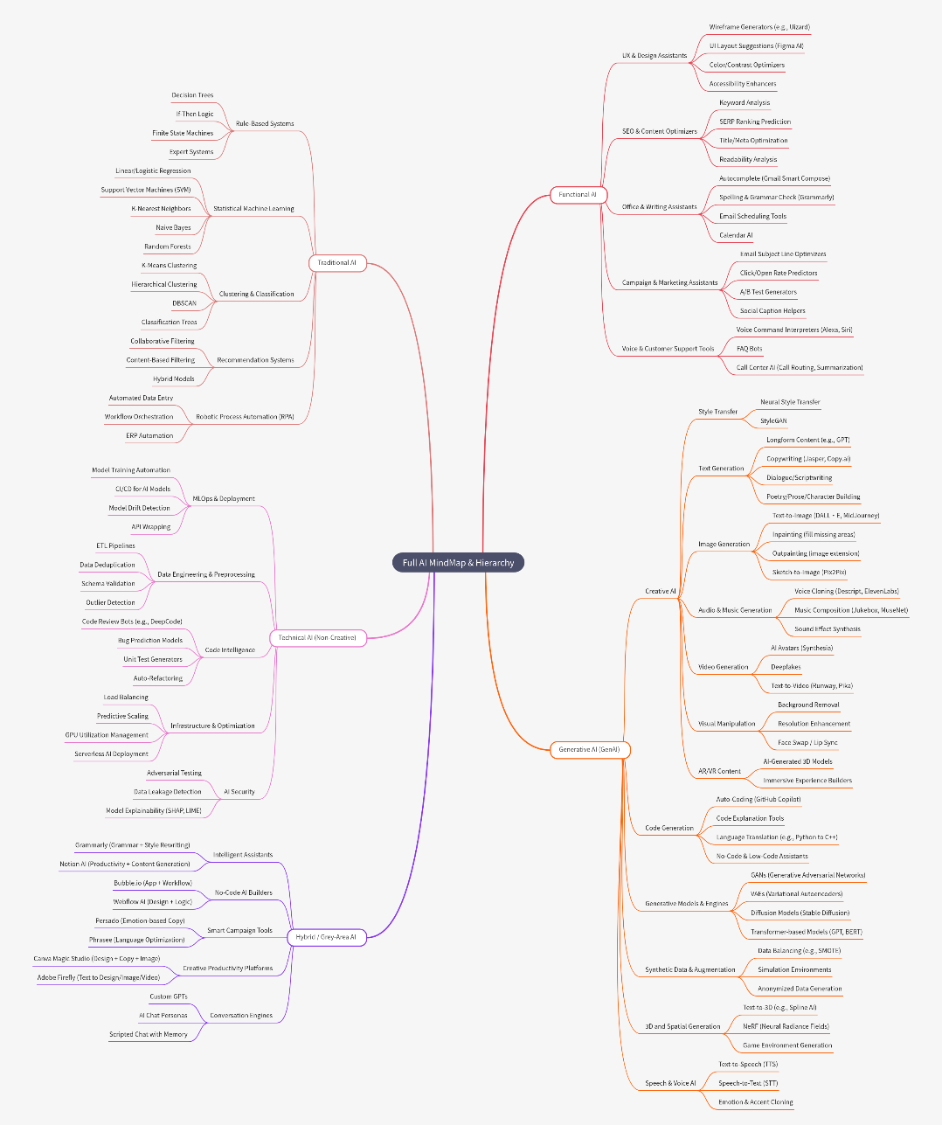
Full AI Mindmap
Intelligent Systems AI
Intelligent Agents Machine Learning
Deep Learning

Slide 23
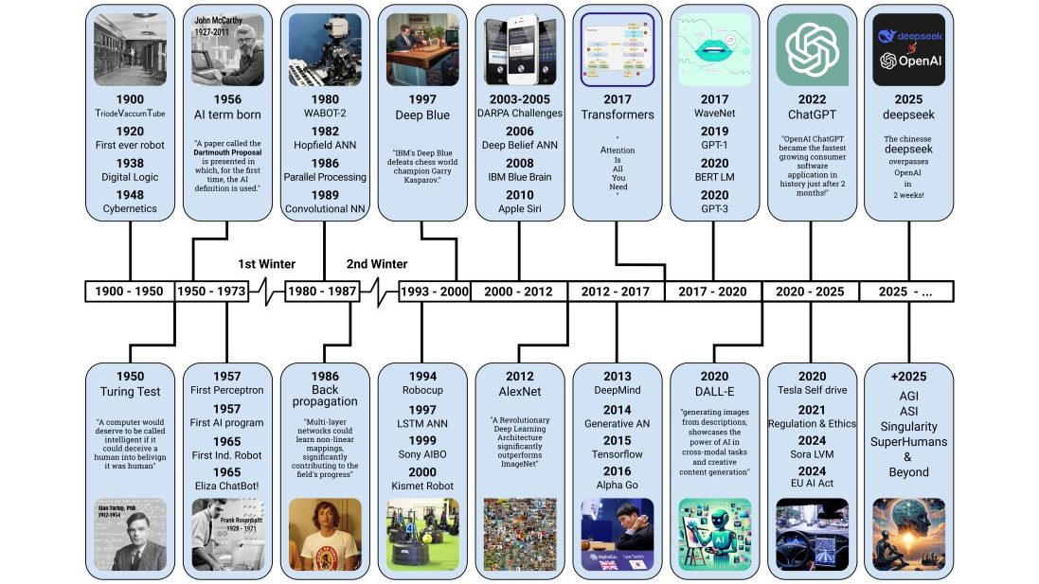
AI History Timeline

Slide 24
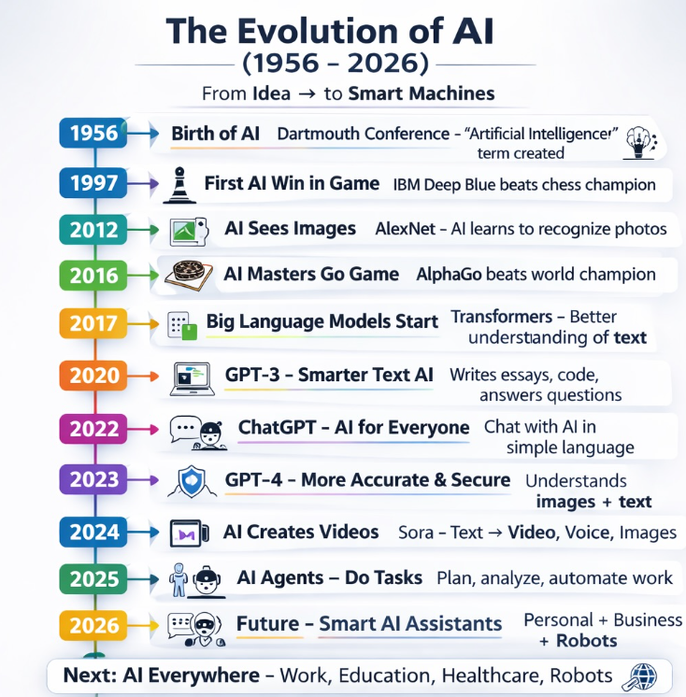
AI History Timeline

Slide 25
AI Breakthrough Timeline
Nov 2022
ChatGPT launches → 100M users in 60 days. Public realisation of LLM capabilities.
Mar 2023
GPT-4 + plugins: first mainstream tool-use. AI can search the web, run code, call APIs.
Jul 2023
Claude 2, Llama 2. Open-weight models democratise fine-tuning.
Jan 2024
Gemini 1.0, Sora (text-to-video). Multimodal becomes standard, not special.
Jun 2024
GPT-4o, Claude 3.5 Sonnet. Voice + vision + text in one seamless model.
Jan 2025
Agentic AI year: Devin, Claude Computer Use, OpenAI Operator: agents run workflows.
2025–26
AI in science: AlphaFold3 for drug design, AI co-authors papers, FrontierMath benchmarks beaten, World Model.

Slide 26
Agentic AI: The Big Shift
From 'answer a question' to 'complete a project'
Traditional AI: Input → Model → Output (one shot, stateless)
Agentic AI: Goal → Plan → Act → Observe → Replan → … → Done
Goal
Plan
Act
Observe
Reflect
Done
User or system sets objective
LLM decomposes into sub-tasks
Calls tools: code, search, browser, API
Reads output, checks for errors
Adjusts plan based on results
Delivers complete result or escalates
Devin (Cognition AI)
Reads GitHub issue → writes code → runs tests → fixes errors → opens PR — all autonomously
Claude Computer Use
Controls browser and OS: reads emails, books travel, fills forms — given only a goal
OpenAI Operator
Books restaurants, fills checkout forms, interacts with any website on the user's behalf

Slide 27






AI and Intelligent Systems in Industry
Software Development
Finance & Trading
Microsoft Copilot: developers 55% faster in studies. Devin autonomously closes GitHub issues.
JPMorgan COIN processes 360K legal docs in seconds (was 360,000 hrs/yr of lawyer time).
Healthcare
Supply Chain & Retail
AlphaFold3: protein-drug binding prediction. NHS AI detects cancer earlier than radiologists.
Walmart AI reduces out-of-stock by 30%. Amazon: 75% of warehouse tasks assisted or automated.
Scientific Research
Education & HR
AI co-authors in Nature. Materials science: AI discovered 2.2M new crystal structures (2024).
Duolingo, Khanmigo (Khan Academy). AI screening tools process 85% of Fortune 500 job applications.

Slide 28
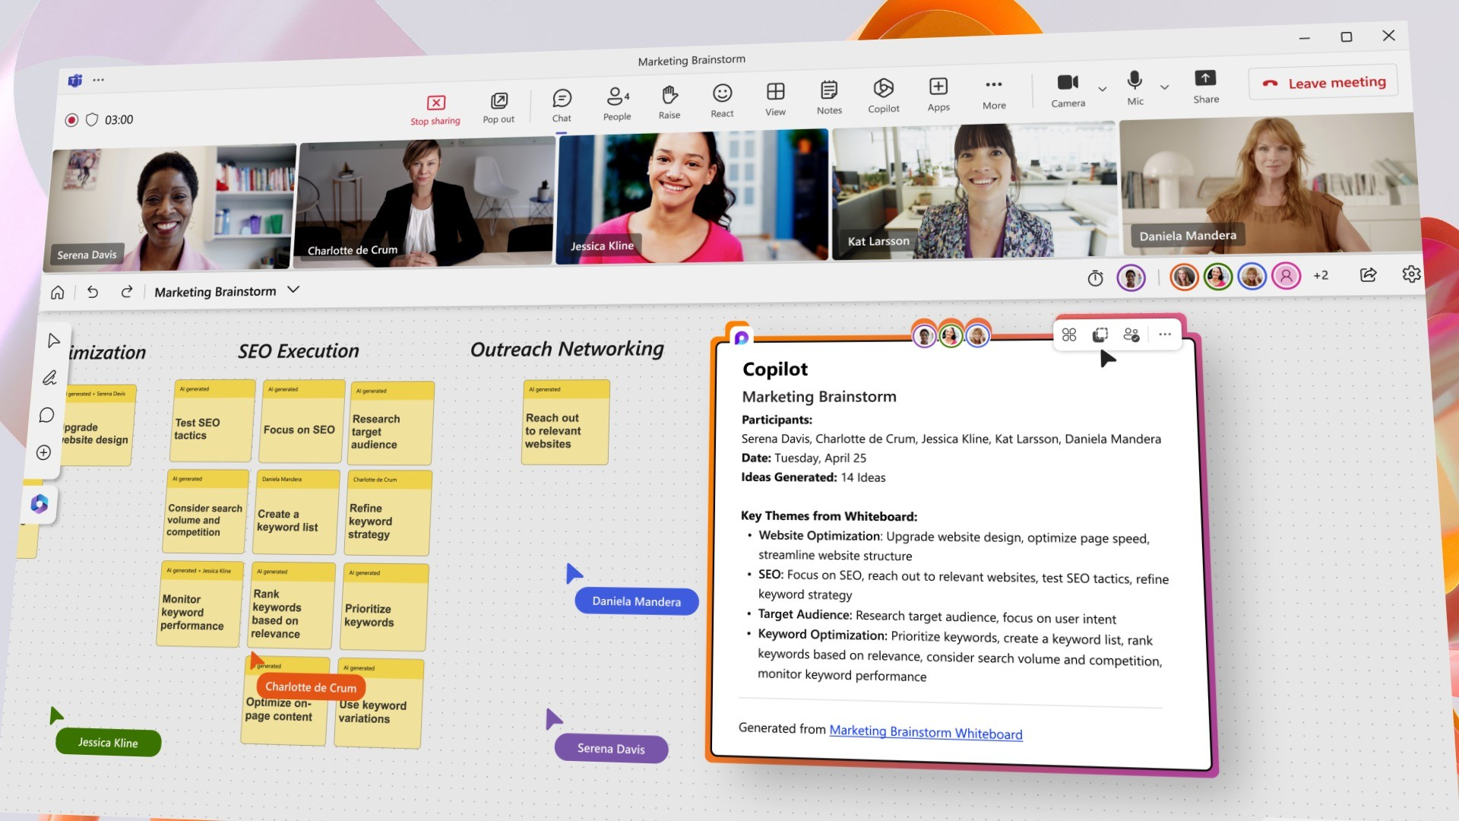
Intelligent systems in business
Microsoft 365 Copilot:
Combines the power of large language models
(LLMs) with your data in the Microsoft Graph and the Microsoft 365 apps
Turns your words into a powerful productivity tool
18

Slide 29
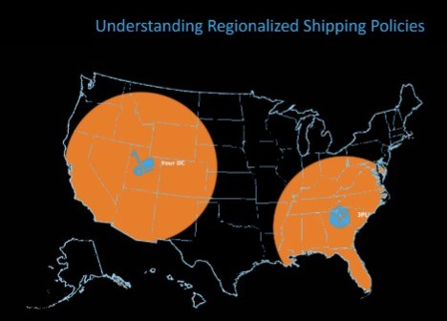
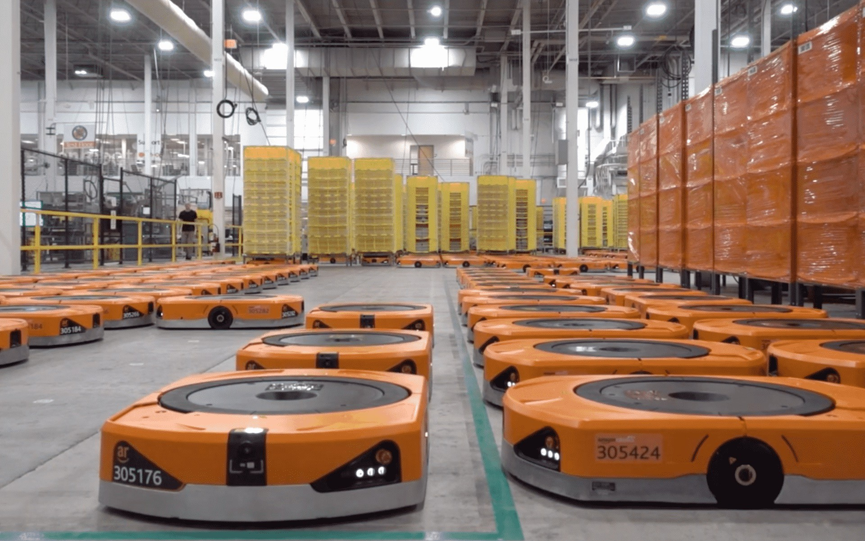
Intelligent systems in business
Amazon is using AI to speed up deliveries:
Amazon’s “regionalization”: ship products to customers from warehouses closest to them
AI-enabled technology to analyze data and patterns in order to predict what products will be in demand and where
19

Slide 30

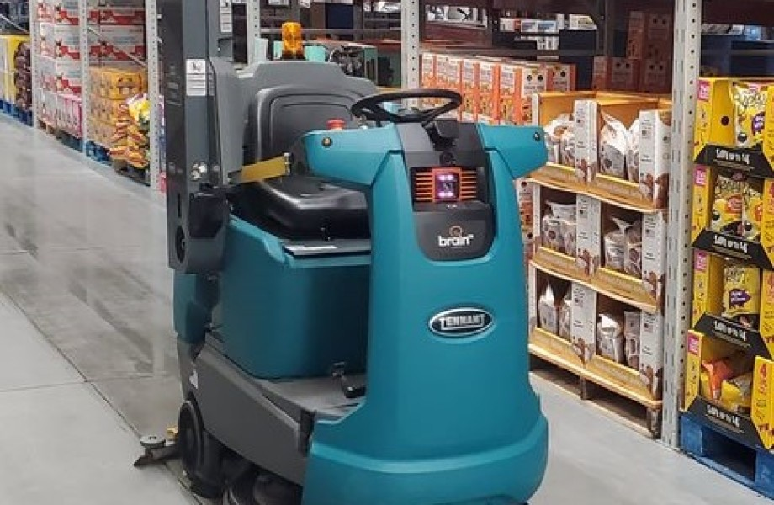
Intelligent systems in business
Walmart:
Using A.I. To Make Smarter Substitutions in Online Grocery Orders
Using Brain Corp’s Robotic Inventory Scanners
20

Slide 31
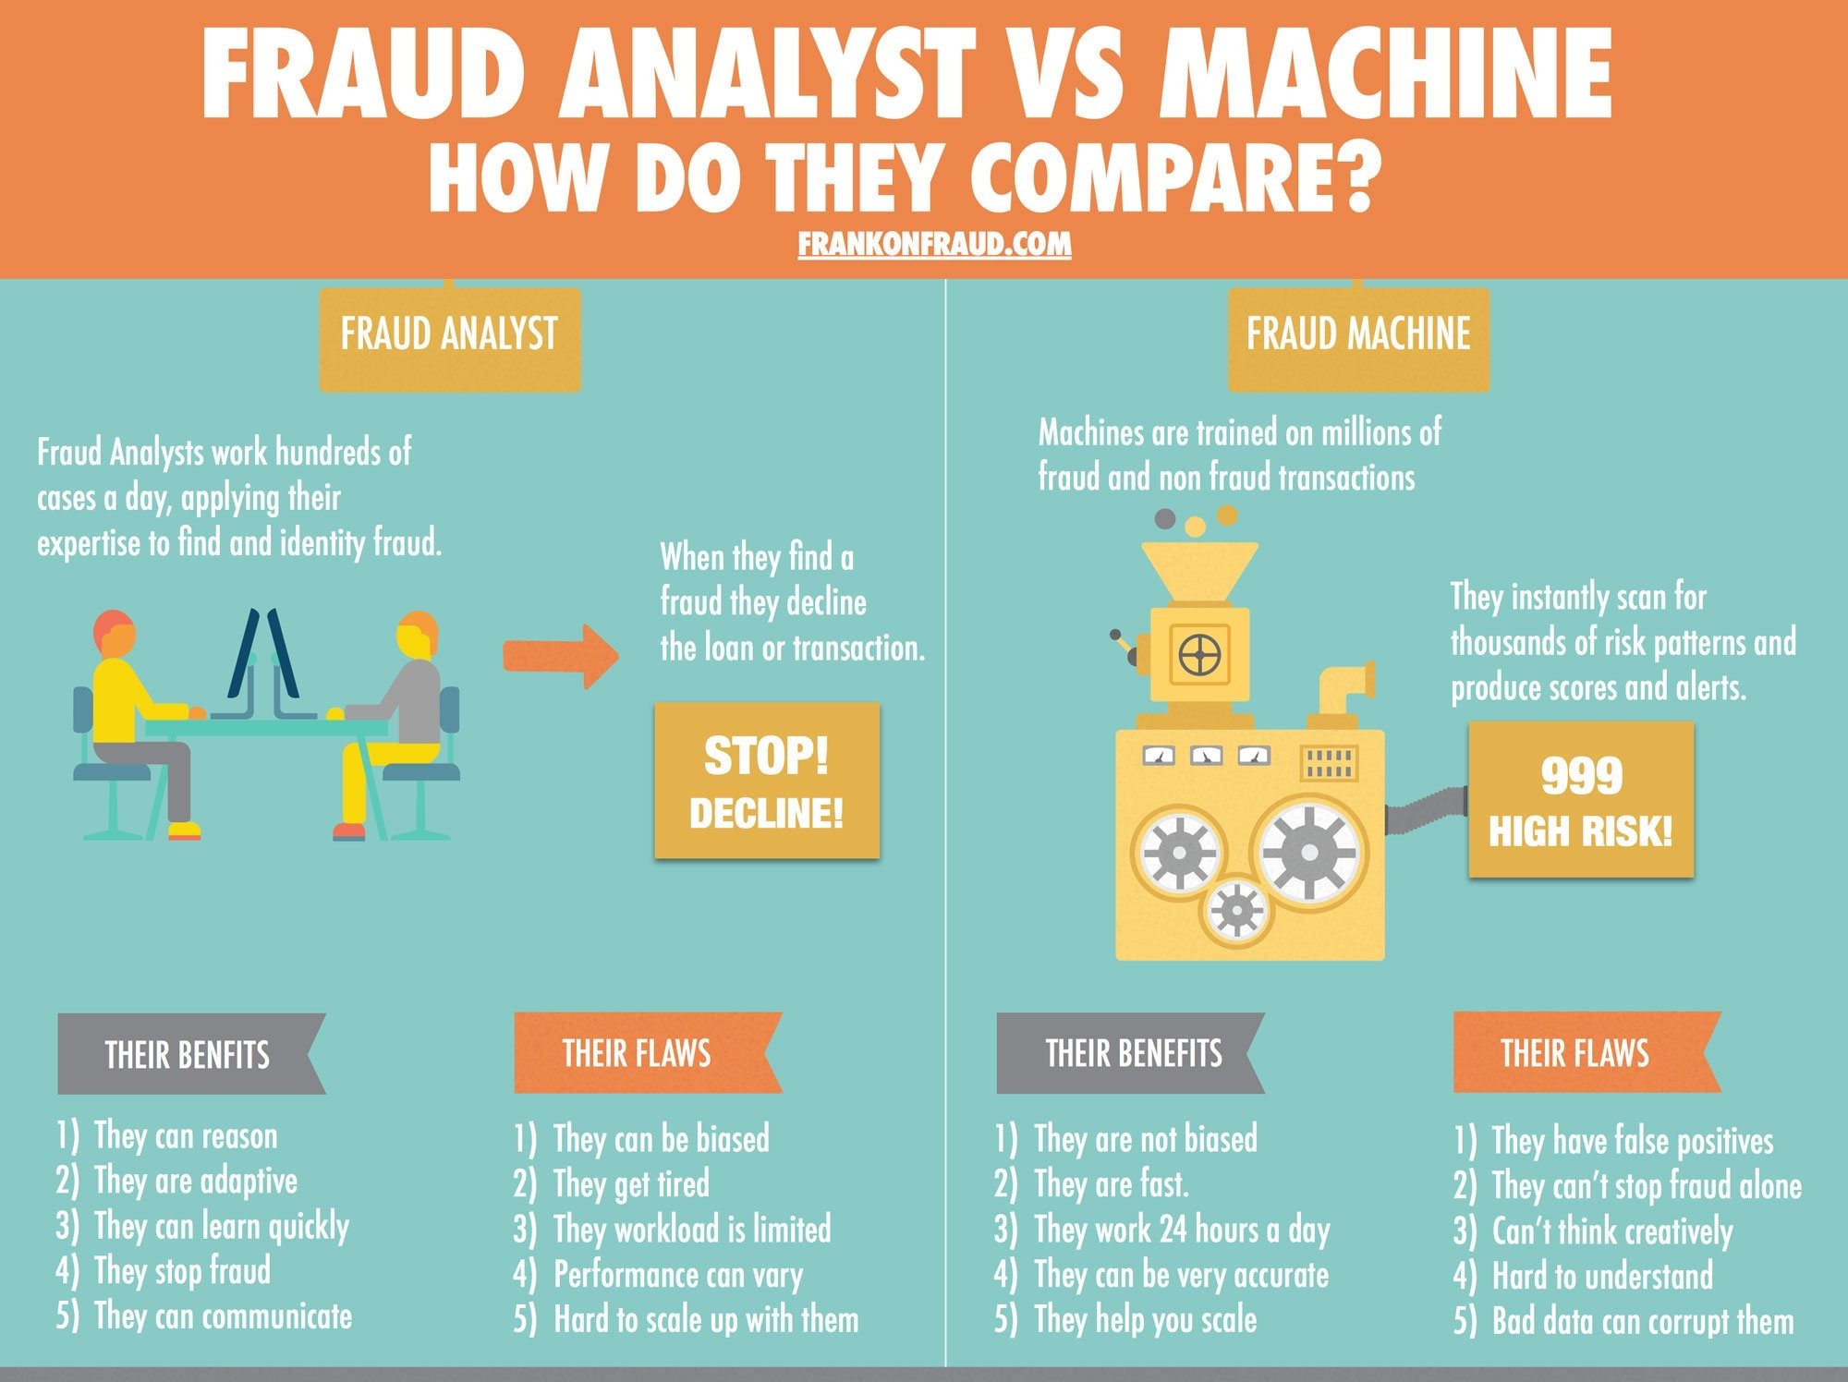
Intelligent systems in business
Visa, Mastercard and PayPal are using machine-learning algorithms to analyze data on customer behaviour:
Fraud detection
21

Slide 32
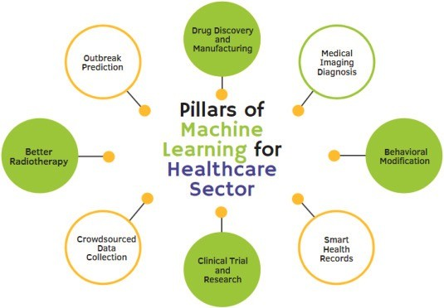
Intelligent systems in business
Pfizer, Genentech and Sanofi:
using AI and machine learning to speed up their R&D efforts.
drug discovery, diagnostics and allocation of resources
GE HealthCare:
digitalisation of health services
22

Slide 33

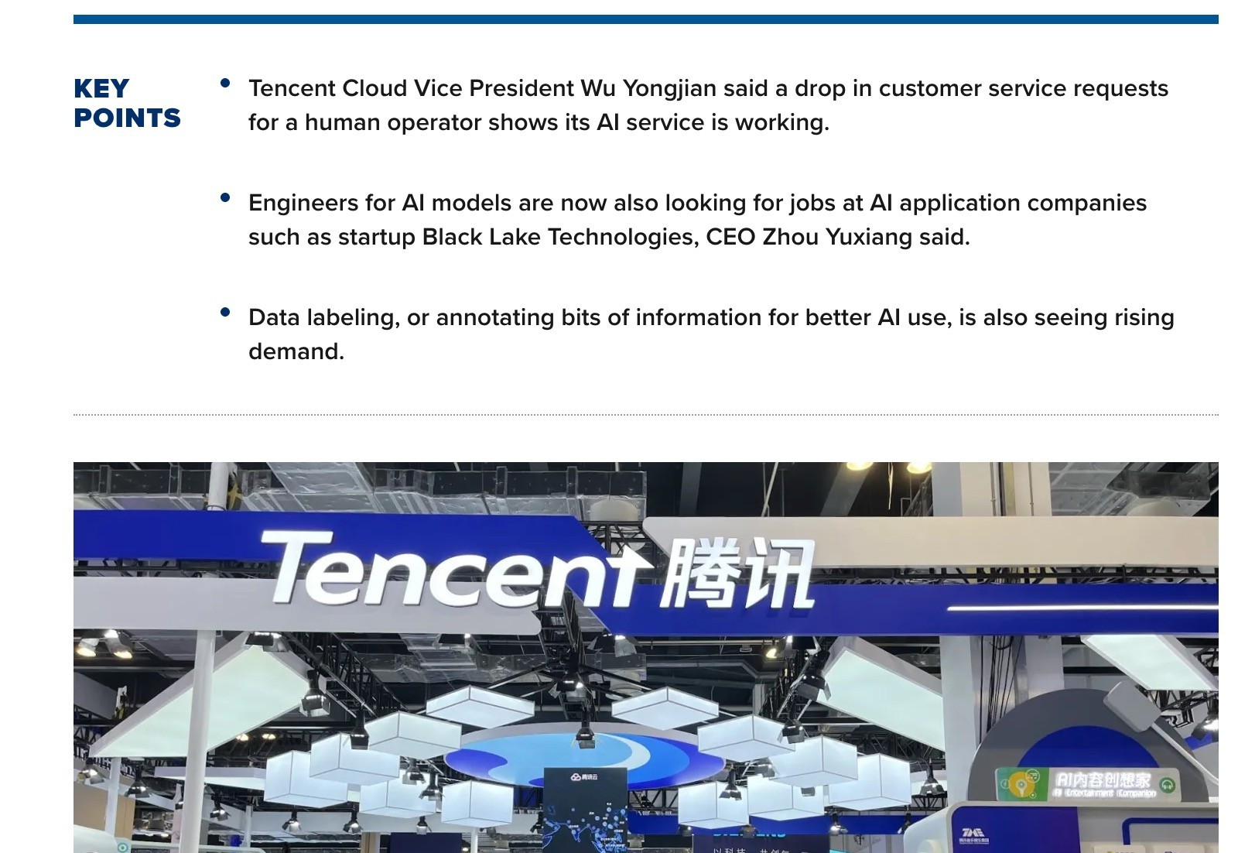
Intelligent systems in business

Slide 34
Characteristics of intelligent systems
Possess one or more of these:
Capability to extract and store knowledge
Human like reasoning process
Learning from experience (or training)
Dealing with imprecise expressions of facts
Finding solutions through processes similar to natural evolution
Has the ability to interact and deal with other agents (including humans)
Recent trend (LLMs & Multimodal Foundation Models - MFMs):
More sophisticated interaction with the user through:
natural language understanding
speech recognition and synthesis
image analysis & synthesis
24

Slide 35
Characteristics of intelligent systems
Capability to extract and store knowledge
Human like reasoning process
Knowledge representation and reasoning:
Logic-based
Rule-based expert systems
Constraint Satisfaction and Optimization Problems

Slide 36
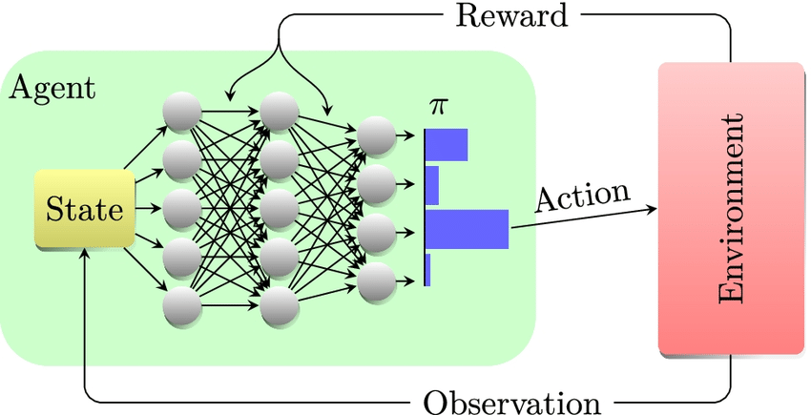
Characteristics of intelligent systems
Dealing with imprecise expressions of facts
Machine Learning
Deep Learning
Deep Reinforcement Learning
In-Context Learning (LLMs)

Slide 37
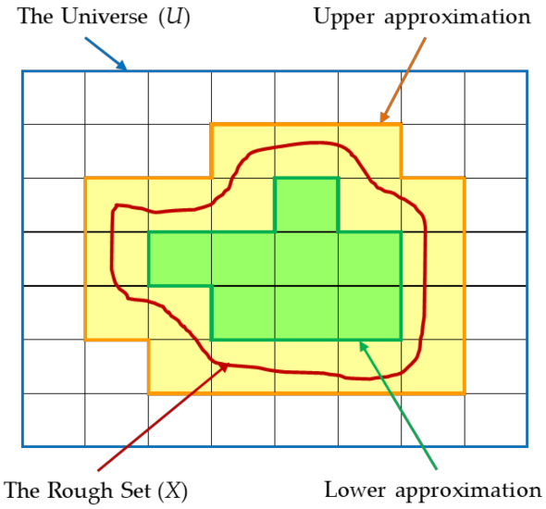
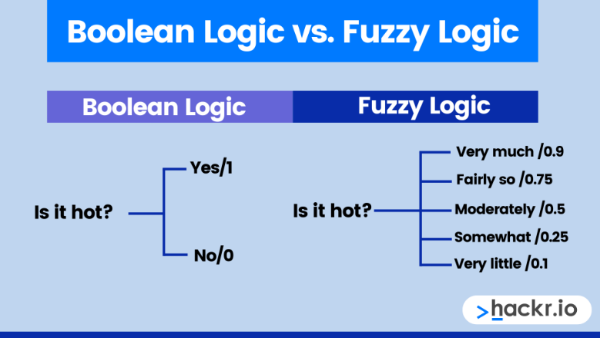
Characteristics of intelligent systems
Learning from experience (or training)
Fuzzy logic
Fuzzy systems
Rough set theory

Slide 38
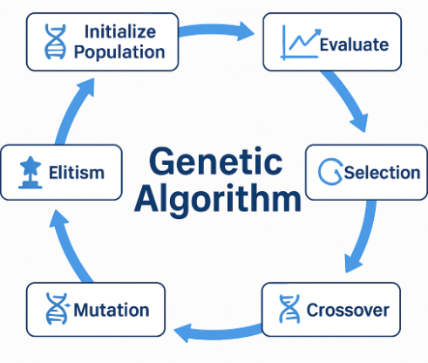
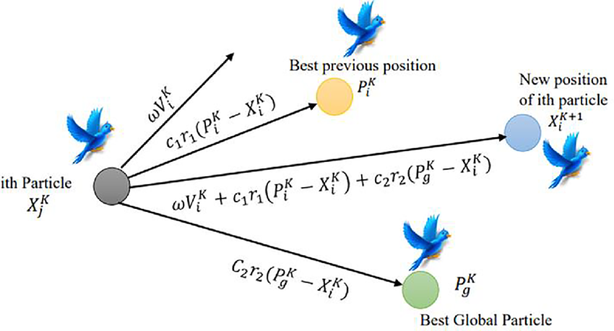
Characteristics of intelligent systems
Finding solutions through processes similar to natural evolution
Soft computing/computational intelligence
• Evolutionary computing (EC)
Genetic algorithm (GA)/Differential Evolution (DE)
Particle Swarm Optimization (PSO)/Ant Colony Optimization (ACO)
Artificial Neural Networks (ANN)

Slide 39
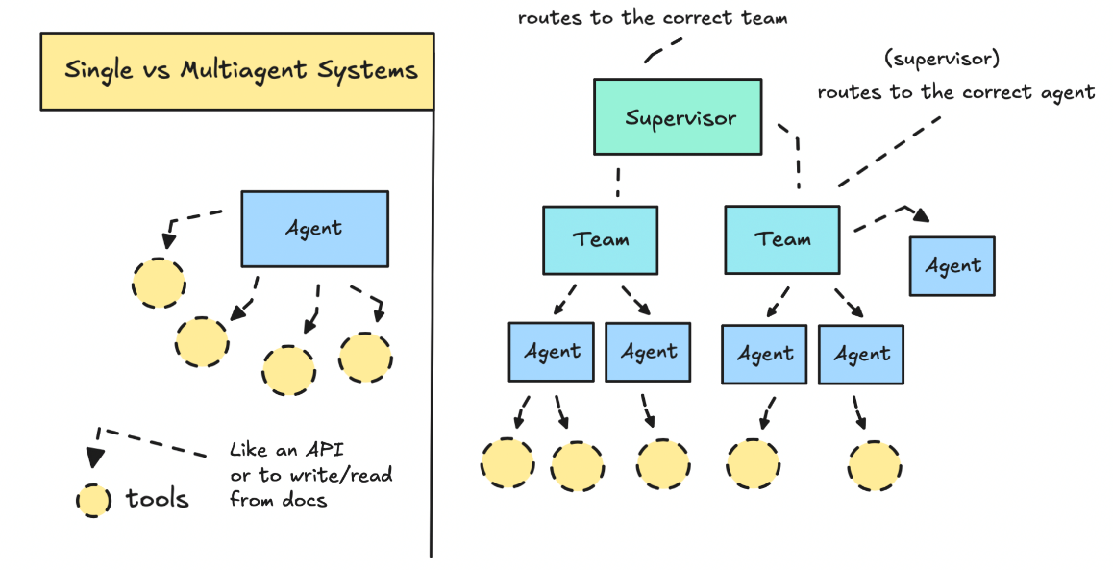
Characteristics of intelligent systems
Has the ability to interact and deal with other agents (including humans)
Multi-agent systems
Agent communication
Automated negotiation
Natural language processing (NLP)
NL-based conversational agents

Slide 40
Intelligent Agent (IA)
What is an intelligent agent?
A computer system that is capable of autonomous action in some environment in order to meet its design objectives.
Autonomy:ability to act independently, exhibiting control over one’s internal state
Driven by The agent’s Performance measure
Agent
Sensors
Percepts
Environment
?
Actuators
Actions
30

Slide 41
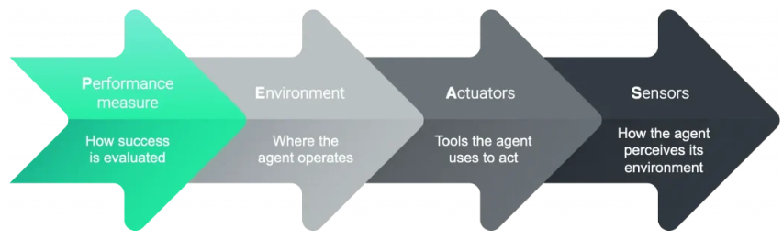
Example: The PEAS Framework in Self-Driving Car
Performance measures – Maintain safety, reach destination, obey laws, provide passenger comfort, …
Environment – urban streets, freeways, traffic, pedestrians, weather, customers, …
Actuators – steer, accelerate, brake, horn, indicator, …
Sensors– Video, sonar, speedometer, laser, odometer, engine sensors, microphone, GPS, …

Slide 42
The PEAS Framework
Agent | Performance | Environment | Actuators | Sensors
Self-Driving Car | Safe, fast, legal, comfortable, fuel-efficient | Roads, traffic, pedestrians, weather, maps | Steering, throttle, brake, horn, indicators | Cameras, LIDAR, radar, GPS, speedometer
LLM Personal Agent (e.g. Claude) | Task completed correctly, user satisfied, no harm | Files, web, APIs, email, calendar, user goals | Text output, code execution, web clicks, API calls | User text, images, file contents, tool results
Medical Diagnosis AI | Correct diagnosis, no false negatives, speed | Patient records, lab results, imaging, symptoms | Diagnosis report, treatment recommendations | EHR data, DICOM images, lab values

Slide 43
Agent Types
Agent can be classified as follows based on their decision-making ability:
Simple Reflex Agent
Model-based Reflex Agent
Goal-based Agent
Utility-based Agent
Learning Agent (by combining one of the above with the learning capability)
Multi-Agent Systems (MAS)
Hierarchical Agent
LLM-Based Agent

Slide 44
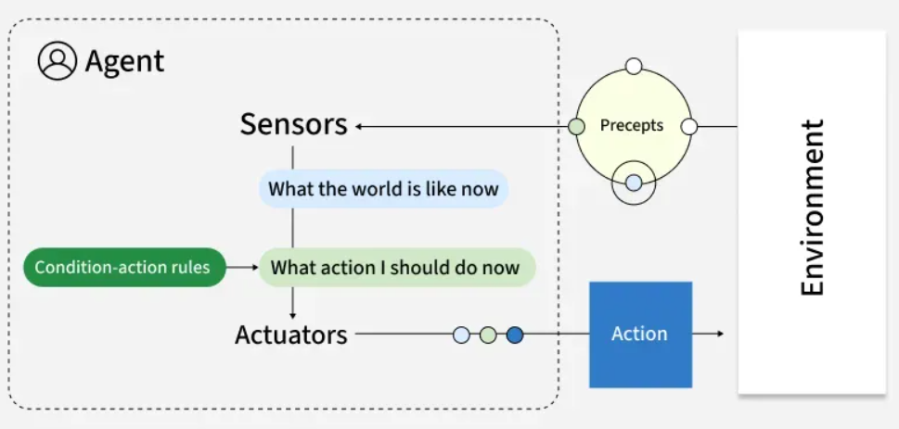
Simple Reflex Agents
Select action on the basis of only the current percept.
E.g. the vacuum-agent
Large reduction in possible percept/action situations.
Implemented through condition-action rules
If dirty then suck
Notes:
Simple reflex agents act solely on the current percept using predefined condition–action rules, without storing or considering any history. They are fast and easy to implement, making them suitable for fully observable, stable environments with clear and simple rules. However, they tend to fail in dynamic or partially observable situations because they lack memory and deeper reasoning capabilities.
Key Characteristics:
Reactive: These agents respond immediately to inputs without consideration for prior events or predicting future outcomes.
Limited Scope: They excel in predictable environments where tasks are straightforward and the relationships between actions and results are well understood.
Quick Response: Since decisions are made based only on immediate input, it can react without delay.
No Learning: These agents cannot improve or change their behavior based on past experiences.
Example: Traffic light control systems that change signals based on fixed timing.

Slide 45
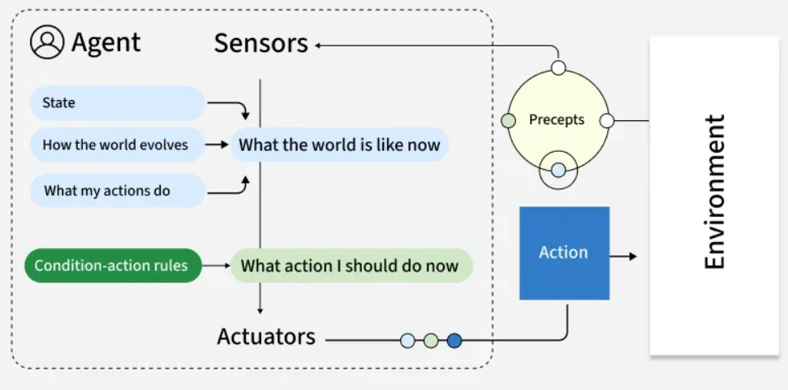
Model-Based Reflex Agents
To tackle partially observable environments.
Maintain internal state
Over time update state using world knowledge
How does the world change.
How do actions affect world.
-> Model of World
Notes:
Model-based reflex agents enhance the simple reflex approach by maintaining an internal state or model of the world, that tracks aspects of the environment not directly observable at each moment. This enables them to deal with partial observability and dynamic changes more effectively, although their decisions are still largely reactive and dependent on the accuracy of the model they maintain.
Key Characteristics:
Internal State: By maintaining an internal model of the environment, these agents can handle scenarios where some aspects are not directly observable thus it provides more flexible decision-making.
Adaptive: They update their internal model based on new information which allows them to adapt to changes in the environment.
Better Decision-Making: The ability to refer to the internal model helps agents make more informed decisions which reduces the risk of making impulsive or suboptimal choices.
Increased Complexity: Maintaining an internal model increases computational demands which requires more memory and processing power to track changes in the environment.
Example: Robot vacuum cleaners that map rooms and tracks cleaned areas.

Slide 46
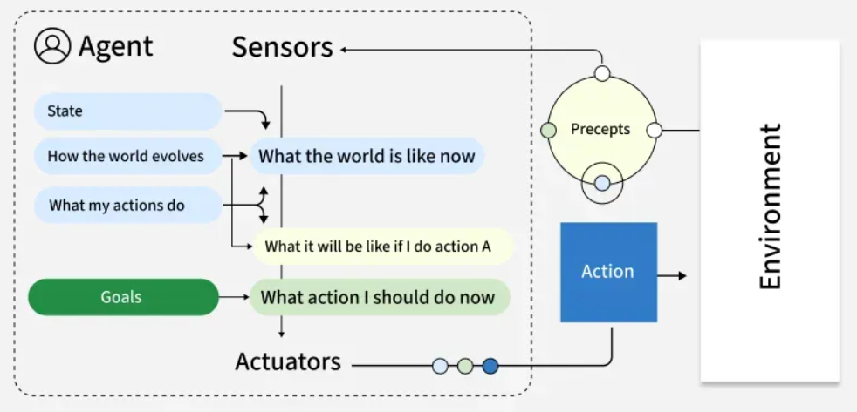
Goal-Based Agents
The agent needs a goal to know which situations are desirable.
Things become difficult when long sequences of actions are required to find the goal.
Typically investigated in search and planning research.
Major difference: future is taken into account
Is more flexible since knowledge is represented explicitly and can be manipulated.
Notes:
Goal-based agents select actions by considering future states relative to explicit goals. They are capable of planning sequences of actions to reach these goals rather than just reacting to the current state which enables more flexible and intelligent problem-solving. However, they require well-defined goals and effective planning algorithms to perform well in complex domains.
Key Characteristics:
Goal-Oriented: They have explicit goals and make decisions based on how well their actions align with these objectives.
Planning and Search: They often use planning algorithms that explore multiple possible actions to find the most effective sequence of steps that lead to their goal.
Flexible: If conditions change or new information arises, it can re-plan and adjust their strategies to stay on track toward their objective.
Future-Oriented: Unlike reflex agents, they think ahead and predict future outcomes to find the best course of action.
Example: Logistics routing agents that find optimal delivery routes based on factors like distance and time. They continuously adjust to reach the most efficient route.

Slide 47
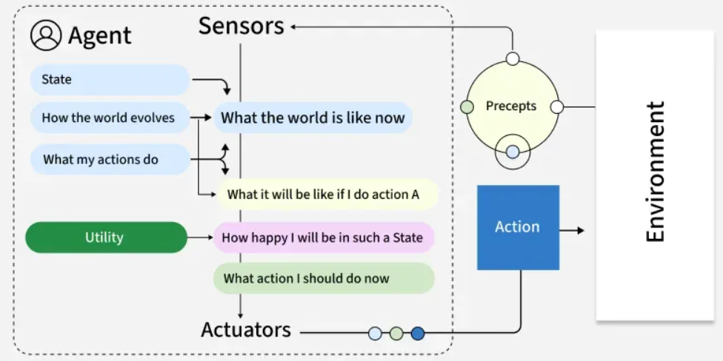
Utility-Based Agents
Certain goals can be reached in different ways.
Some are better, have a higher utility.
Utility function maps a (sequence of) state(s) onto a real number.
Improves on goals:
Selecting between conflicting goals
Select appropriately between several goals based on likelihood of success.
Notes:
Utility-based agents extend goal-based reasoning by considering not only whether a goal is met but also how valuable or desirable a particular outcome is. They use a utility function to quantify preferences and make trade-offs between competing objectives, enabling nuanced decision-making in uncertain or resource-limited situations. Designing an appropriate utility function is crucial for their effectiveness.
Key Characteristics:
Multi-Criteria Decision Making: These agents find multiple factors like cost, benefits, risk, time, etc to find the best possible course of action.
Trade-Offs: They can make decisions by balancing competing goals and preferences often finding the best "compromise."
Subjectivity: They are customizable to reflect subjective preferences or goals, making them more adjustable to individual or organizational needs.
Increased Complexity: Finding utility functions for different factors can be computationally intensive and complex.
Example: Financial portfolio management agents that evaluate investments based on factors like risk, return and diversification operate by choosing options that provide the most value.

Slide 48
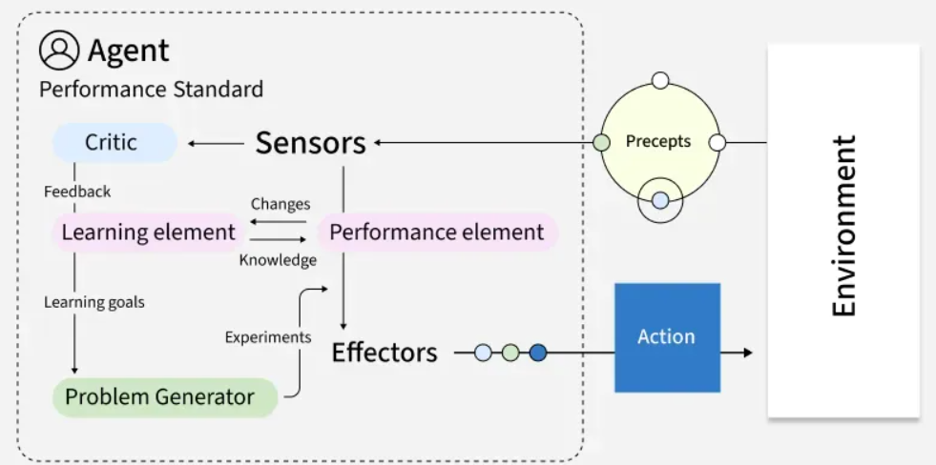
Learning Agents
All previous agent-programs describe methods for selecting actions, yet it does not explain the origin of these programs.
Learning mechanisms can be used to perform this task.
Teach them instead of instructing them.
Robust towards initially unknown environments.
Notes:
Learning agents improve their performance over time by learning from experience and updating their internal models, strategies or policies. They can adapt to changes in the environment and often outperform static agents in dynamic contexts. Learning may involve supervised, unsupervised or reinforcement learning techniques and these agents typically contain both a performance element (for acting) and a learning element (for improving future actions).
Key Characteristics:
Adaptive Learning: It improve their decision-making through continuous feedback from their actions.
Exploration vs. Exploitation: These agents balance exploring new actions that may lead to better outcomes with exploiting known successful strategies.
Flexibility: They can adapt to a wide variety of tasks or environments by modifying their behavior based on new data.
Generalization: It can apply lessons learned in one context to new, similar situations enhancing their versatility.
Example: Customer service chatbots can improve response accuracy over time by learning from previous interactions and adapting to user needs.

Slide 49
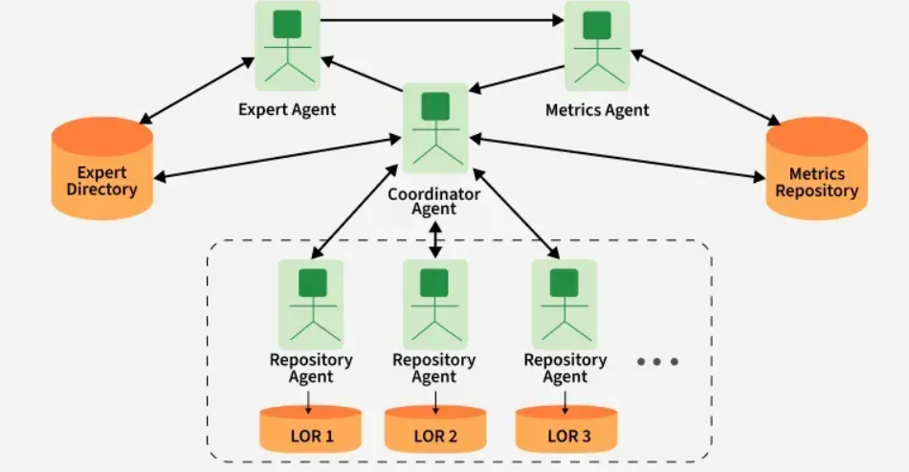
Multi-Agent Systems (MAS)
Operate in environments shared with other agents, either cooperating or competing to achieve individual or group goals, often requiring communication, negotiation or coordination protocols.
Cooperative MAS: Agents work together toward shared objectives.
Competitive MAS: Agents pursue individual goals that may conflict.
Mixed MAS: Agents cooperate in some scenarios and compete in others.
Notes:
Multi-agent systems operate in environments shared with other agents, either cooperating or competing to achieve individual or group goals. These systems are decentralized, often requiring communication, negotiation or coordination protocols. They are well-suited to distributed problem solving but can be complex to design due to emergent and unpredictable behaviors. Types of multi-agent systems:
Cooperative MAS: Agents work together toward shared objectives.
Competitive MAS: Agents pursue individual goals that may conflict.
Mixed MAS: Agents cooperate in some scenarios and compete in others.
Key Characteristics:
Autonomous Agents: Each agent acts on its own based on its goals and knowledge.
Interactions: Agents communicate, cooperate or compete to achieve individual or shared objectives.
Distributed Problem Solving: Agents work together to solve complex problems more efficiently than they could alone.
Decentralization: No central control, agents make decisions independently.
Example: A warehouse robot might use:
Model-based reflexes for navigation
Goal-based planning for task sequencing
Utility-based decision-making for prioritizing tasks
Learning capabilities for route optimization

Slide 50
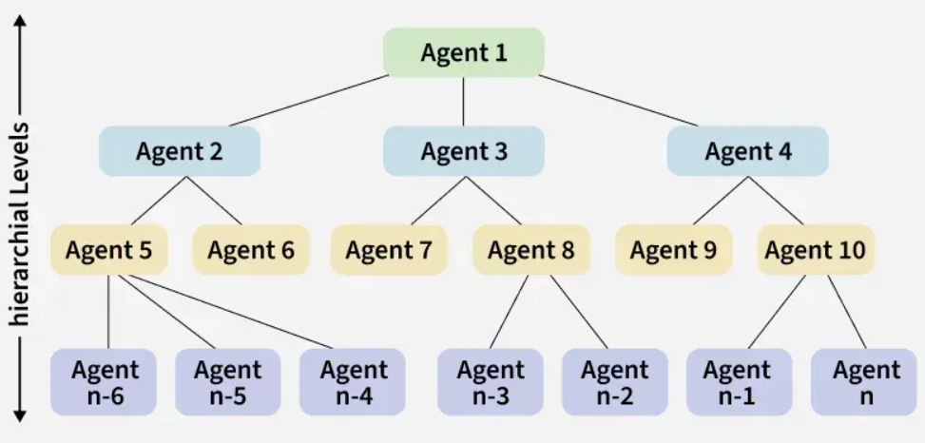
Hierarchical Agent
Organize behavior into multiple layers such as strategic, tactical and operational.
Higher levels make abstract decisions that break down into more specific subgoals for lower levels to execute.
Notes:
Hierarchical agents organize behavior into multiple layers such as strategic, tactical and operational. Higher levels make abstract decisions that break down into more specific subgoals for lower levels to execute. This structure improves scalability, reusability of skills and management of complex tasks, but requires designing effective interfaces between layers.
Key Characteristics:
Structured Decision-Making: Decision-making is divided into different levels for more efficient task handling.
Task Division: Complex tasks are broken down into simpler subtasks.
Control and Guidance: Higher levels direct lower levels for coordinated action.
Example: Drone delivery systems in which fleet management is done at top level and individual navigation at lower level.

Slide 51
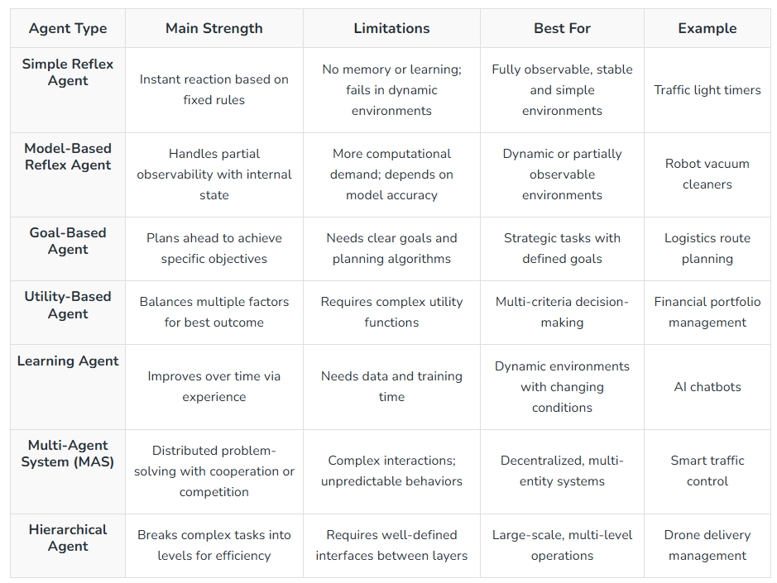
Comparison of Agent Types
Notes:
When to Use Each AI Agent Type
1. Simple Reflex Agent
Environment is fully observable and predictable
Tasks are repetitive with fixed rules
2. Model-Based Reflex Agent
Some information about the environment is hidden but can be modeled
Environment changes but follows predictable patterns
3. Goal-Based Agent
Tasks require planning multiple steps ahead
Clear goals are defined and can be measured
4. Utility-Based Agent
Need to balance trade-offs like cost, time and risk
Multiple objectives must be prioritized
5. Learning Agent
Environment changes over time and the system must adapt
Performance should improve with experience
6. Multi-Agent System (MAS)
Multiple agents must work together or compete
Problem-solving is decentralized and distributed
7. Hierarchical Agent
Tasks can be split into strategic, tactical and operational levels
Large-scale operations require coordination between layers

Slide 52
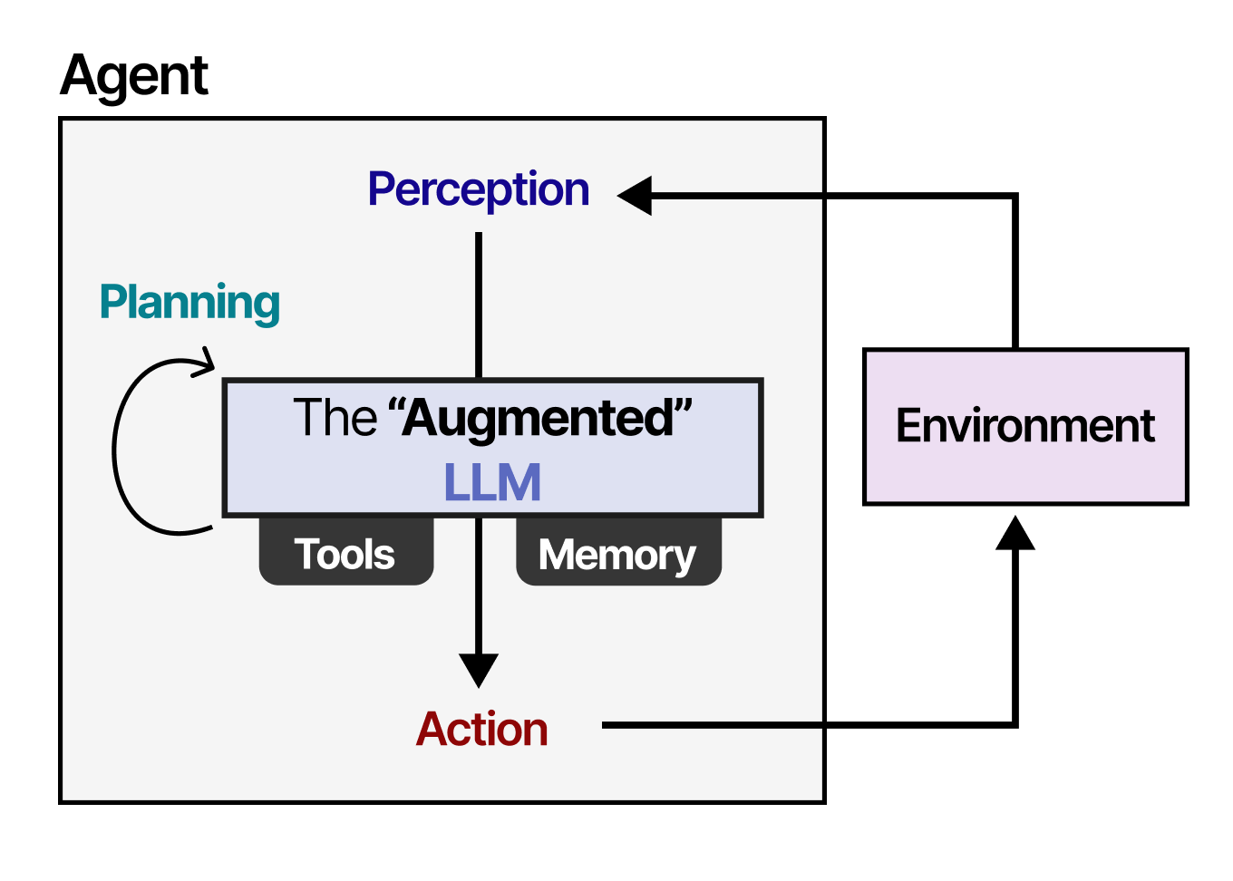
LLM-based Agents
Use an LLM as their central "brain" or coordinator to autonomously plan, reason, and execute multi-step tasks to achieve specific goals.
Notes:
Agent Core (The Brain): The foundational LLM that processes input data, applies domain knowledge, and handles decision-making. It is guided by specialized prompts that outline its goal and define its specific persona or behavioral constraints.
Planning Module: Responsible for decomposing macro tasks into smaller, sequential sub-goals. Advanced modules utilize iterative feedback mechanisms, such as ReAct (Reasoning + Acting) or Reflexion, allowing the agent to analyze execution errors and dynamically pivot its strategies.
Memory Module: Maintains historical awareness across extensive trajectories. Short-term memory relies on the model’s immediate in-context learning window. Long-term memory interfaces with external vector databases to store and surface relevant records over extended operations.Tool Use (Action): External APIs and software extensions that grant the agent agency beyond text generation. These include code interpreters, custom databases, web search engines, or localized mathematical calculators.

Slide 53
Summary
Four main paradigms of AI (think vs act, rational vs human-like)
How you choose to view AI will define the appropriate techniques
Main characteristics of intelligent systems
To develop a system with certain characteristics, some AI techniques will be introduced to you in this unit of study
Intelligent agents (IA):
Some basic agent types + some advanced agent types (by combining each basic agent type with the learning capability)

