Slide 1
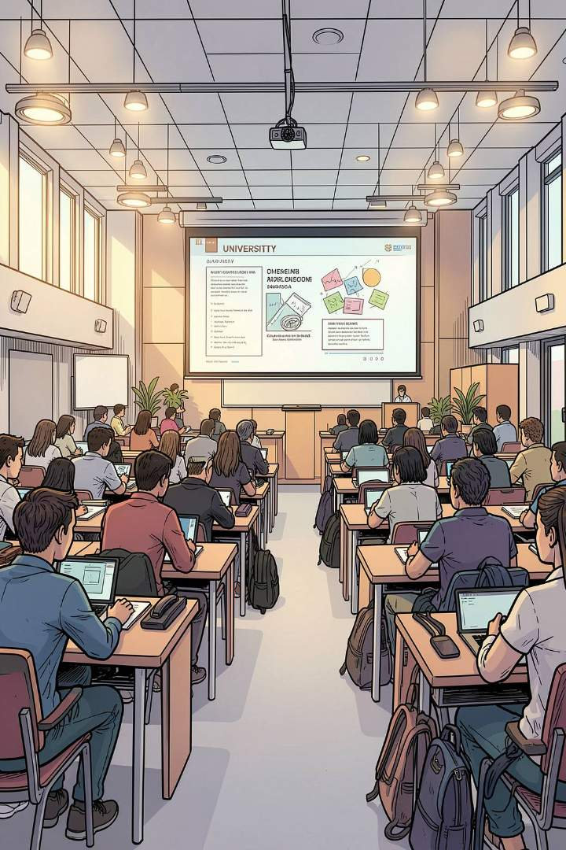
SWE30003 – Week 7: Design Patterns & OO Design
Software Architectures and Design · Swinburne University of Technology

Slide 2



What Is a Design Pattern?
Definition
A reusable, well-proven solution to a recurring design problem within a specific context — describing both the problem and a generic solution scheme, including components, responsibilities, and relationships.
A Pattern is a Process AND a Thing
It tells you what to build (the resulting design structure) and how to build it (the process that creates it).
Why Patterns Matter
Improve communication, enable reuse, boost maintainability — and help novices act like experts without years of accumulated experience.

Slide 3
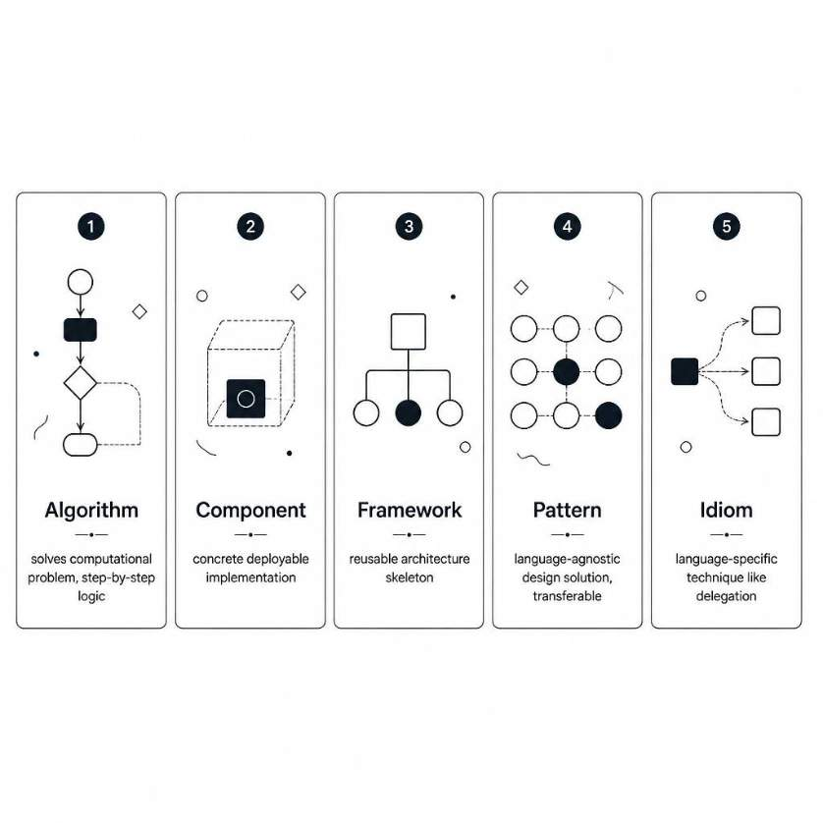
Patterns vs. Related Concepts
Understanding where patterns sit in the design vocabulary helps apply them correctly:
Algorithm — step-by-step computational logic
Component — a concrete, deployable unit
Framework — an architecture skeleton you fill in
Pattern — a language-agnostic, transferable design solution
Idiom — a language-specific technique (e.g. programming to an interface)

Slide 4
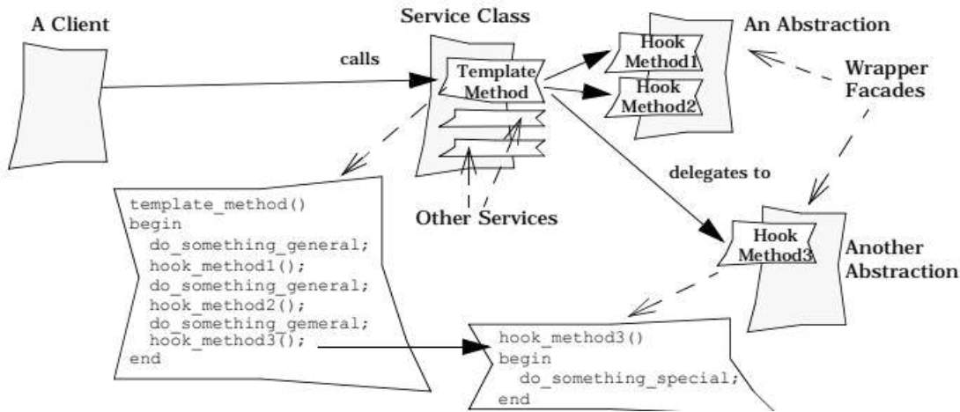
Template Method Pattern
INHERITANCE-BASED
Intent
Define the skeleton of an algorithm in a base class; let subclasses override specific hook operations without altering the overall structure.
Mechanism
The parent class calls abstract hook methods. Subclasses provide concrete implementations for those hooks only.
Benefit
Common behaviour is written once. Variation is cleanly isolated to hook methods — no duplication, easy extension.

Slide 5



Factory Method Pattern
Intent
Key Benefit
When to Use
Define an interface for creating an object, but let subclasses decide which concrete class to instantiate — creation is delegated downward.
Decouples the creator from the concrete product. Callers depend only on the interface, not the implementation — reducing coupling and improving extensibility.
When the exact type of object isn't known until runtime, or when subclasses should control which product gets created based on context.

Slide 6
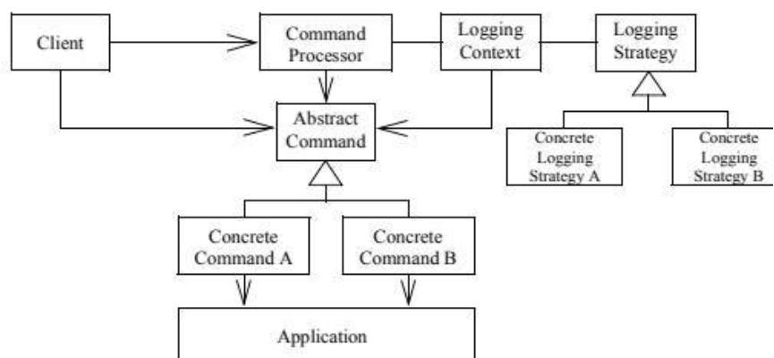
Strategy Pattern
COMPOSITION-BASED
Intent
Define a family of algorithms, encapsulate each one, and make them interchangeable at runtime.
Mechanism
The context holds a reference to a strategy interface and delegates the algorithm to it — no subclassing required.
Strategy vs. Template Method
Strategy — swaps whole algorithms at runtime via composition
Template Method — customises steps at compile time via inheritance

Slide 7
ATM CASE STUDY
ATM Case Study: Identifying Classes
Hardware Interfaces
System Logic
Core Data Entities
CardReader
Display
Keypad
CashDispenser
ReceiptPrinter
ATMController — orchestrates lifecycle
SessionManager — tracks one user session
BankDatabase
Account
Card
Transaction + subclasses: Withdrawal, Deposit, Transfer, Inquiry
Classes are identified through Responsibility-Driven Design (RDD) — hardware interfaces, control logic, and data entities emerge as distinct layers.

Slide 8
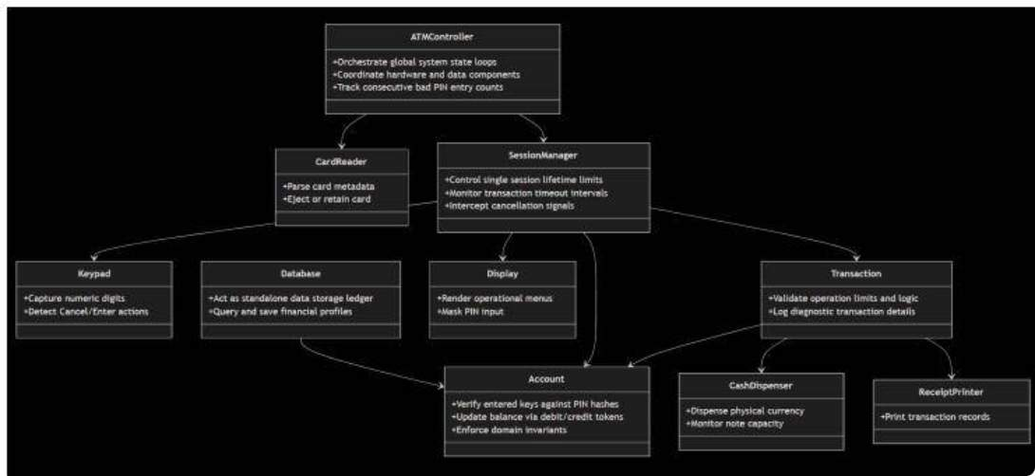
ATM CASE STUDY
ATM Case Study: Assigning Responsibilities
ATMController
Orchestrates global state; collaborates with CardReader to detect card insertion/ejection and with SessionManager to validate user state flows.
SessionManager
Drives PIN entry and menu navigation; authenticates via Account; triggers the appropriate Transaction subclass.
Transaction Subclasses
Validate limits, update Account balance, command CashDispenser and ReceiptPrinter to complete each operation.

Slide 9
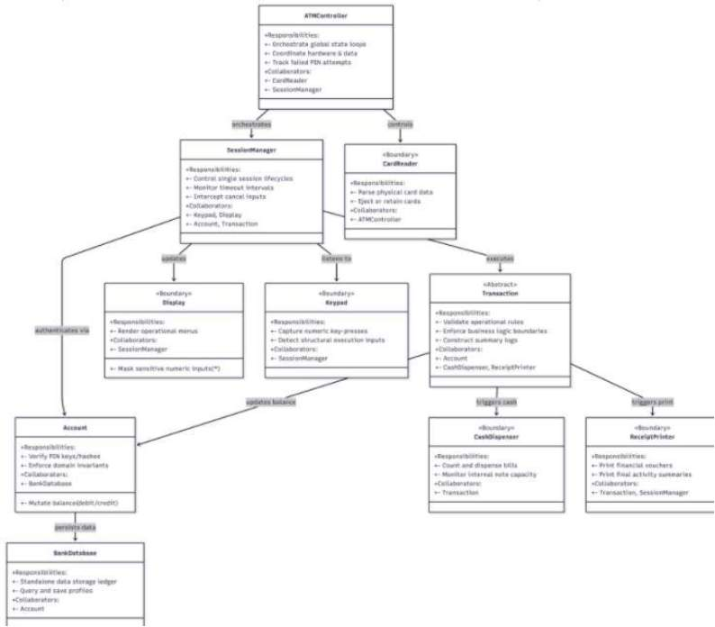
ATM CASE STUDY
CRC Cards & Class Hierarchies
CRC Cards
Class – Responsibility – Collaboration cards document each class's purpose, what it does, and who it collaborates with. They are the core artefact of RDD.
Transaction Hierarchy
An abstract Transaction base class with subclasses — WithdrawalTransaction, DepositTransaction, TransferTransaction, BalanceInquiryTransaction — is a natural application of the Template Method pattern.
Factory Method Applied
SessionManager uses a Factory Method to instantiate the correct Transaction subclass based on the user's menu selection — decoupling control flow from creation logic.

Slide 10
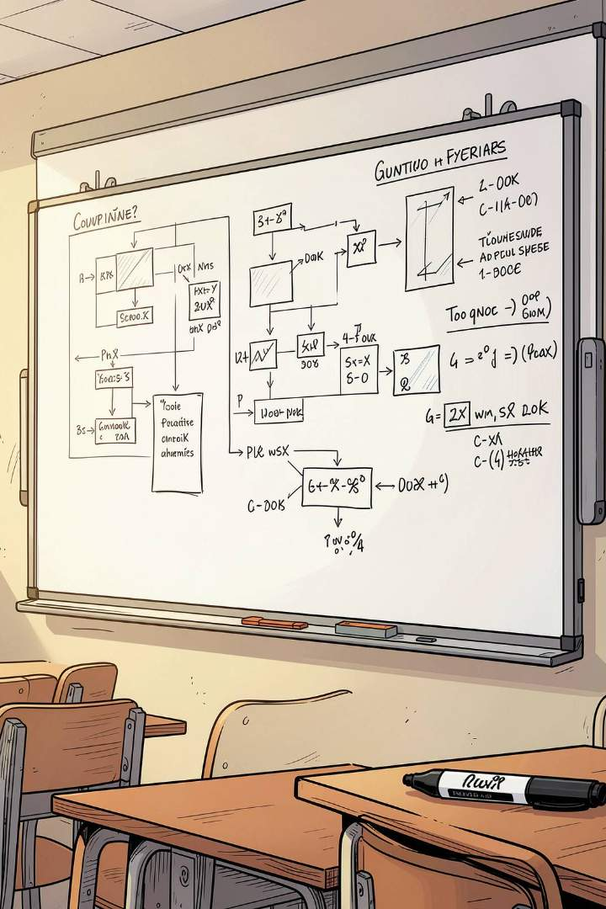
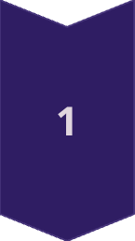
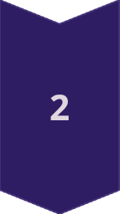
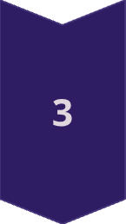
Key Takeaways
Proven Design Knowledge
Patterns are language-agnostic and reusable across domains — they capture decades of collective design expertise.
Three Patterns, Three Mechanisms
Template Method → inheritance + hooks · Factory Method → decouple creation · Strategy → swap algorithms via composition
Patterns Emerge from Good Design
In the ATM exercise, RDD + CRC cards → clear class boundaries → patterns arise naturally from well-allocated responsibilities.

Slide 11
Sources
Inside Patterns(1).pdf
Week07_Patterns_Summary.docx
Tutorial Answer Week07.pdf

