Slide 1
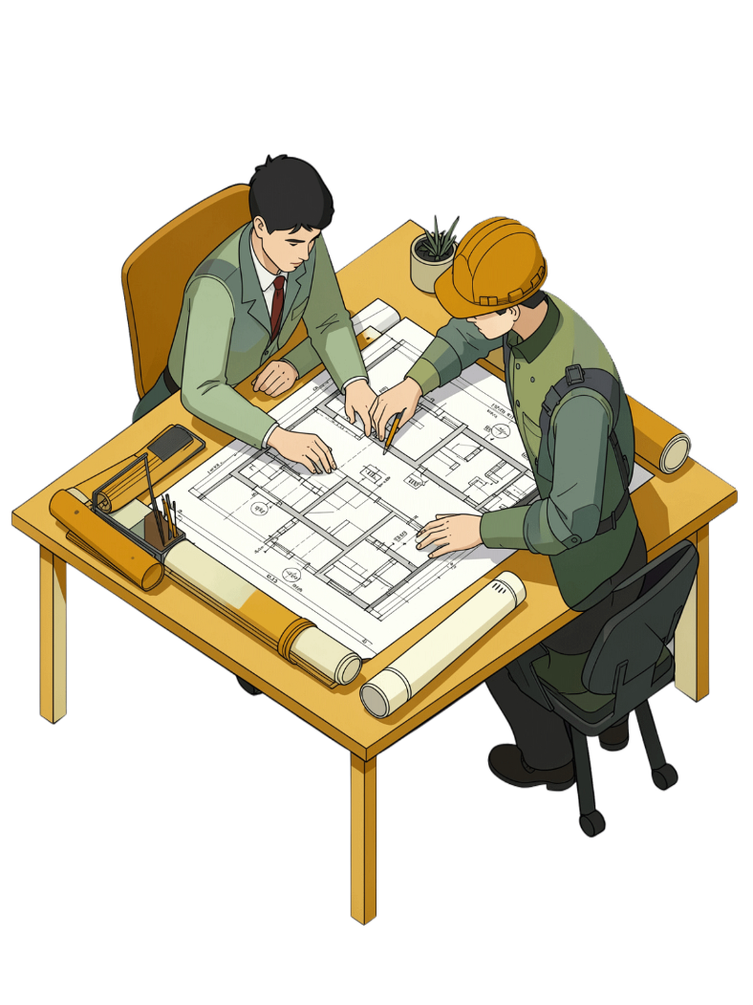
SWE30003 – Software Architectures and Design
Lecture 8: Software Architectures and Architectural Styles

Slide 2
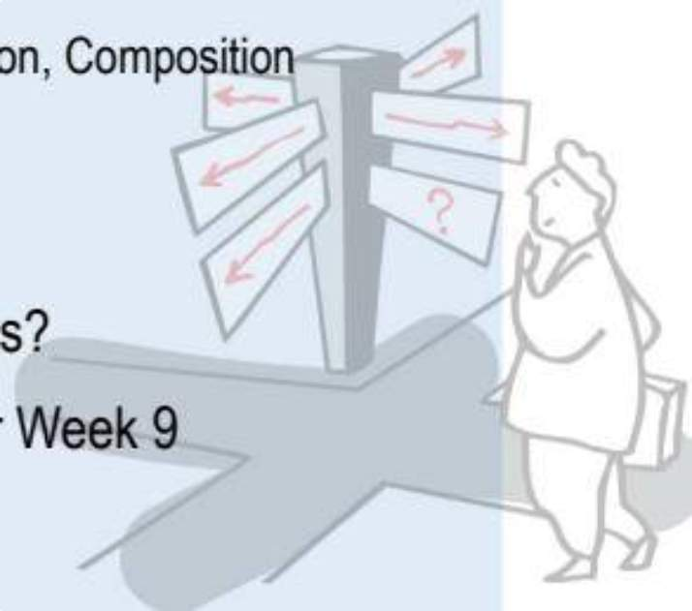
Lecture Outline
01
02
03
Software Architectures
Architectural Styles
Why Use Architectures?
Processing, Interaction, and Composition
Deployment perspectives and style categories
Managing complexity with rationale and structure

Slide 3
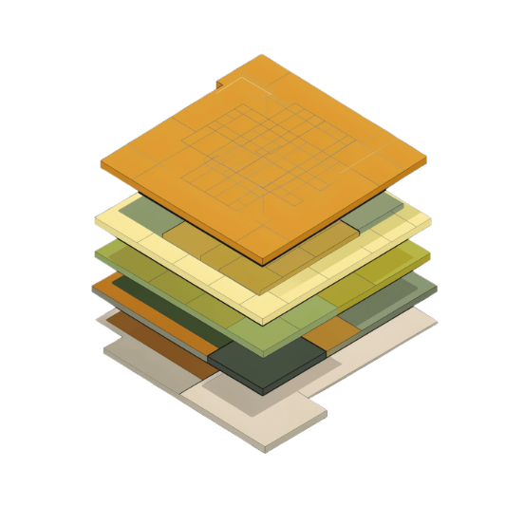

Software Abstractions – The Hierarchy
High-Level
Mid-Level
Low-Level
Software Architectures → Subsystems → Components → Modules/Packages
Objects, Interfaces, Abstract Data Types, Functional abstractions
Primitive data types, machine instructions, symbolic names

Slide 4
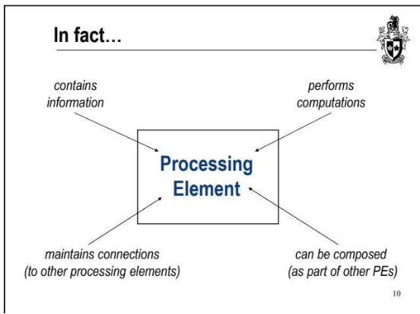
What is a Processing Element?
Core Properties of a Processing Element
All contemporary design methods support abstraction, decomposition, and composition.
Contains Information
Performs Computations
Maintains Connections
Can Be Composed
Nested as part of larger PEs
Holds state and data
Executes logic and transforms data
Interfaces with other PEs

Slide 5
What is Software Architecture?
"This shared understanding is often called 'architecture'. It includes how the system is divided into processing elements and their interaction through interfaces."
— Ralph Johnson, 2003
Structure
Visibility
Relationships
High-level processing elements and how the system is divided
Externally visible properties of each element
Constraints and interactions between elements

Slide 6

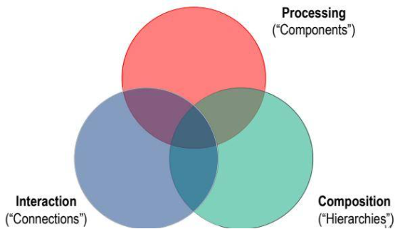
Separation of Concerns
Software architecture cleanly separates four fundamental concerns:
Processing
Interaction
"Components" — what computations are performed
"Connections" — how components communicate
Composition
Deployment
"Hierarchies" — how components are structured and nested
Where components physically run

Slide 7
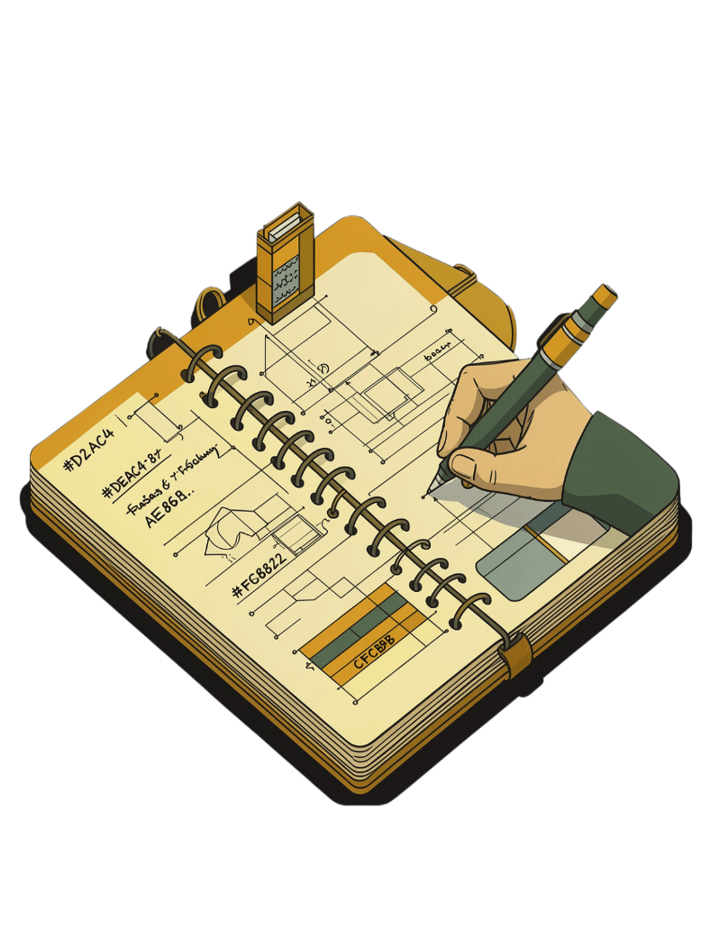
Rationale – Why Decisions Matter
Rationale explains why a decision was made and the implications of changing it. Good rationale is essential for long-lived systems.
System-Wide Choices
Document overarching design decisions that affect the entire architecture
Changing Requirements
Record the effects and risks of evolving or shifting requirements
Rejected Alternatives
Capture what was considered and why it was not chosen

Slide 8
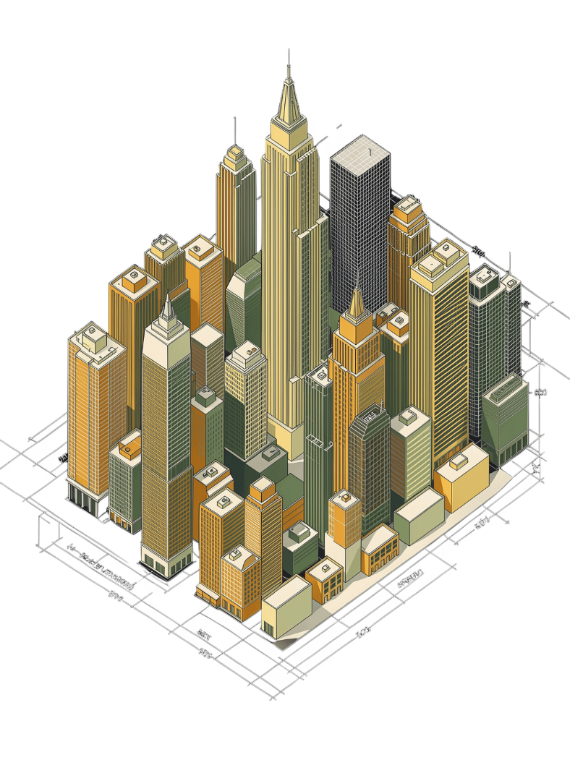
CHAPTER 2
Architectural Styles
Deployment perspectives and established patterns for organising systems at scale

Slide 9
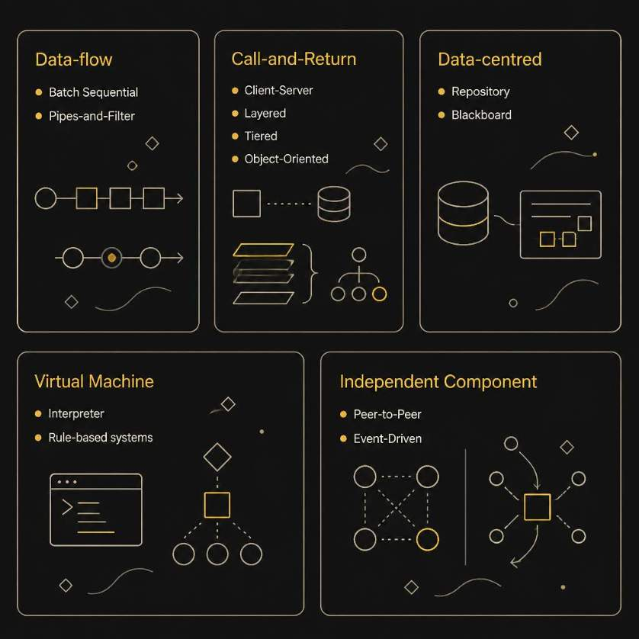

Popular Architectural Styles
Architectural styles provide proven, reusable solutions to recurring structural problems. Choosing the right style early shapes every subsequent design decision.
Data-flow
Call-and-Return
Batch sequential, Pipes-and-Filter
Client-Server, Layered, Tiered, OO
Data-centred
Independent Component
Repository, Blackboard
Peer-to-Peer, Event-Driven

Slide 10
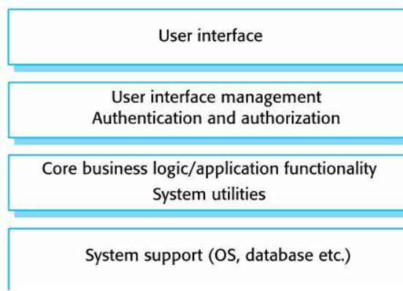
Layered Architecture
Organises a system into layers — each provides services to the layer above and uses services from the layer below.
Elements only "see" the same layer or the layer below
Call-backs communicate upward through defined interfaces
Example: UI → UI Mgmt/Auth → Core Business Logic → System Support (OS/DB)

Slide 11
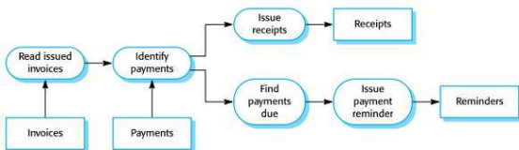
Dataflow & Pipes-and-Filter
Each component (filter) performs one type of data transformation; data flows from one filter to the next via pipes.
Unix example: tar -cvf - . | gzip -9 | ssh mercury dd
Key Property
Limitation
Generally free of cycles — data moves in one direction
Not suitable for interactive systems requiring real-time feedback

