Slide 1

SWE30003 – Week 9: Architecture Design Case Study & Tactics
Swinburne University of Technology · SWE30003 Software Architectures and Design

Slide 2

This Week's Agenda
01
02
Part 1: KWIC Case Study
Part 2: Architectural Tactics
Four architectural styles compared — Shared Memory, ADT, Implicit Invocation, and Pipe-and-Filter
Scalability, Availability, Modifiability, Performance, and Security tactics
03
Tutorial
Discussion questions on architectural styles and patterns

Slide 3

CHAPTER 1
Part 1: KWIC Case Study
A classic decomposition study from Parnas (1972) — how you break a system apart matters as much as what you build.

Slide 4

What Is the KWIC Index System?
The Problem
The Key Word in Context (KWIC) index system accepts an ordered set of lines, each line is an ordered set of words, and each word is an ordered set of characters. Any line may be circularly shifted by repeatedly removing the first word and appending it at the end. The system outputs all circular shifts of all lines in alphabetical order.
Why It Matters
Small system — but big architectural implications depending on decomposition choice
Classic case study from Parnas (1972): how you decompose matters as much as what you build

Slide 5
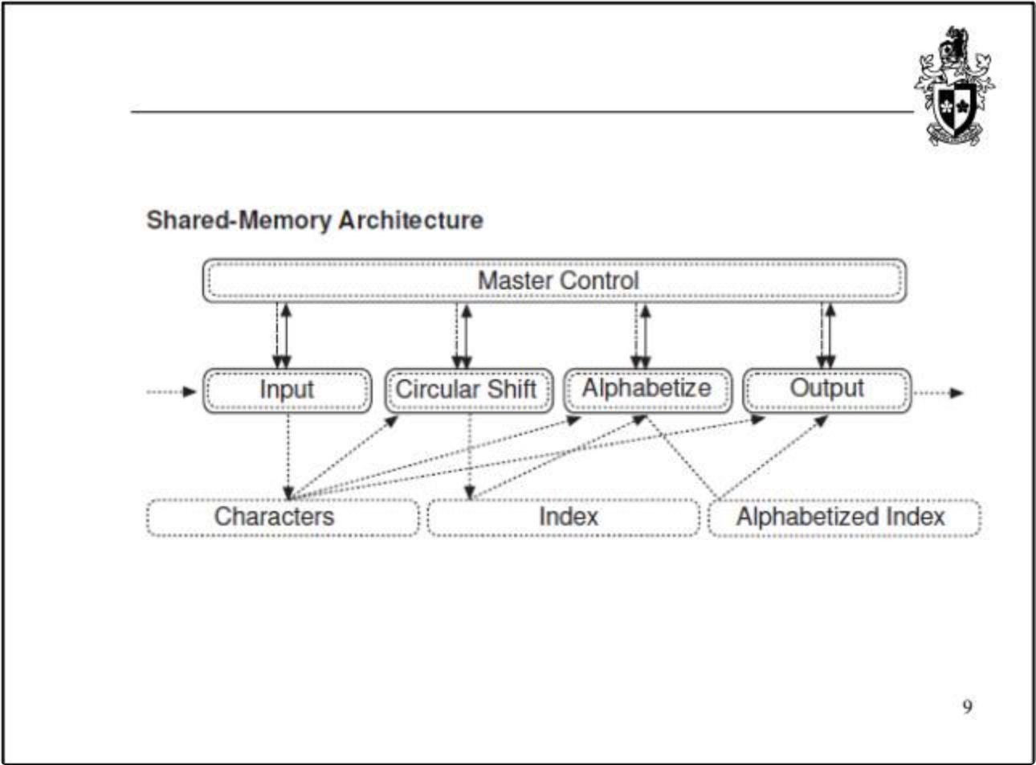
KWIC: Shared-Memory Architecture
How It Works
Modules — Input, Circular Shift, Alphabetize, and Output — share a common data store directly, with no abstraction layer between them.
+ Performance
− Modifiability
Fast access, no data copying overhead
Changing data representation affects all modules

Slide 6
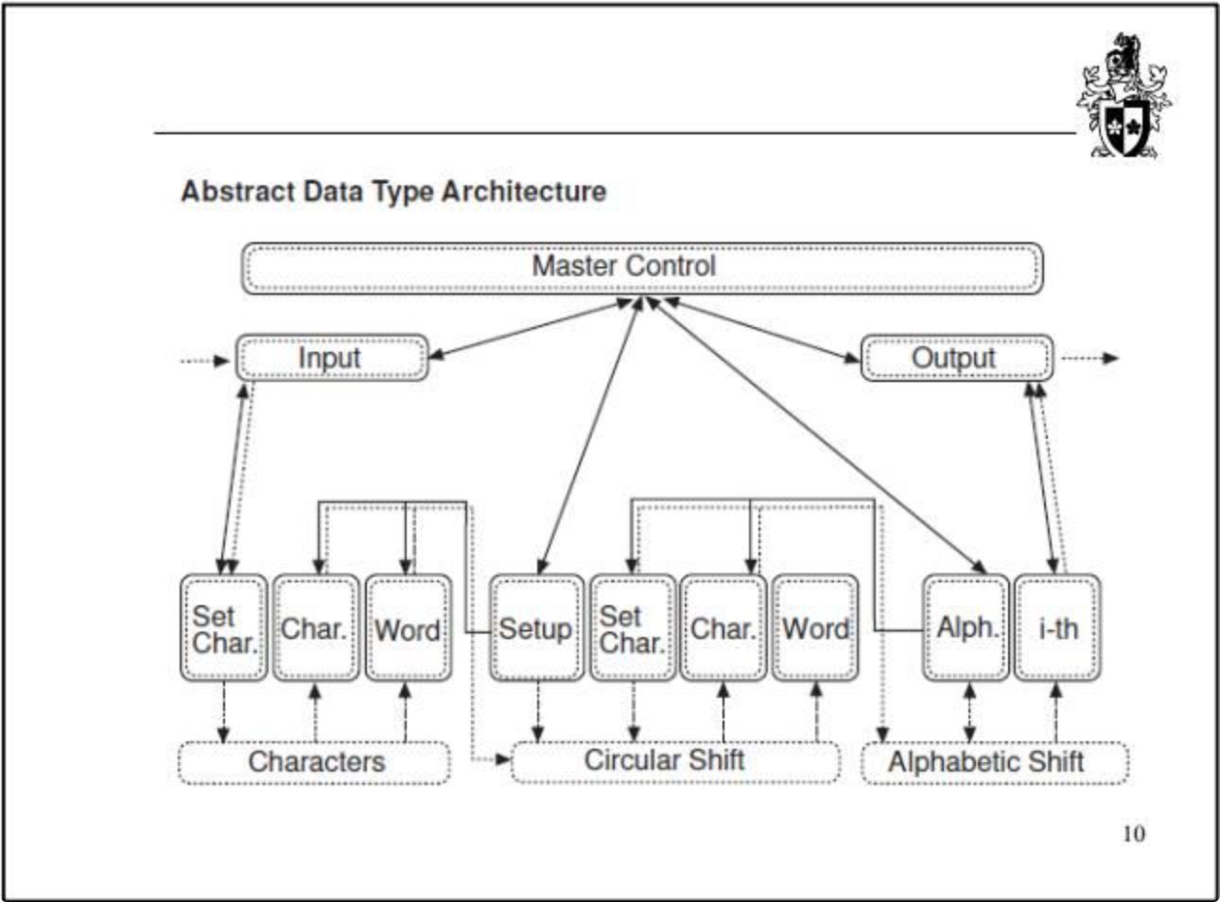
KWIC: Abstract Data Type (ADT) Architecture
How It Works
Each data store — Characters, Circular Shift, Alphabetized Index — is encapsulated as an ADT with well-defined interfaces. Internal representation is hidden from consumers.
+ Modifiability
− Performance
Internal representation can change without affecting other modules
Overhead in speed and space due to abstraction layers

Slide 7
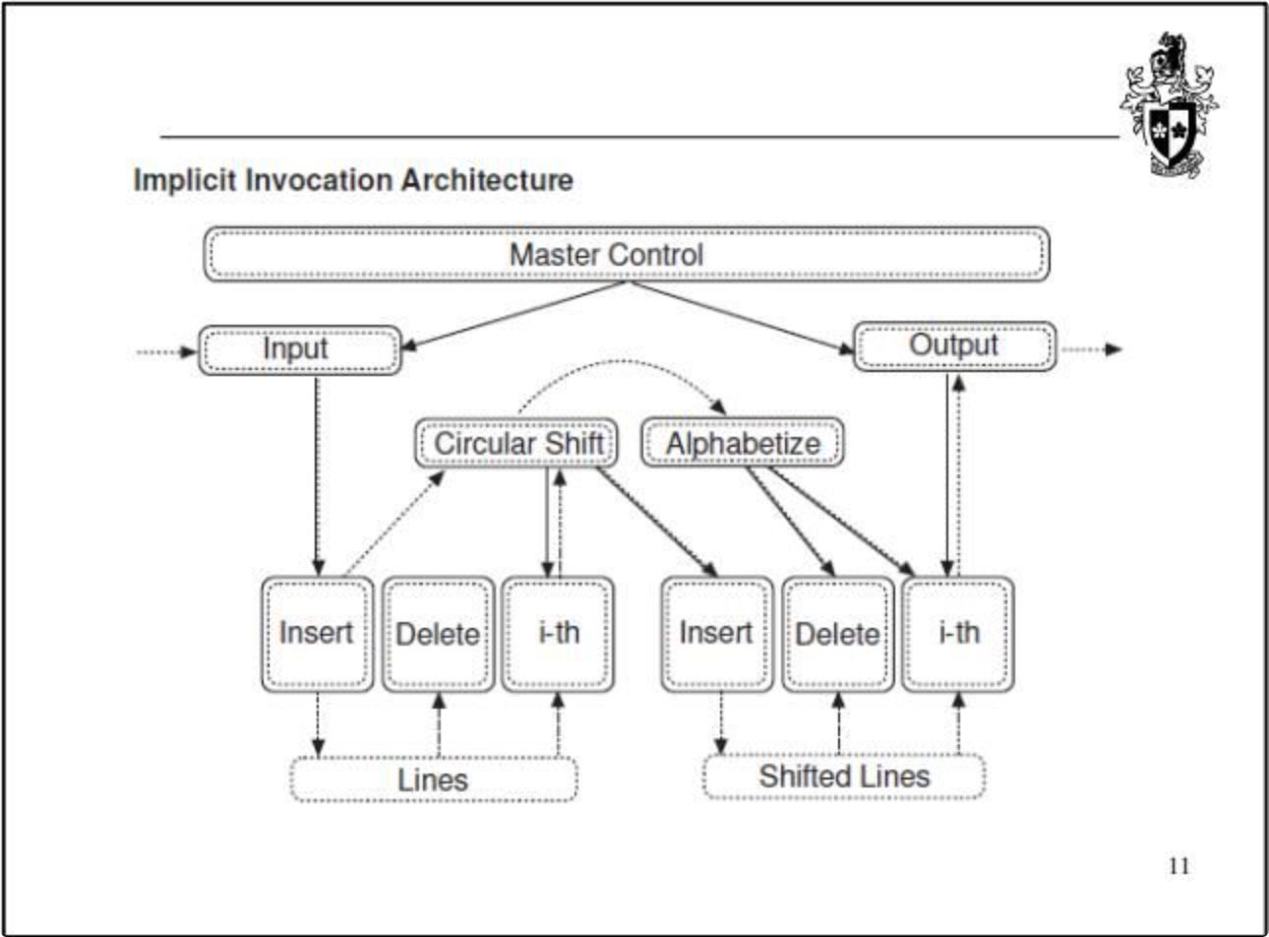
KWIC: Implicit Invocation Architecture
How It Works
Modules register interest in events. Circular Shift and Alphabetize are triggered automatically when data changes — no explicit call needed.
+ Extensibility
− Control
New modules can be added without modifying existing ones
Operation ordering is harder to reason about; higher space cost

Slide 8
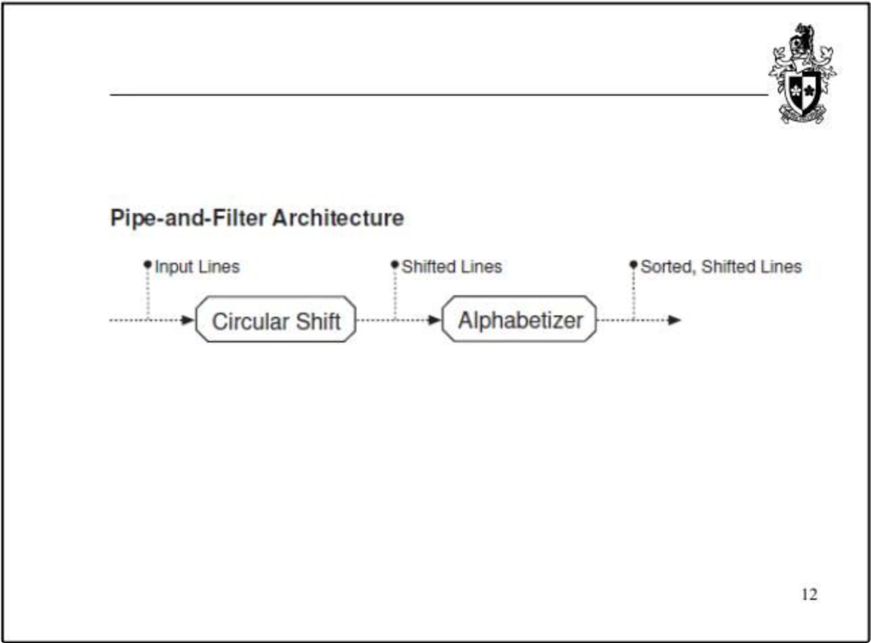
KWIC: Pipe-and-Filter Architecture
How It Works
Data flows through a sequential pipeline: Input → Circular Shift → Alphabetizer → Output. Each filter is fully independent and composable.
+ Intuitive & Reusable
−− Performance
Each filter is independent and easily composed
Worst speed and space — data must be fully passed between every filter

Slide 9

Architecture & Quality Trade-offs
Architecture
Performance
Modifiability
Extensibility
Shared Memory
✅ Best
❌ Worst
⚠️ Limited
ADT
⚠️ Poor
✅ Best
✅ Good
Implicit Invocation
⚠️ Poor space
✅ Good
✅ Best
Pipe-and-Filter
❌ Worst
✅ Good
✅ Reusable
No single architecture wins on all dimensions — choice depends on which quality attributes matter most for your system.

Slide 10

CHAPTER 2
Part 2: Architectural Tactics
Design decisions that directly influence quality attribute responses — the building blocks of architecture-level engineering.

Slide 11


What Is an Architectural Tactic?
Tactic Examples by Quality Attribute
An architectural tactic is a transformation on an architecture or a change to the input to a system that results in the improvement of a specific quality attribute.
Modifiability
Information hiding — encapsulate decisions likely to change
Tactics are the elementary design decisions architects apply to steer a system toward target quality levels. Patterns are often composed of multiple tactics working together.
Availability & Reliability
Redundancy — duplicate components to tolerate failure
Performance
Reduce arrival rate of requests to improve latency and response time

