Slide 1
Chapter 7 . 6

Slide 2
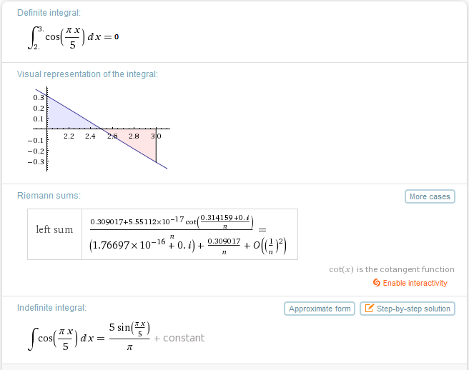

Slide 4
W=
=
2J = [0.5]k(42cm-30cm)²
2J=[0.5]k(12cm)²
2J=[0.5]k(0.12)² k = 277.778N/m
W₁= (0.5)k(Δx) where Δx = (35cm – 30cm), but must be converted to meters.
W₂= (0.5)k(Δx) where Δx = (40cm – 30cm), but must be converted to meters.
W_{F} = W₂ – W₁

Slide 5
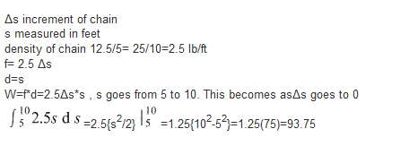

Slide 6
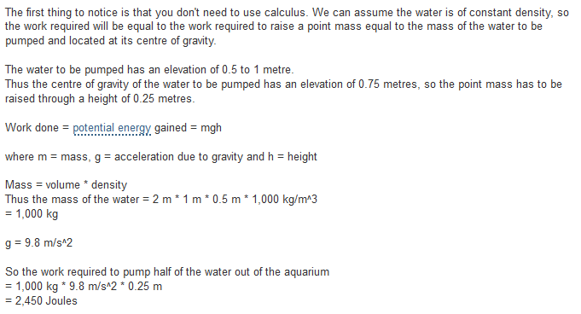

Slide 7
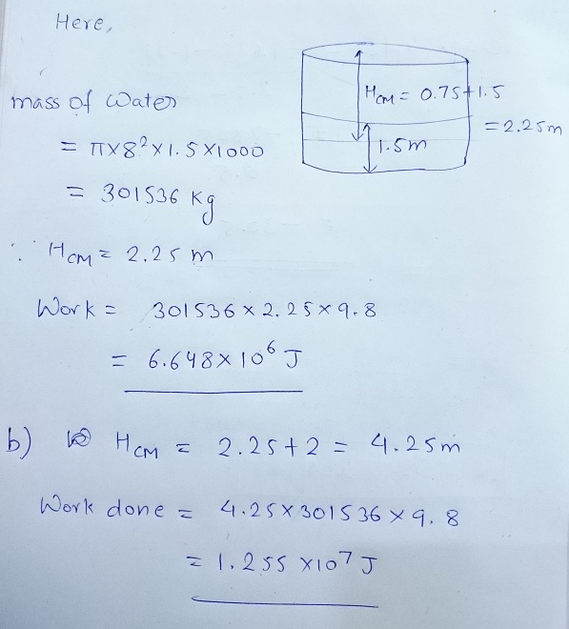

Slide 8
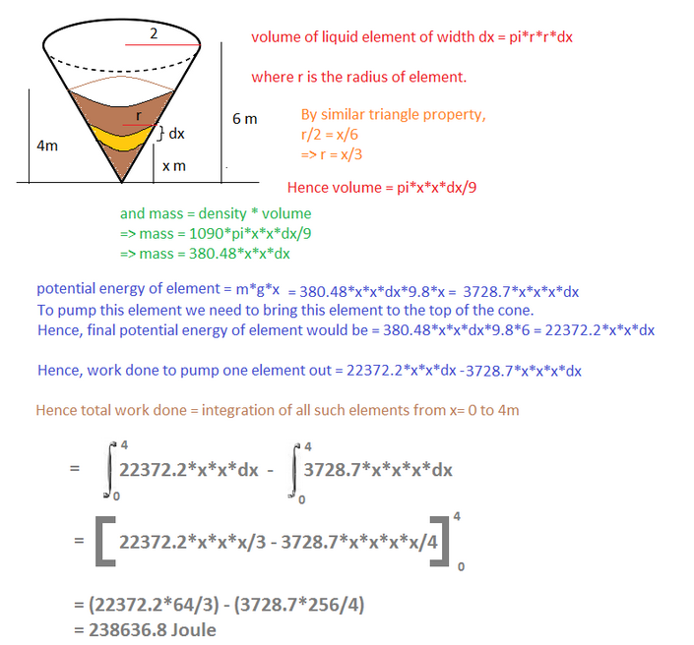

Slide 9
Technically you could just siphon the water out and not do any pump work. But if you mount a pump on top of the tank, the work required to pump it out can be found by : 1. Calculate the total weight of the water in the tank = 2/3*Pi*r^3*62.5 = 16,362.5 pounds 2. Calculate the center of mass of the hemisphere from the circular top of the tank = 3*r/8 = 1.875 feet Then the work required is 1.875 feet *16,362.5 pounds = 30679.6875 foot - pounds

