Slide 1
PHY121
TEST4

Slide 2
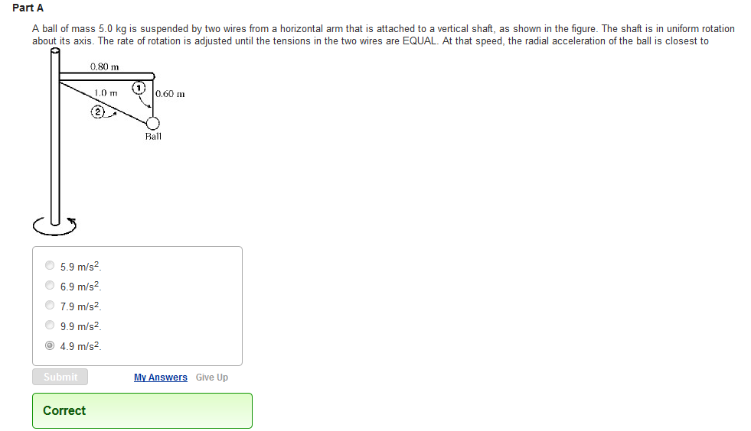
QUESTION 1

Slide 3
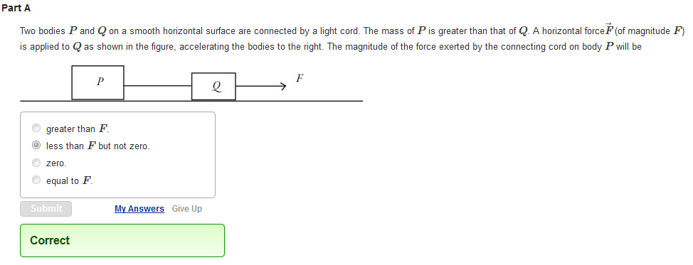
QUESTION 2

Slide 4
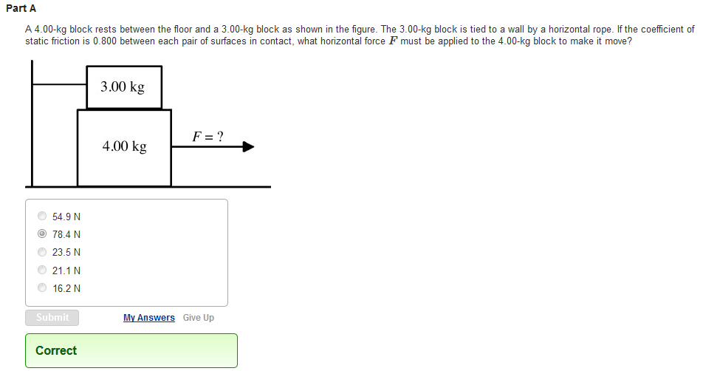
QUESTION 3

Slide 5
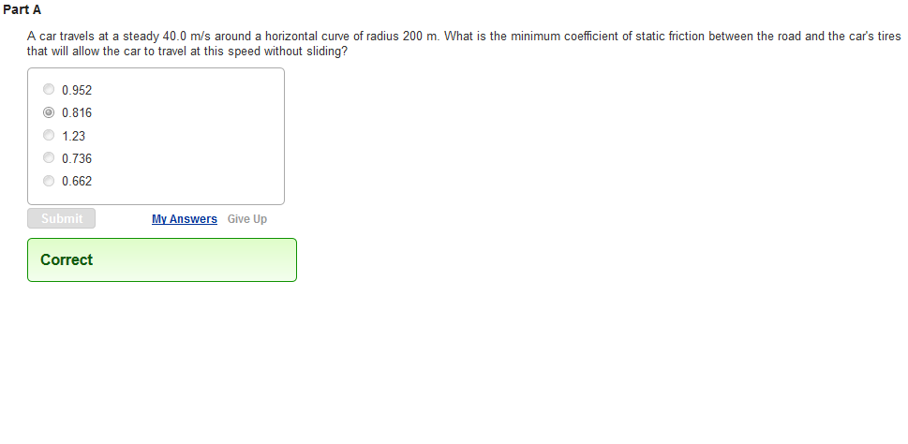
QUESTION 4

Slide 6
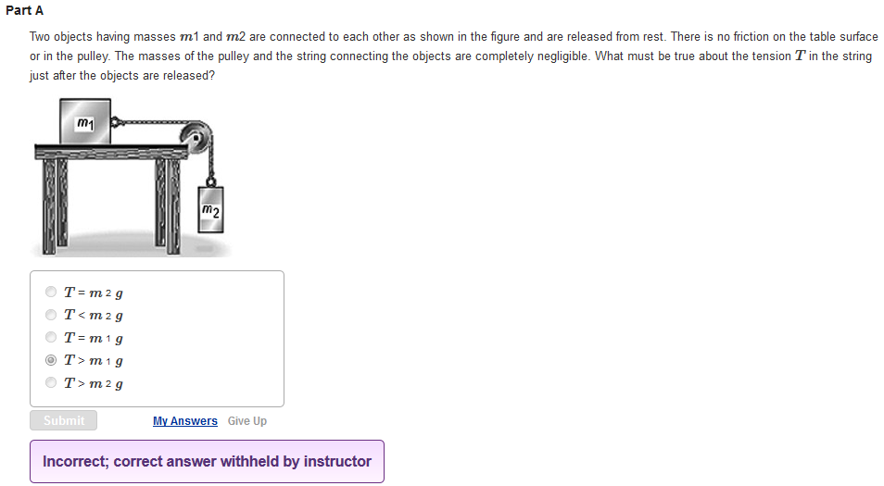
QUESTION 5

Slide 7
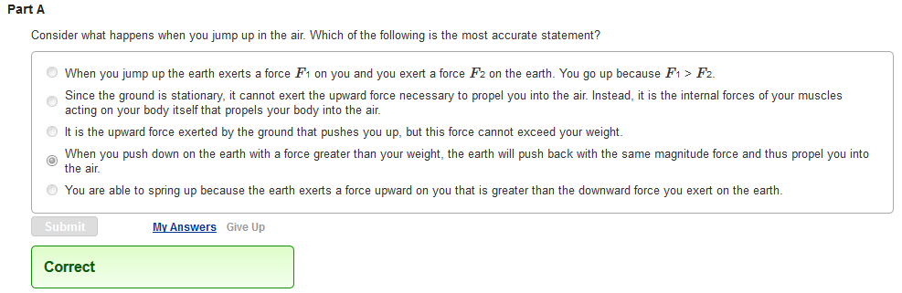
QUESTION 6

Slide 8
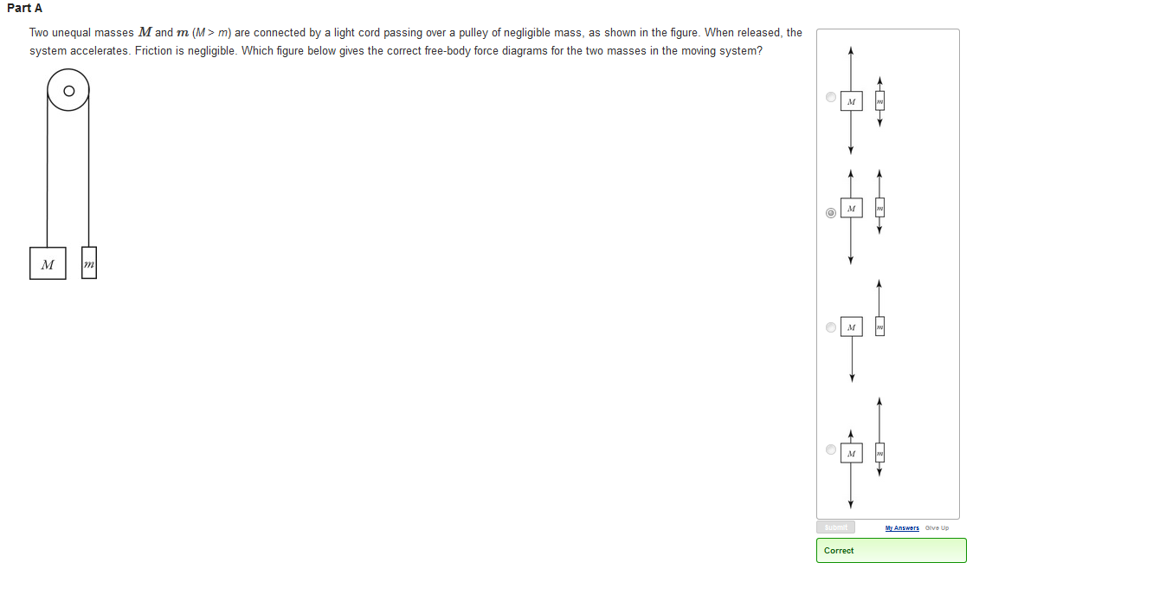
QUESTION 7

Slide 9
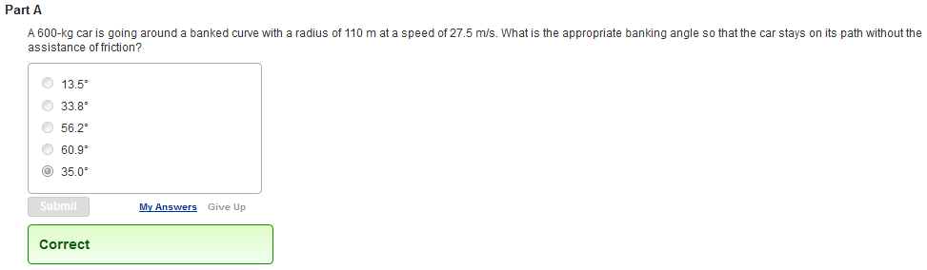
QUESTION 8

Slide 10
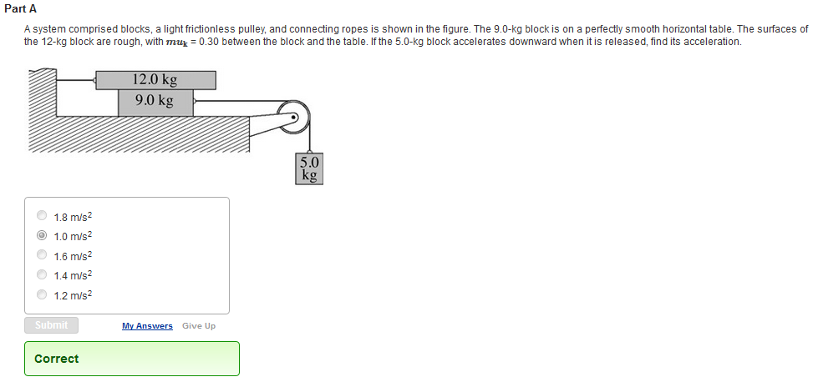
QUESTION 9

Slide 11
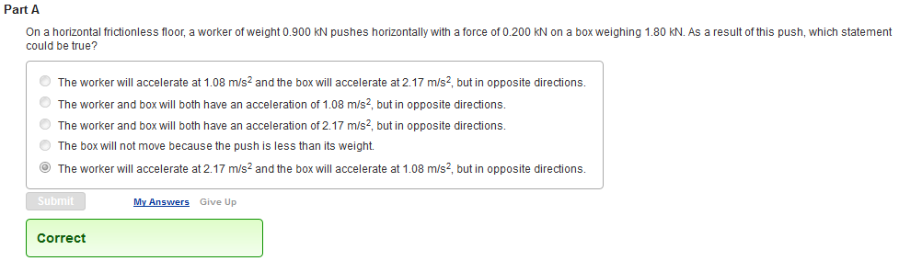
QUESTION 10

