Slide 1
Caddy Server
A Lightweight HTTP/2 Web Server
#Harry Ha @ Black Flag – 0x1115
http://hieuht.0x1115.org
https://github.com/hieuha/Caddy-Configuration

Slide 2

Caddy! What is it?
Getting Started
A High Available Caddy System Using HAProxy - Keepalived

Slide 3
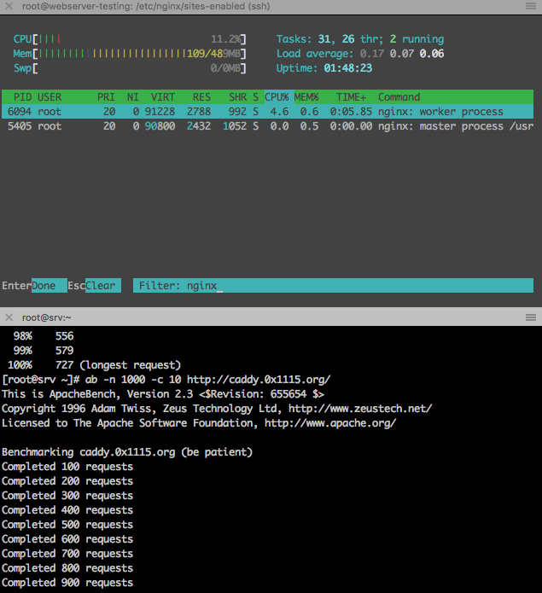
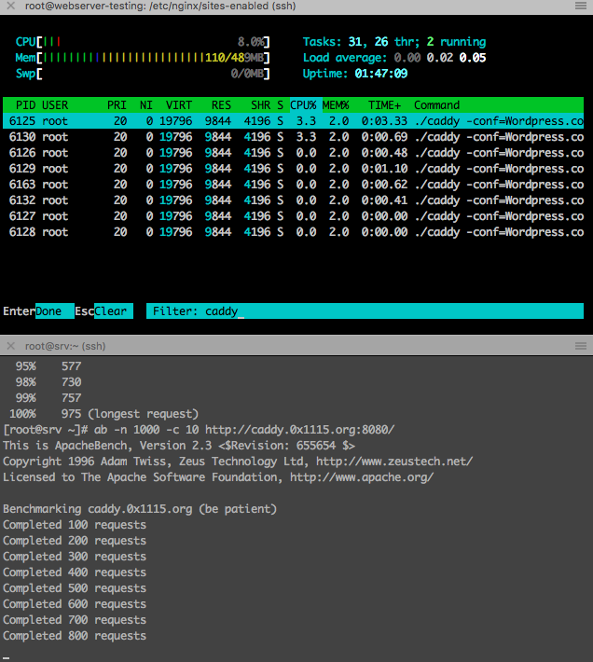

Slide 4
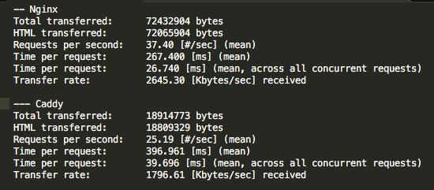

Slide 5
Caddy Core
CORS
HUGO
GIT
JWT
IPFilter
Upload
Search
Your Add-on
Template
Made by Golang
Speedy HTTP Request using HTTP/2
Run on multiple CPUs/ Cores
Server Markdown documents on fly
Advance Websockets technology
Available for All known Platform – Windows, Linux, BSD, Mac, Android. Portable Executables.
Serve FastCGI, Reverse Proxy, Rewrite and Redirects, Clean URL, Gzip compression, Directory Browsing, Virtual Hosts and Headers. ( Of Course)

Slide 6
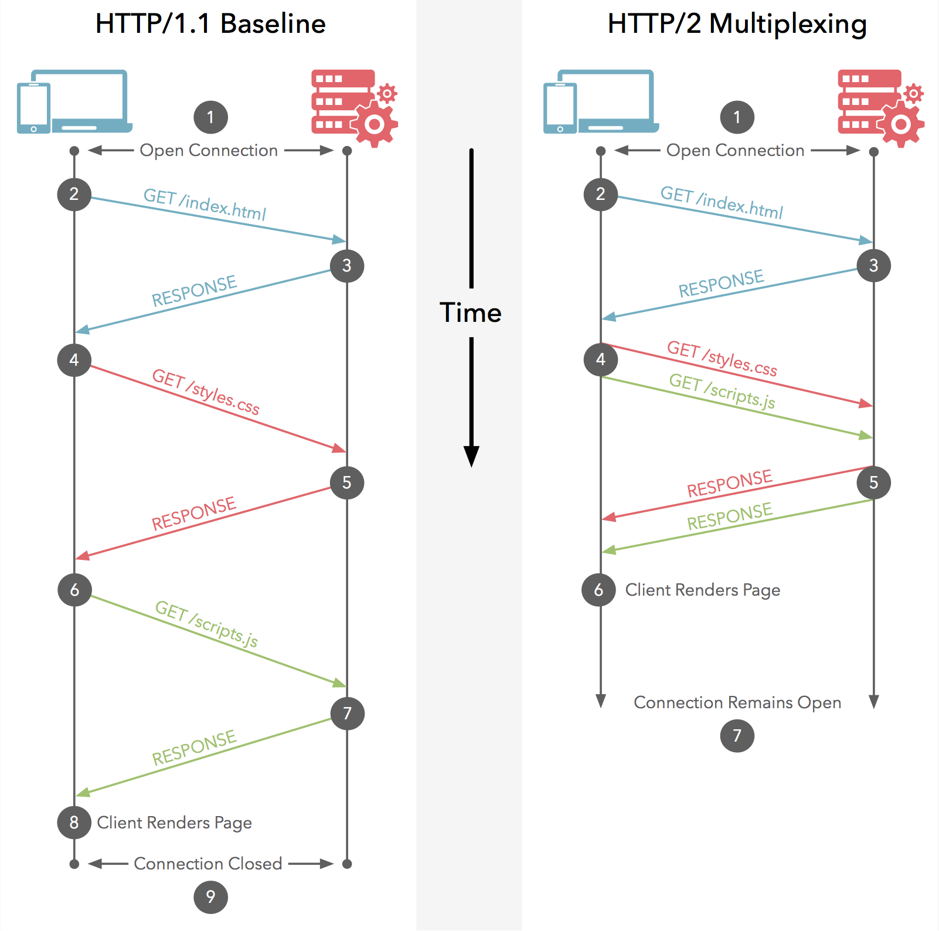
HTTP 1.0 vs HTTP 2.0
Credits: cascadingmedia.com

Slide 7
Getting Started
$ caddy -conf="/path/to/Caddyfile"
# Gobal Configuration
# Default site
:2015 # Host: <any>, Port: 2015
localhost # Host: localhost, Port: 2015
localhost:8080 # Host: localhost, Port: 8080
0x1115.org # Host: 0x1115, Port: 443
http://0x1115.org # Host: 0x1115.org, Port: 80
https://0x1115.org # Host: 0x1115.org, Port: 443
http://0x1115.org:1234 # Host: 0x1115.org, Port: 1234
gzip
log /var/log/caddy/default-access.log
errors /var/log/caddy/default-error.log
# Comments can start a line
0x1115.org {
root /www/0x1115.org
log /var/log/caddy/0x1115.org
}
blog.0x1115.org {
root /www/blog.0x1115.org
gzip
log /var/log/caddy/blog-0x1115-access.log
}
hieuht.0x1115.org:2020, https://hieuht.0x1115.org, http://hieuht.0x1115.org {
...
}

Slide 8
Path Matching
/foo
/foo/
/foo
/foobar
/foo.html
/foo/bar
/foobar

Slide 9
Template Actions
Caddy templates use the syntax defined in Go's text/template package
Templates are supported by a few different directives such as:
Template
Browse
Markdown
Syntax: {{ variable}}
Does not apply for customizing error pages

Slide 10
Template
Include another file:
{{.Include "path/to/file.html"}}
Include and render a Markdown file
{{.Markdown "path/to/file.md"}}
Show current timestamp: (format)
{{.Now "Monday, 2 Jan 2006"}}
Cookie value:
{{.Cookie "name"}}
Header field value:
{{.Header "name"}}
Visitor's IP:
{{.IP}}
Request URI:
{{.URI}}
Host portion of request:
{{.Host}}
Port portion of request:
{{.Port}}
Request method:
{{.Method}}
A part of the URL:
{{.URL.RawQuery}}

Slide 11
browse
browse enables directory browsing within the specified base path. It displays a file listing for directories which don't have an index file in them
browse /photos ../photo_album.tpl
Response:
Template Format (HTML)
JSON Response
$ curl -H "Accept: application/json" 'localhost:2015/?limit=1'

Slide 12
Markdown
markdown serves Markdown files as HTML pages on demand, but it can also generate a static site from Markdown so it doesn't have to render on-the-fly. You can specify whole custom templates or just the CSS and JavaScript files to be used on the pages to give them a custom look and behavior.
markdown /blog {
ext .md .txt
css /resources/css/blog.css
js /resources/js/blog.js
template default.html
template blog blog.html
template about about.html
}

Slide 13
Baiscauth
basicauth /secret Bob hiccup
basicauth "Mary Lou" milkshakes {
/marylou-files
/another-file.txt
}
rewrite {
if {file} not favicon.ico
to {path} {path}/ /maintenance.html /index.php
}
rewrite {
if if {>User-agent} has mobile
to {path} {path}/ /mobile/index.php
}
Rewrite
rewrite [basepath] {
regexp pattern
ext extensions...
if a cond b
status code
to destinations...
}

Slide 14
Private repository pulled into the "subfolder" directory with tag v1.0 once per day:
git {
repo git@github.com:user/myproject
branch v1.0
key /home/user/.ssh/id_rsa
path subfolder
interval 86400
}
Git (Add-on)
git repo [clonepath] {
repo repo
path clonepath
branch branch
key key
hook path [secret]
interval interval
then command [args...]
then_longcommand [args...]
}

Slide 15
Fast-cgi
fastcgi /blog/ 127.0.0.1:9000 php
fastcgi / /var/run/php5-fpm.sock php
Search (Using Bleve Engine)
full-text search and indexing for Go
search ^/blog/ {
+path /static/docs
-path ^/blog/admin/
-path robots.txt
}

Slide 16
IPFilter
Real-IP (Add-on)
ipfilter paths... {
rule block | allow
ip list or/and range of IPs...
country countries ISO codes...
database db_path
blockpage block_page
strict
}
realip {
header name
from cidr
strict
}
realip {
header X-Forwarded-For
from cloudflare
from 1.2.3.4/32
from 0.0.0.0/0
}
ipfilter / {
rule block
ip 212.10.15.0-255 213.10.15.0-10 5.23.4.24
blockpage /local/data/default.html
}
ipfilter /notglobal /secret {
rule block
country US JP
database /local/data/GeoLite2-Country.mmdb
blockpage /local/data/default.html
}

Slide 17
Proxy
proxy / web1.local:80 web2.local:90 web3.local:100 {
policy round_robin
health_check /health
proxy_header Host {host}
proxy_header X-Real-IP {remote}
proxy_header X-Forwarded-Proto {scheme}
}
Proxy WebSocket connections:
proxy / localhost:8080 {
websocket
}
Proxy everything except requests to /static or /robots.txt:
proxy / backend:1234 {
except /static /robots.txt
}
proxy from to... {
policy random
| least_conn
| round_robin
fail_timeout duration
max_fails integer
health_check path [duration]
proxy_header name value
without prefix
except ignored_paths...
insecure_skip_verify
preset
}

Slide 18
Logs
log / access.log {
rotate {
size 100 # Rotate after 100 MB
age 14 # Keep log files for 14 days
keep 10 # Keep at most 10 log files
}
}
errors {
log / error.log {
size 50 # Rotate after 50 MB
age 30 # Keep rotated files for 30 days
keep 5 # Keep at most 5 log files
}
}

Slide 19
Credits: digitalocean

